Slide 1

Behavioral Threat Assessment and Management (BTAM)
Level 1
Presented by Tina Eblen and Tammy Tolleson Knee

Slide 2
Who we are
•Director – Dr. Emily Sallee
•Assistant Director – Nancy Berg
•Training and Technical Assistance Specialist – Tina Eblen
•School Support Liaison – Tammy Tolleson Knee

Slide 3
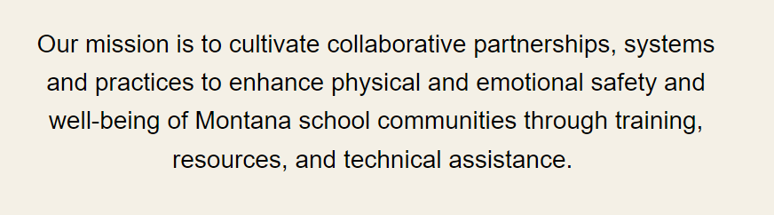
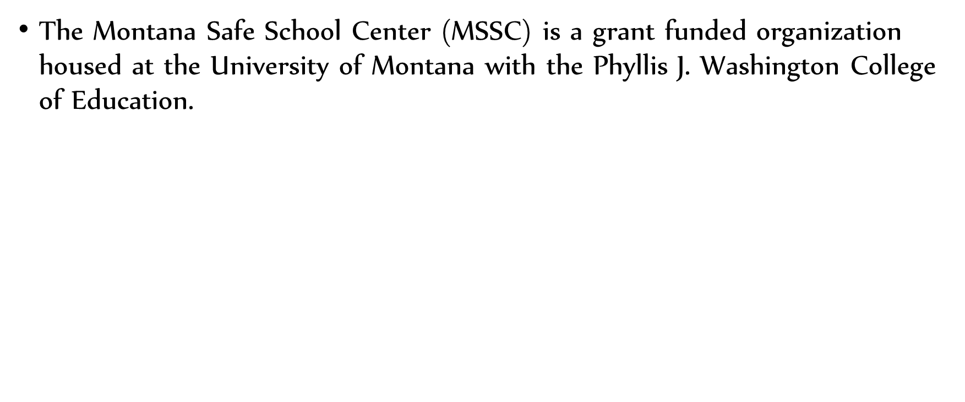
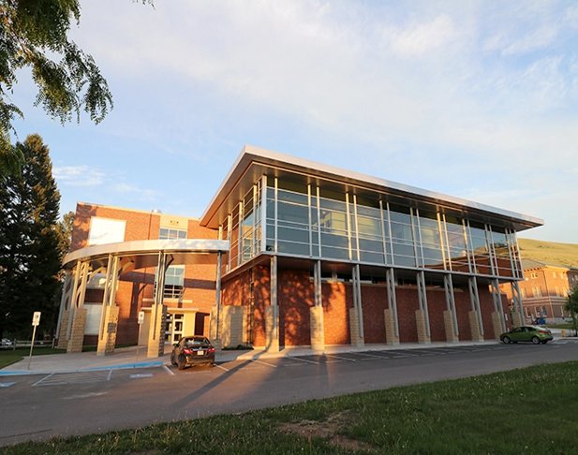
About us

Slide 4
Services we provide
Trainings
Technical Support
Readiness and Emergency Management for Schools (REMS)Assessment
VAST – tele counseling
Anonymous School Tip line (Safer MT)
Emergency Operations Plan (EOP) Technical Assistance

Slide 5
Just a few of the trainings we provide:
BTAM – Levels 1, 2 and 3.
School Safety 101
Student Resource Officer
Behavioral Intervention Team
Trauma-Informed Schools Training (HEARTs Model and LSOC)
Adverse Childhood Experiences (ACEs)
Impacts of Stress on Brain Development
Happiness
Teacher Resiliency
Standard Response Protocol, I Love U Guys!
Reunification
Emergency Operations Plan (EOP)
Incident Command System (ICS)
Suicide Intervention Skills Training (ASIST, Safe TALK, CAST-S and YAM)
Grit
De-escalation
Non-Suicidal Self-Injury
Question, Persuade, Refer (QPR)

Slide 6

Anonymous Tip Line

Slide 7
VAST – tele-counseling
MSSC partners with Counseling, Social Work and School Psychology programs at UM and Carroll College
The mission of VAST is to provide high-quality, accessible tele-mental health services to youth in rural and tribal communities across Montana
25
Expanding

Slide 8
Training Overview
What is a threat?
Why should we do Behavioral Threat Assessment and Management?
Overview of the BTAM process
Impact of trauma and stress on the developing brain and why it relates to threat assessment
Creating a Threat Assessment Team

Slide 9

Goal of BTAM
Prevent future acts of targeted violence.
Support and enhance the health, safety, and well-being of the school community.

Slide 10
What constitutes a threat?

Slide 11
aberrant or concerning communication or behavior
Notes:
that suggests a person may intend to harm someone else, or themselves
Unusual or atypical

Slide 12

A threat may be…
Notes:
Communication may not be verbal – how do you know if another driver is mad at you without hearing them?
Only 7% is verbal
spoken, written, gestured, electronic, or other
observed by or communicated directly to the target or it may be observed by or communicated to a third party
target of the threat does not need to be aware of the threat
issued by someone known or unknown to the target
might be veiled or not immediately understood BTAM teams

Slide 13
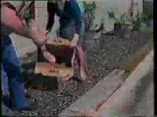
Targeted or Reactive?
Video

Slide 14

Targeted or Reactive?
Notes:
Reactive can lead to targeted

Slide 15

Making
Posing
Notes:
BTAM Team works to figure out if concerning or aberrant behavior poses a threat.

Slide 16
I'm going to beat you up after school!
Notes:
Discuss how the team would go about determining if the subject intended violence
What is a scenario where the student would not pose a threat?
What is a scenario where the student would pose a threat?

Slide 17
Discuss:
What is a scenario where the student would not pose a threat?
What is a scenario where the student would pose a threat?

Slide 18
Is BTAM Punitive or Preventative?
Behavioral Threat Assessment and Management is designed to be fair, objective, reasonable, and timely to prevent violence or harm to self or others where possible
Notes:
Pair/share There might be a consequence for behaviors that led to the TA but BTAM in and of itself is not a punative process?

Slide 19
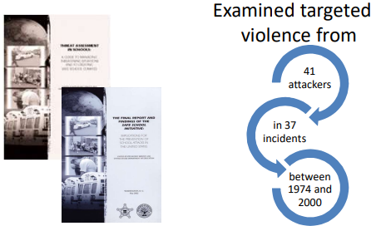
The Safe Schools Initiative (SSI)
Notes:
This initiative was a partnership between the Secret Service and the Department of Education
.The goal was to determine whether it could have been known that incidents of targeted violence at schools were being planned and whether anything could have been done to prevent them from occurring.

Slide 20
Were rarely sudden or impulsive
Usually others knew about the plan prior to the event
Most did not threaten target prior to event
There is no accurate profile for a person who perpetrates an attack but most had loss/failure prior to event
Most felt bullied, persecuted, or injured by others prior to attack
Most had access to weapons prior to attack.
Most had concerned others prior to the attack
Notes:
What does this tell us about prevention?

Slide 21
Why is BTAM important?
Notes:
Share at table

Slide 22
It’s the law!
SB 213
The school safety plan or emergency operations plan must include the following threat assessment practices:
(i) the adoption of a threat assessment protocol, outlining policies and procedures for implementation when there is notification of a student threat of harm to others or property; and
(ii) an identified threat assessment team, composed of key staff, that meets at least monthly and may include behavioral threat assessment addressing students in need of academic and behavioral supports or interventions.

Slide 23
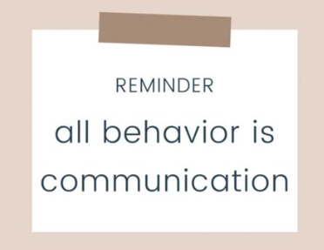
Notes:
behavior communicates need.
BTAM helps us identify student needs based on behavior so that we can prevent harm to self or others.
BTAM reduces the risk of overreacting – intentionally or unintentionally escalating a situation or behavior.
Nabita – human behavior is wholly predictable.

Slide 24
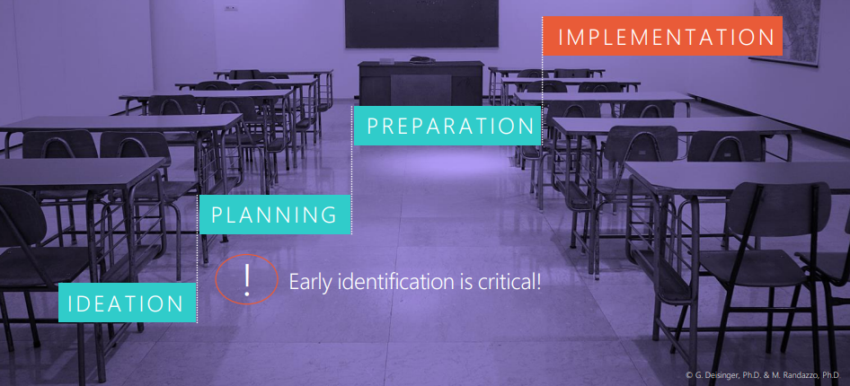
Pathway to Violence
Notes:
Targeted violence begins with a pathway
Schools need solutions to intervene earlier
Violence begins with a Grievance – may be real or perceived, creating a sense of loss and injustice

Slide 25
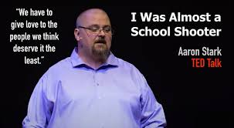
Notes:
A switch didn’t turn
I’m not looking to be fixed, I’m looking to be seen
Put bits of humanity on the bottom shelf of my existence
Give love to the ones you think deserve it the least, they need it the most.

Slide 26

Behavioral Threat Assessment and Management Team
Also known as…
Behavior Intervention Team
School Safety Team
School Support Team

Slide 27
Building a BTAM Team
A threat assessment team must be creative, flexible, multi-disciplinary, and consultative in nature
School/district leaders (administrator, superintendent)
Specialists (school counselor, school psychologist)
School Nurse, or similar
School Resource Officer, or similar
Teacher or staff who has good understanding of student behaviors and social dynamics.

Slide 28
Role of the Threat Assessment Team
Determines if there are threating statements or behaviors that are threatening, aberrant, or concerning.
Determines if a person poses a threat to self or others or are they on a pathway to violence.
Conducts Screenings and/or Full Team Threat Assessment.
Implements a strategy to continue to assess, monitor and manage the case.
Violence Prevention

Slide 29
When Does a Threat Assessment Team Meet?
When a threat has been identified
or
Regularly to review possible threats and management plans?
BOTH

Slide 30
What is the process of BTAM?

Slide 31
BTAM is the process of distinguishing transient or reactive threats from serious or targeted ones in a systematic, data-informed way.
Notes:
BTAM is a process it is not a tool.

Slide 32

Threat to
Self
Threat to Others

Slide 33
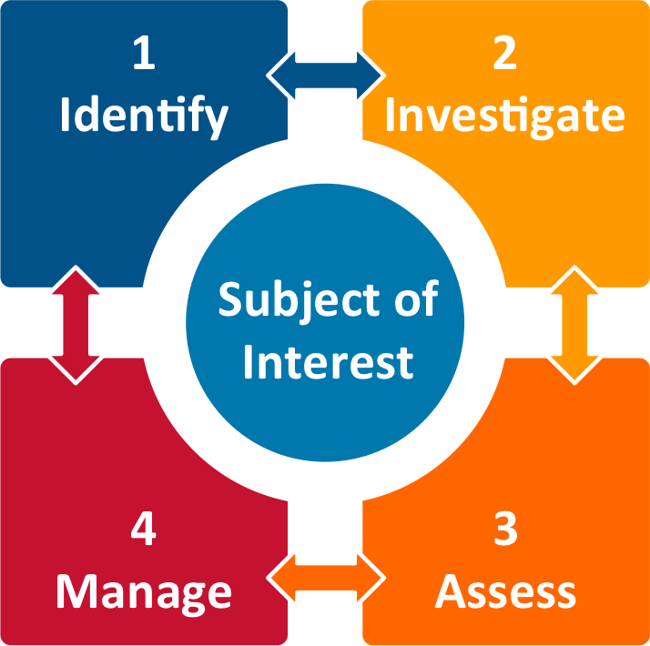
Threat Assessment Model
Notes:
Focus on four factors:
Identifying persons whose behavior is threatening, aberrant or concerning
Gathering relevant information – interviews, records, etc.
Assessing the person and the situation – using a tool, should include risk factors and protective factors.
Managing the person and situation to prevent violence and mitigate the risk of harm

Slide 34
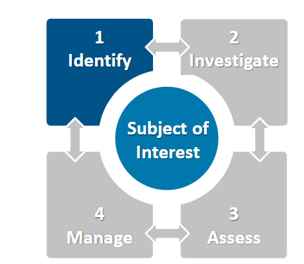
Threat Assessment Model: Identify

Slide 35
Identify: Potential Referral Sources
Office Discipline Referrals (ODRs)
Law enforcement report
Student/Teacher/Parent report
Written or other educational content
Anonymous reporting tip line
Social media

Slide 36

Identify: Receive
How do students, parents, staff, and community members notify the threat assessment team when they have a concern?

Slide 37
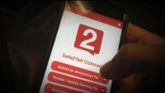

Triage Reported Communications
Triage Reporting Communications

Slide 38
Identify: Screen
Team member (s) collects preliminary information
  What is the threat, when did it occur?
  Any weapon involved/threatened
  Details about concerns and relevant background about the situation
  Name of the Concerned Person
  Identified/identifiable Targets
Notes:
When a report is made, the threat assessment team will initiate a fact-finding process, which would include:
• The details of the concerning, threatening or aberrant behavior
Any witnesses to contribute to the fact finding efforts;
Information regarding the background and circumstances of the person alleged to be engaging in threatening or aberrant behavior
Information regarding the targets of the threat;
Other people in the school who have first-hand experiences with the person of concern (such as a coach or music director, or work colleague)
Preservation and documentation of any threatening communication or behaviors.

Slide 39
In an online post, a student threatens to "make a teacher pay" for embarrassing them in class. It is reported at 10:15 am by another student. The subject is at school and will attend the teacher's class beginning at 10:30 am.
What should happen next?

Slide 40
IMPORTANT
If IMMINENT danger to self or others
Follow district emergency protocols
Secure the student “subject” (and “target”) in a safe setting
Notes:
Example – a student threatens to make a teacher pay for embarrassing them in class. It is reported at 10:25am by another student. The subject is at school and will attend the teachers class beginning at 10:30. What should happen next?

Slide 41
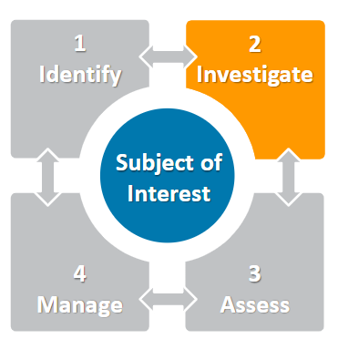
Threat Assessment Model: Investigate

Slide 42
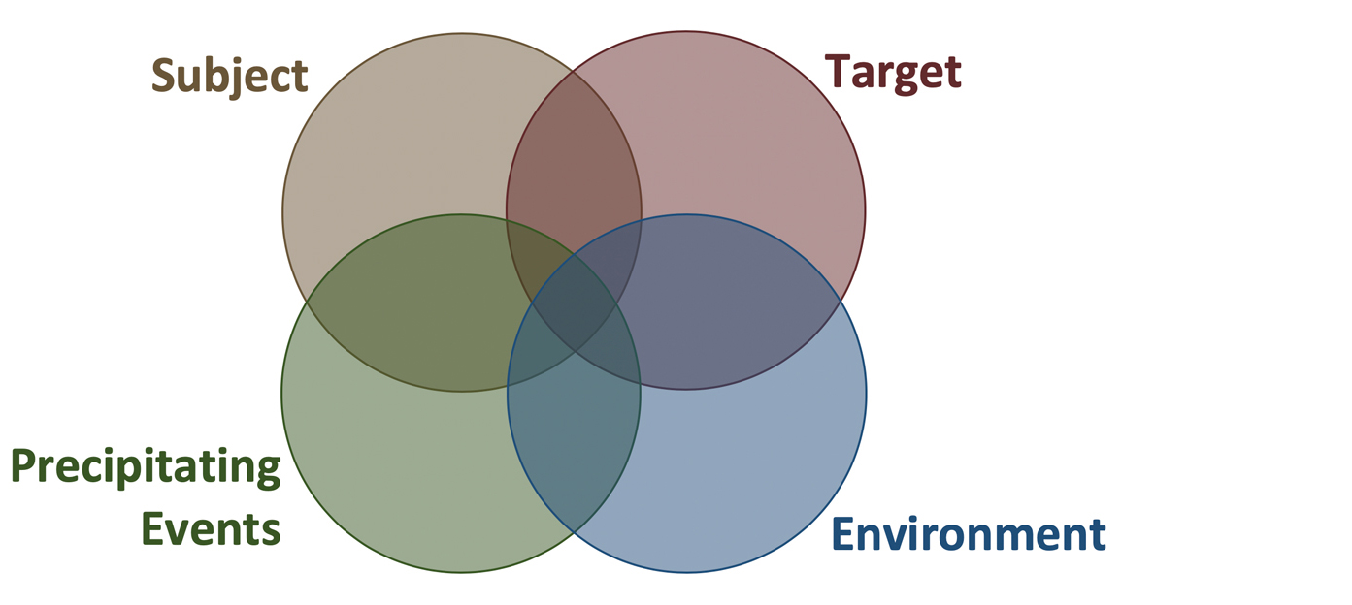
Investigate: Gathering information
Notes:
S Is the Subject (i.e. the Concerning Person) engaging in behavior(s) causing concerns for violence, harm, or significant disruption?
T Are Targets vulnerable, impacted, or taking protective actions as if there are concerns for violence or significant disruption?
E Are there Environmental/systemic issues impacting the situation?
P Are there reasonably foreseeable Precipitating events that may escalate the situation?
We use the acronym “STEP” to make these domains easy to remember.

Slide 43
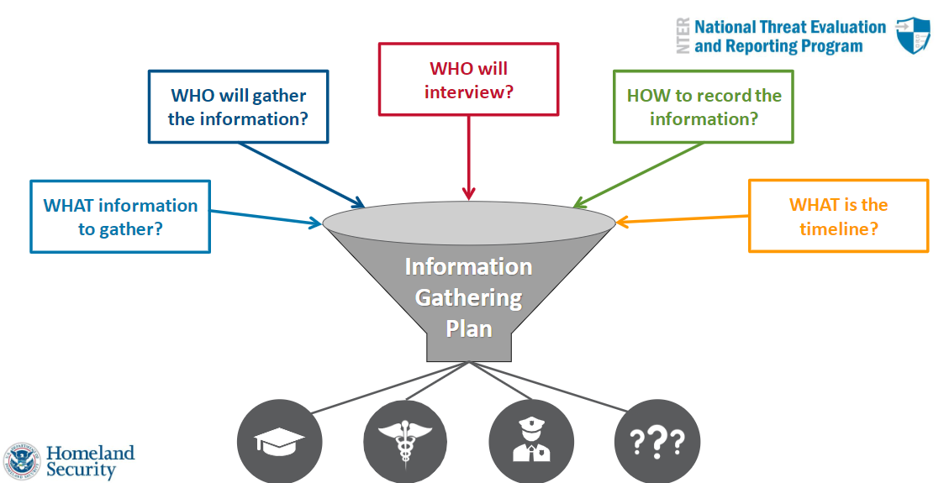
Investigate: Gathering Information

Slide 44
Investigate: Data Sources
Academic data
Behavioral data
Attendance data
Interviews
Law enforcement

Slide 45
Let’s Pause for some Practice!
Allison threatens to stab Crystal the next time she sees her when she learns that Crystal has been talking to her boyfriend. Both students are frequent flyers in the Admin office.

Slide 46
And more Practice!
One of Bryce’s friends told the school counselor that he wrote him an apology letter for being a bad friend and he ended the letter stating that he “was mostly sorry for what would happen next”
Notes:
What steps need to be taken by the BTAM team?

Slide 47
Impact of trauma and stress on the developing brain and why it relates to BTAM
Notes:
BTAM is a fact-based, systematic process designed to identify, gather information about, assess, and manage potentially dangerous or violent situations.

Slide 48
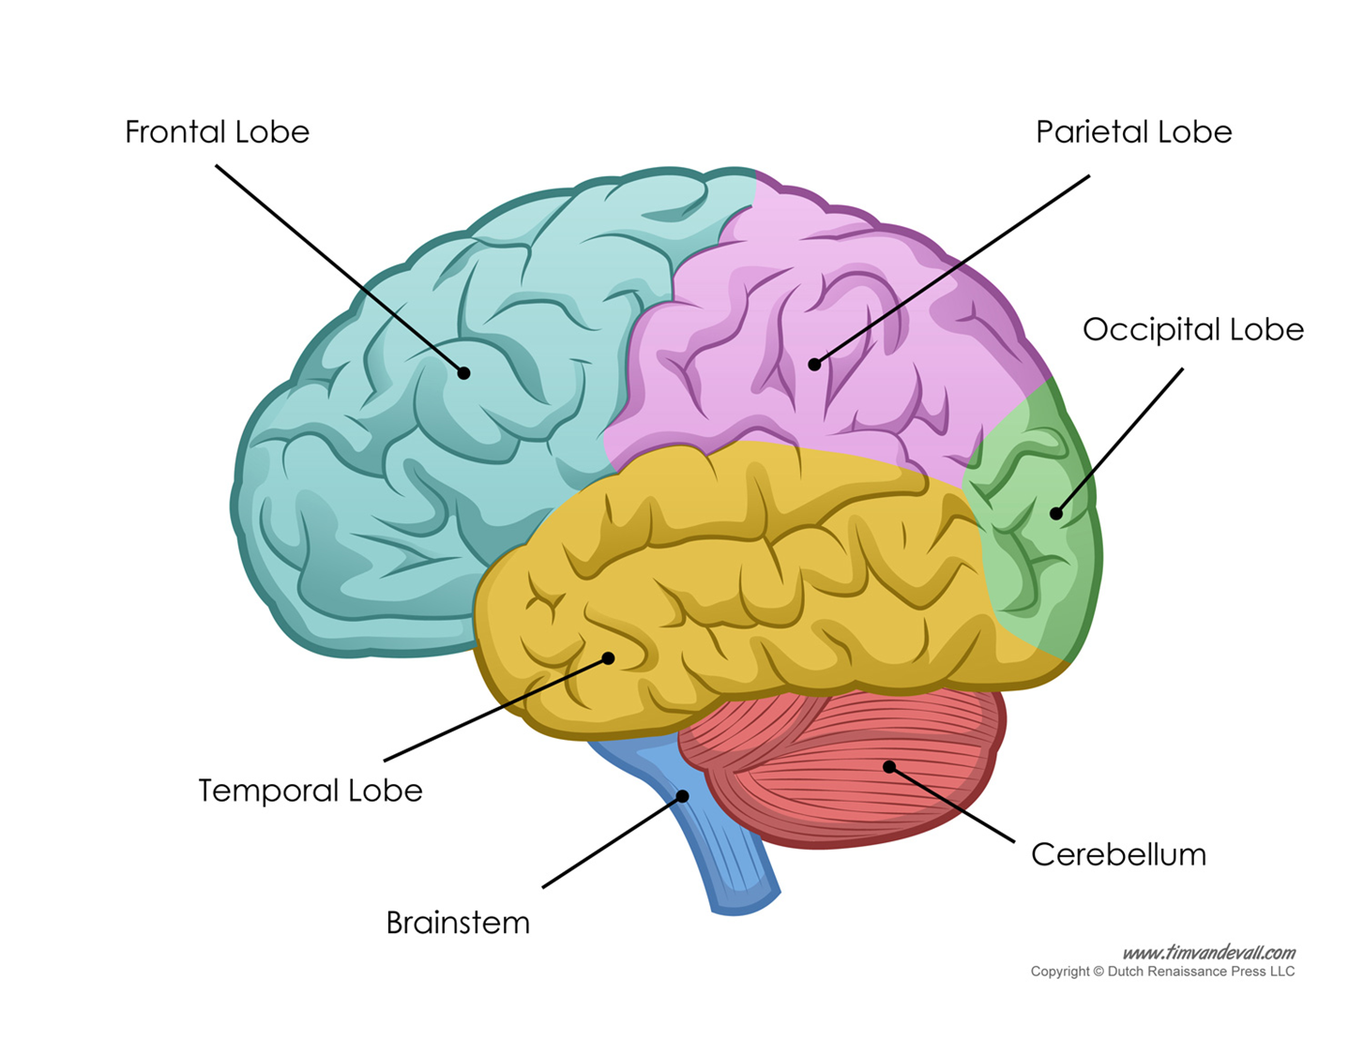
Think about the sequencing of Brain Development
Age 2
Age 1
Birth

Slide 49
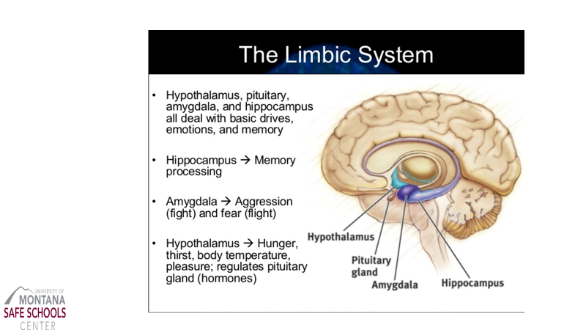

Slide 50
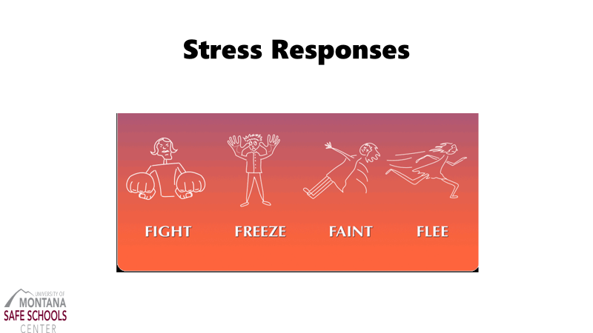

Slide 51
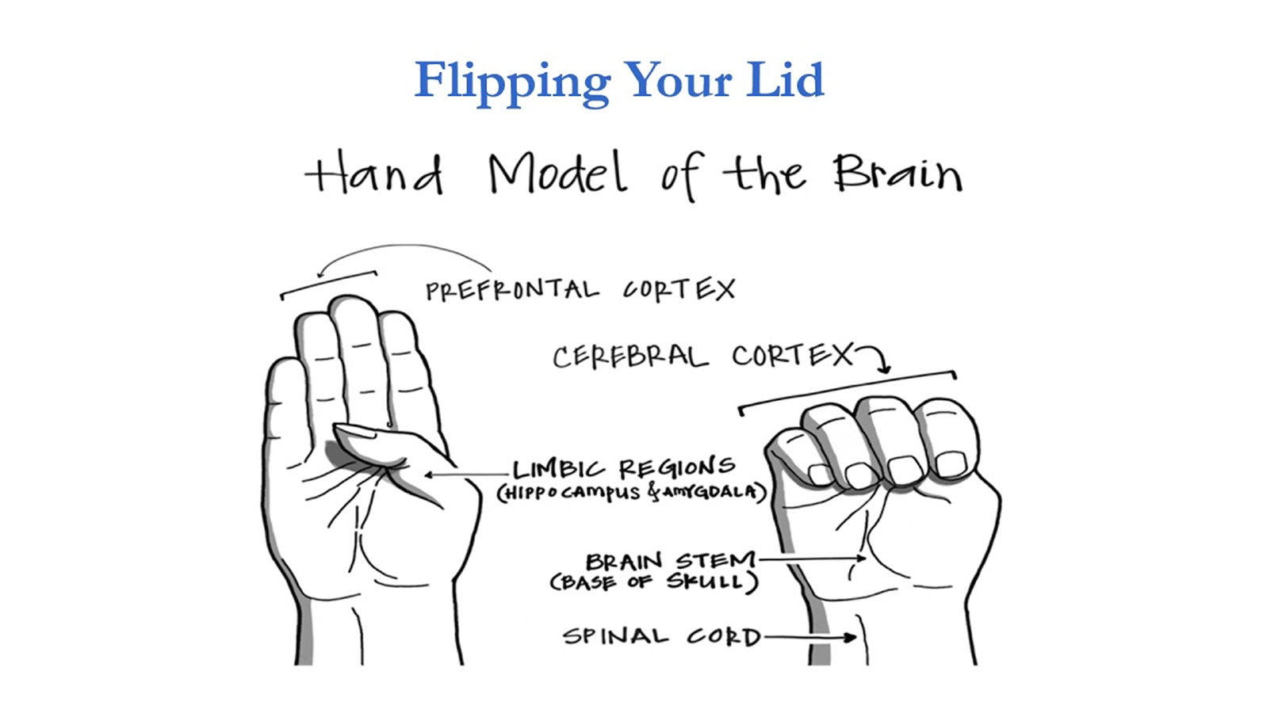
What happens when you flip your lid

Slide 52
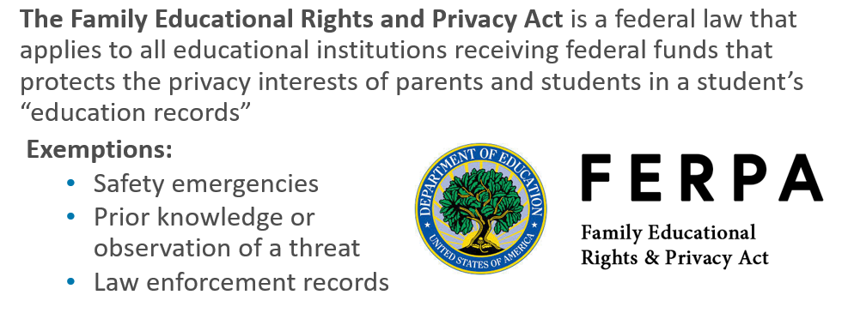
FERPA
Notes:
The Family Educational Rights and Privacy Act (or FERPA) should not be an impediment to an effective threat assessment, nor to case management. FERPA protects student’s educational records only, rather than observations and direct communications. School administrators, teachers and other staff may share information including educational records with other school officials that have a need to know the information; this includes the members of the threat assessment team. Where safety concerns exist, schools can share information with others outside the school that can help address safety concerns, such as parents, law enforcement officials, and mental health professionals, that can help address the safety concerns. Additional information regarding FERPA can be found at www2.ed.gov/policy/gen/guid/fpco/ferpa. In addition, DCJS has an Information Sharing Guide available to help threat assessment teams better understand information sharing in the K-12 public school setting

Slide 53
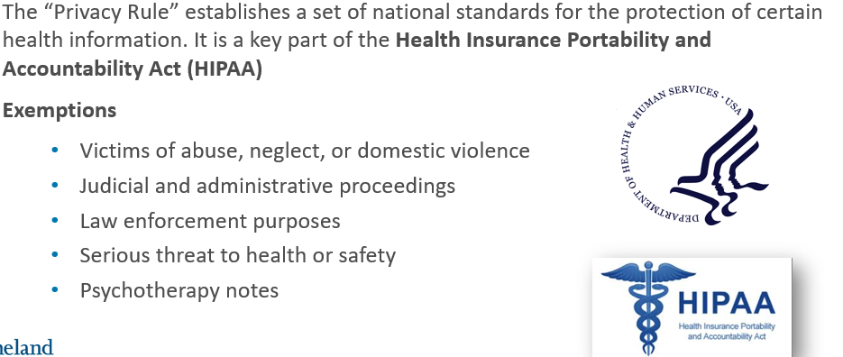
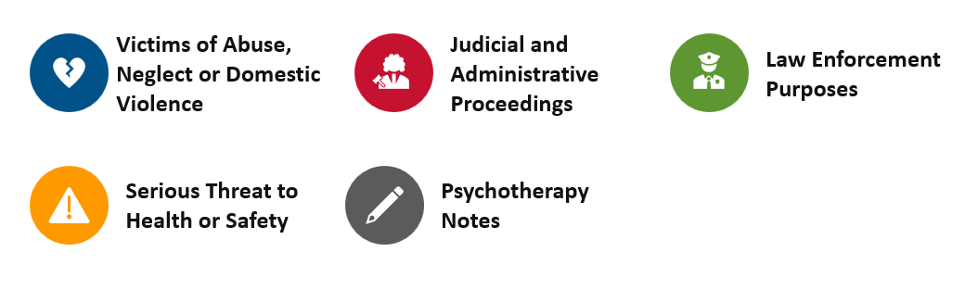
HIPPA Privacy Rules Exemptions

Slide 54
Sharing Any Private Information
Safety Emergency Disclosure:
Permits disclosures, without consent of the parent or student, to protect the health/safety of the student or others
Limited to the period of the emergency
Case-by-case basis

Slide 55
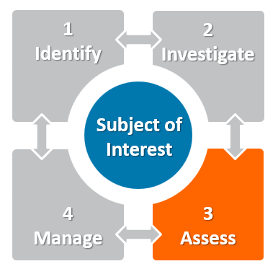
Threat Assessment Model: Assess
Notes:
What does the team need to do next?

Slide 56

Assessment: Avoiding bias

Slide 57

Types of Unconscious Bias

Slide 58
Assess
BTAM Team gathers to analyze information
Interpret Threat Enhancers or Mitigator
Prepare the findings

Slide 59
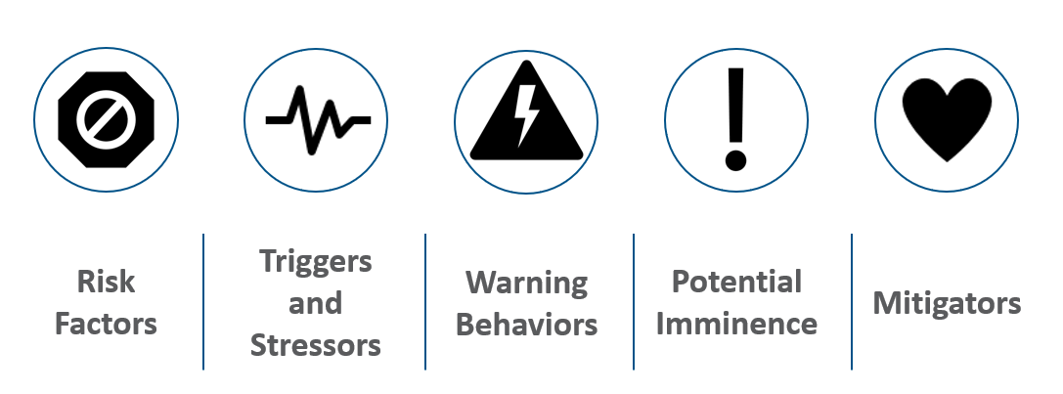
Enhancers and Mitigators

Slide 60





Risk
Factors
Triggers and Stressors
Warning Behaviors
Potential Imminence
Mitigators
M2 – Threat Assessment Model
Notes:
Jeff

Slide 61
VIOLENCE HISTORY
OTHERS ARE CONCERNED
HEALTH/MENTAL HEALTH
SOCIAL/ENVIRONMENTAL
PERSONALITY DISTURBANCES/DISORDER
PROBLEMATIC
BEHAVIORAL HISTORY
SEVERE MENTAL ILLNESS
WEAPONS
HISTORY OF SUICIDALITY
M2 – Threat Assessment Model
Notes:
Jeff

Slide 62
Risk
Factors
Triggers and Stressors
Warning Behaviors
Potential Imminence
Mitigators
M2 – Threat Assessment Model
Notes:
Jeff

Slide 63





Life Stressors
FINANCIAL
LAW
ENFORCEMENT
WORK OR HOME
RELATIONSHIPS
M2 – Threat Assessment Model
Notes:
Jeff

Slide 64
Risk
Factors
Triggers and Stressors
Warning Behaviors
Potential Imminence
Mitigators
M2 – Threat Assessment Model
Notes:
Jeff

Slide 65
FIXATION
LEAKAGE
IDENTIFICATION
DIRECTLY COMMUNICATED THREAT
NOVEL AGGRESSION
APPROACH BEHAVIOR
M2 – Threat Assessment Model
Notes:
Jeff

Slide 66
Risk
Factors
Triggers and Stressors
Warning Behaviors
Potential Imminence
Mitigators
M2 – Threat Assessment Model
Notes:
Jeff

Slide 67
Deviations in normal non-aggressive behavior
End of life planning
Last resort
Sudden withdrawal from life pattern
M2 – Threat Assessment Model

Slide 68
Risk
Factors
Triggers and Stressors
Warning Behaviors
Potential Imminence
Mitigators
M2 – Threat Assessment Model
Notes:
Jeff

Slide 69
CONFLICT RESOLUTION
FLEXIBILITY OF THINKING
“ON THE RADAR”
ACCESS AND RECEPTIVENESS TO ASSISTANCE
POSITIVE, REALISTIC GOALS
SUPPORTIVE FAMILY
POSITIVE COPING MECHANISMS
HEALTHY SOCIAL SUPPORTS
M2 – Threat Assessment Model
Notes:
Jeff

Slide 70
Three-Step Process: Step 3
Assessing Allison
Group Activity
Notes:
What are Allison’s Risk Factors and Mitigators

Slide 71

For More Practice
Notes:
Allison worksheets

Slide 72
Three-Step Process: Step 3
As You Prepare Findings
Make sure to…
Utilize district-adopted documentation throughout
Include the threat assessment team
Communicate findings and plan to the subject (student) and family

Slide 73
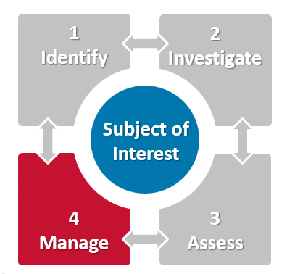
Threat Assessment Model: Manage
Notes:
Just to introduce. This topic will continue tomorrow with Curtis!

Slide 74
Manage
Notes:
Identifying, gathering information, making an assessment, and intervening before harm occurs requires a focus on the four components below and their interaction
Subject of concern (i.e., the person that the team is assessing) - should provide insight into how the individual perceives and deals with conditions, often stressful, in their life and the intensity of effort they direct toward planning and preparation for violence. ● Target – examine access that the subject has to the target(s) and ways to decrease a target’s vulnerabilities; also examine the relationship between the target and subject and how the relationships dynamics may be influencing the subject's intended goals. 1 Fein, R., Vossekuil, B., Pollack, W., Borum, R., Modzeleski, W., & Reddy, M. (2002). Threat Assessment in Schools: A Guide to Managing Threatening Behavior and Creating Safe School Climates. Washington, DC: U.S. Secret Service and U.S. Department of Education © Ontic Technologies (2023) Page 11 ● Environment - examines school/workplace climate and systemic issues that contribute to the risk of violence, or do not discourage it. ● Precipitating events - should examine critical stressors or events such as bullying, personal losses, enforcement actions, or even threat assessment team interventions, which may increase or decrease the risk for violence.

Slide 75
Threat Management
“Threat management is about diverting direction of interest, diminishing dangerous and concerning behaviors, and altering a trajectory toward targeted violence.”
- Making Prevention a Reality: Identifying, Assessing, and Managing the Threat of Targeted Attacks
August 2024
Notes:
This presentation will continue tomorrow with Curtis from WestEd

Slide 76
Resources
Trauma Aware Schools (https://traumaawareschools.org)
The National Child Traumatic Stress Network (NCTSN; https://www.nctsn.org)
National Threat Evaluation and Reporting Program (NTER; DHS; https://www.dhs.gov/national-threat-evaluation-and-reporting-program)
National Association for Behavioral Intervention and Threat Assessment (NABITA; https://www.nabita.org)
OPI Teacher Learning Hub (https://opi.mt.gov/Educators/Teaching-Learning/Teacher-Learning-Hub)

Slide 77
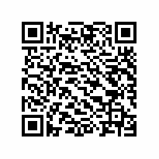
Your feedback is appreciated
Please contact us at:
Tina Eblen
Christina.eblen@mso.umt.edu
406.243.4976
Tammy Tolleson Knee
Tamara.tollesonknee@mso.umt.edu
406.243.9479

Slide 78
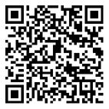
Jeremy Bullock

