Slide 1

Supporting Your Students and Yourself During these Stressful Times
Melissa Brymer, Ph.D., Psy.D.
Director, Terrorism & Disaster Program
UCLA/Duke University National Center for Child Traumatic Stress
mbrymer@mednet.ucla.edu

Slide 2
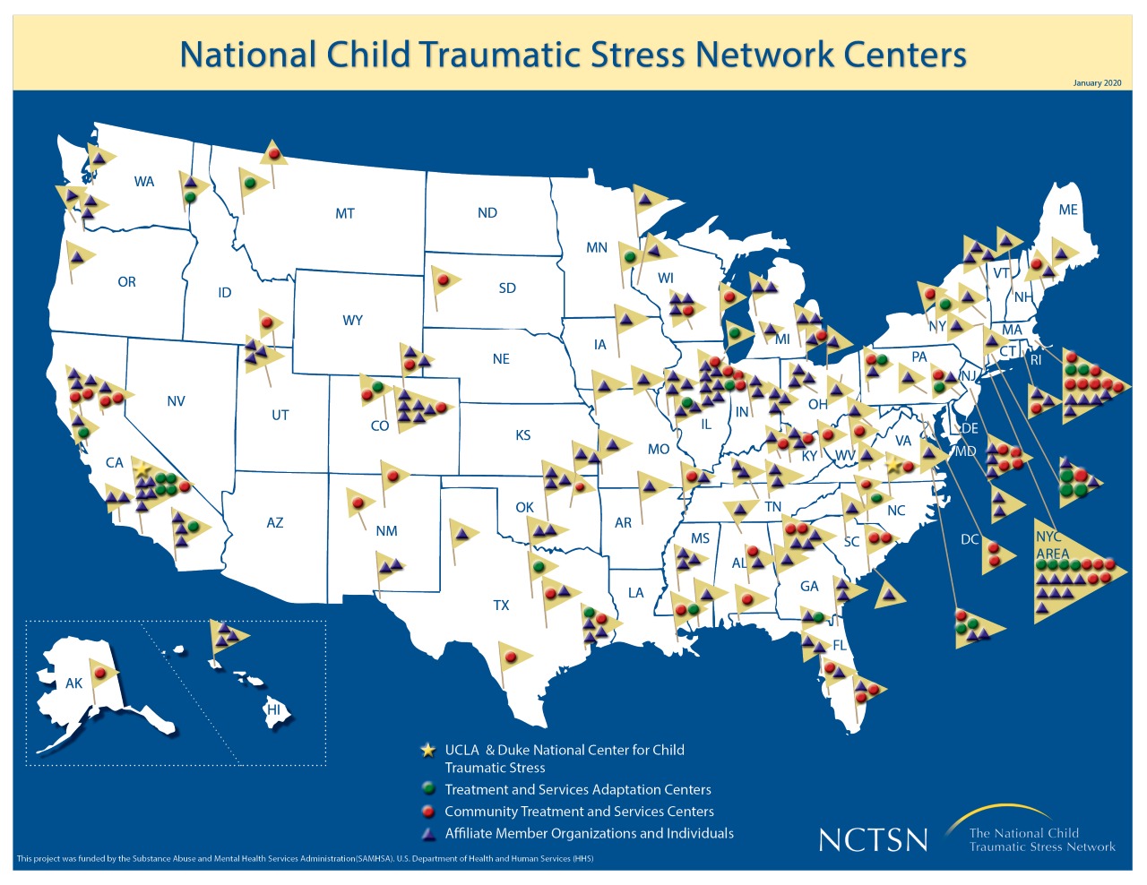

Slide 3

Acknowledge
Uncertainty is stressful
Anxiety is appropriate under the circumstances
We can’t do everything for everyone
There will be good days & “not so good” days
Minimizing all the above is disingenuous
We are charting “new waters”
We are balancing more
We are all directly exposed to this event
Cohen Silver & Gurwitch, SciLine, 2020

Slide 4
Why Focus On Staff Well-Being
Addressing school staff mental health:
Reduces burnout and turnover
Improves morale and effectiveness
Well-being of the school staff will be a major factor in student success
The burden of teachers to address the students who are falling behind academically may affect their mental health and well-being further
Timeline for recovery varies across individuals and is rarely linear. Staff may continue to be impacted even after the summer break

Slide 5

Disproportionate Impact:
Trauma and loss histories
BIPOC and immigrant students
Students with disabilities
Special education
Poverty
Rural and under-resourced neighborhoods

Slide 6

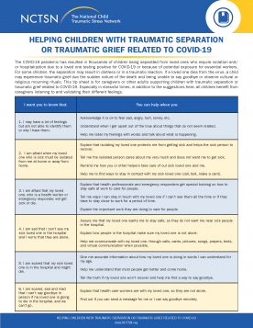
Need to Acknowledge Grief and Losses
Different with COVID-19
Couldn’t say good-bye
Couldn’t engage in many religious/cultural rituals
Needed to adapt ways to honor the deceased
Many missed developmental
milestones
www.NCTSN.org

Slide 7
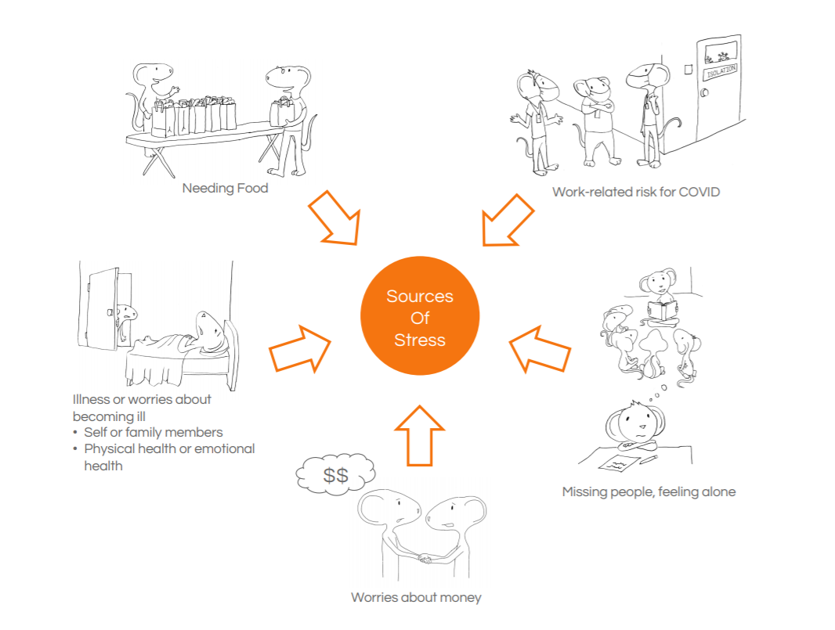


Slide 8
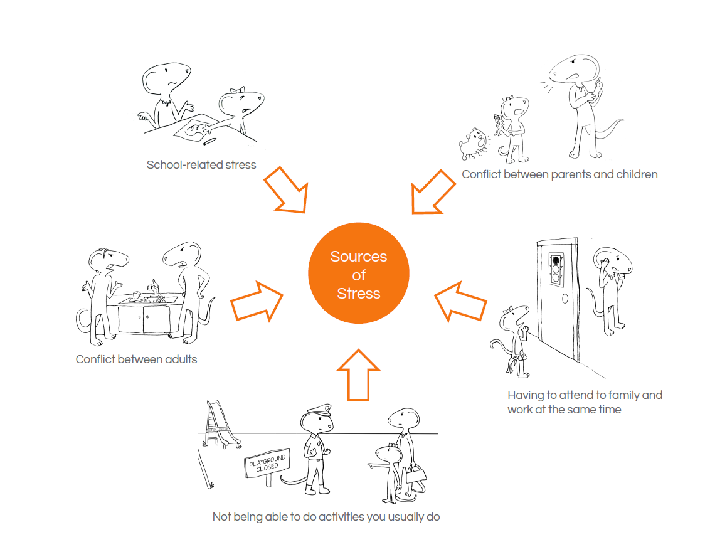

Slide 9
Mental Health and COVID-19 COVID
Increased isolation and feelings of loneliness
Adults reporting increases in anxiety, worry, and depression
Increased substance abuse
Difficulties sleeping
Diminished supports
Increased concerns related to work, housing, food, money
Increased reports of job burn-out
Adults report increased mental health challenges, which can adversely impact parenting

Slide 10
Children at Increased Health and Mental Health Risk 9Health Risk During COVID19
Children with pre-existing mental health concerns
Children with pre-existing developmental/learning challenges
Children whose families are without access to technology or missed school year
Children who had or now have economic hardships and food insecurities
Children with underlying health conditions
Children with family members who have underlying health conditions
Children who have family members who are sick with COVID-19 or who have died due to COVID-19

Slide 11
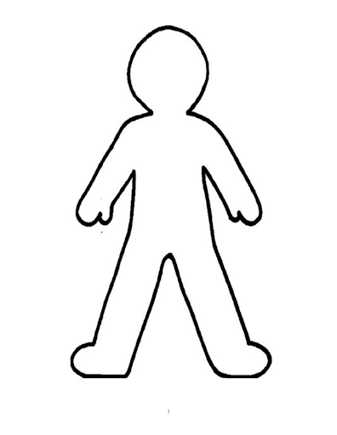
Traumatic Stress Reactions Seen At School
Memory Problems
Poor Attention/Concentration
Poor Decision-Making
Irritability
Change in Alertness
Lack of Trust
Rejecting Supports
Problems with Transitions/Change
Difficulty Calming Down
Negativity
Fear
Anxiety
Anger
Depression
Grief
Trauma

Slide 12
Safety: Intervention Strategies
Address current safety concerns and additional adversities
Communicate what steps are being done to address safety concerns
Encourage teachers and counselors to provide space and encourage students to talk about their safety concerns
Address issues of mistrust

Slide 13

Relational Trust in Learning Communities
Schools were responding to information, misinformation, and partial information as we all learned about the potential impact of COVID.
Along the way, schools necessarily made decisions that conflicted with some educator, student and family perspectives about what was most needed at the time. These decisions created conflict and broke some essential aspects of trust.
We can also admit our mistakes, help folks feel seen, valued and heard, share in the experience, and offer trust.
To encourage trust, we need more experience with each other, sharing our stories – our hopes and fears – so we can develop understanding, empathy, connections and the probability of mutual support.
Notes:
Kate:
Why and how has COVID impacted relational trust within learning communities & how can we address trust building moving forward? And how we frame “learning loss” may be integral to our process of trust building?
Schools were in the position of responding to information, misinformation, and partial information- as we all learned about the potential impact of COVID. Along the way, schools necessarily made decisions that conflicted with some educator, student and family perspectives about what was most needed at the time. These decisions created conflict and broke some essential aspects of trust. How do we rebuild?
We can apply these lessons learned from educational research, across the nation and across the globe: Admit our mistakes, help folks feel seen, valued and heard, share in the experience, offer trust.
CHAT PROMPT: What are some ways schools can rebuild some of the trust that was broken due to decision-making?

Slide 14
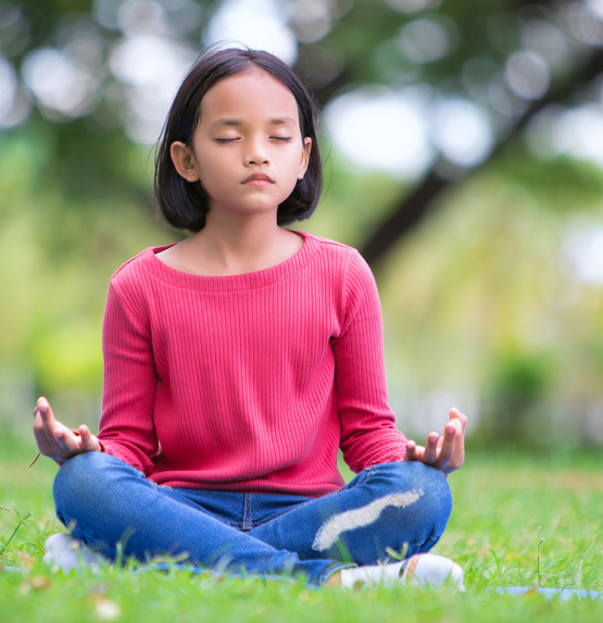
Calming: Intervention Strategies
Addressing the impacts of stress and trauma on the mental health and social-emotional well-being of students can create increased opportunity for academic achievement
Model being calm and using calming actions. Not only is it great self-care, but it also teaches those skills to students
Give tools to educators and parents on how they can support the children and each other
Large-scale education about:
Stress and grief reactions
Anxiety management techniques
Signs of more severe problems
When and how to seek help

Slide 15
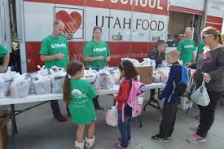
Self-Efficacy: Intervention Strategies
Everyone learned new things about school and themselves and we can capitalize on this strength
Should acknowledge the flexibility, openness, and hard work of students to adapt to the challenges of the last year regardless of grades or performance on paper
As much as possible involve parents/educators in decision-making policy and efforts
Connect families to community resources
Caregivers partnered in their child’s learning like never
before – we need to acknowledge this incredible effort

Slide 16

Connectedness: Intervention Strategies
Helping students and families reconnect with schools and build relationships that allow them to feel safe and seen by school staff is more important than ever
Although we have been impacted differently, we are not alone
Identify those who:
Lack strong support
Are likely to be more socially isolated
May need different types of supports
Increase the quantity, quality, and frequency of supportive transactions (Monitor engagement)
Address potential negative social influences

Slide 17

Hope: Intervention Strategies
Support rebuilding of local economies and resources
Make sure youth hear that their futures matter
Have students ask people who they respect how they stayed hopeful in troubled times
Share a positive affirmation or a strength of a student or a colleague–it can go a long way
Highlight that these changes are temporary. Mention other times your community or another community rebounded after other hard times

Slide 18
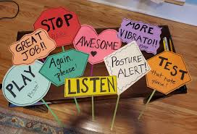
Creating a Trauma-Informed Learning Environment
Trust, relationships, and connection are key elements of recovery and are critical for promoting an effective learning environment in schools
Establish a routine and clearly define transitions
Make information digestible
Build in time each “class” to share
Success
Positive activities
Kindness/helping others
Gratitude
Growth
A little bit of fun!
Create opportunities for students to work in small groups on projects (academic or for fun)
Empower students with choice
Promote self-regulation strategies

Slide 19
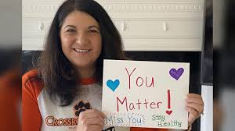
Teaching is All About Relationships
Key to educational success
Students remember teachers who inspire, give a push when needed and make sure students get back up when they fall.
These teachers are the ones whose words of encouragement are remembered years later
All this, AND teaching academic materials so they can succeed in their classes
Especially now, important for students to know teachers care about their overall well-being

Slide 20
Things to Consider:
Instead of looking at last year as a lost year, honor experiences as different kinds of learning and resiliency skill-building.
Remember that staff may be equally impacted by their own experiences and will likely need additional supports.
Administrators need to model vulnerability as leaders to demonstrate how the school community can continue to support one another through the struggles they are facing.
Allow educators to experience the very sort of relationship that they are expected to provide for students and families.
Increase offerings for staff wellness, self care, and we care experiences. They too need time for connection, community, and relationship building.

Slide 21
ATTEMPTS AT DE-ESCALATION REQUIRE CONNECTION ATTEMPTS AT CONNECTION REQUIRE UNDERSTANDING
-Is this about fear in relationships?
-Is this about overwhelming emotions?
-Is this about difficulty thinking?
-Is this about an out of balance body?
-Is this about shame?
Massie-Lambert, S. (2021)
Notes:
What happened to you?
NOT
What is wrong with you

Slide 22

Before You Intervene.....
Check in with yourself (how do you feel?)
Reframe behavior (what is the child trying to gain, avoid, control?)
Decide what intervention is feasible, reasonable, and/or necessary
Recommend \further trauma-focused supports
Massie-Lambert, S. (2021)
Notes:
Reflect, validate, normalize

Slide 23
Recommendations for Students
Students need space to reflect, process, grieve, and heal from the events of the past year and a half.
Students need their engagement in school, whatever the level, to be valued. Some students disappeared during COVID because they began to fail and then gave up.
Do not rush to make one-size fits all decisions until we have a better understanding of the context and experience that students are bringing with them when they return to the classroom.
Reflect on what positive lessons have been learned over the past 16 months and think about outside the box, creative alternatives for student engagement, connection, and learning.
Don’t forget that students and staff alike may have much more going on underneath the surface now.

Slide 24
Multi-Level Intervention Options
Tier 1 – General Population-based Interventions
Mental health literacy, social emotional learning, wellness activities, crisis preparedness
Classroom WISE, Psychological First Aid
Tier 2 – Specialized Group Interventions
Trauma/Grief-focused, short-term, strength-based
Skills for Psychological Recovery, CBITS/Bounce Back
Tier 3 – Specialized Individual-Based Interventions
Psychiatric Services, long-term
Trauma Focused-CBT

Slide 25
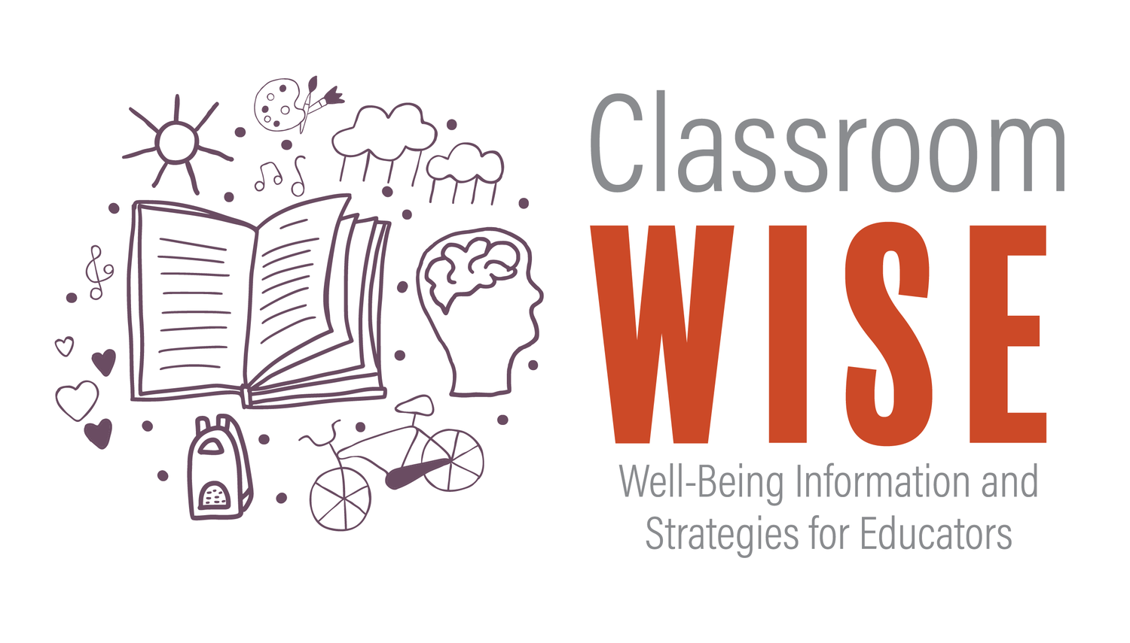
Well-Being Information and Strategies for Educators
a FREE 3-part training package that assists K-12 educators in supporting the mental health of students in the classroom.
Offers evidence-based strategies and skills to engage and support students with mental health concerns in the classroom.
https://www.classroomwise.org/

Slide 26
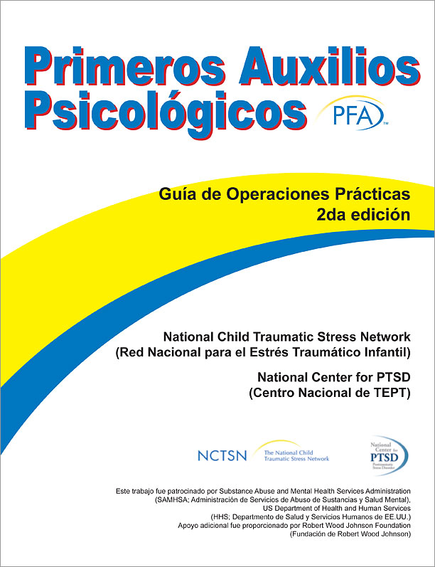
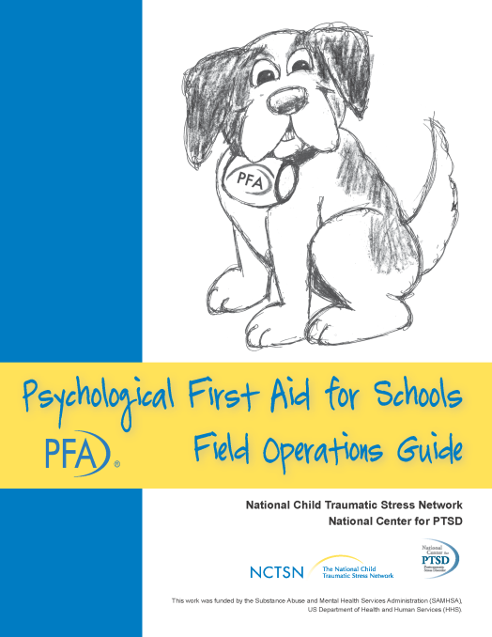
Psychological First Aid
An acute intervention to assist students, educators, and families in the immediate aftermath of disasters
Has been adapted for different systems and translated into different languages
www.NCTSN.org – all manuals
Learn.NCTSN.org – PFA Online
PFA Mobile available for IOS and Android mobile devices
Notes:
26

Slide 27
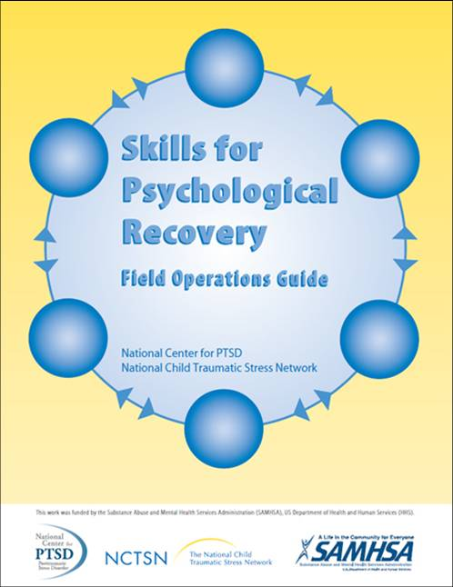
Skills for Psychological Recovery
SPR is a modular intermediate intervention that aims to help survivors gain skills to manage distress and cope post-disaster
SPR is designed to be 1-5 visits, each which can “stand alone, but you should encourage multiple visits
Was created for use with children, adolescents, and adults
Used in a variety of settings and with paraprofessionals
www.NCTSN.org – all manuals
Learn.NCTSN.org – SPR Online

Slide 28

Tier 2 Evidence-based Treatments
https://bouncebackprogram.org
http://cbitsprogram.org

Slide 29
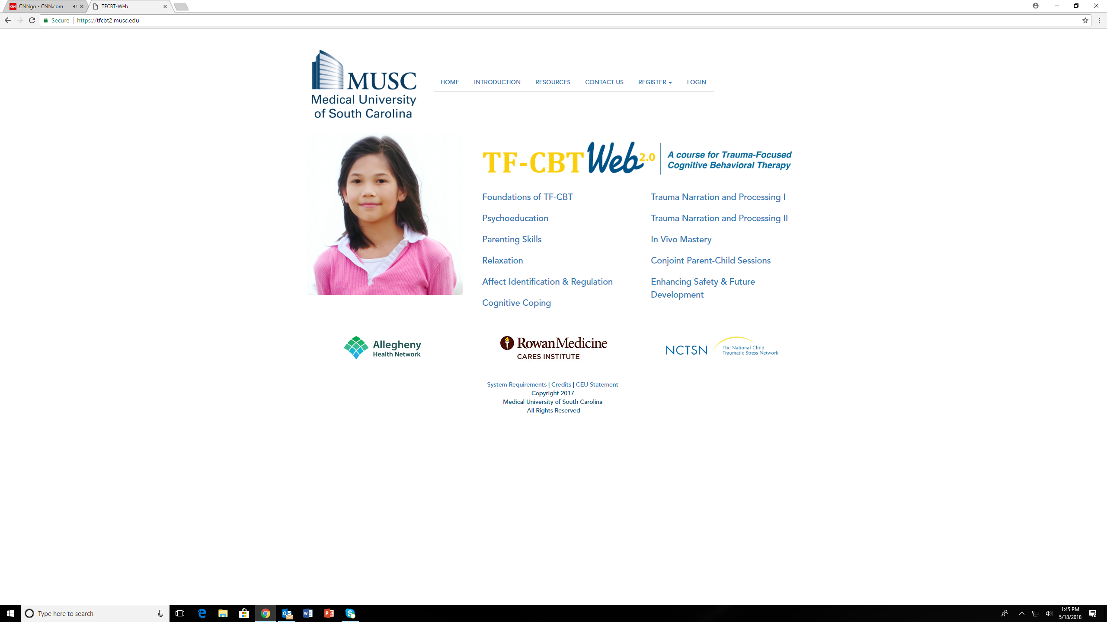
Tier 3 Evidence-based Treatment
https://tfcbt2.musc.edu

Slide 30
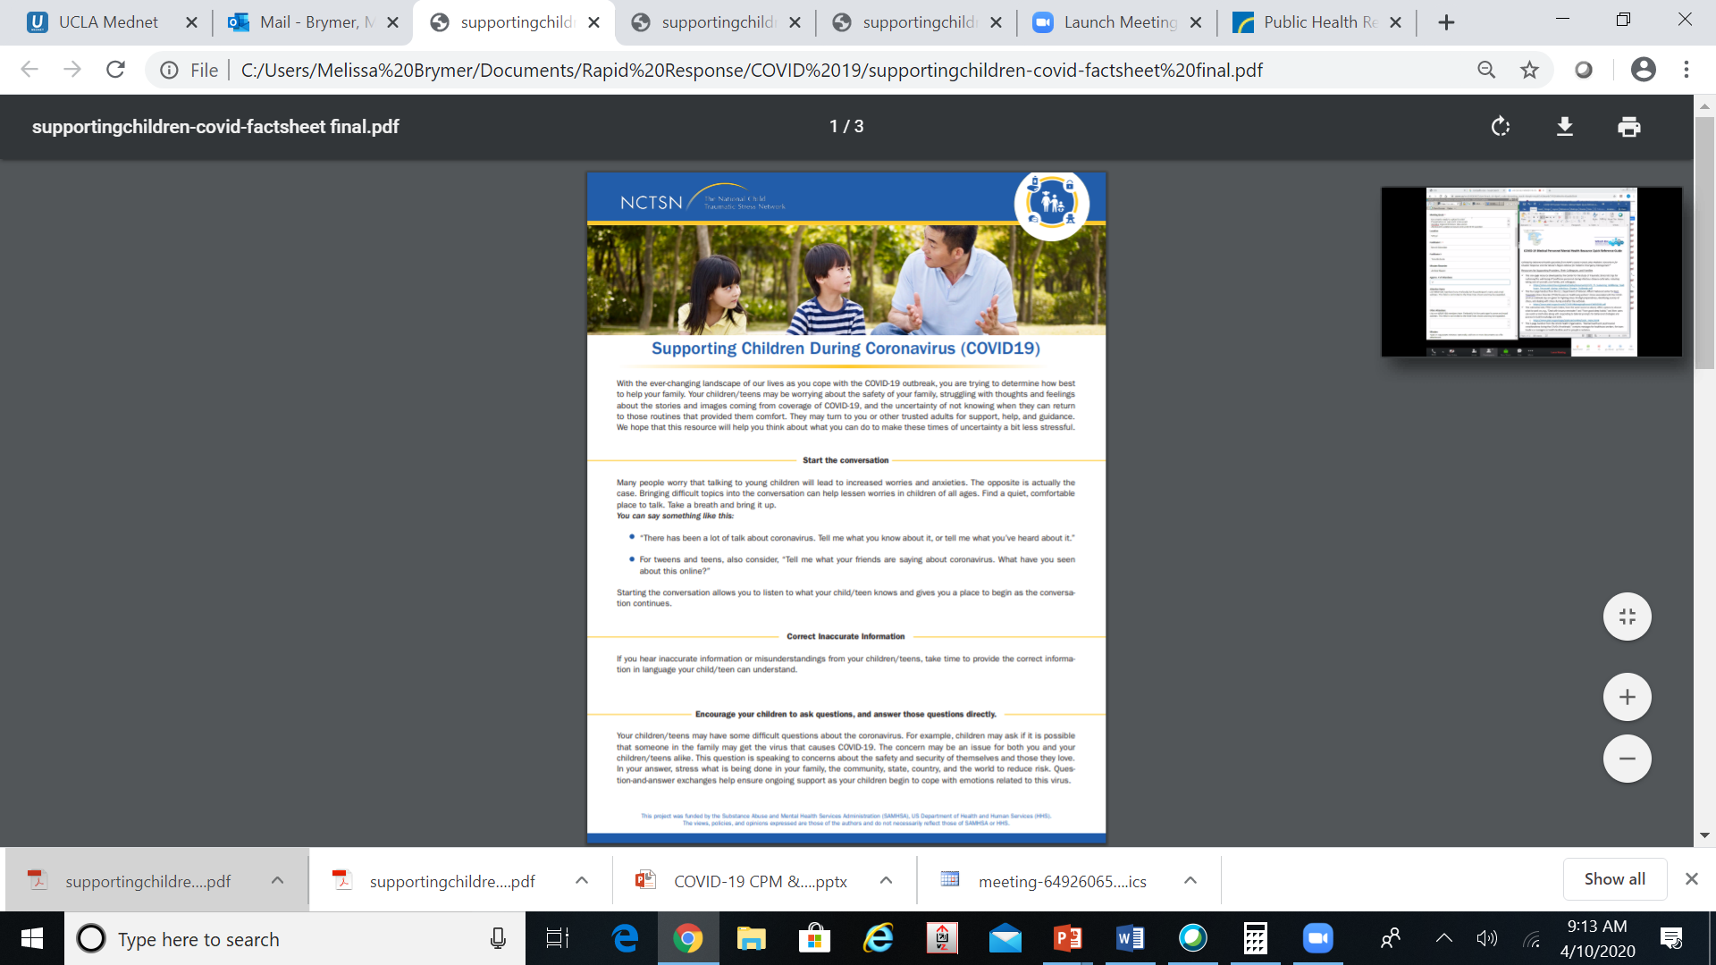
Offer Support to Parents
Start the conversation
Validate feelings
Create a routine, building in calm/quiet time
Minimize media/social media exposure
Model self-regulation
Provide reassurance
Stay connected
Address missed developmental milestones
Check in on a regular basis
www.NCTSN.org

Slide 31
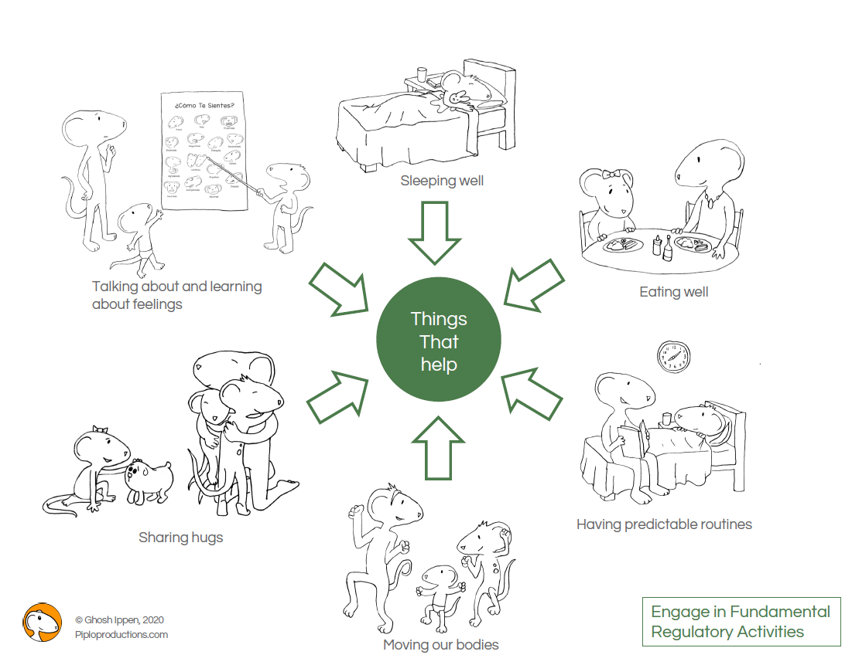

Slide 32
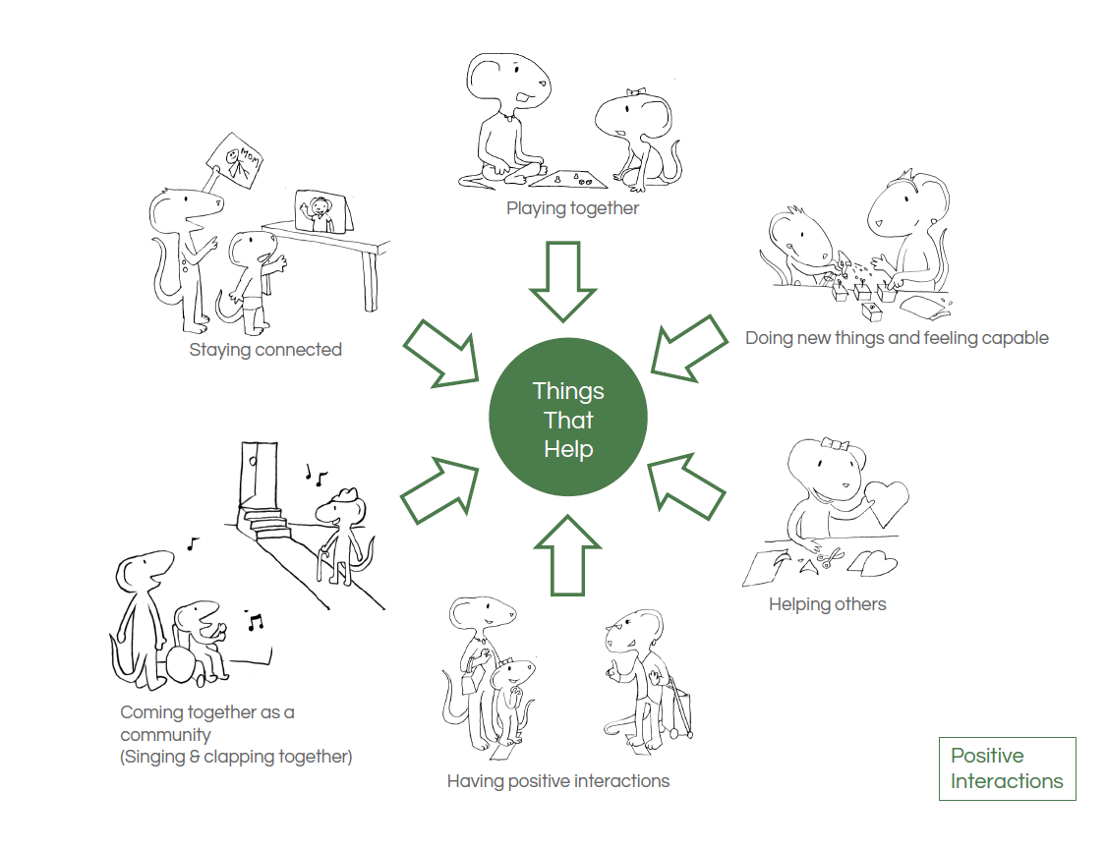

Slide 33
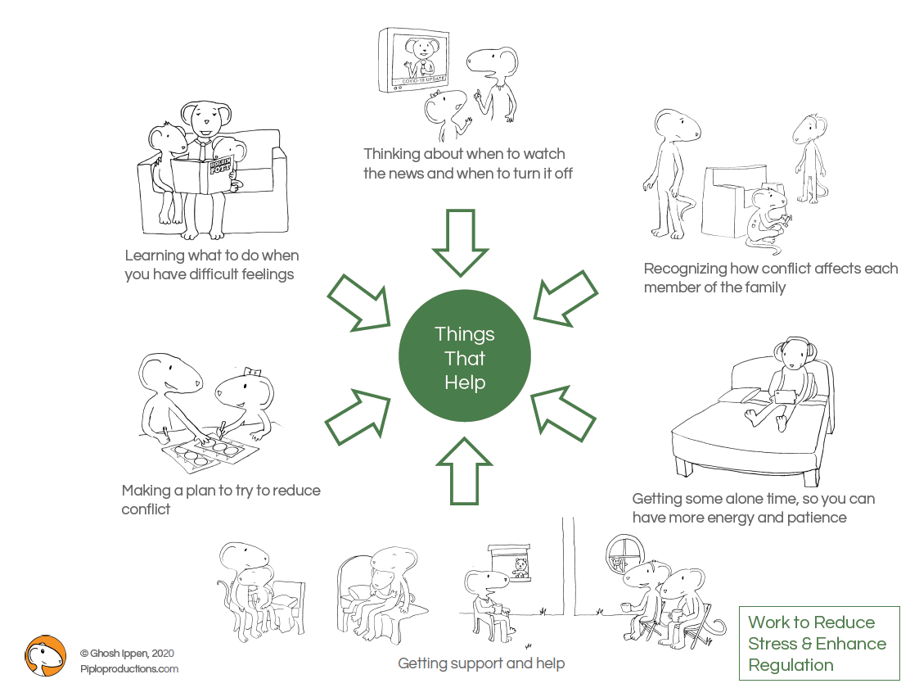

Slide 34
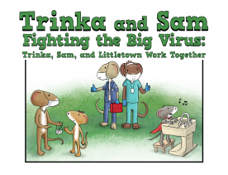
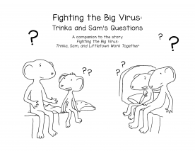
Trinka and Sam: children’s book
English
Spanish
Mandarin
Simplified Chinese
Portuguese
Finnish
www.NCTSN.org

Slide 35
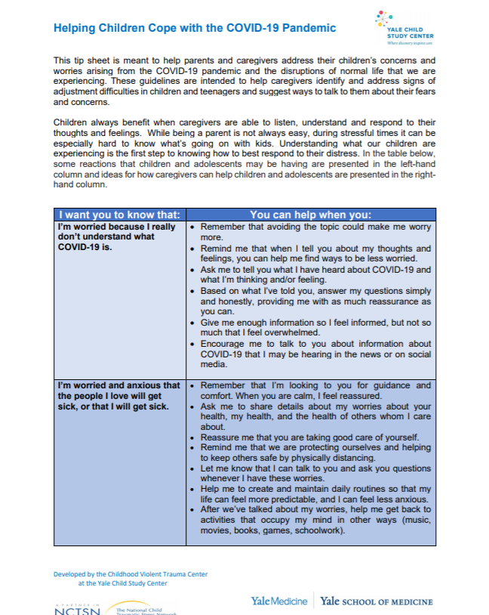
Helping Children with Specific Worries & Reactions
Worry
Negative thoughts
Clingy behaviors
Sleep difficulties
Physical reactions (racing heart, stomach aches, headaches)
Lost enjoyment in activities
Frustration and irritability
Difficulty with attention and concentration
www.NCTSN.org

Slide 36
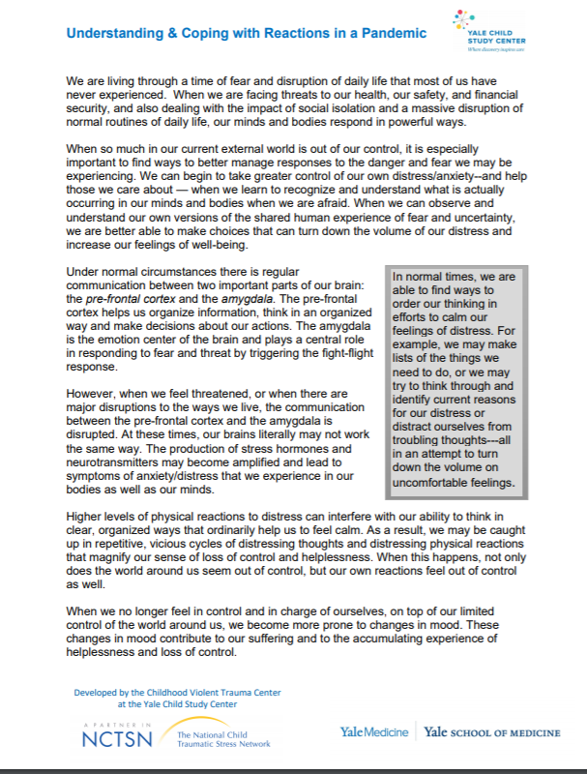
Helping Adults Cope during COVID-19
Anxiety/Stress
Trouble Sleeping
Changes in Mood
Changes in Thoughts
Loneliness & Social Isolation
What/why
Changing
How to Cope
Why it works
Body
Behavior
Feelings
Thoughts
www.NCTSN.org

Slide 37
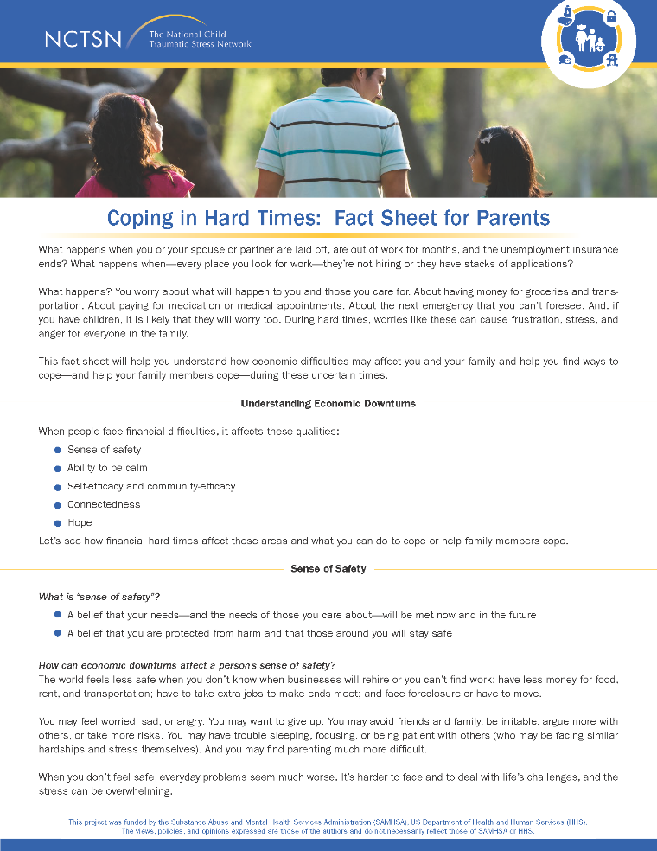
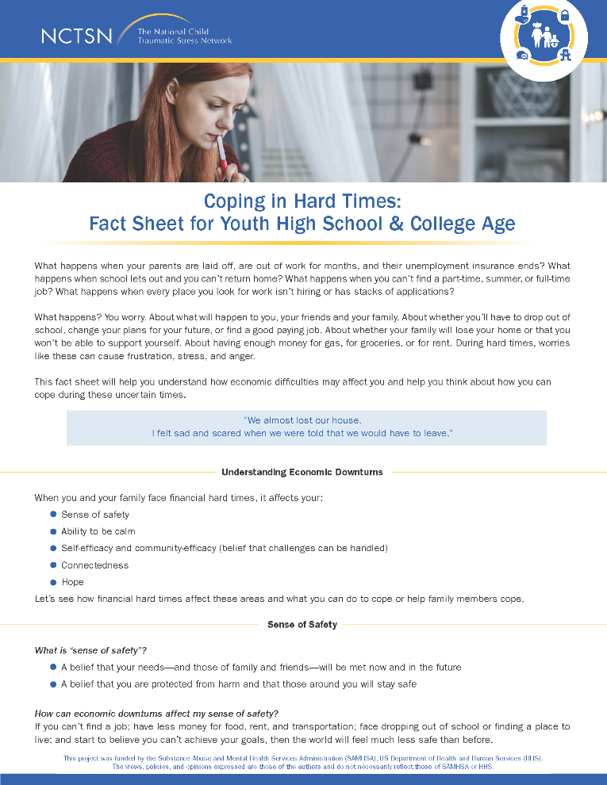
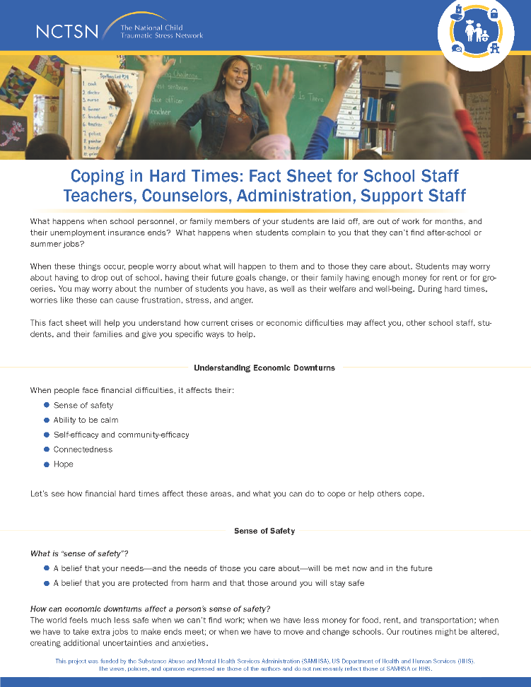
Economic Hardships
Parents
School Staff
High School & College Age Students
www.NCTSN.org

Slide 38

Why Self-Care?

Slide 39
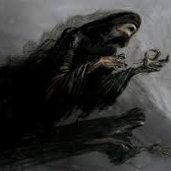
Dementors Among Us
Dementors feed on human happiness and thus generate feelings of depression and despair in any person in close proximity to them.
COVID-19 Stress
Work stress
Family stress
Grief and Loss
Continued uncertainty
COVID-19
Racism and Social Injustice
Political Climate

Slide 40

Another Dementor: Challenges to Self-Care
Believing that STS is real but can’t impact YOU
Making time when all around you seem to need your help
Feelings of guilt and shame for taking time for yourself
Believing those around you are doing fine, so you should be doing fine too
Lack of modeling or support from administration for self-care activities

Slide 41

Our Protection
Awareness
Balance
Connection
Self-Care

Slide 42

A New Framework for Self-Care: PRN
Notes:
We’re going to look at another framework to reduce compassion fatigue today. PRN: National Center Traumatic Stress Network, 2020. As we talked about in the last session, we are all under tremendous stress from the Covid pandemic, the racism pandemic, and the unsettled political situation. We may be dealing with additional responsibilities at work and new challenges with schooling or parenting. PRN practices can help to reset and rebalance your nervous system, and can help to prevent compassion fatigue. These can be done frequently throughout each day in just a few minutes. Let’s talk about the three steps of PRN: pause, reset, and nourish.

Slide 43

Pause
“Pausing” just means taking 3 slow breaths to check how you are feeling
Check in
Body – where do you hold your stress
Mind – is your mind cluttered or full of worries
Feeling – notice and name any intense feelings
Frustration
Anxiety
Anger
Grief
Sadness
www.NCTSN.org
Notes:
Slowing your breathing down and taking deep, conscious breaths can help you to do a physical and internal check at how you are feeling at the present moment.

Slide 44

Reset
Actively do something to help you feel steadier, more calm, confident, or focused on your next task
Take a quiet moment
Meditation
Petting an animal
Going outside for a minute
Looking at a favorite photo
Acknowledge the feeling of being “uncentered”
Imagine letting this feeling go (leaf in a river)
Focus on something positive
Affirmation
Sharing gratitude
Watching something funny
Talking with a colleague
Practice self-compassion—what would you say to a friend or colleague to provide caring and support?

Slide 45

Nourish
Ask yourself, “What do I need to nourish myself right now?”
Consider ways to replenish your mind-body-heart-soul-spirit
Name one rewarding or meaningful moment at home and at work.
Find a moment (or more) to be playful, lighthearted, joyful
Create your own affirmation or mantra you can repeat to yourself in times of stress
Find ways to honor/commemorate someone who has died
Remind yourself of WHY you went into this work in the first place and think of one way you are making a difference
Celebrate the small victories
Notes:
Review awareness, balance,and connection briefly before they go into the small groups.

Slide 46
Support for Teachers Affected by Trauma
Online course addressing educator secondary stress
Self-assessment helps to monitor stress over the school year
Offers strategies for increasing well-being
https://statprogram.org/

Slide 47




Helpful Apps
Headspace / Headspace Plus is a meditation tool with hundreds of sessions on physical health, personal growth, stress management, and anxiety relief.
COVID Coach to help with self-care and overall wellness during the pandemic.
Liberate Meditation app for the Black, Indigenous, and People of Color community to ease anxiety, find gratitude, heal internalized racism and microaggressions and celebrate Blackness.
7 Minute Workout is the #1 fitness app in 127 countries with 12 high intensity exercises, 30 seconds per exercise, 10 seconds rest between exercises.

Slide 48
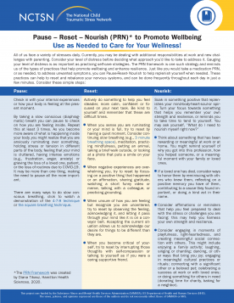
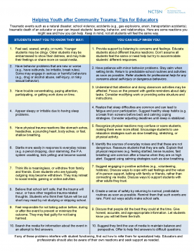
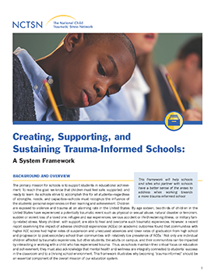
NCTSN Resources
info@nctsn.org
www.NCTSN.org
Learn.NCTSN.org
Notes:
Looks jumbled because of your PFA core actions click
PFA-S
SPR
Child Trauma Toolkit for Educators
Child Clinicians and the Media
Pediatric Toolkit

Slide 49
Additional Resources
National Center for Safe and Supportive Schools
https://www.ncs3.org/
National Center for School Mental Health
http://www.schoolmentalhealth.org/
Readiness and Emergency Management for Schools
https://rems.ed.gov/

Slide 50
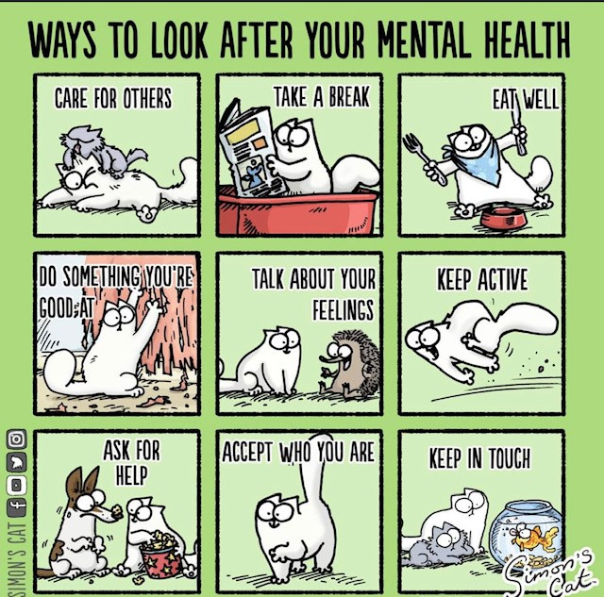
Other Questions

