Slide 1


Comprehensive School and Community Treatment Outcomes for Youth
2023 Legislative Update

Slide 2

Objectives
Overview of CSCT
Case Studies
CSCT Outcomes
Questions about CSCT
Legislative Update 2023

Slide 3
CSCT overview
Comprehensive School and Community Treatment (CSCT) is a school based mental health service provided to students in a public school by a licensed mental health center.

Slide 4
GOAL of the CSCT Program
The primary goal is to help high-risk students be successful behaviorally, socially, emotionally, and academically.
We seek to accomplish this goal through:
Decreasing problem behaviors and facilitating the student's social, emotional growth to remain in regular public school settings
Provide individualized mental heath services, coordinated with the student's education
Build social and academic skills
Provide counseling and support to parents/families

Slide 5
CSCT Program Facts:
CSCT Team(s) are comprised by at least one master’s level therapist and up to two mental health aides/specialists.
They are available during school hours and provide after-hour emergency on-call services
Team(s) work with the students throughout school breaks, including Christmas and summer.
Team(s) are required to attend IEP meetings, if requested, for their client to coordinate services with IEP accommodations.

Slide 6
Youth Qualifications for CSCT
Serious Emotional Disturbance (SED) refers to a youth who meets the requirements for a qualified diagnosis and has behavior impairment in various settings.
Insurance/Funding
Tier 3 MTSS
Common SED Diagnoses:
  Anxiety
  Depression
  Posttraumatic Stress Disorder (PTSD)
  Oppositional Defiant Disorder
  Bipolar Disorder
  Autism

Slide 7
SED Diagnosis
What might a student with an SED look like in the school setting?
Arguing, fighting, hostility, overreacting, impulsive, inattentive, hyperactive
Withdrawn, tearful, lack of peer relations
Continuously needs to be redirected
Irritable, low frustration tolerance
Frequent absences
Contact with law enforcement
Increased discipline referrals

Slide 8
Case Study
Max:
Max was born with in-utero drug and alcohol use. He was born to a young mother and by 9 months of age was removed from his mother’s home and placed with his maternal grandparents. By Kindergarten, his maternal grandparents began seeing behavioral and emotional concerns. Max is now 8.5 years old and entering the 3rd grade.
Interventions:
  Therapy – Play therapy, Group, and Family Therapy
  Classroom support
  Recess support
  Home Support

Slide 9
Case Study
Jane:
Jane is 15 years old in her Sophomore year of High School. She has a history of trauma, including witnessing domestic violence, and sexual abuse by a family member. Jane lives with her mom and siblings.
Interventions:
  Therapy – Individual, Group, and Family therapy
  Classroom support
  Employment support
  Home Support

Slide 10
CSCT Aggregate Outcomes
Does CSCT truly help youth remain in school, in their home, and out of trouble?
  97% of CSCT youth did not receive out of home mental health treatment.
  No CSCT youth received any out of state residential treatment.
  95% of CSCT youth (K-12) were reported to be enrolled and attending school.
  95% of CSCT youth were reported to have no youth court involvement.

Slide 11
TCM Outcomes
How do these outcomes compare to TCM?
  83% of TCM youth did not receive out of home mental health treatment.
  1% of TCM youth received any out of state residential treatment.
  91% of CSCT youth (K-12) were reported to be enrolled and attending school.
  92% of CSCT youth were reported to have no youth court involvement.

Slide 12
CSCT Outcomes
Montana DPHHS and YBGR partnered to look at CSCT effectiveness based on preventing PRTF admission. The study looked at 1405 MT Medicaid youth receiving YBGR CSCT services anytime between 1/1/2016 and 12/31/2022.
  For comparative analysis, YBGR PRTF youth served between 1/1/2019 – 12/31/2022 were also evaluated. Both populations were analyzed using Medicaid claims data which ensured that non-YBGR services were captured.

Slide 13
CSCT Outcomes
Of 1405 YBGR CSCT youth reviewed, only 24 (1.71%) were currently receiving CSCT when they entered PRTF.
Of 422 YBGR PRTF youth reviewed, only 13 (3.08%) were currently receiving CSCT when they entered PRTF (of any CSCT provider in the state)

Slide 14
CSCT Outcomes:
The data demonstrates that CSCT is effective in preventing PRTF admission.
Youth who are not currently receiving CSCT appear to be more likely to enter PRTF.
SED diagnosis criteria is present for both programs and both serve high-risk youth.
CSCT can offer earlier interventions to help youth stay within their communities and reduce overall treatment costs.

Slide 15
Interested in a CSCT team at your school?
Talk with your building Principal and Superintendent
Choose a Mental Health Center
  Contract requirements
Board approval
MOU with DPHHS
District clerk accounting requirements – Intergovernmental Transfer of Funds

Slide 16
Questions about CSCT

Slide 17
Legislative Session 2023

Slide 18
Legislative Session
HB 872 Behavioral Health Systems for Future Generations
  The commission is tasked with developing recommendations for allocating the historic $300 million investment to: stabilize behavioral health and developmental disabilities service providers; increase and strengthen the behavioral health and developmental disabilities workforce to provide critical care to those in need; increase availability of integrated physical and behavioral health care; and support the establishment of behavioral health settings and intermediate care facilities for individuals with intellectual disabilities.

Slide 19
Legislative Session
HB 2 – Medicaid Provider Rate Increases
Legislators from both parties and the Gianforte administration all expressed support for some level of increases in Medicaid rates. The final state budget includes $339 million in increases for Medicaid providers over the next two years.

Slide 20
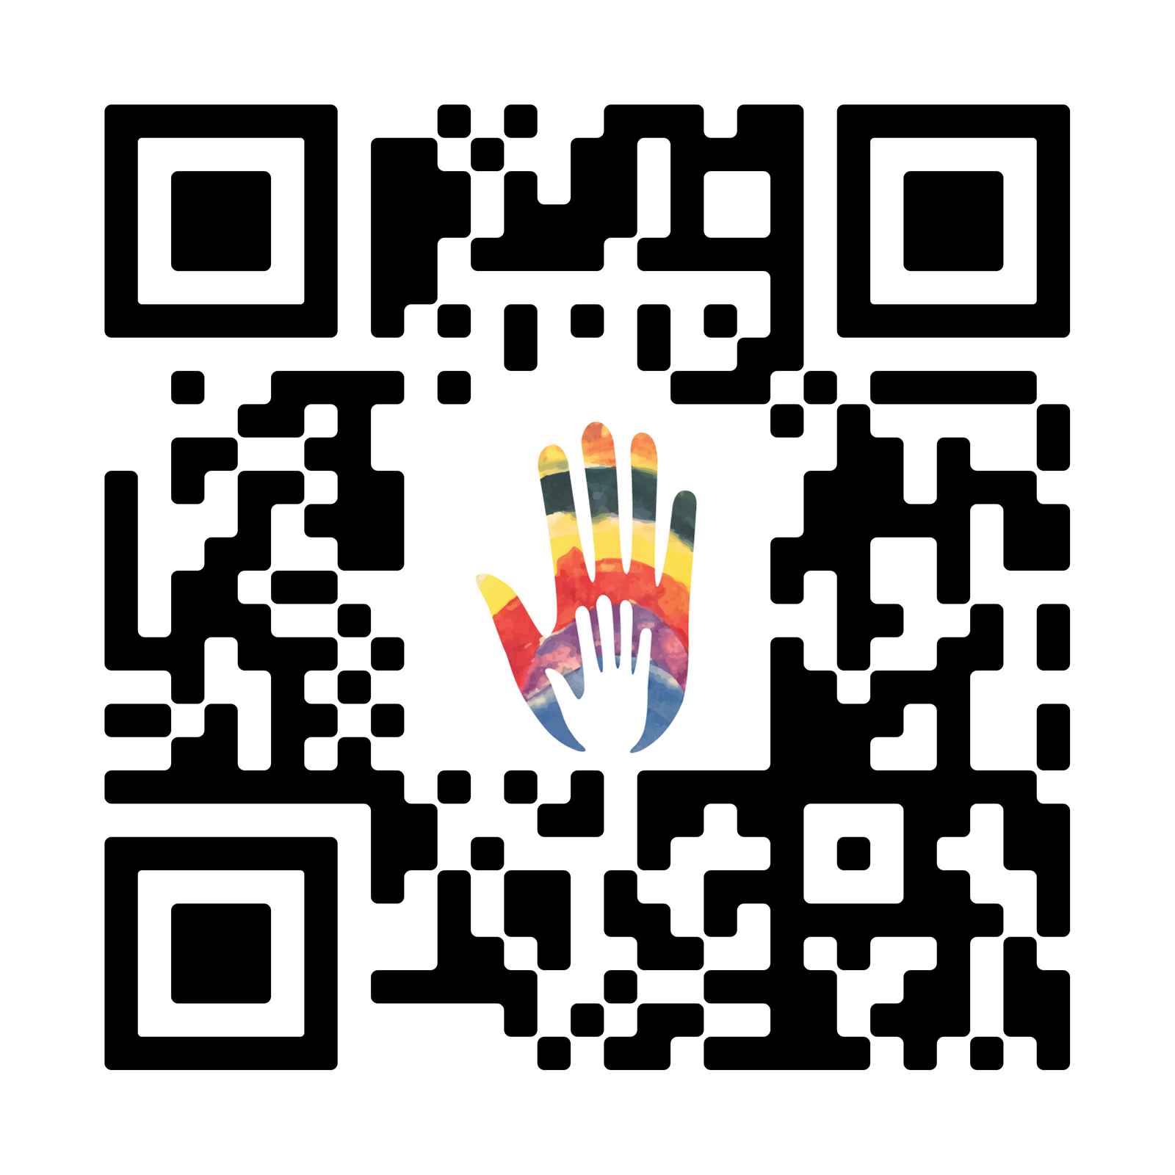
FOR MORE INFORMATION:
            Meghan Peel, Bureau Chief
            DPHHS - Children’s Mental Health Bureau
            mpeel@mt.gov
            (406) 444-4545
            Kim Collins, Executive Director
            YBGR – Community Based Services
            kcollins@ybgr.org
            (406) 655-2100
FEEDBACK QR CODE

