Slide 1
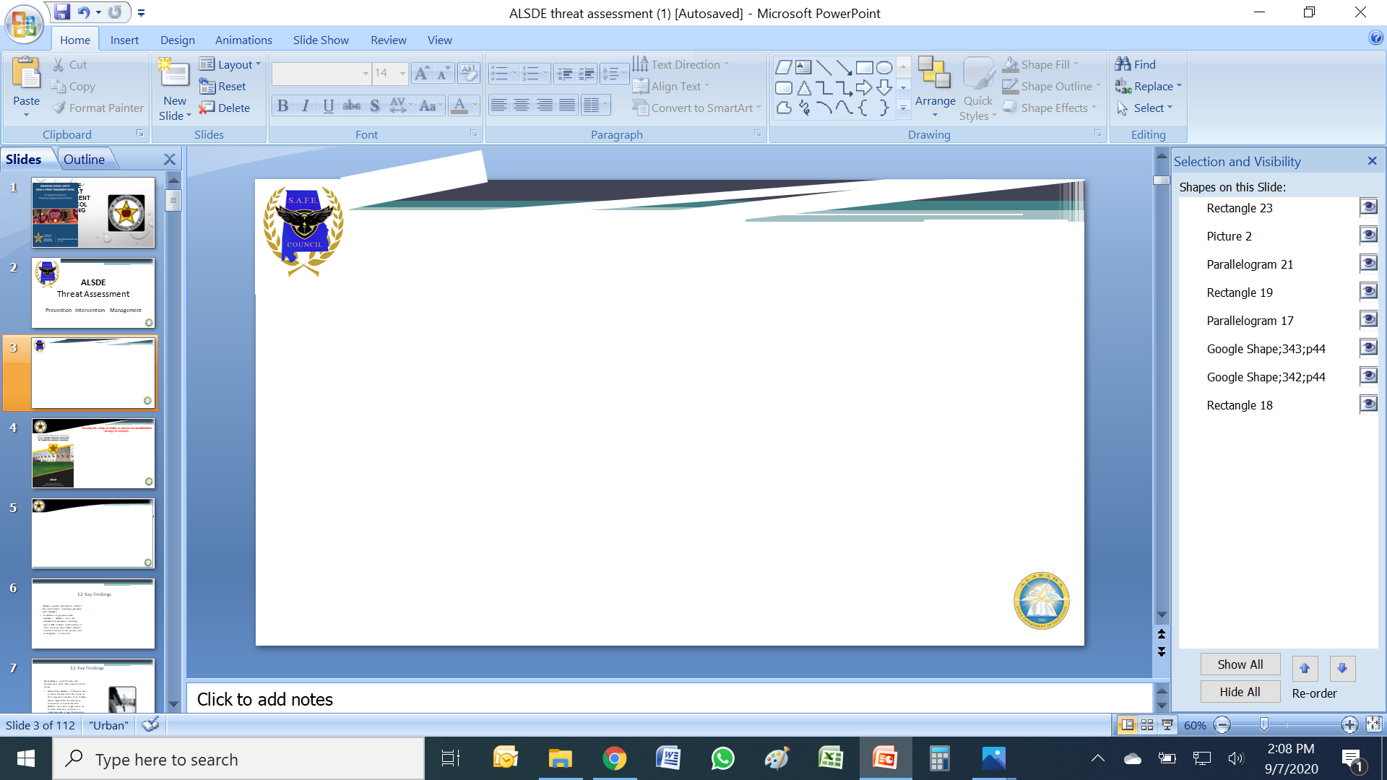
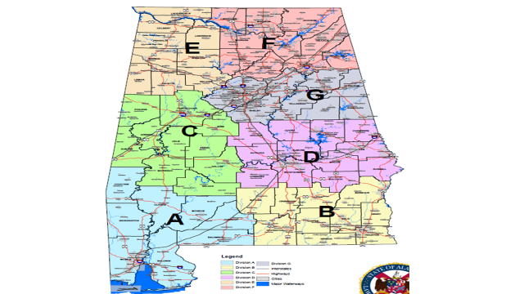
S.A.F.E.
Safe School Specialist
Dr. Dale Stripling
dstripling@ALSDE.edu
205-288-3266
.

Slide 3
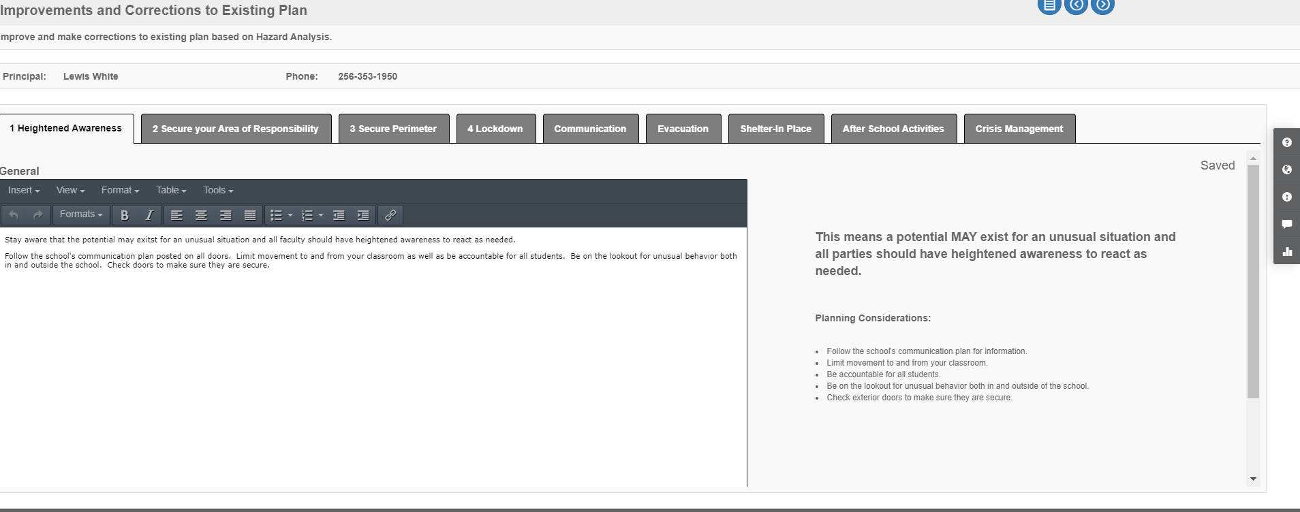
Heightened Awareness

Slide 4
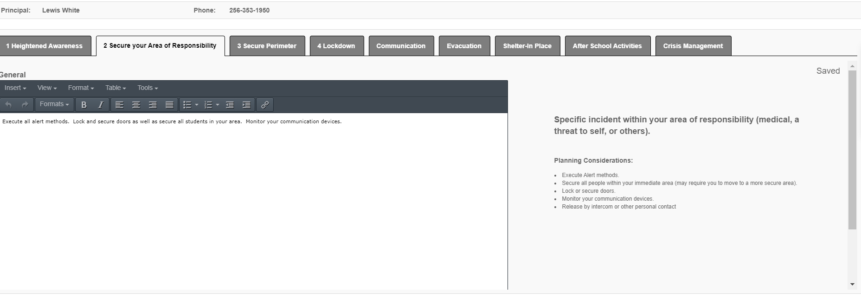
Secure Your Area of Responsibility

Slide 5
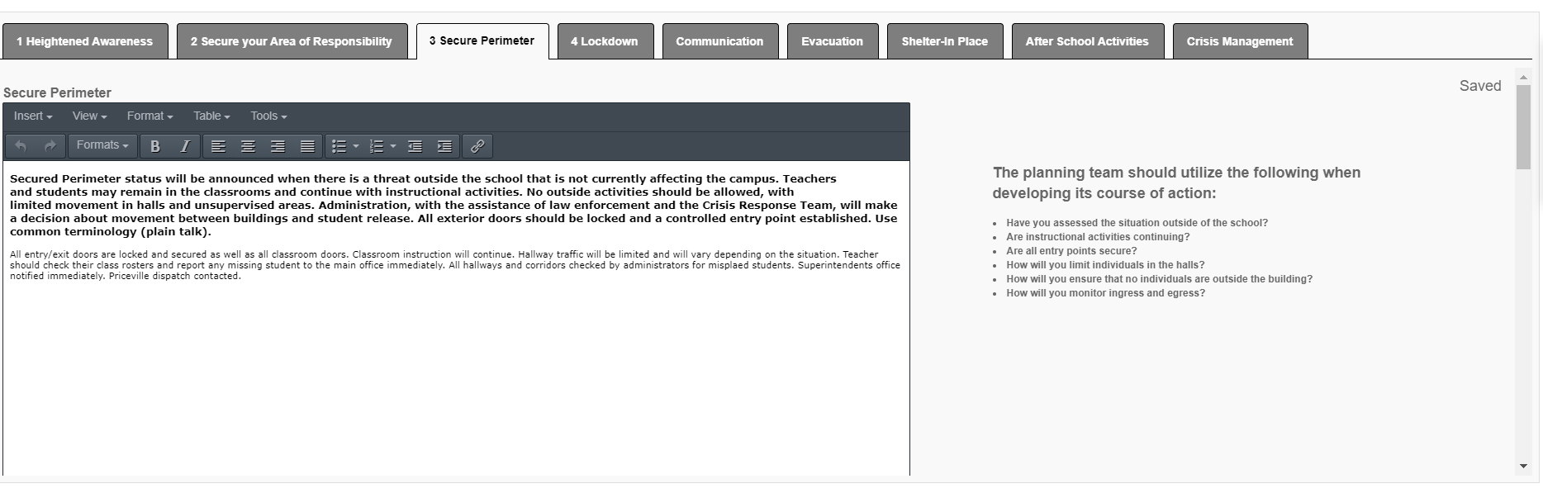
Secure Perimeter

Slide 6
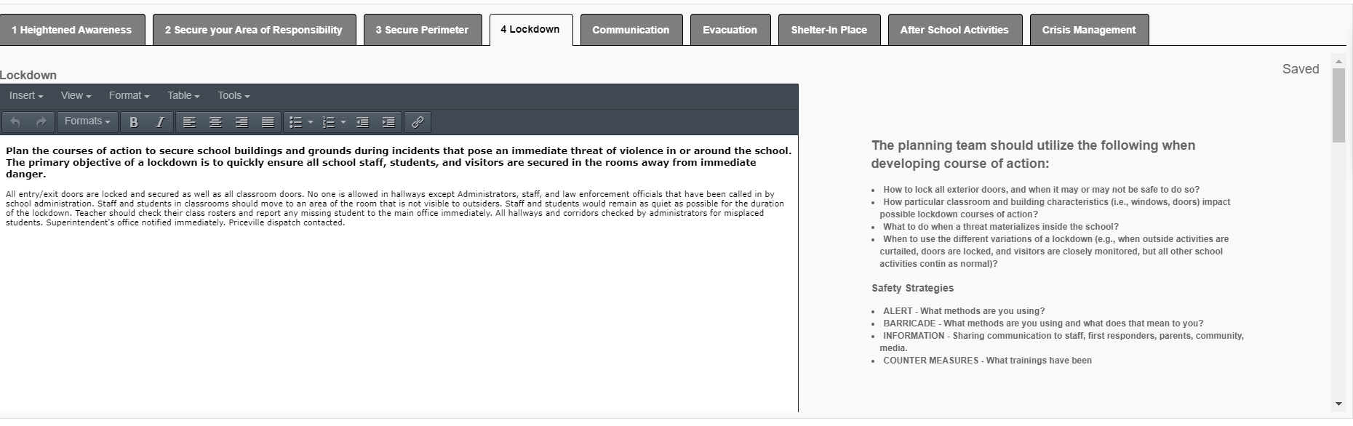
LOCKDOWN

Slide 7

When should I do a Lockdown Drill
The ALSDE mandates that you conduct 2 Lockdown drills per year 16-1-44 code of Alabama
When do most School Shootings occur?
What happens when FIRE ALARM goes off during lockdown drill?
What about students who are Outside.

Slide 8
How do I Lockdown
You should have scanned and checked hallways as you were closing doors: Secured doors, closed blinds and engaged Secondary locks, Students should have been moved and hidden in a safe place and quiet. Older students may be dispersed throughout classroom.
You should now begin to barricade, Think High Wide and Deep. All classroom doors will open outward, barricaded will help to slow entry of anyone who breaches lock and it will also serve to absorb ballistic projectiles.

Slide 9
First Step is your Mindset
It CAN HAPPEN HERE!
We Want to build a “Culture of Safety”
We must have no TOLERANCE for Violence.
EVERYONE is part of our PLANNING for the Safety and Security of our Children.

Slide 10
How much time do you have?
What do you think is the Average response time for “YOUR LOCAL POLICE Department” to a “Felony in Progress” call at your school?
Every “One Minute” of Police Response Time equals an average of “4 Deaths”
What is your PLAN ?
Before, During, and After the Police response?

Slide 11


ALSDE
Behavioral Threat Assessment
Prevention Intervention Management

Slide 12

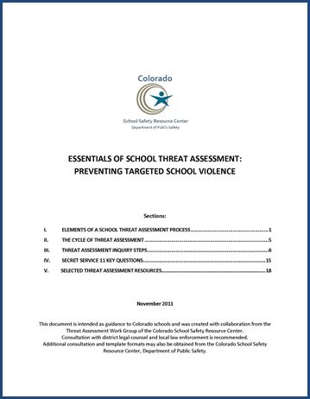
The Final Report and Findings of the Safe School Initiative
US Secret Service and Department of Education
Patterned after the Secret Service's Exceptional Case Study Project (ECSP)
US Secret Service and Dept. of Ed. (2004)
Essentials of School Threat Assessment (CSSRC)
Notes:
Safe School Initiative is the foundation of all of the threat assessment work conducted throughout the United States since the Columbine High School tragedy. It is the outcome of the collaboration between the US Secret Service and the Department of Education and reveals the key findings regarding 37 incidents of students who threatened targeted violence between 1974 and 2000.
The collaboration is patterned after the Secret Service’s Exceptional Case Study Project examining the lives of individuals who have carried out or tried to carry out lethal attacks on public officials. The monograph can be found on the internet by searching ‘Safe School Initiative.’

Slide 13

Triggering Events for a Threat Assessment
Student directly or indirectly threatens to harm person, group, and/or entire school
Artistic, written, or symbolic expression with disturbing and/or violent content is presented
Report that someone may possess a weapon on campus
Student demonstrates imminent warning signs or a cluster of concerning early warning signs
Student makes threat to harm or kill self (along with threats to others, or additional factors)
Student has escalating pattern of behavior that has been resistive to intervention at school
Other reasons?

Slide 14
Making vs. Posing a Threat
Some students who make threats ultimately pose threats.
Many students who make threats do not pose threats.
Some students who pose threats never make threats.
Implication: All threats must be taken seriously; threats are not a necessary condition to initiate an inquiry or
preliminary evaluation.

Slide 15
When did the first school shooting occur?
What was it?
Notes:
Use these two slides to discuss the fact that we as Americans have had violence in our schools for a long time. They didn’t just start in the 60’s or 90’s

Slide 16

Notes:
The Enoch Brown school massacre of Pontiac's War. On July 26, 1764, four Delaware (Lenape) American Indians entered a settlers' log schoolhouse in the Province of Pennsylvania in what is now Franklin County, near the present-day city of Greencastle.
Inside were the schoolmaster, Enoch Brown, and a number of young students. Brown pleaded with the warriors to spare the children; nonetheless he was shot and scalped. The warriors then tomahawked and scalped the children. Brown and nine children were killed. Two scalped children survived their wounds. Four children were taken as prisoners. The first school shooting in the Americas.
School shootings happen in every size school, every type of school, every area of the country, all spaces within the school and they have been occurring since before our country was even united.

Slide 17
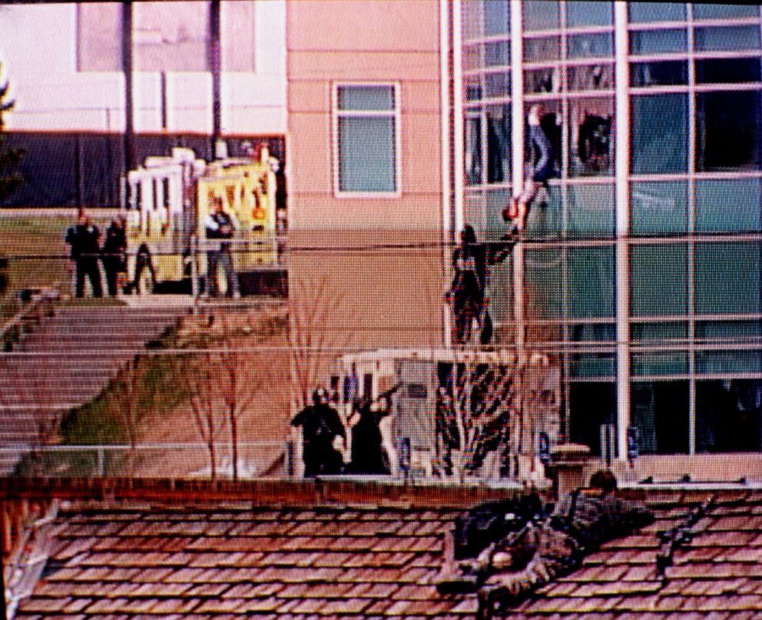

10 Killed Along With Brown
13 Victims at Columbine
17 Killed At Parkland
What Has Changed!

Slide 18

Assemble Threat Assessment Team
Team consists of at least 3 trained people:
Administrator
Principal
Assistant Principal
School Counselor/Mental Health Worker
Others as needed (school Nurse
Special Ed. Teacher)
SRO
This Photo by Unknown Author is licensed under CC BY-NC
Notes:
We always recommend that threat assessment be conducted by a team – never a single individual making a determination of possible violence.
Those listed on this slide should comprise the school team. Others on staff, with knowledge of the student, may be called upon to assist the team.
When should law enforcement be involved in an assessment?
They may assist in interviewing family
They may assist in interviewing persons outside school
They may conduct searches of the student’s house with the proper authority
District level teams have been used to ensure compliance and fidelity or to review only the most serious of threats, as a backup to the school level team. Some districts are small enough that the building level is the district level. Having a district level team available for consultation is an excellent component of your threat assessment protocol.

Slide 19
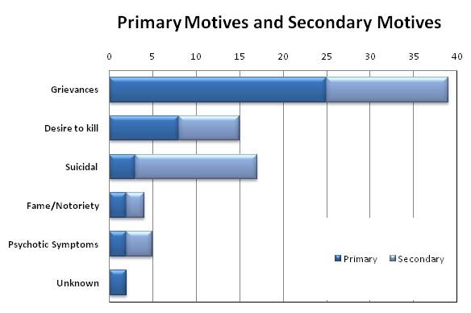
United States Secret Service National Threat Assessment Center, 2019.
¾ of attacks occurred within 1 week of returning from break in attendance
¼ were on first day
¾ targeted a specific person, most had a secondary motive
6 targeted particular group or people.

Slide 20
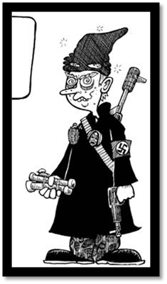
There is no accurate profile of a student attacker, nor is there a profile for the type of school that has been targeted
Attackers varied in age, gender, race, grade level, academic performance, and social characteristics. Similarly, there was no identified profile of the type of school impacted by targeted violence, as schools varied in size, location, and student-teacher ratios.
Notes:
Rather than focusing on a set of traits or characteristics, a threat assessment process should focus on gathering relevant information about a student’s behaviors, situational factors, and circumstances to assess the risk of violence or other harmful outcomes.
Click will bring up picture
Picture represents old stereotype of school attacker. Columbine trench coats, white males, loner, guns to name a few
Today anybody- no profile!

Slide 21

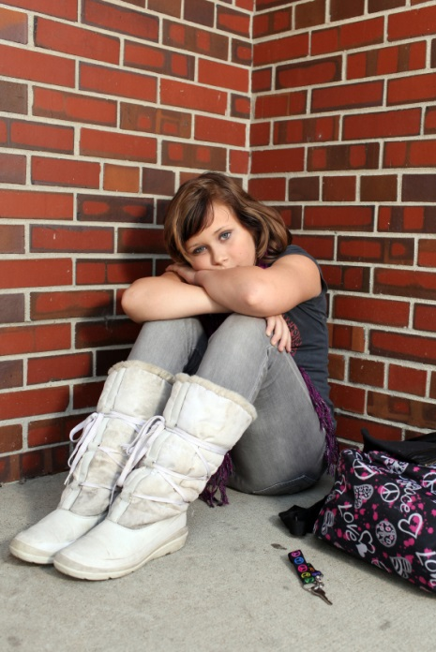
MENTAL HEALTH
Peter Langman
“Why Kids Kill”
Psychotic
Psychopathic
Traumatized
Psychological
Behavioral
Developmental Health
Notes:
In Peter Langman’s book Why Kids Kill, he examined ten school shooters. They fell into the following three categories:
Psychopathic (Existential rage – angry at life) Two were classified as truly psychopathic –demonstrated narcissism, a lack of empathy, a lack of conscience, and sadistic behavior. Think Eric Harris, one of the Columbine attackers, who was very narcissistic and had a god-like complex
Psychotic (Schizophrenic and/or Existential anguish – self-loathing, hopelessness) Dr. Langman believed five of the shooters would have been diagnosed either with schizophrenia or schizotypal personality disorder, including paranoid delusions, delusions of grandeur, and auditory hallucinations. Think Dylan Klebold, the other Columbine attacker.
Traumatized (Extreme reactivity) – The three traumatized shooters all came from broken homes.
They suffered physical and/or sexual abuse. Each had at least one parent with substance abuse problems, and each had at least one parent with a criminal history.
Students who make credible threats of targeted violence experience mental health concerns that drive the movement from idea to action. Many who have mental health diagnoses are psychotic, narcissistic, and/or traumatized. They often experience existential rage and anguish. Many are extremely reactive to the typical experiences of a routine school day. Their hyper vulnerability can manifest as excessive complaints about other students or experiences with teachers.
See also “Rampage School Shooters: A Typology” by Peter Langman, Ph.D. at www.schoolshooters.info Version 1.1 (31 July 2014)

Slide 22

Safe School Initiative Key Findings
Most attackers had significant losses and/or personal failures; ¾ history of suicidal thoughts, gestures, attempts
Most attackers had access to weapons (3/4 get weapons from their own home)
Notes:
These losses may not rise to a level that we as adults will see as problematic, again it is that students perception of loss, a pet dying may be a significant loss to an already vulnerable student.
Among those shootings where it was possible to determine the source of the firearm, three-quarters of the shooters obtained their guns from home. It is also important to consider other weapons as we are seeing more hybrid violence, consider edged weapons, explosives and chemicals as well as vehicles.
Implications: assess a student for difficulty coping, personal failures, feelings of desperation, efforts to acquire weapons. Ask parents/guardians about access to weapons. Be willing to address talking with them about safe storage of weapons.

Slide 23

Most attackers used firearms, and firearms were most often acquired from home.
Many of the attackers (75%) were able to access firearms from the home of their parents or another close relative. While many of the firearms were unsecured, in several cases the attackers were able to gain access to firearms that were secured in a locked gun safe or case. It should be further noted, however, that some attackers used knives instead of firearms to perpetrate their attacks

Slide 24
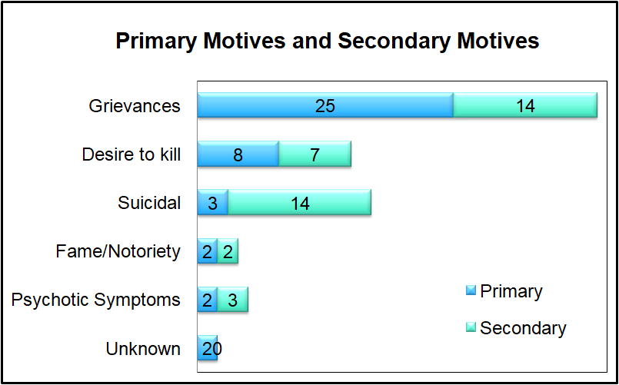
Key Findings
Attackers usually had multiple motives, the most common involving a grievance with classmates:
In addition to grievances with classmates , attackers were also motivated by grievances involving school staff, romantic relationships, or other personal issues. Other motives included a desire to kill, suicide, and seeking fame or notoriety.
Notes:
Discovering a students motive for engaging in concerning behavior is critical to assessing the student’s risk of engaging in violence and identifying appropriate interventions to change behavior and manage risk.

Slide 25
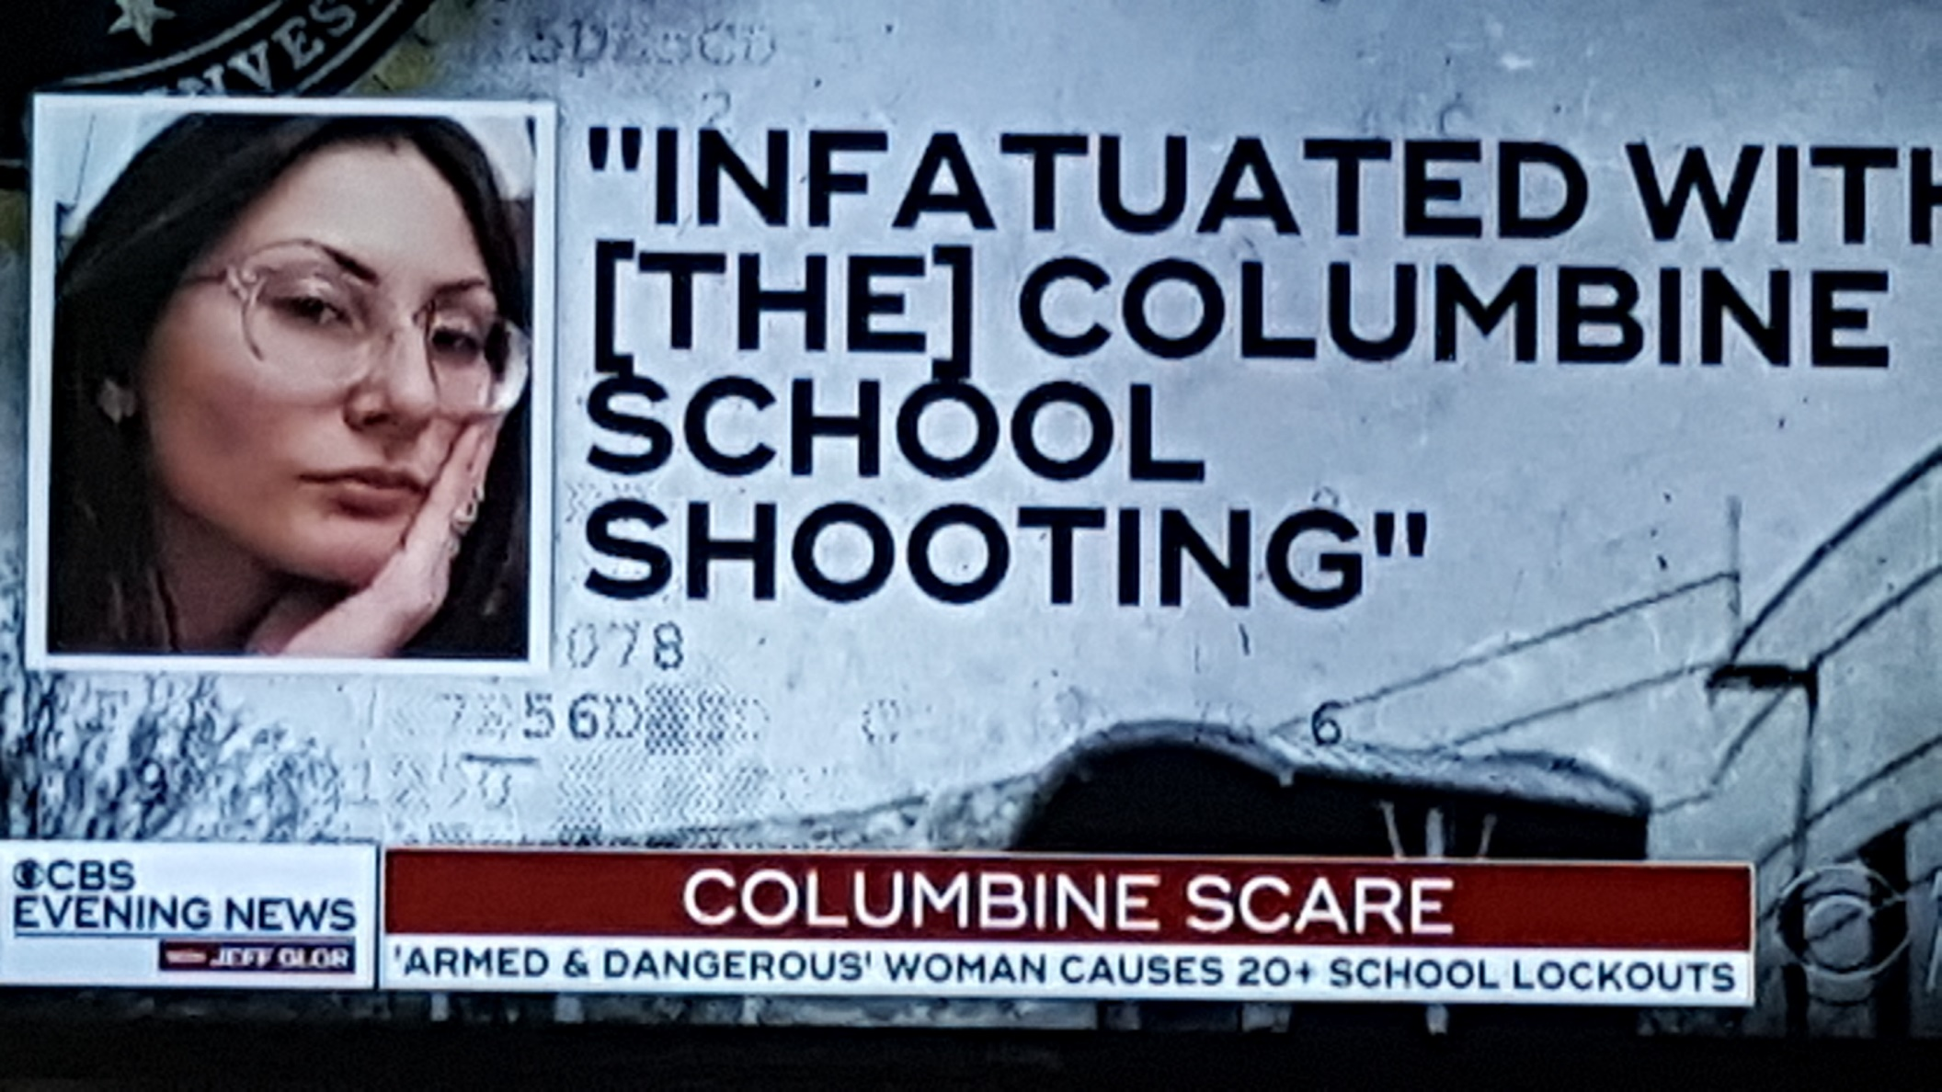
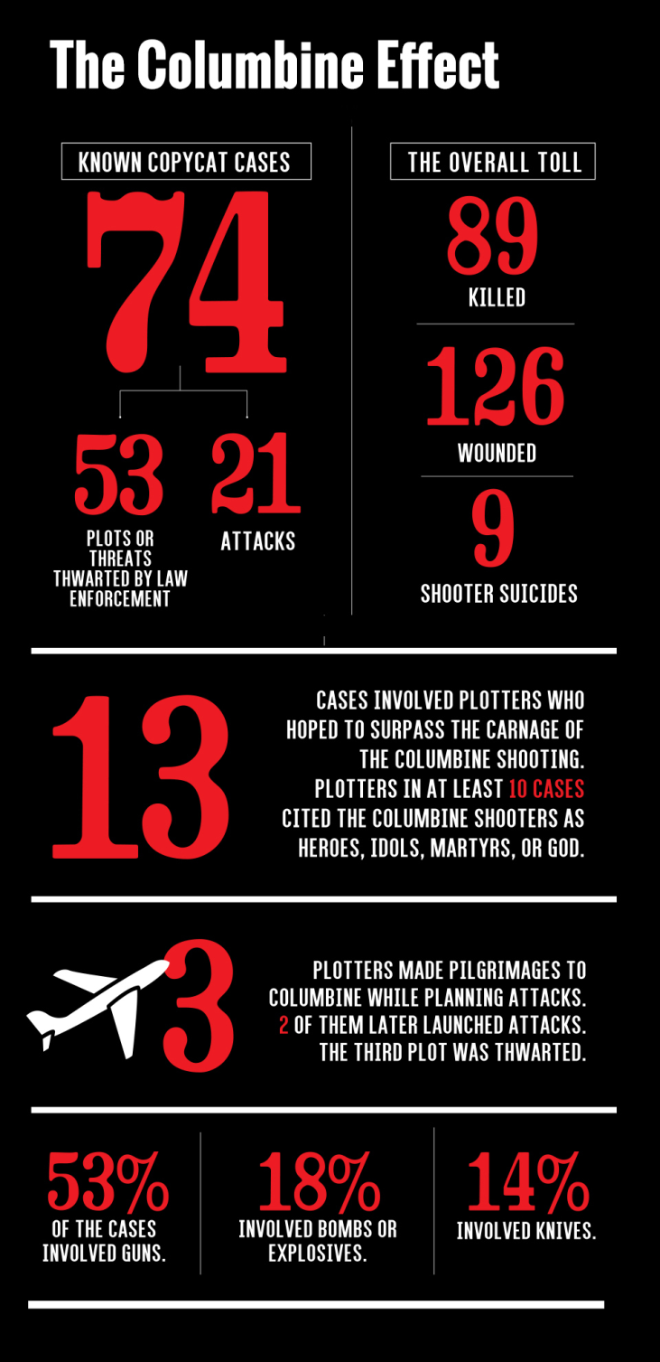
Key Findings
Half of the attackers had interests in violent topics:
Violent interests, without an appropriate explanation, are concerning, which means schools should not hesitate to initiate further information-gathering, assessment, and management of the student’s behavior.

Slide 26
Key Findings
ALL attackers experienced social stressors involving their relationships with peers and/or romantic partners:
Attackers experienced stressors in various areas of their lives, with nearly all experiencing at least 1 in the 6 months prior to their attack, and ½ within 2 days of the attack.
In addition to social stressors, other stressors experienced by many of the attackers were related to families and conflicts in the home, academic, disciplinary actions, or other personal issues.
Notes:
All school personnel should be trained to recognize signs of a student in crisis. Additional training should focus on crisis intervention, teaching students skills to manage emotions and resolve conflicts, and suicide prevention.

Slide 27
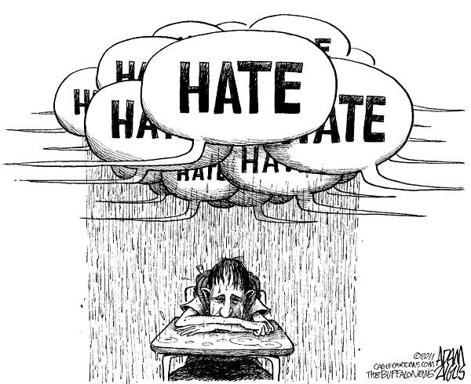
Key Findings
Most attackers were victims of bullying, which was often observed by others:
Most attackers felt bullied by their classmates, and for over half of the attackers the bullying appeared to be of a persistent pattern which lasted for weeks or longer.
Notes:
It is critical that schools implement comprehensive programs designed to promote safe and positive school climates, where students feel empowered to report bullying when they witness it or are victims of it, and where school officials and other authorities act to intervene.

Slide 28

Key Findings
Most attackers had a history of school disciplinary actions, and many had prior contact with law enforcement:
Most attackers had a history of receiving school disciplinary actions resulting from a broad range of inappropriate behavior.
Notes:
The most serious of those actions included the attacker being suspended, expelled, or having law enforcement interactions as a result of their behavior at school. Schools should employ disciplinary practices that ensure fairness, transparency with student and family, and appropriate follow-up.

Slide 29
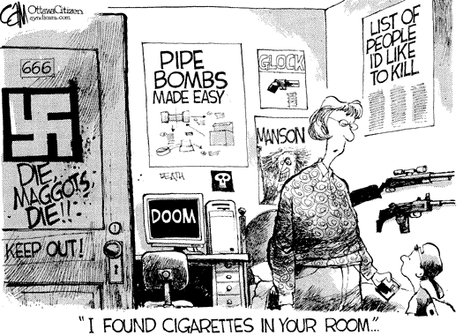
Key Findings
ALL attackers exhibited concerning behaviors. Most elicited concern from others.
Notes:
100% In many cases, someone observed a threatening communication or behavior but did not act, either out of fear, not believing the attacker, misjudging the immediacy or location, or believing they had dissuaded the attacker. Students, school personnel, and family members should be encouraged to report troubling or concerning behaviors to ensure that those in positions of authority can intervene.

Slide 30
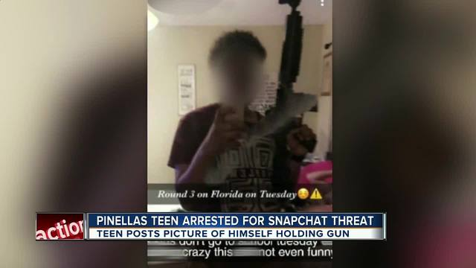
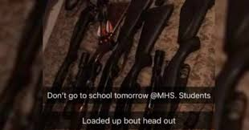
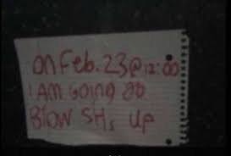
Communication
Prior to most incidents, other people knew about the attacker's idea or plan
Notes:
In 81% of the incidents someone knew about attacks before they occurred. Students who are in the planning stages of acts of targeted violence often ‘leak’ or ‘broadcast’ elements of their plans to others or through their academic assignments, or other representations of what they stand for, i.e. posters, websites, social media posts.
Implications: All students in the student body must be part of prevention efforts. Teach all students what information should be reported. When a situation is reported, seek information from anyone in contact with potentially threatening student.

Slide 31
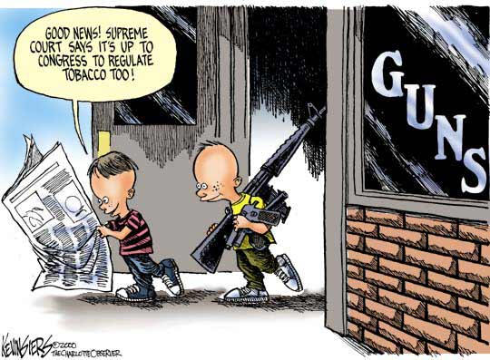
In many cases, other students were involved in some capacity.
What do you think, Columbine or Jonesboro?

Slide 32
FERPA (1974)
2000 exception: educational agencies and institutions may share information from educational records of at-risk or delinquent youth.
2008 exception: may disclose information to appropriate parties when knowledge of the information is necessary to protect the health and safety of a student or other individual, if there is a significant and articulable threat to the health and safety of an individual
June, 2010: directory information may be disclosed to an emergency agency trying to locate parents
Information covered by FERPA can be disclosed to school staff who have legitimate interests in the behavior of that student. Sec 99.36(b)2
Such information can be disclosed to staff of another school who have legitimate educational interests in the behavior of that student. Sec 99.36 (b)3
Personal knowledge or observation
Information overheard
Https://www.Ncjrs.Gov/pdffiles/163705.Pdf
Latest document is in your packet – June 2011.
Notes:
Family Educational Rights & Privacy Act
Many misconceptions about FERPA and student information
1994 Amendments to FERPA:
Allows schools to pass along disciplinary information for conduct that poses a significant risk to the safety of others and to those who have legitimate interest in behavior of the student.
2000 exception – at-risk, delinquent youth info can be shared to others
2008 Exception -- to protect the health and safety of a student or other individual, this may be the most important exception
June 2011 (document is included in your materials)
Family Policy Compliance Office
http://www.ed.gov/policy/gen/guid/fpco/index.html

Slide 33
Develop a Response, Management, and Support (RMS) Plan
Provide management of the situation
Protect and aid possible targets
Purpose:
Provide support and guidance to the student
Monitor the student short and long term
Connect student to services and support systems

Slide 34
What is your process for reporting concerns about students?

Slide 35
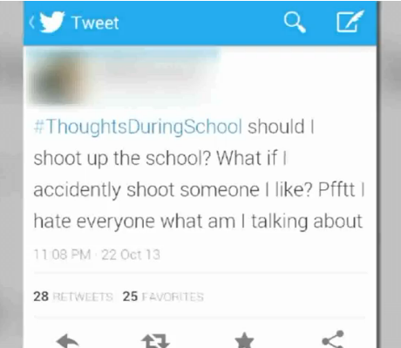
Message on Social Media
At a high school basketball game on a Friday night, a concerned parent pulls you aside to show you a posting that her son just showed her:
You recognize the student as one that has had a few fights in the past and was recently suspended for possessing marijuana.
You immediately contact the principal and the superintendent, who calls the local police. Officers go to the student’s house and meet with the family. The student was agitated about the whole situation, but reports that he was “just joking around.” He admits to being mad about being suspended, but said he “wouldn’t do anything that stupid.” Officers ask about weapons in the home and the parents report that there are only two shotguns locked in a gun safe. Law enforcement reports back to school officials that they do not feel this is an immediate concern, but they will keep an investigation open.

Slide 36
Preventing School Violence
Develop and maintain a positive school climate
Provide awareness and ongoing training in early warning signs
Outline clear procedures for reporting
Timely and appropriate response to threats
Use a team process to gather information and evaluate threat
Seek assistance, as needed
Implement interventions that are equal in weight to the behavior(s) of concern
Provide ongoing monitoring of students of concern

Slide 37


