Slide 1



MONTANA STATE UNIVERSITY
CENTER FOR RESEARCH ON RURAL EDUCATION
Youth Aware of Mental Health
Mental Health Promotion & Suicide Prevention in Montana Schools
August 9, 2022
2:45- 4:15 p.m.
Jeremy Bullock Safe Schools Summit
Mental Health in Mind AB

Slide 2


Decrease in incidence suicide attempts
Decrease in incidence suicidal thoughts/plans
Decrease in incidence of depression
Same in prevalence of depression
The observed reduction in incidence of suicide attempts was more than 50%

Slide 3
Practical Impact in a classroom of 25-30 Students:
01
02
03
At least one is likely to have previously attempted suicide
At least one is likely to have active severe suicidal ideation in the last two weeks
5 to 10 students have experienced some kind of suicidal ideation in their lifetime
YAM should be done with 91 youth in order to prevent one new suicide attempt or one new case of severe suicidal ideation.

Slide 4




PROVIDES YOUTH WITH A SAFE SPACE WHERE THEY CAN TRY OUT REAL-LIFE SITUATIONS AND BRING THEIR OWN CONTENT
WHY IS YAM EFFECTIVE IN PREVENTING SUICIDE ATTEMPTS?
INCREASES AWARENESS AND KNOWLEDGE ABOUT MENTAL HEALTH
PROVIDES OPPORTUNITIES FOR REFLECTION AND WORKING OUT THEIR OWN BEST COPING STRATEGIES
ENHANCES EMPATHY AND CLASSROOM CLIMATE
PROMOTES DIFFERENT KINDS OF HELP-SEEKING INCLUDING PEER HELP AND SUPPORT

Slide 5

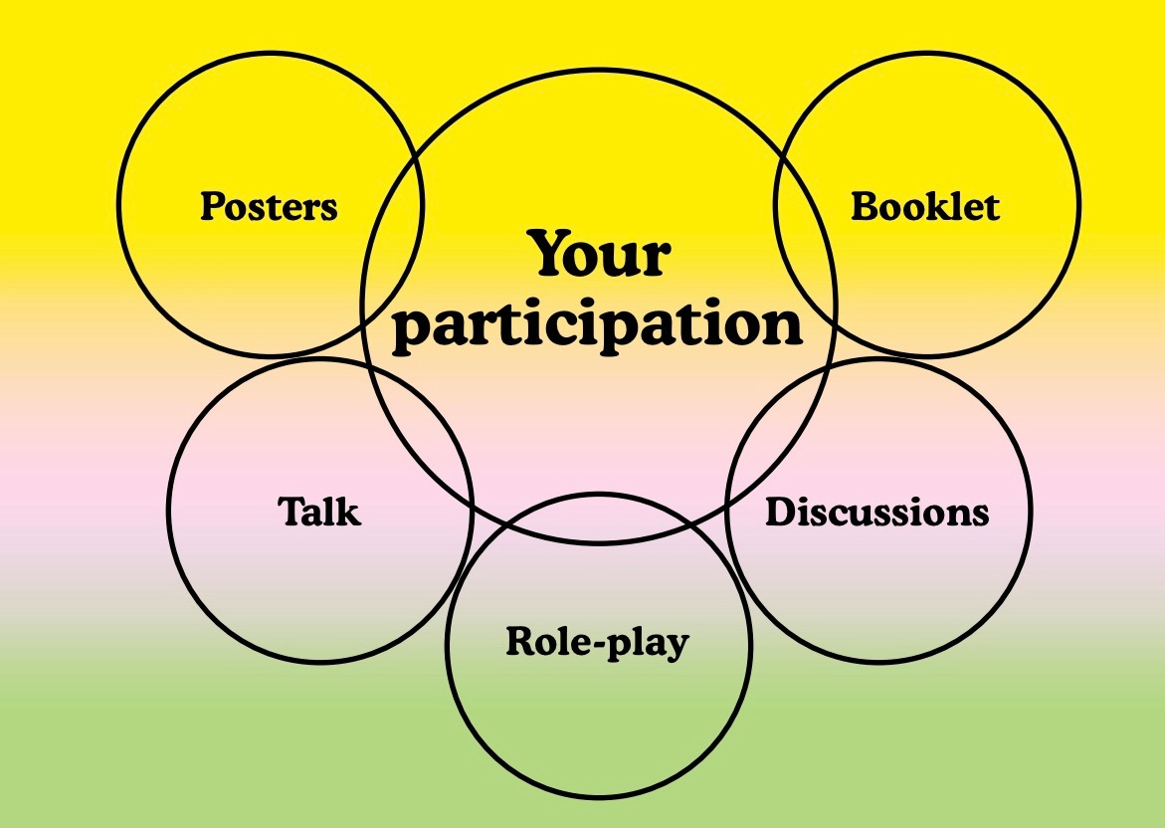


Slide 6

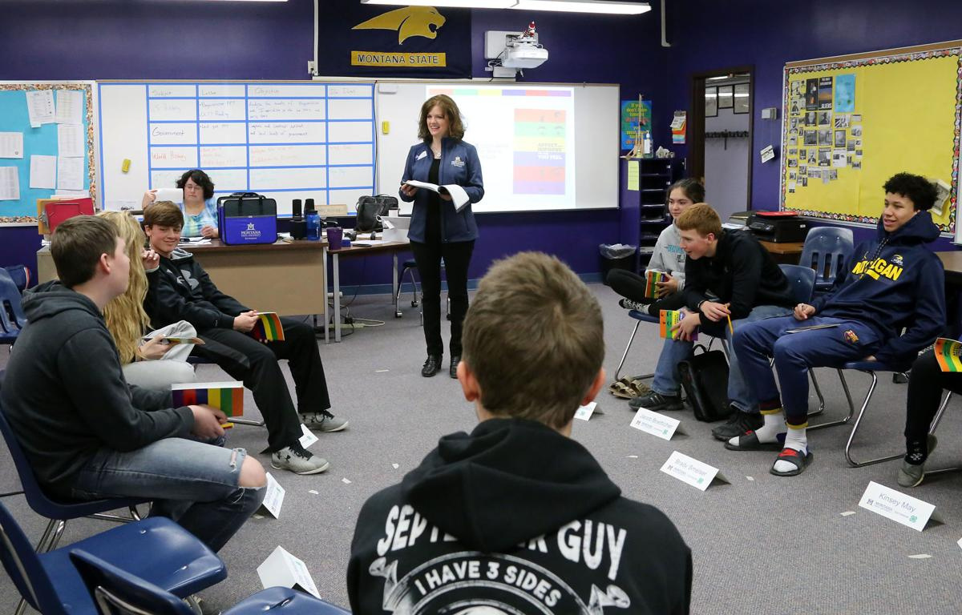

WEEK ONE
OPENING SESSION DILEMMA EXERCISE
WEEK TWO
ROLE PLAYS: STRESS & CRISIS
ROLE PLAYS: DEPRESSION & SUICIDE
WEEK THREE
CLOSING SESSION
YAM IS 3 WEEKS/5 SESSIONS

Slide 7


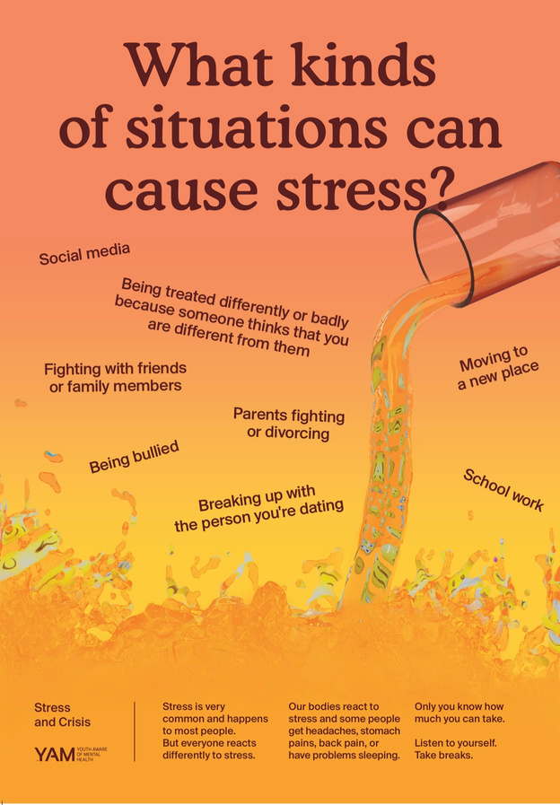

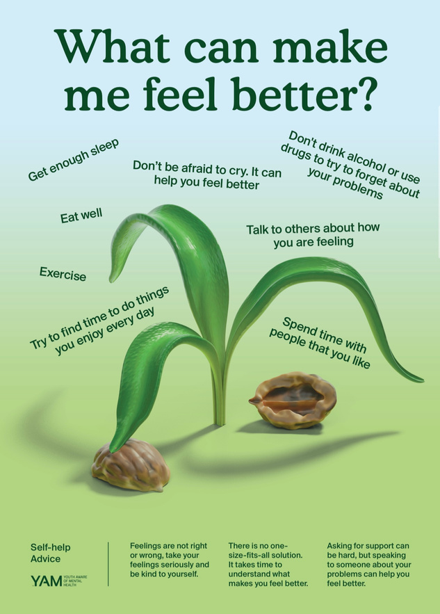
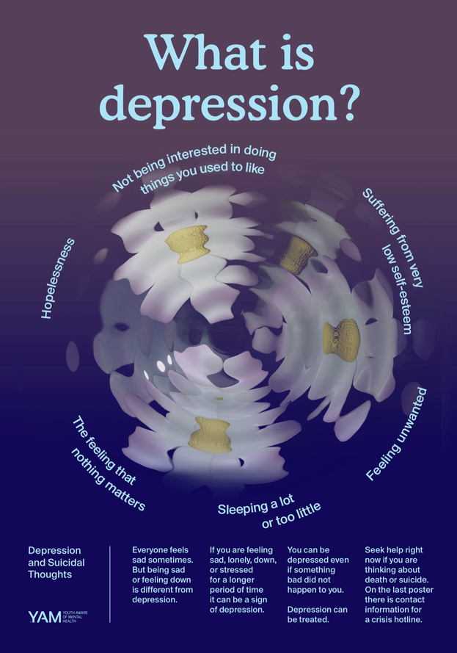
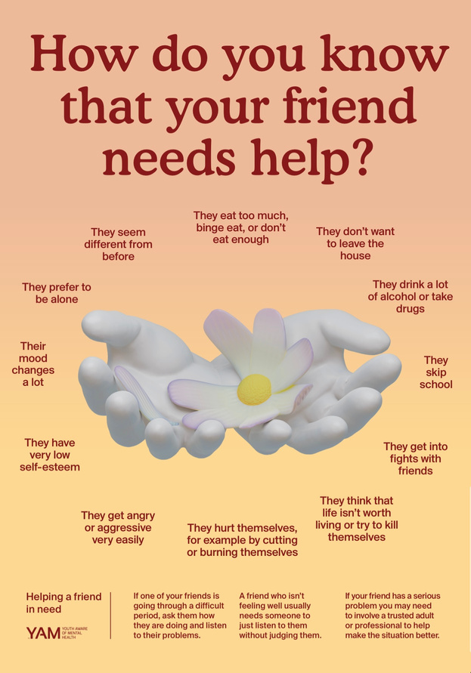


Slide 8
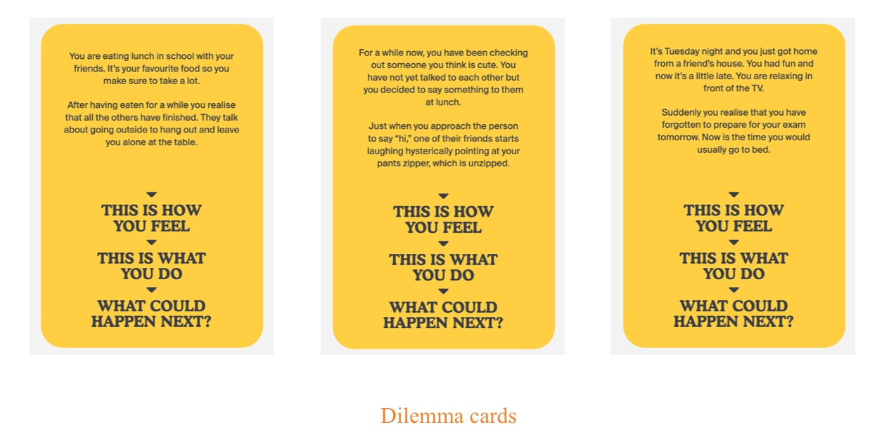

Slide 9
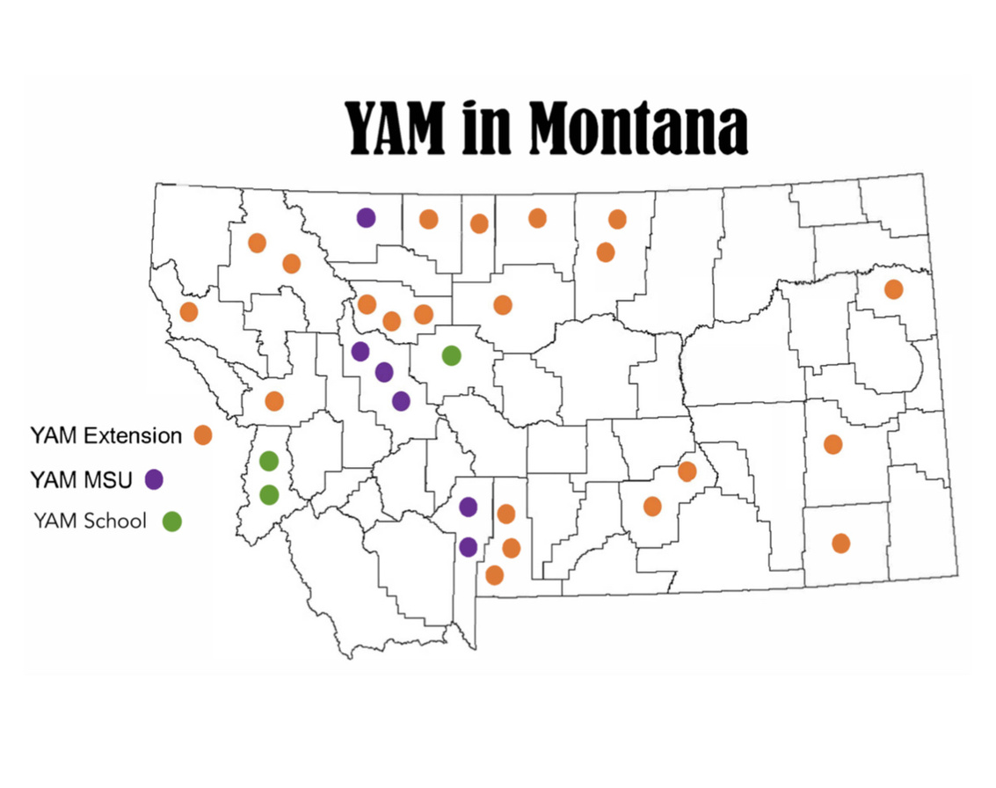
4 YAM-certified MT Trainers
55 YAM-certified Facilitators trained
30+ schools reached
2 cultural adaptions completed: 1 for mainstream American students and 1 for Blackfoot tribal students facilitated in conjunction with our Native American trainers
11,065 MT students have participated in the YAM program to date.

Slide 10

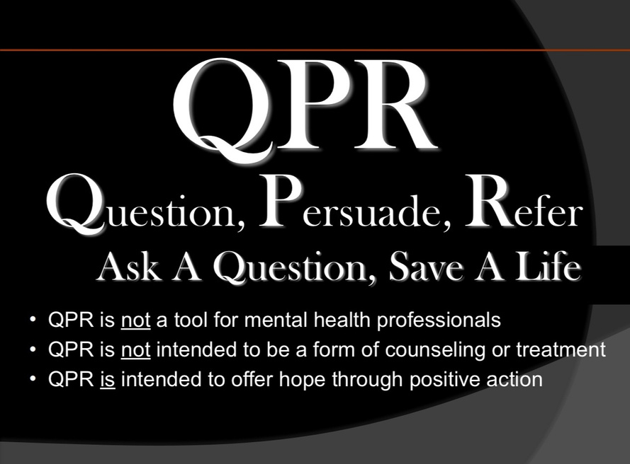
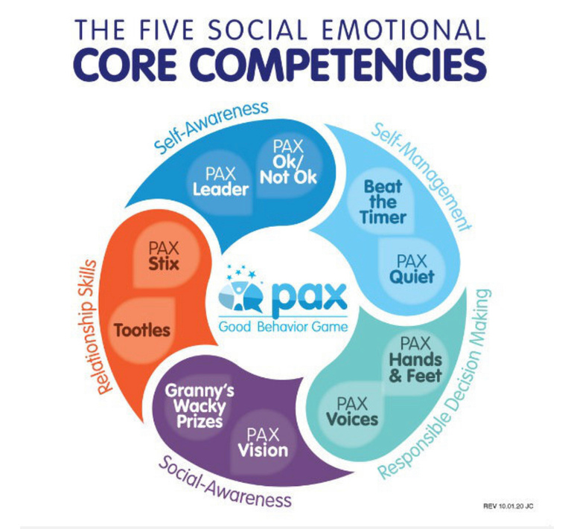
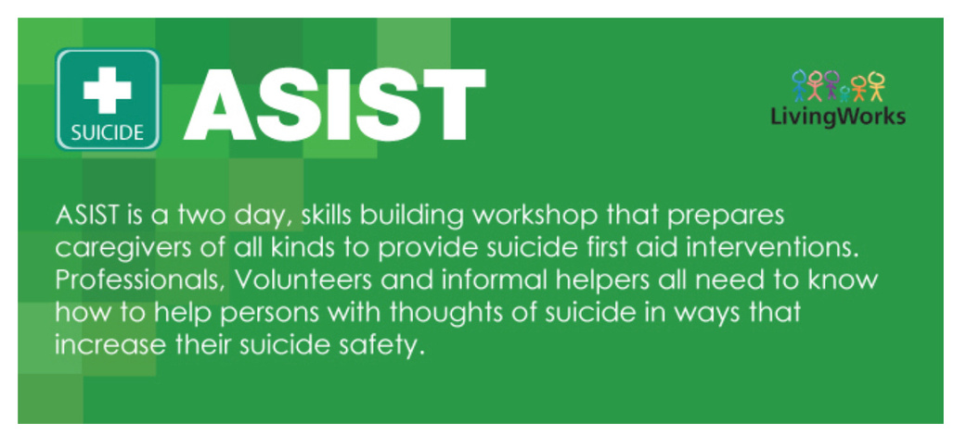
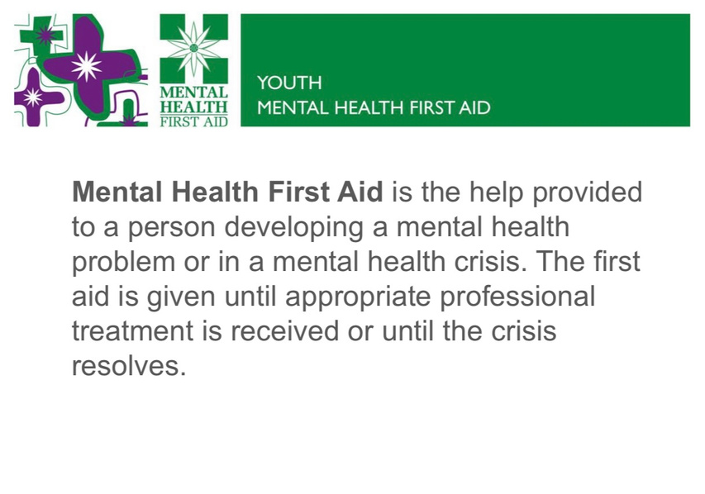
SUICIDE PREVENTION PROGRAMS IN MONTANA SCHOOLS

Slide 11
01
School-based suicide prevention programmes: the SEYLE cluster-randomized, controlled trial
Danuta Wasserman et al. Lancet. 2015
Resource Page
02
The Youth Aware of Mental Health Intervention: Impact on Help Seeking, Mental Health Knowledge, and Stigma in U.S. Adolescents
Janet C. Lidlow et al. Journal of Adolescent Health. 2020 July.
03
Feasibility, acceptability,and fidelity: Extension agents teaching youth aware of mental health.
Sandra J. Bailey et al. Journal of Rural Mental Health, 46(2), 88-99.
For more information about YAM contact:
KELLEY EDWARDS
YAM PROGRAM MANAGER
Kelley.edwards@montana.edu
(406) 994-1606
04
Blueprint for Youth Suicide Prevention: Strategies for Community and School Settings
A joint initiative or the American Academy of Pediatrics and the American Foundation for Suicide Prvention, in collaboration with experts from the National Institute of Mental Health
Youth Aware of Mental Health: https://www.y-a-m.org

Slide 12

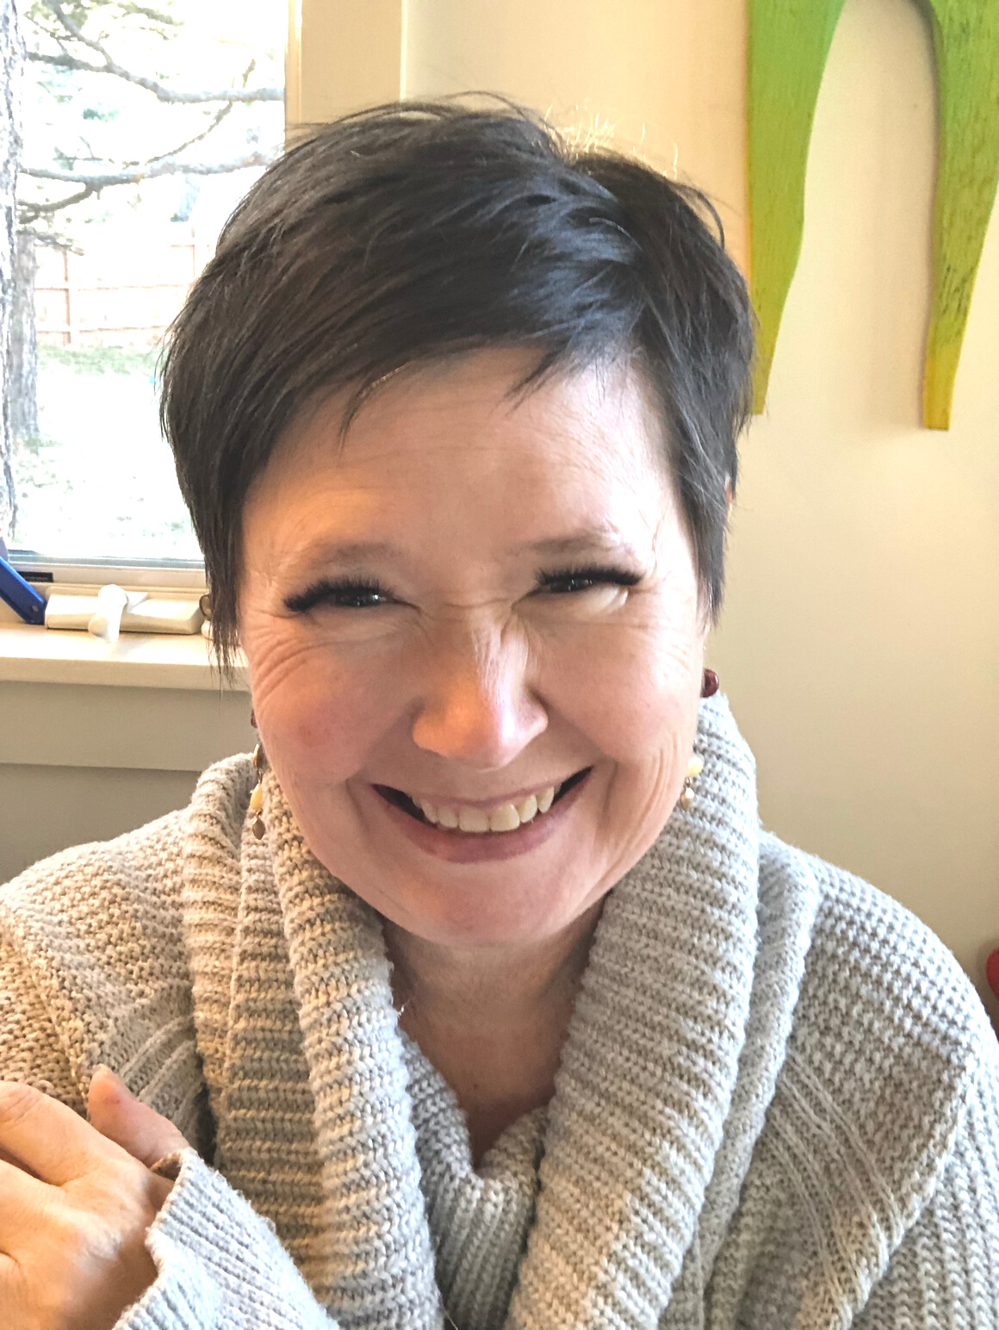
About the Speaker
Kathleen Kinsella Shea, LCSW
YAM-Certified International Trainer
kathleenkinsellashea@gmail.com

Slide 13
NAMI MONTANA
MSU EXTENSION PROGRAM
OPPORTUNITY BANK
INTREPID CREDIT UNION
BLACKFEET COMMUNITY COLLEGE
CARTER COUNTY MUSEUM
BOZEMAN HEALTH
COUNTLESS INDIVIDUAL COMMUNITY MEMBERS ACROSS THE STATE THAT HAVE VOLUNTEERED THEIR TIME AS CLASSROOM ASSISTANTS
Friends of YAM
Community Partners
without whom YAM could not grow and thrive

Slide 14
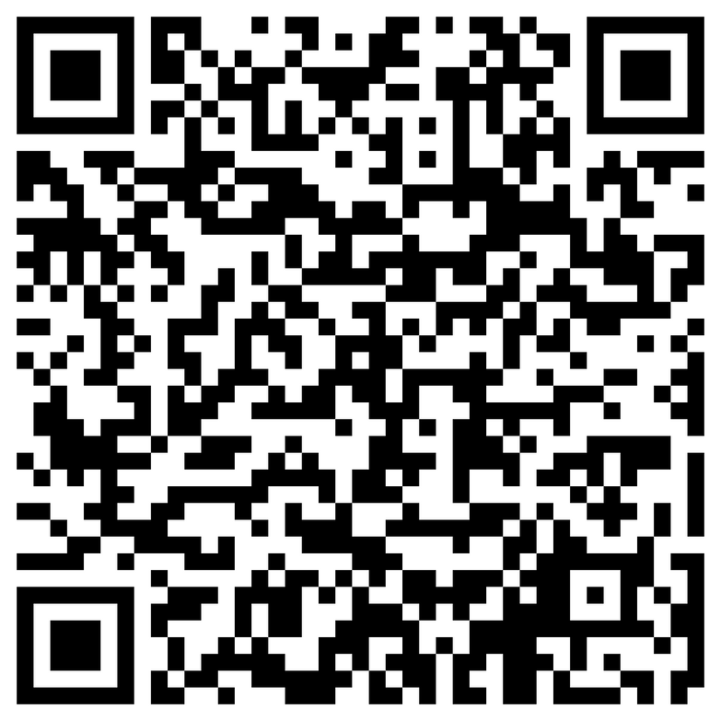
Participant Survey

