Slide 1


Safety and Security at K-12 Special Events
Lt. Jeremy Barnes

Slide 2


ABOUT US
The State Security Division is tasked with establishing recommendations and best practices regarding school safety and security through partnerships with the State Board of Education, School Safety Center, county sheriffs, local law enforcement, and local education agencies.

Slide 3

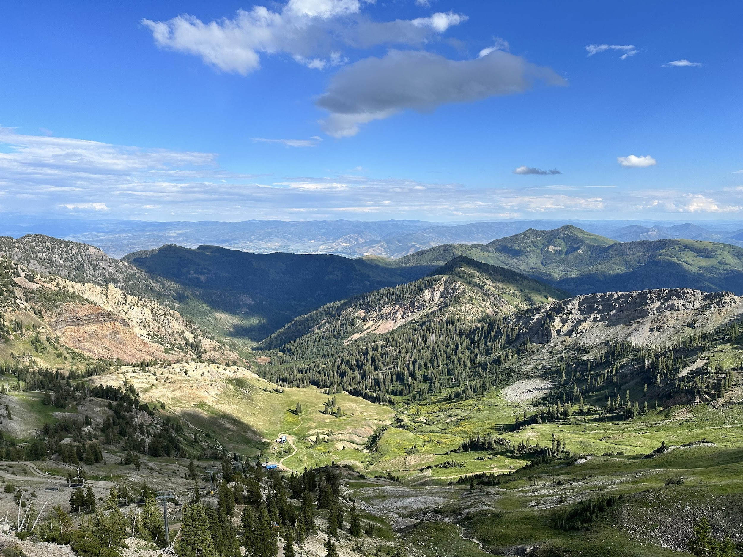

VISION
To provide a safe and secure environment to learn, work, and recreate statewide.

Slide 4
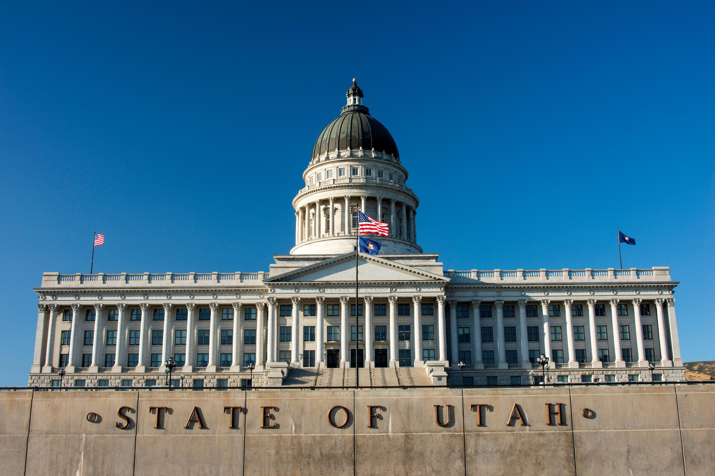
MISSION
Providing a safe and secure environment statewide through professional service and engaged partnerships.

Slide 5

VALUES
Professional
Providing a safe and secure environment statewide through professional service and engaged partnerships.
Collaborative
We will strive to collaborate with stakeholders across the state to foster ideas and innovative solutions to address individual needs while meeting state statutory requirements.
Innovative
Be innovative with solutions to individualize environments and conditions.

Slide 6
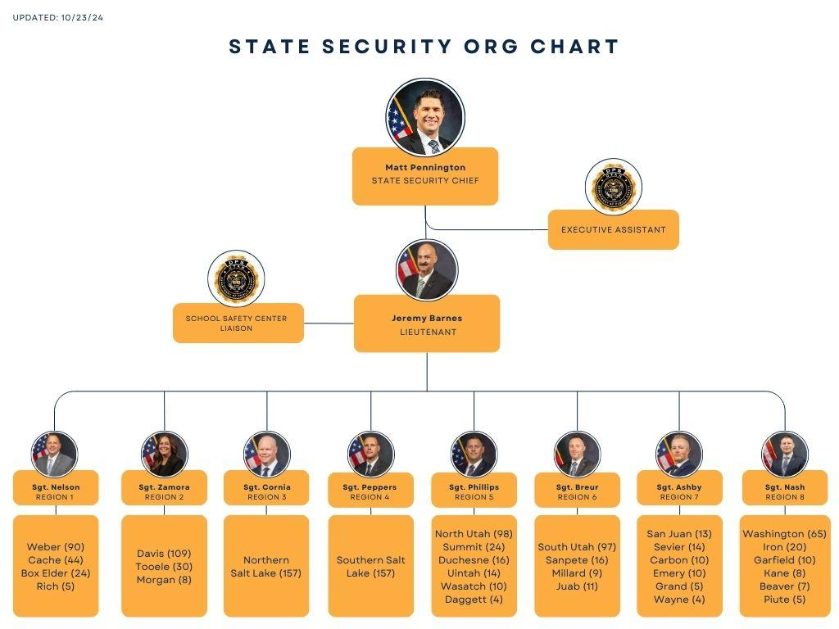
OUR TEAM
OUR TEAM
MATT PENNINGTON
JEREMY BARNES

Slide 7
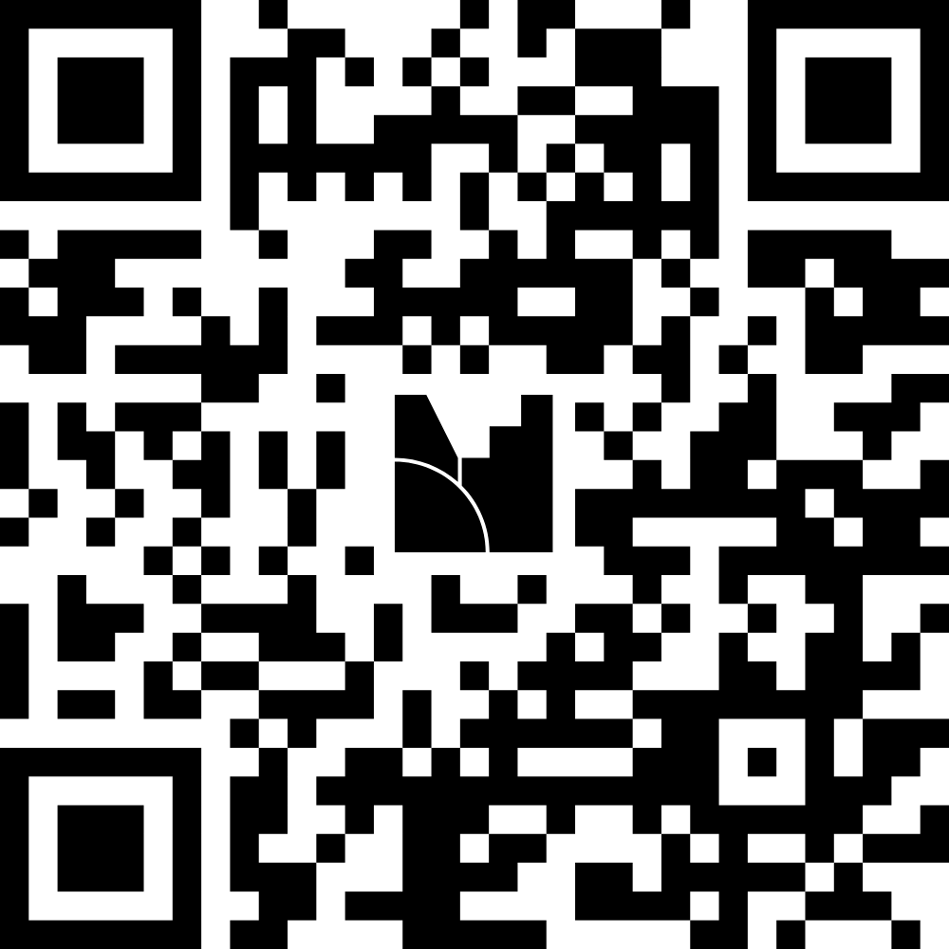

Slide 8
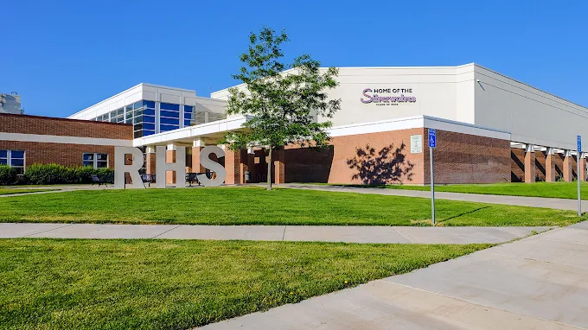
Vested Interest Theory
“Simply, when individuals perceive something to be important (i.e. highly vested), they are more likely to act on it.”
-Curto, Goldsmith, Miller, Carroll, Martin. 2023.

Slide 9
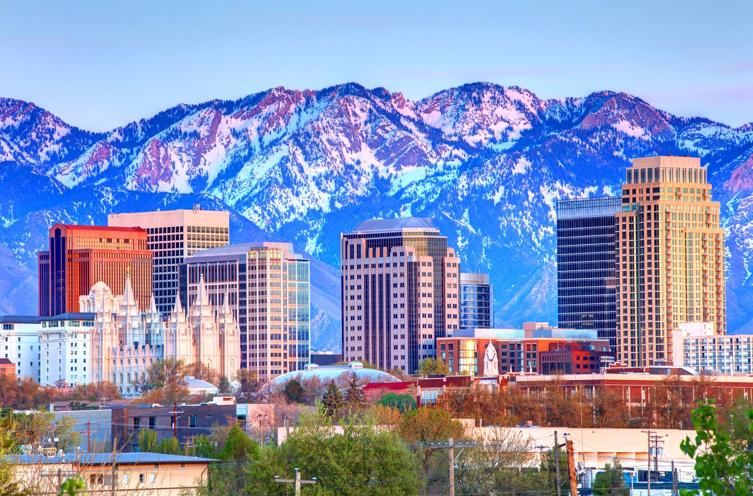
K-12 School Shooting Database
What is a School Shooting?
“The K-12 School Shooting Database is a widely inclusive, open-source research project that documents when a gun is fired, brandished (pointed at a person with intent), or bullet hits school property, regardless of the number of victims, time, day, or reason.”
K-12 School Shooting Database
https://k12ssdb.org/

Slide 10
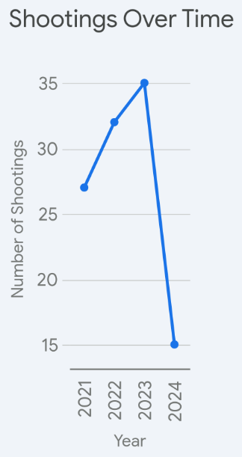
Shootings at High School Football Games
Analyzed Data from 2021-2024
Specifically
Number of Victims
High School Football Games
Parking Lot vs Stadium
Gang Related
Escalation of Violence
*Data obtained from K-12 School Shooting Database

Slide 11
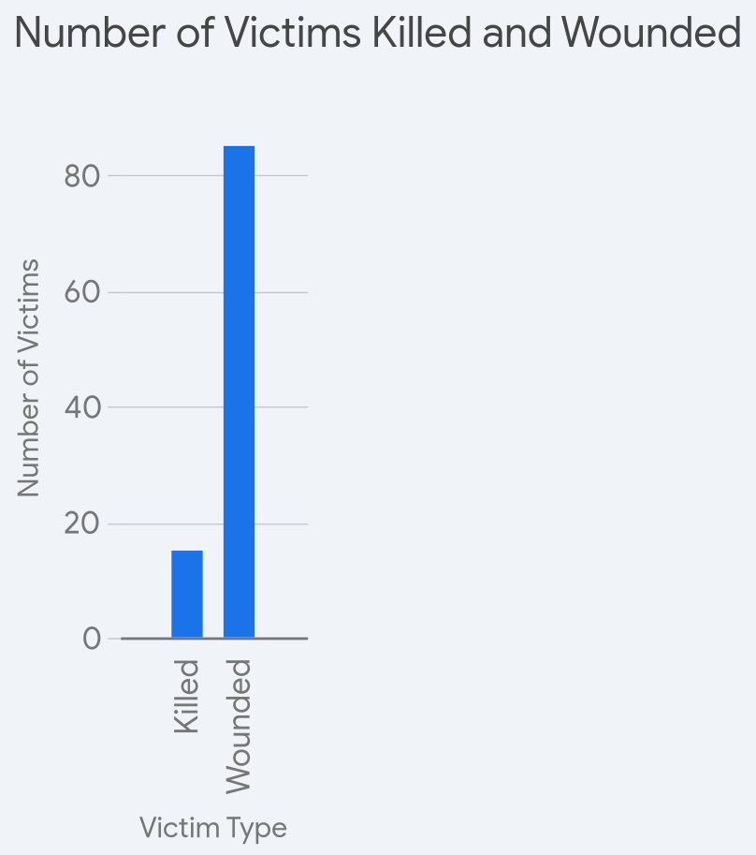
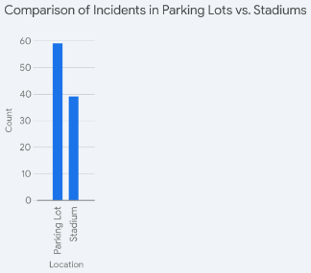
Shootings at High School Football Games

Slide 12
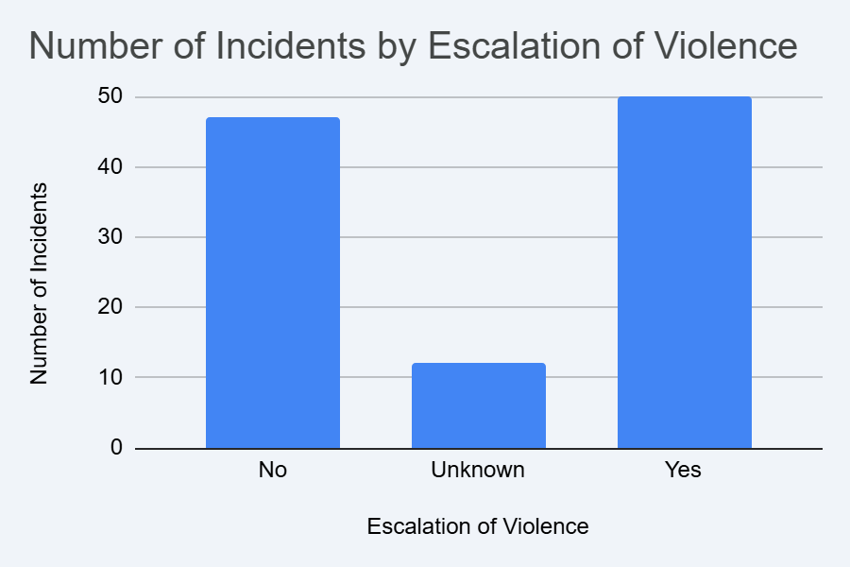
Shootings at High School Football Games

Slide 13
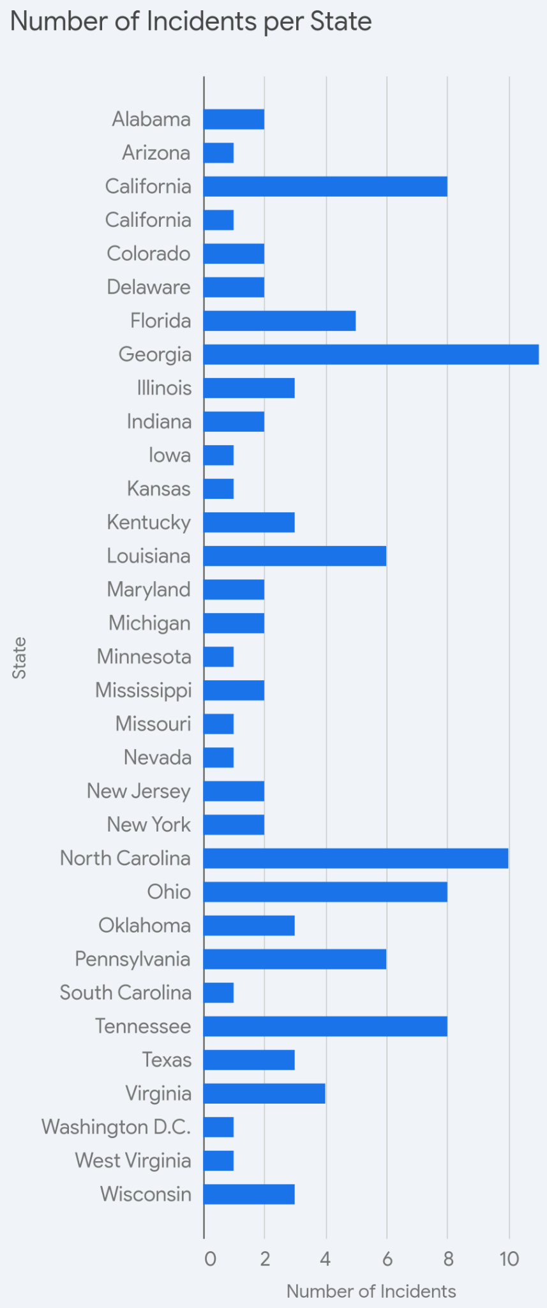
Shootings at High School Football Games

Slide 14
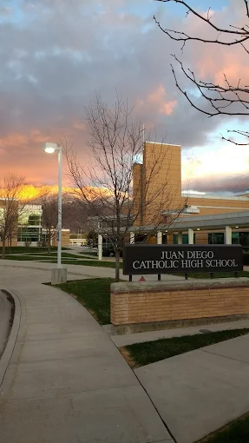

Takeaways
OUR TEAM
More incidents have taken place in parking lots (59, 39)
In 109 incidents, 15 victims were killed, 85 were wounded
The number of shootings rose from 27 in 2021 to 32 in 2022, and further to 35 in 2023, followed by decline to 15 in 2024
Georgia and North Carolina had most incidents in the analyzed period
There's a near-even split between incidents with and without escalation of violence (50 with escalation, 47 without), with 12 incidents having an unknown escalation status. This indicates that escalation of violence is a significant factor in a large portion of these incidents.

Slide 15
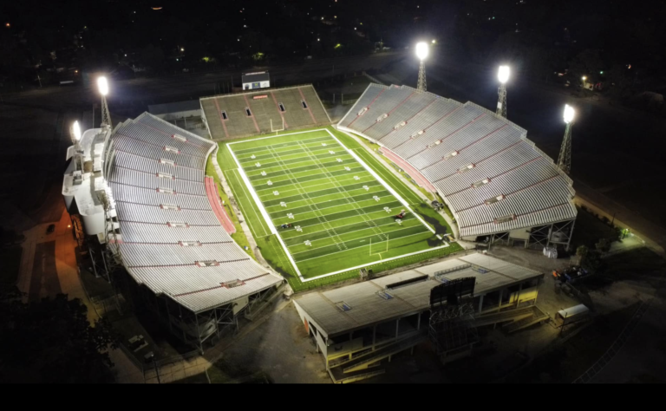
October 15, 2021, Ladd-Peebles Stadium
Mobile, AL
01
Three individuals entered the game unarmed (measures were present)
02
Mobile, AL
The three left the game
Two of the three returned with guns after the metal detectors had been removed
Five victims shot
Violence escalated from fight two weeks prior
03

Slide 16
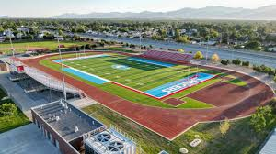
September 13, 2019
Granger High School
Football Game
01
Fight Occurred at South Gate
Two Shots Were Fired
No Injuries
02
West Valley City, UT
Assumed to be gang related
Weapon was used in multiple shootings
03

Slide 17
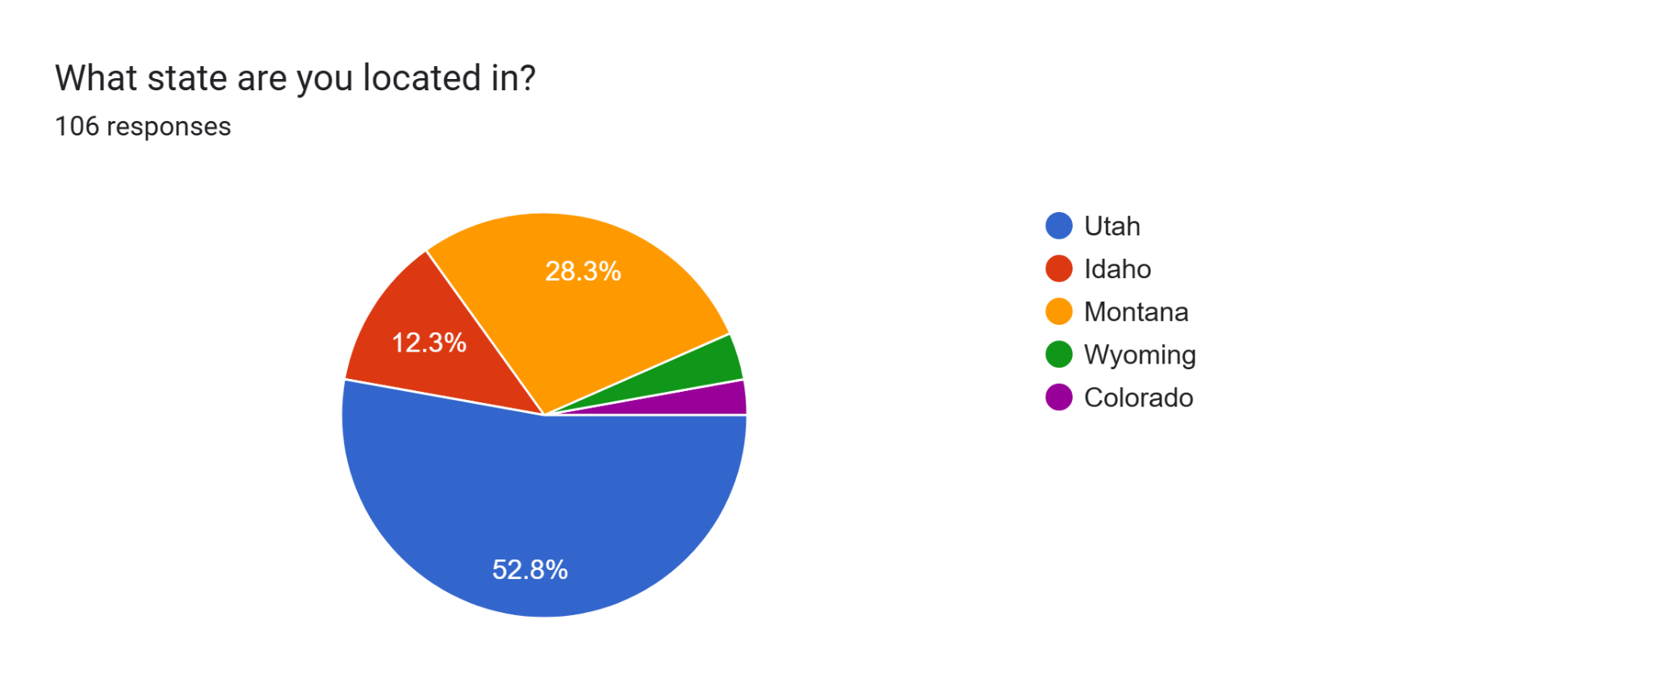
Perceptions of Safety in the Mountain West

Slide 18
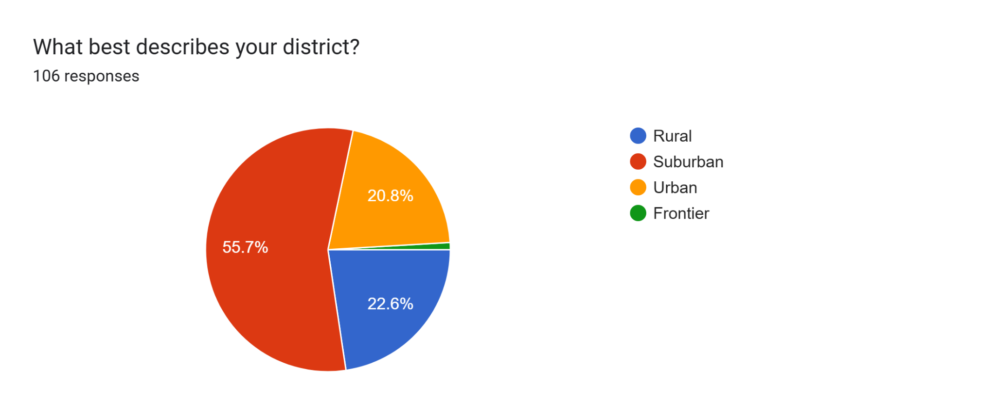
Perceptions of Safety in the Mountain West

Slide 19
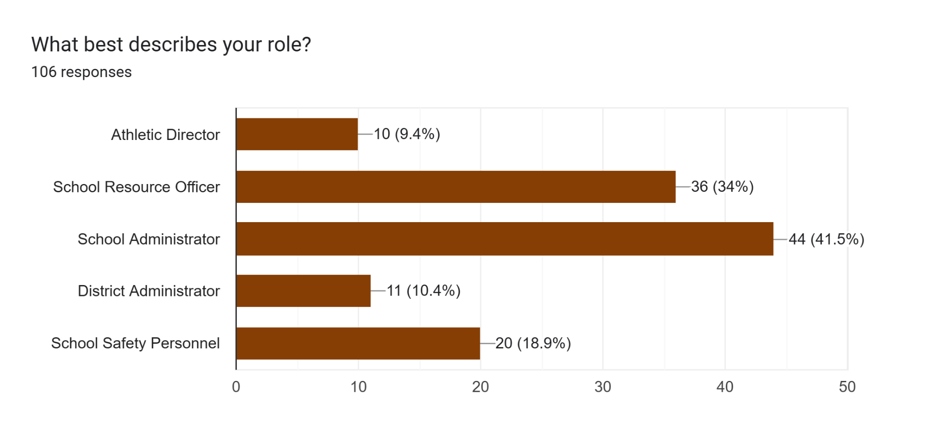
Perceptions of Safety in the Mountain West

Slide 20
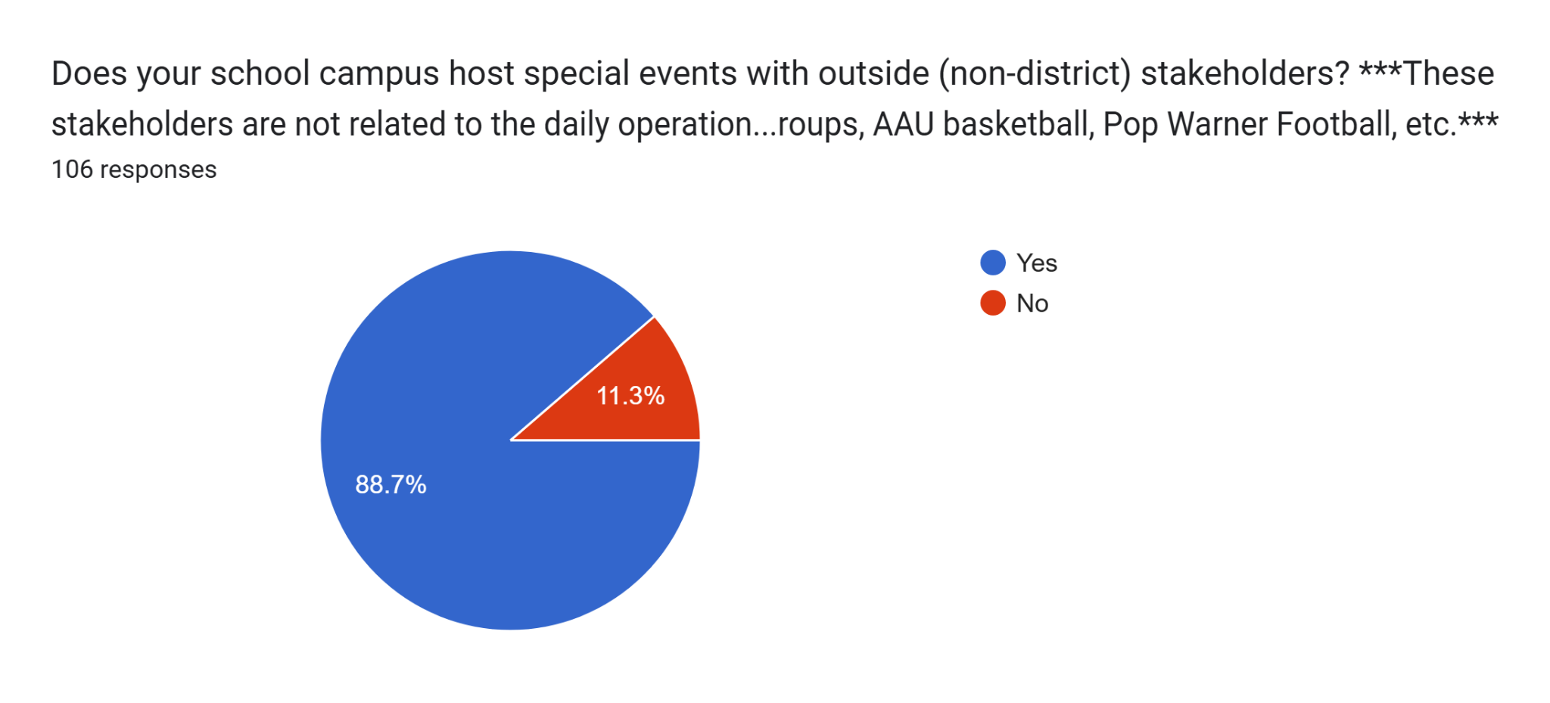
Perceptions of Safety in the Mountain West

Slide 21
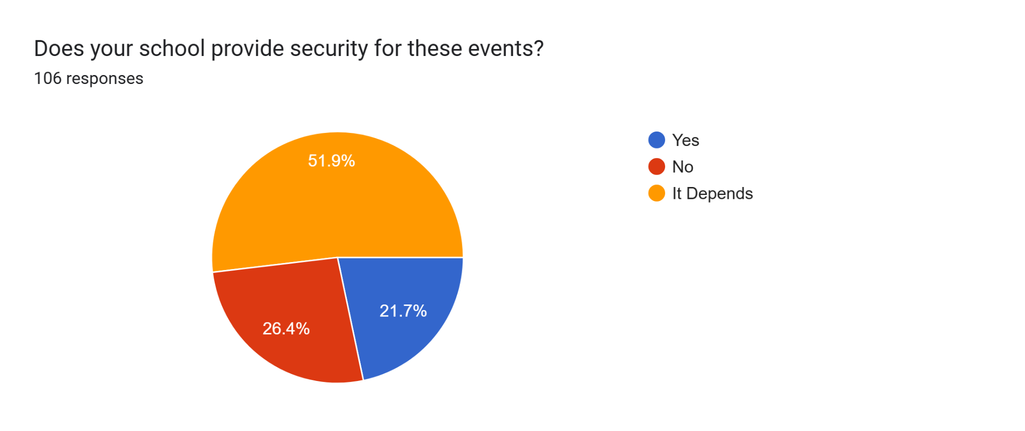
Perceptions of Safety in the Mountain West

Slide 22
Perceptions of Safety in the Mountain West
Sporting Events: Security is primarily provided for varsity football and basketball games, especially those involving rival schools or large crowds. Some districts require SRO attendance for these events.
Event Size and Type: Security needs are often determined by the expected crowd size, the type of event (e.g., dances, concerts), and the event's history of incidents or potential conflicts.
Administrative Request: Security presence may depend on specific requests from school administration or district officials, or if the administrator feels it is needed.
Staff Supervision: School personnel, administrators, teachers, or parent volunteers often provide supervision at events, but this may not be considered formal security.
Security Definition: Some responses questioned the definition of "security," distinguishing between police presence and general adult supervision.

Slide 23
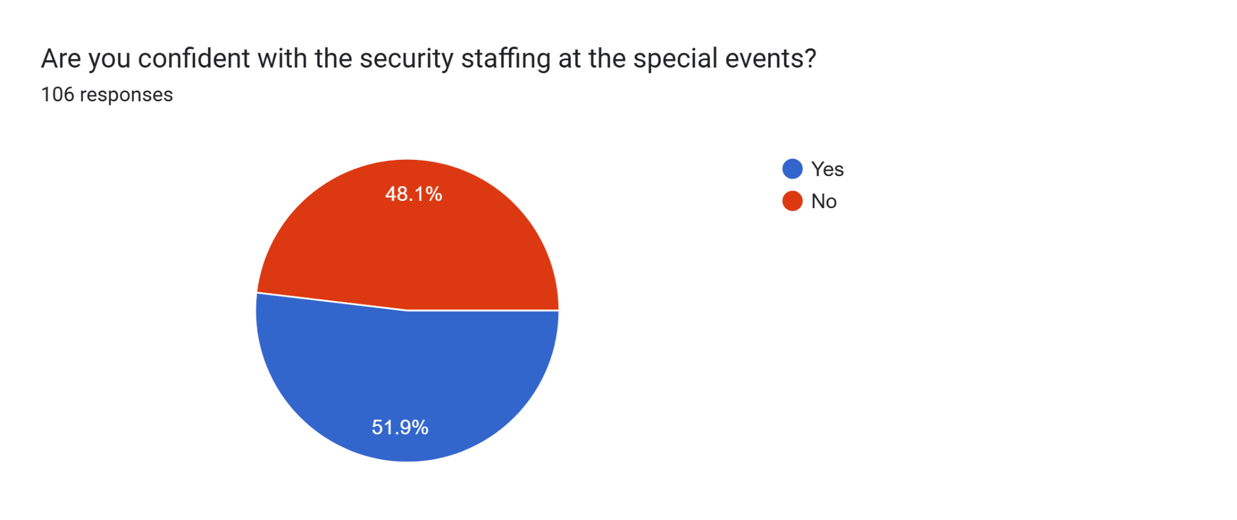
Perceptions of Safety in the Mountain West

Slide 24
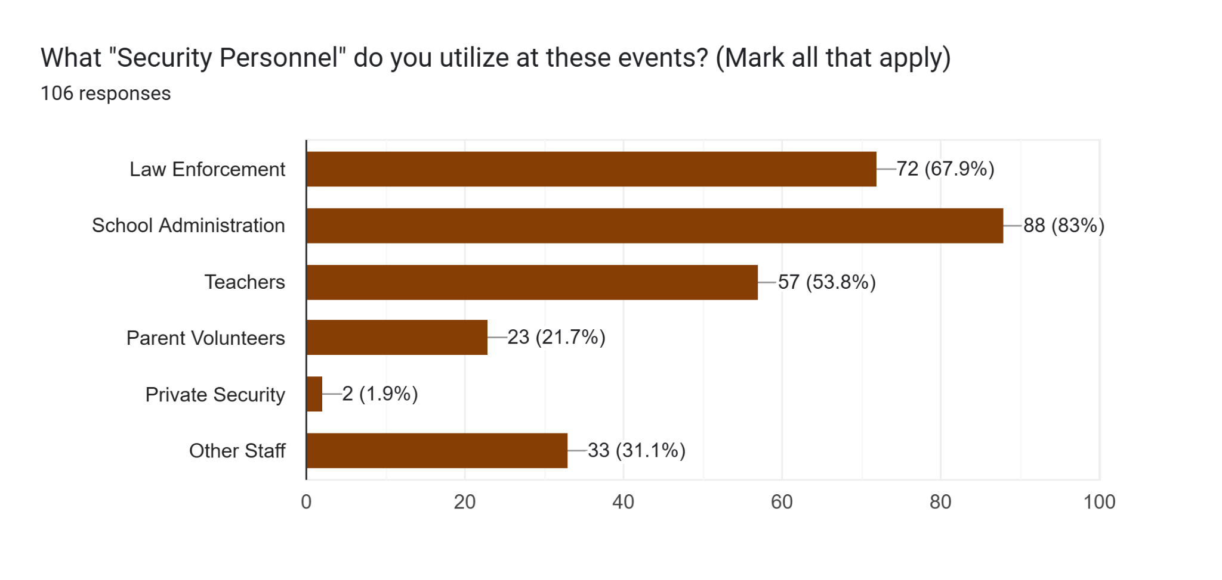
Perceptions of Safety in the Mountain West

Slide 25
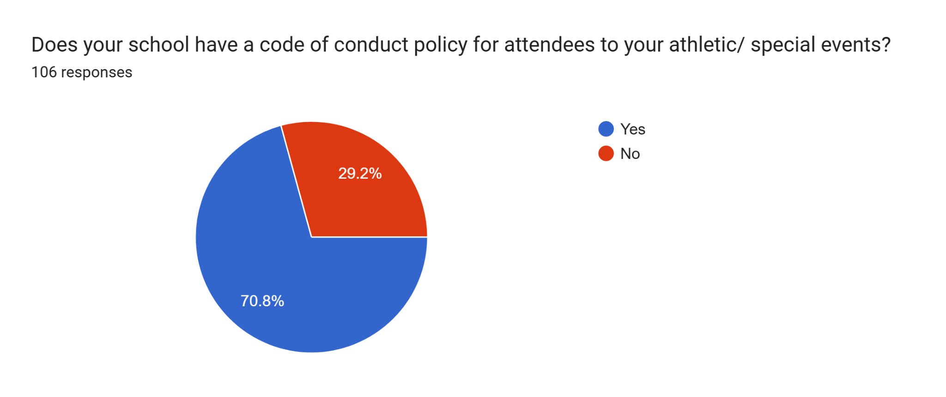
Perceptions of Safety in the Mountain West

Slide 26
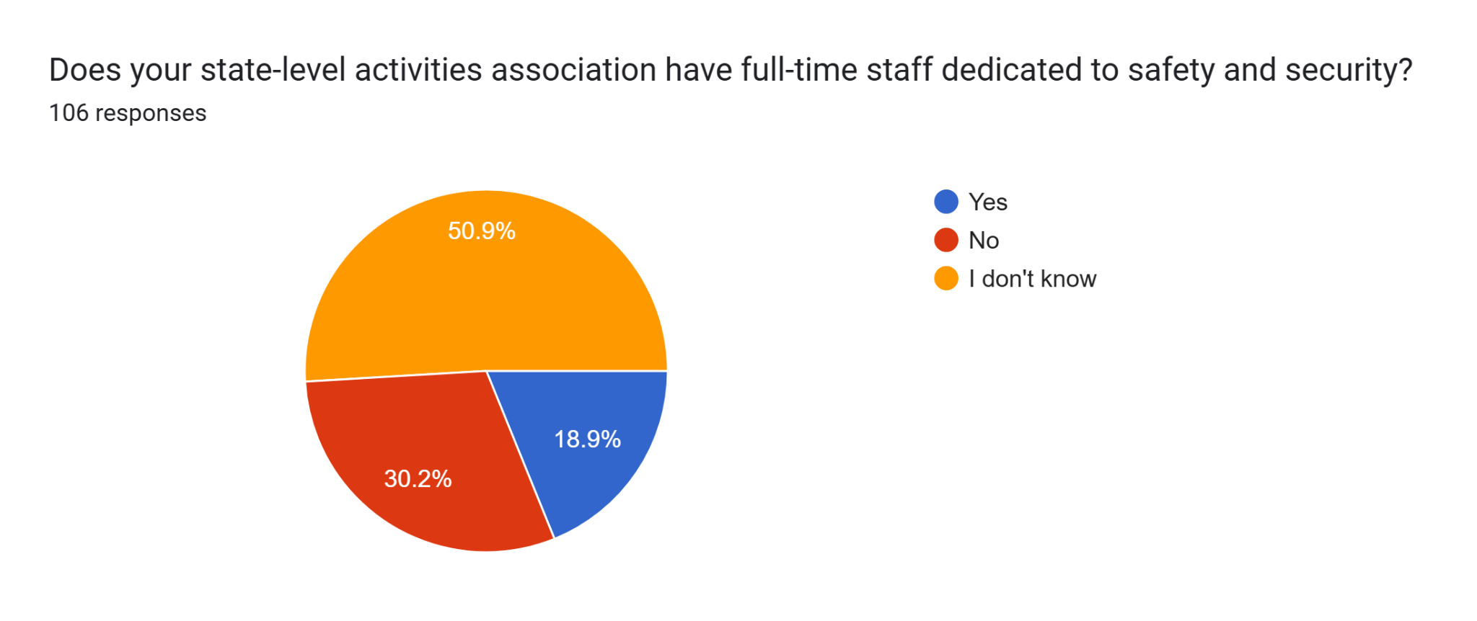
Perceptions of Safety in the Mountain West

Slide 27
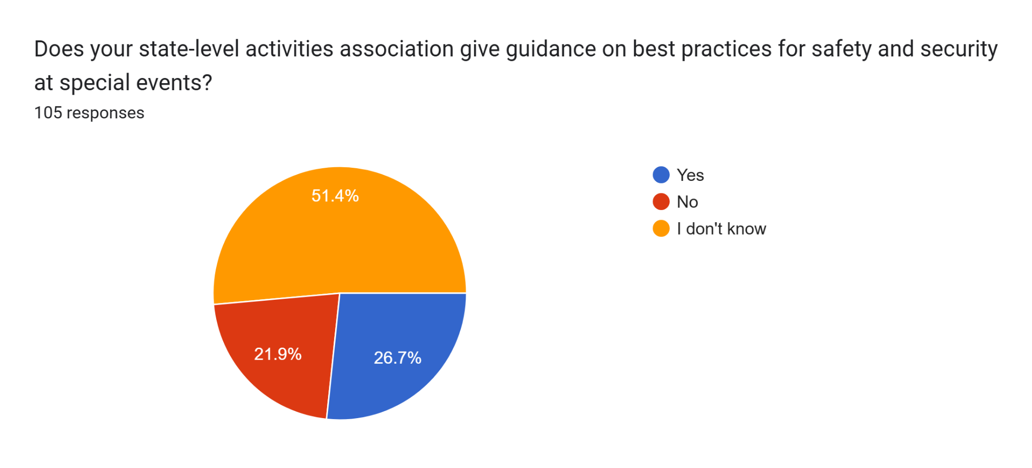
Perceptions of Safety in the Mountain West

Slide 28
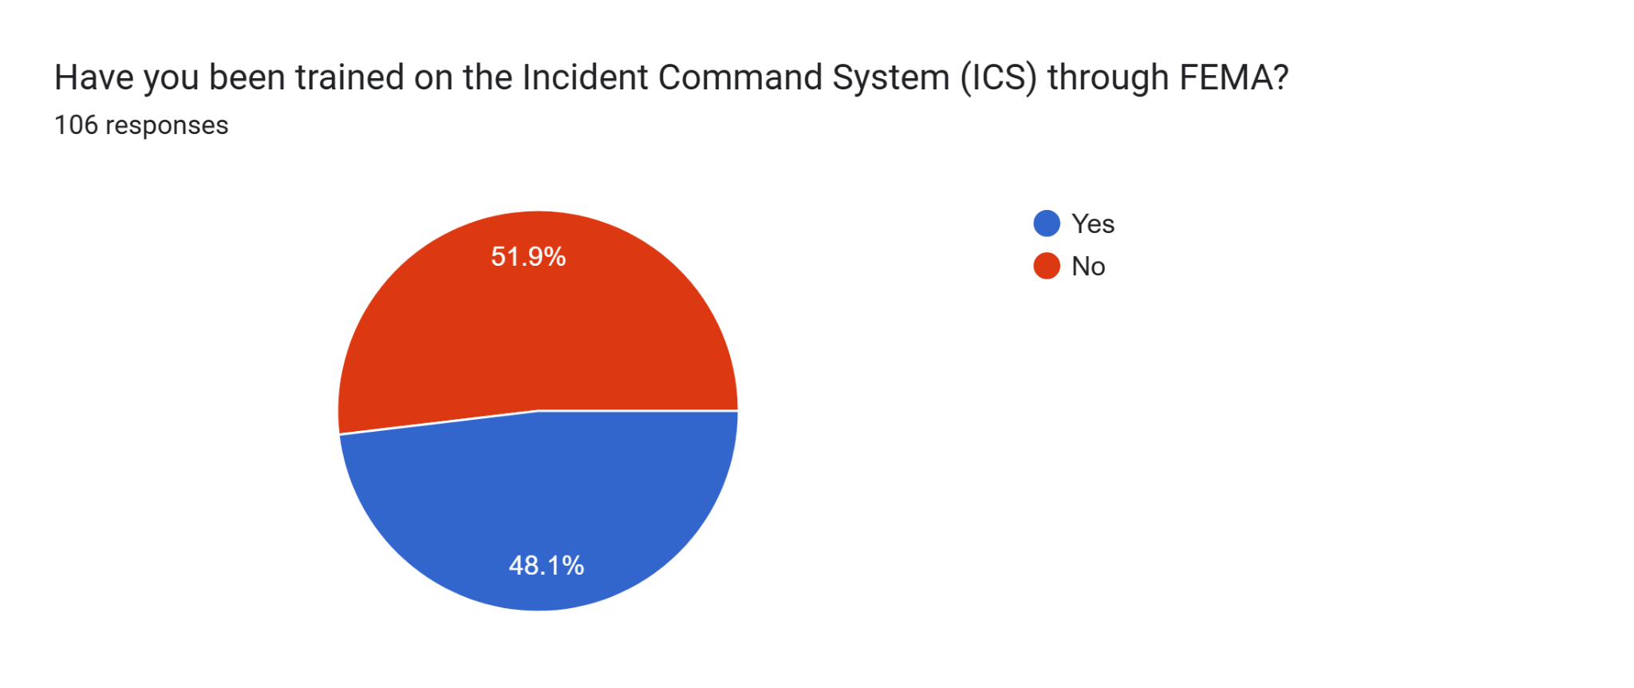
Perceptions of Safety in the Mountain West

Slide 29
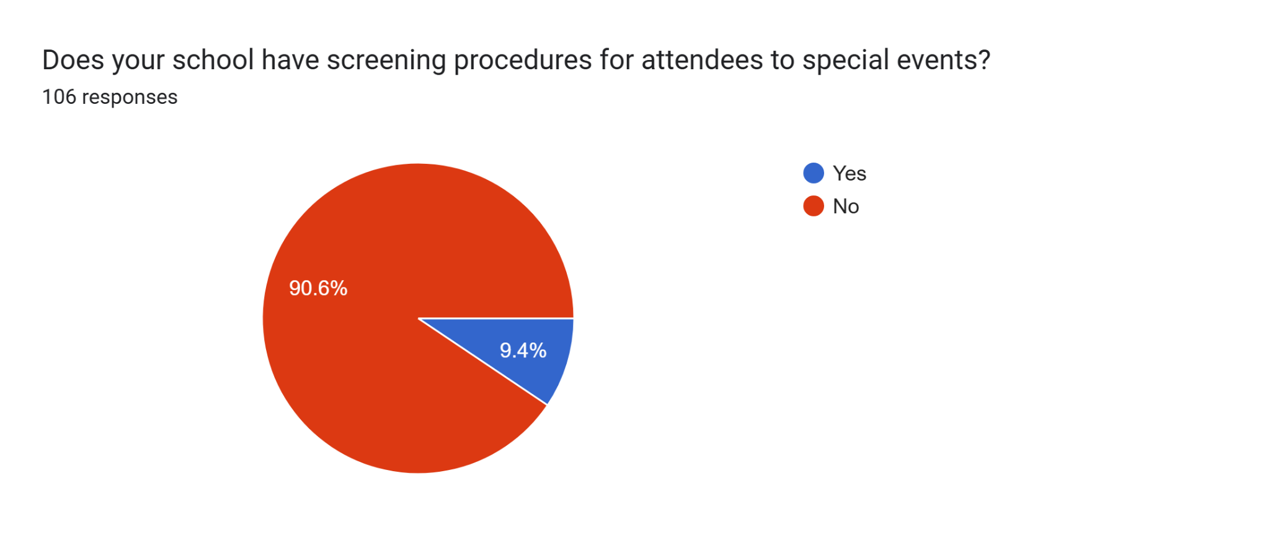
Perceptions of Safety in the Mountain West

Slide 30
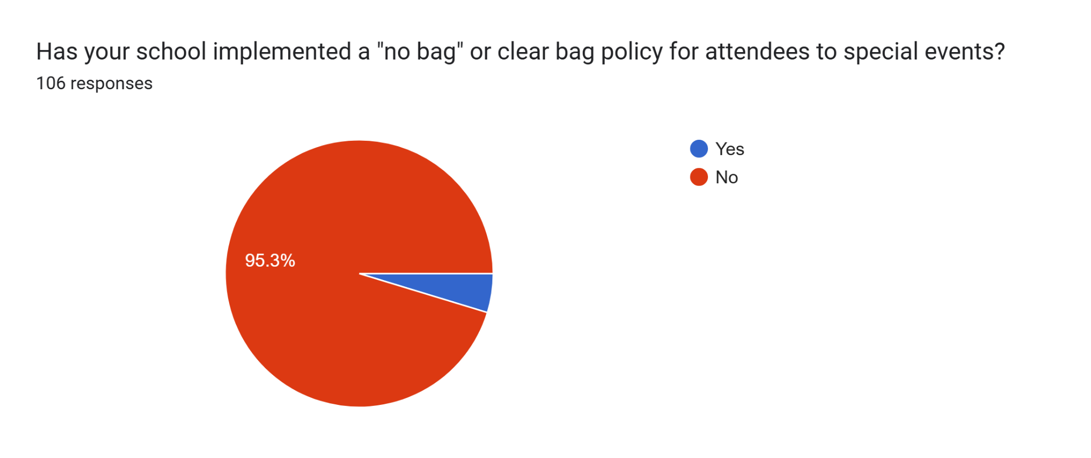
Perceptions of Safety in the Mountain West

Slide 31
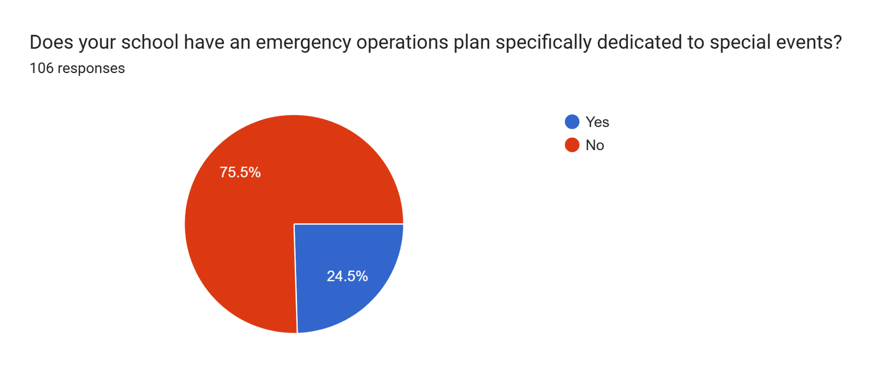
Perceptions of Safety in the Mountain West

Slide 32
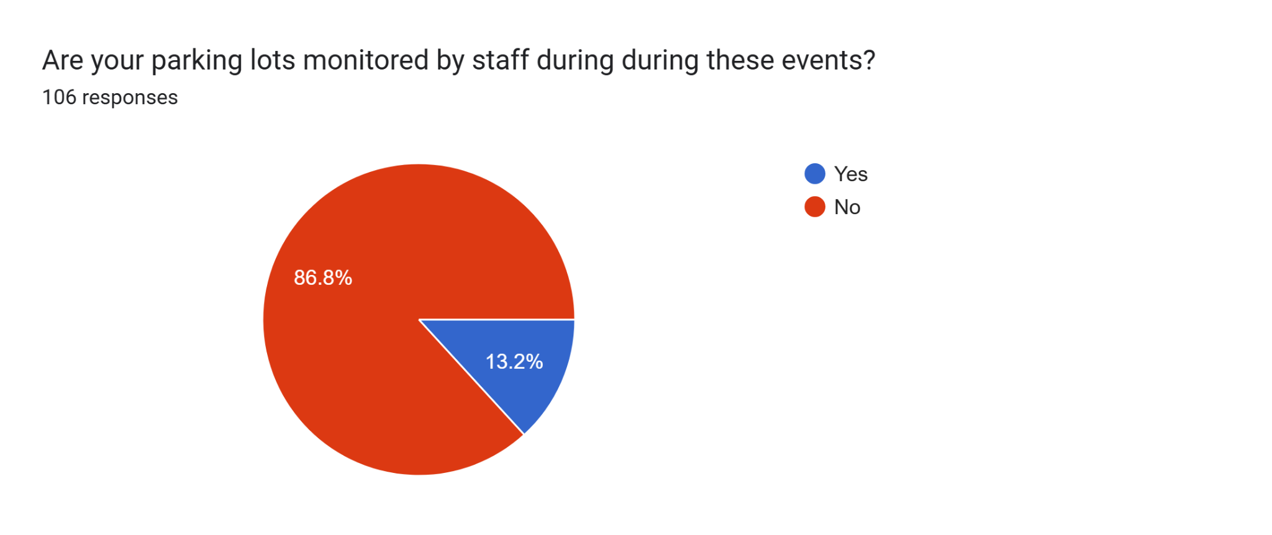
Perceptions of Safety in the Mountain West

Slide 33
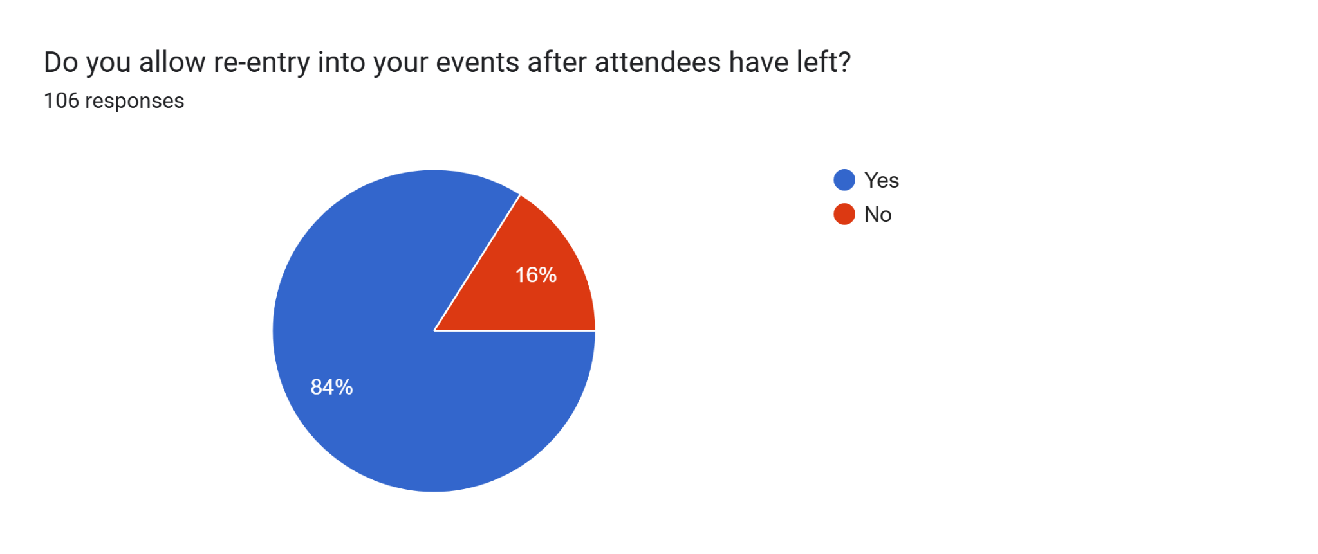
Perceptions of Safety in the Mountain West

Slide 34
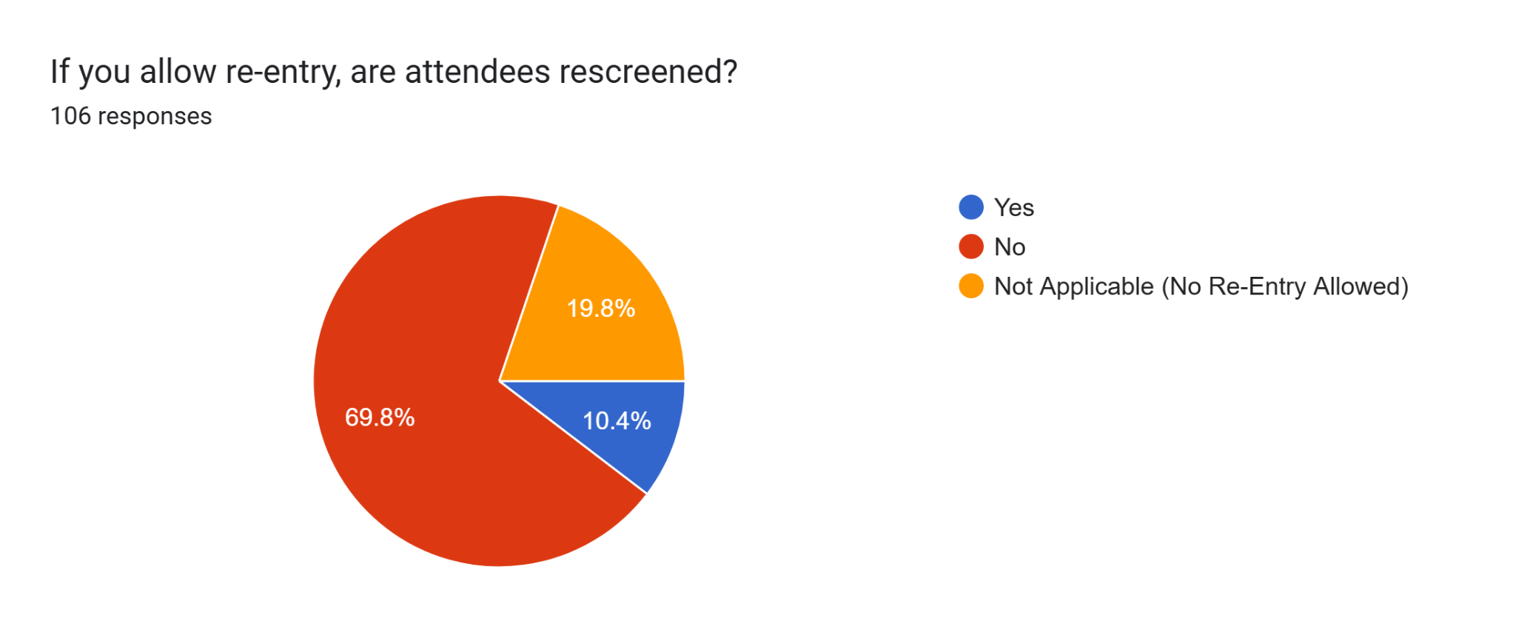
Perceptions of Safety in the Mountain West

Slide 35
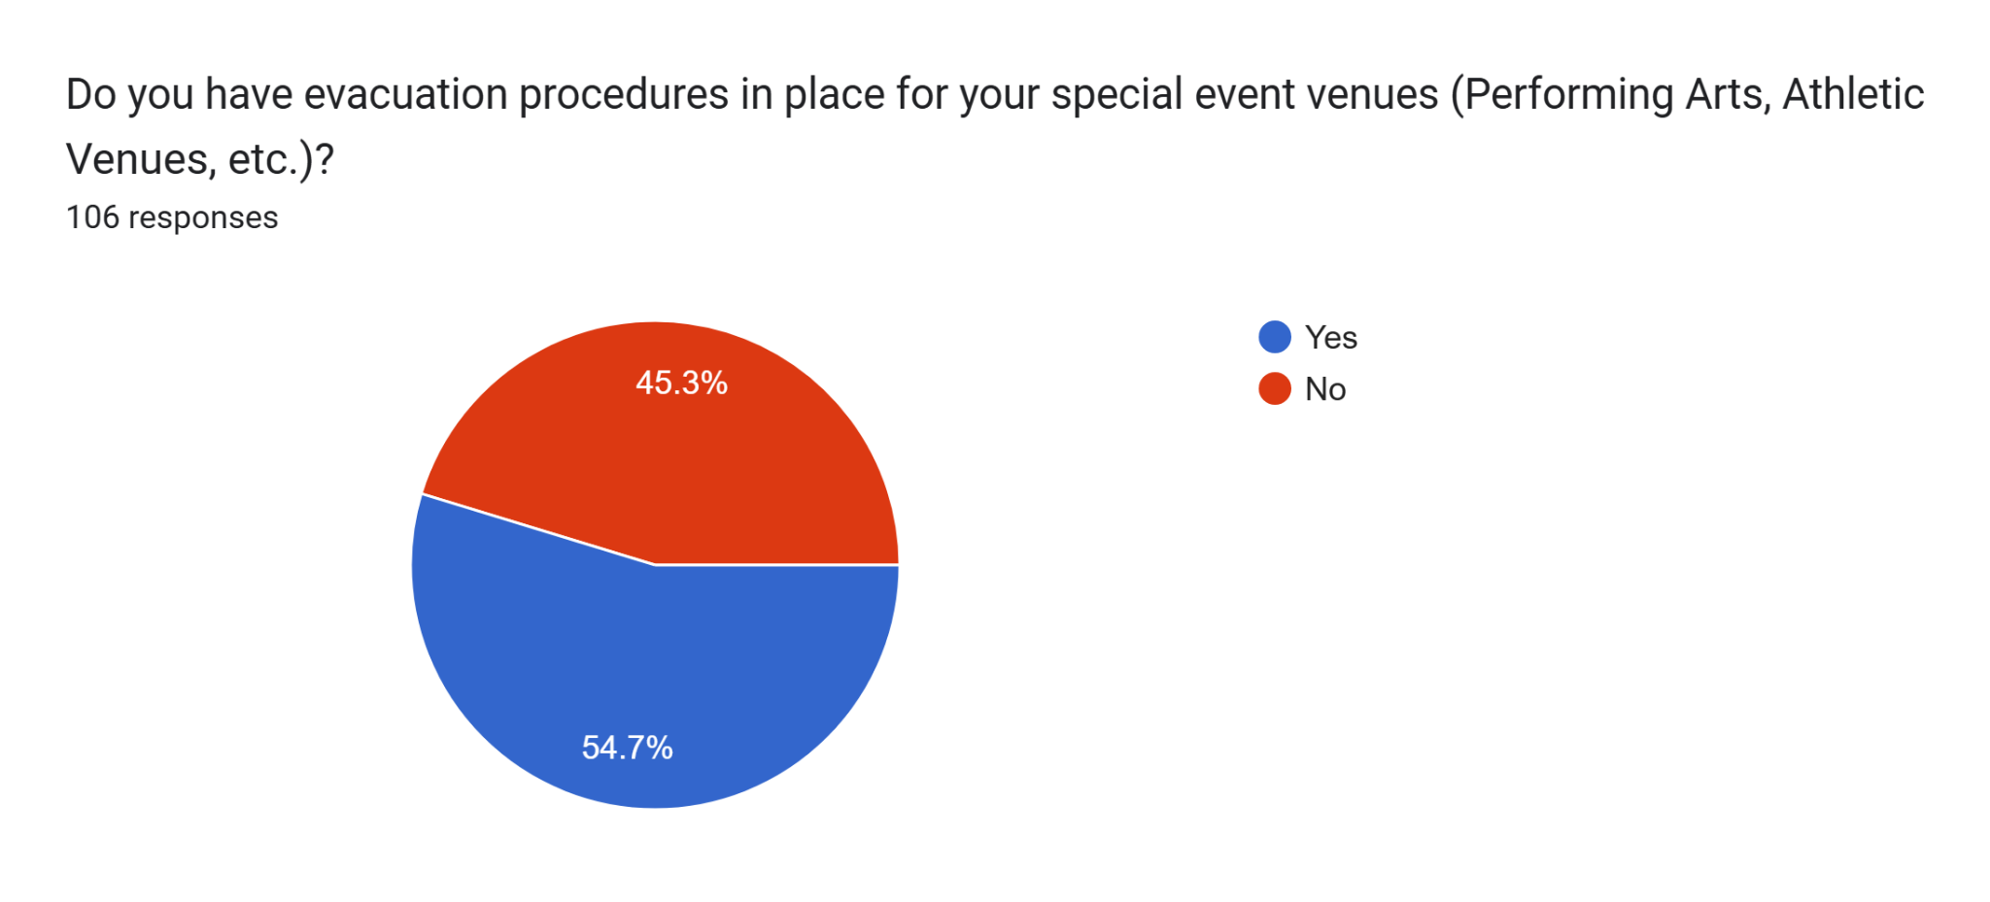
Perceptions of Safety in the Mountain West

Slide 36
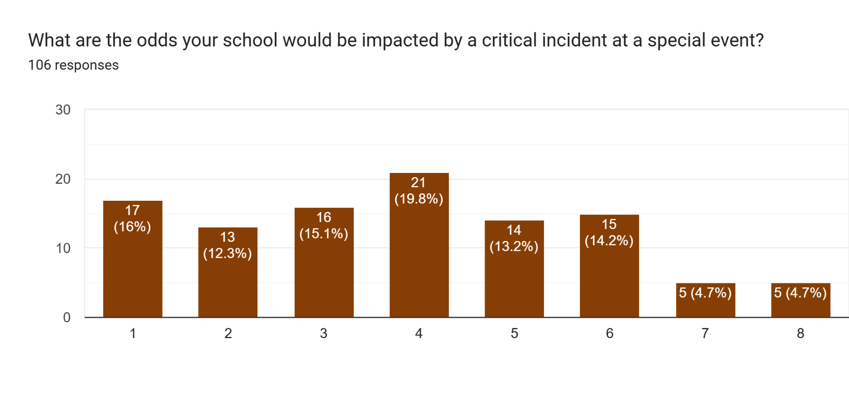
Perceptions of Safety in the Mountain West

Slide 37
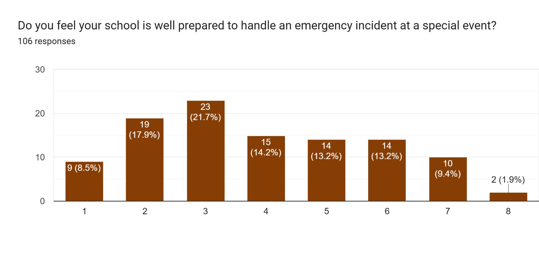
Perceptions of Safety in the Mountain West

Slide 38
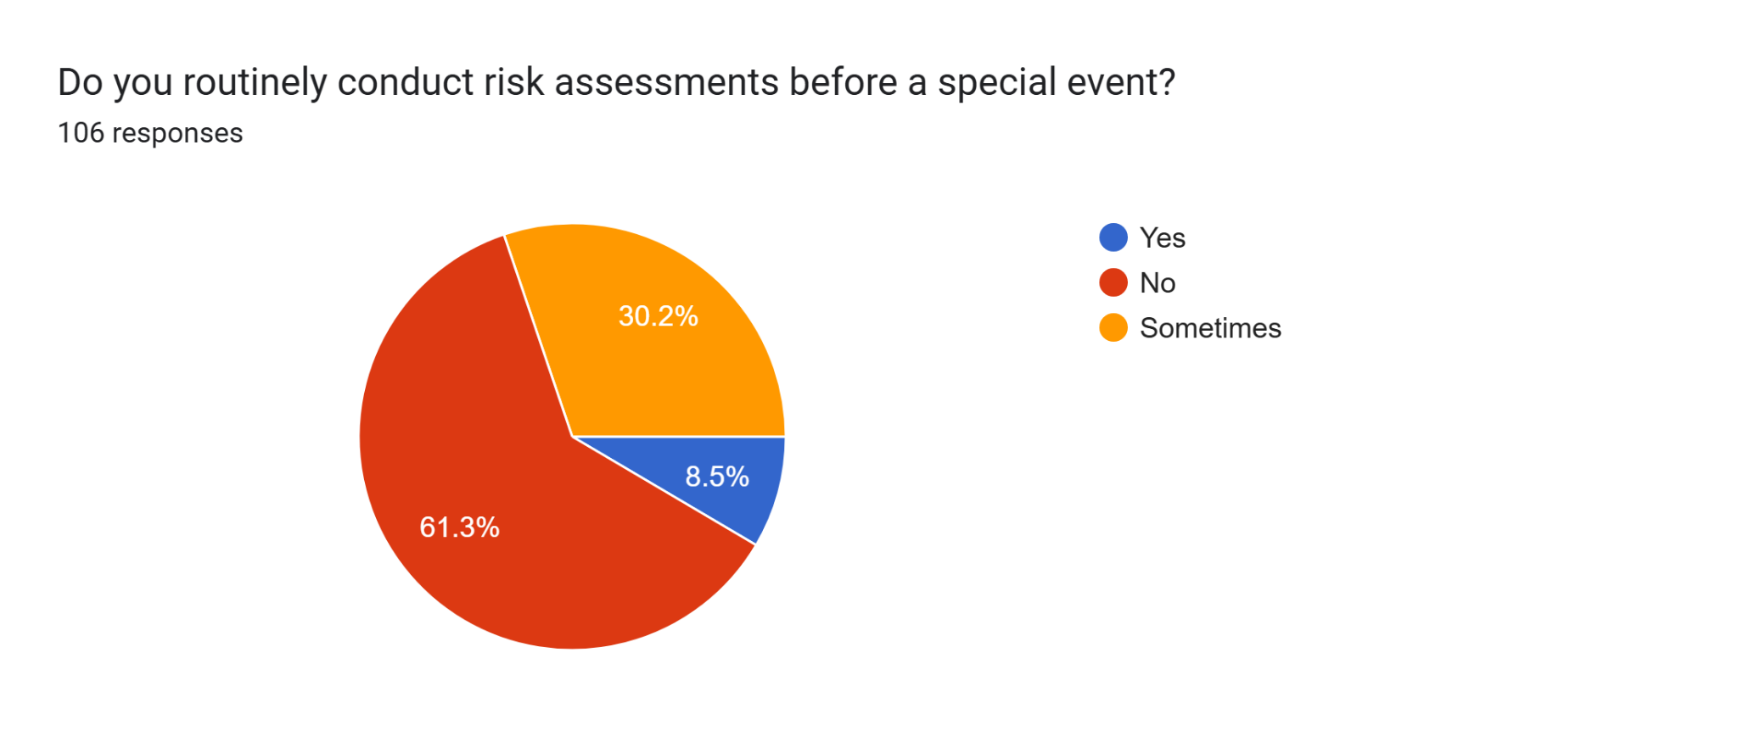
Perceptions of Safety in the Mountain West

Slide 39
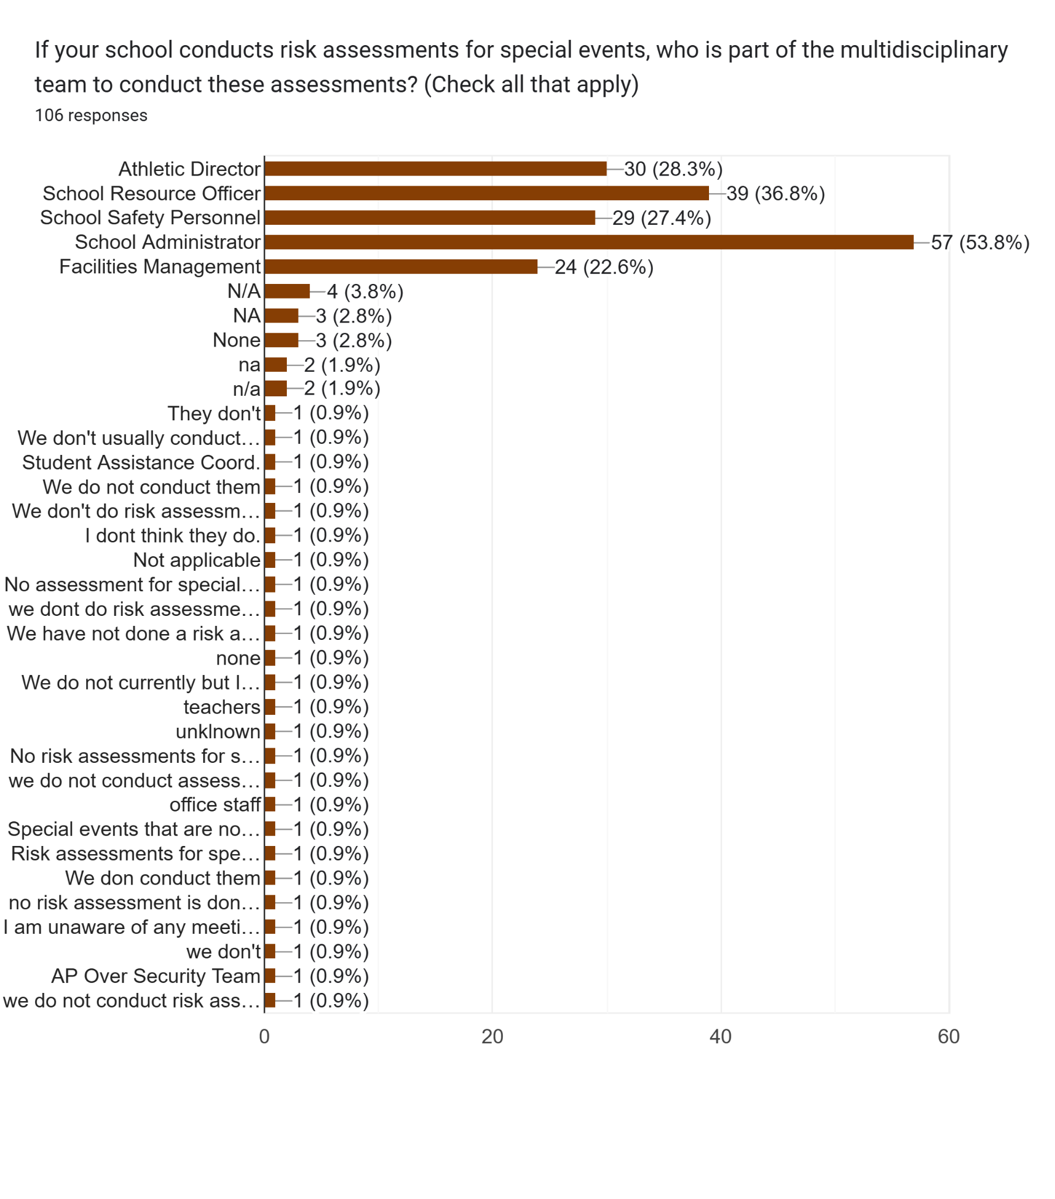
Perceptions of Safety in the Mountain West

Slide 40
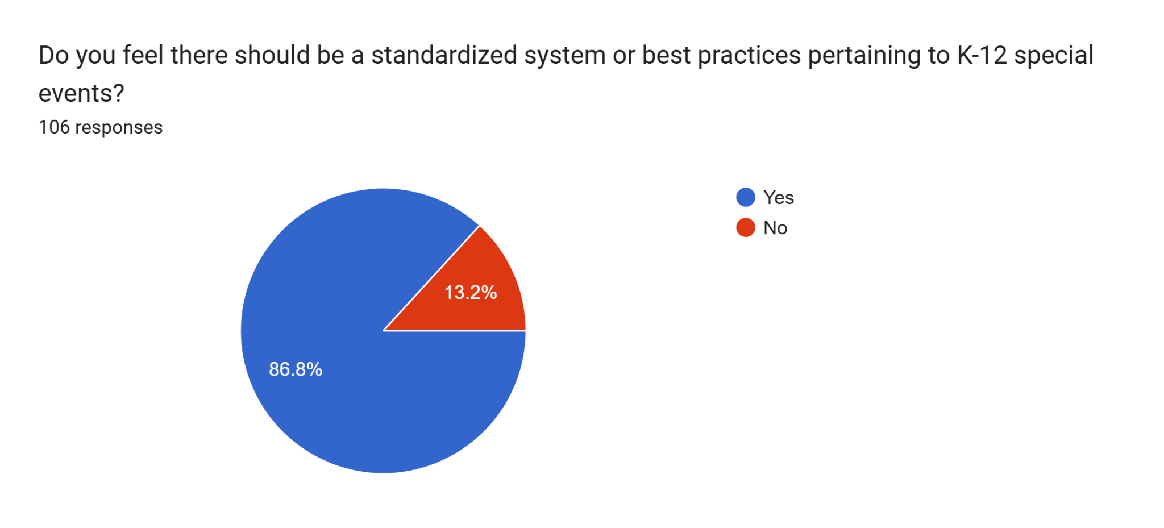
Perceptions of Safety in the Mountain West

Slide 41
Perceptions of Safety in the Mountain West
Utah’s 2024 General Session
SB 260 (Not Passed)- Run by Senator Karen Kwan
Would have directed USBE to create rules:
Clarifying that a school’s administration MAY:
Remove a spectator from a school-sponsored activity if the spectator exhibits certain disruptive behavior for certain circumstances

Slide 42

NCS4
National Center for Spectator Sports Safety and Security (NCS4)
Located at the University of Southern Mississippi
Established in 2006
Nation’s only academic center devoted to the study and practice of spectator sports safety and security
Established best practice guides for:
Professional sports and entertainment
Intercollegiate events
Interscholastic events
Marathon/ Endurance events

Slide 43
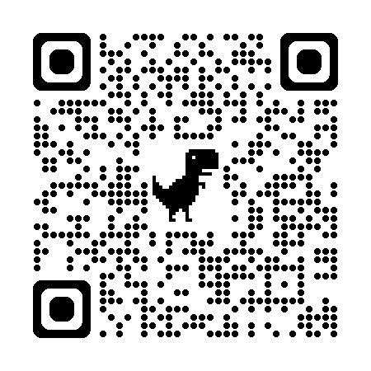
NCS4

Slide 44
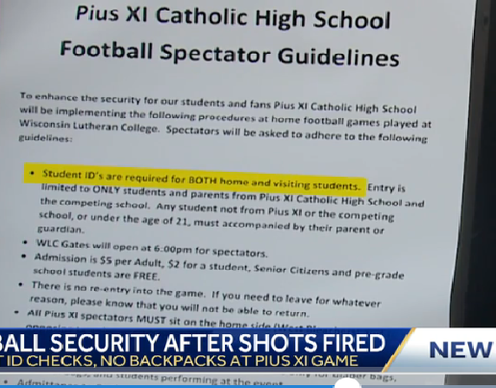
Benefits of Standardized Best Practices
Well Researched
No need to reinvent the wheel
No deviation from norm
Regionally accepted

Slide 45
NCS4 Best Practices
Establish a risk assessment team (K-12)
District Security Director
District Athletic Director
Event stakeholders: visiting team personnel, school administrators, school-based policing, students/parents/community as appropriate
Conduct Risk Assessment
Risk=Threat x Vulnerability x Consequence
Consider:
Previous incidents
Location specific concerns
Consequences of process, system, or equipment failure
Human error
Design/ construction issues with venue

Slide 46
NCS4 Best Practices
Develop an Emergency Operations Plan (EOP)
Should align with the district EOP
Should be shared with visiting teams before event to ensure dissemination to spectators and participants
Address the management of unattended junior high and younger students
FEMA Comprehensive Preparedness Guide
Department of Education: Guide for Developing High-Quality School Emergency Operations Plans
DHS School Safety Resources

Slide 47
NCS4 Best Practices
Screening Procedures:
Staffing and termination
Establish main points of entry
Ensure staffing
Walk Through Weapon Detection (Cost?)
Clear Bag/ No Bag Policies
Requires prior communication with all guests
Signage at event
Inspect, if necessary

Slide 48
NCS4 Best Practices
Re-Entry
Implement a no re-entry policy
Exceptions:
Medical Needs
Emergency Disruption
Childcare
Communicate policy with all stakeholders

Slide 49
NCS4 Best Practices
Perimeter management
Inner (Playing field/ Stage)
Middle (First level of access)
Outer (Venue property to first point of access)
Public/ External (Outside sphere of influence)
Parking lots
Patrol lots

Slide 50
NCS4 Best Practices
FEMA
Ensure practices are compliant with chain of command outlined in IS 100, 200, 700
Consider use of ICS forms 203,204,207
Ensure all involved parties are knowledgeable
Predesignate IC
COOP

Slide 51
NCS4 Best Practices
Third Party Use
Establish clear policies and procedures
Establish MOU with third-party entities
Certificate of insurance or similar
Designate administrator in charge of event
Brief event organizers on emergency procedures and location-specific information
Restrict access to “off-limits” locations

Slide 52
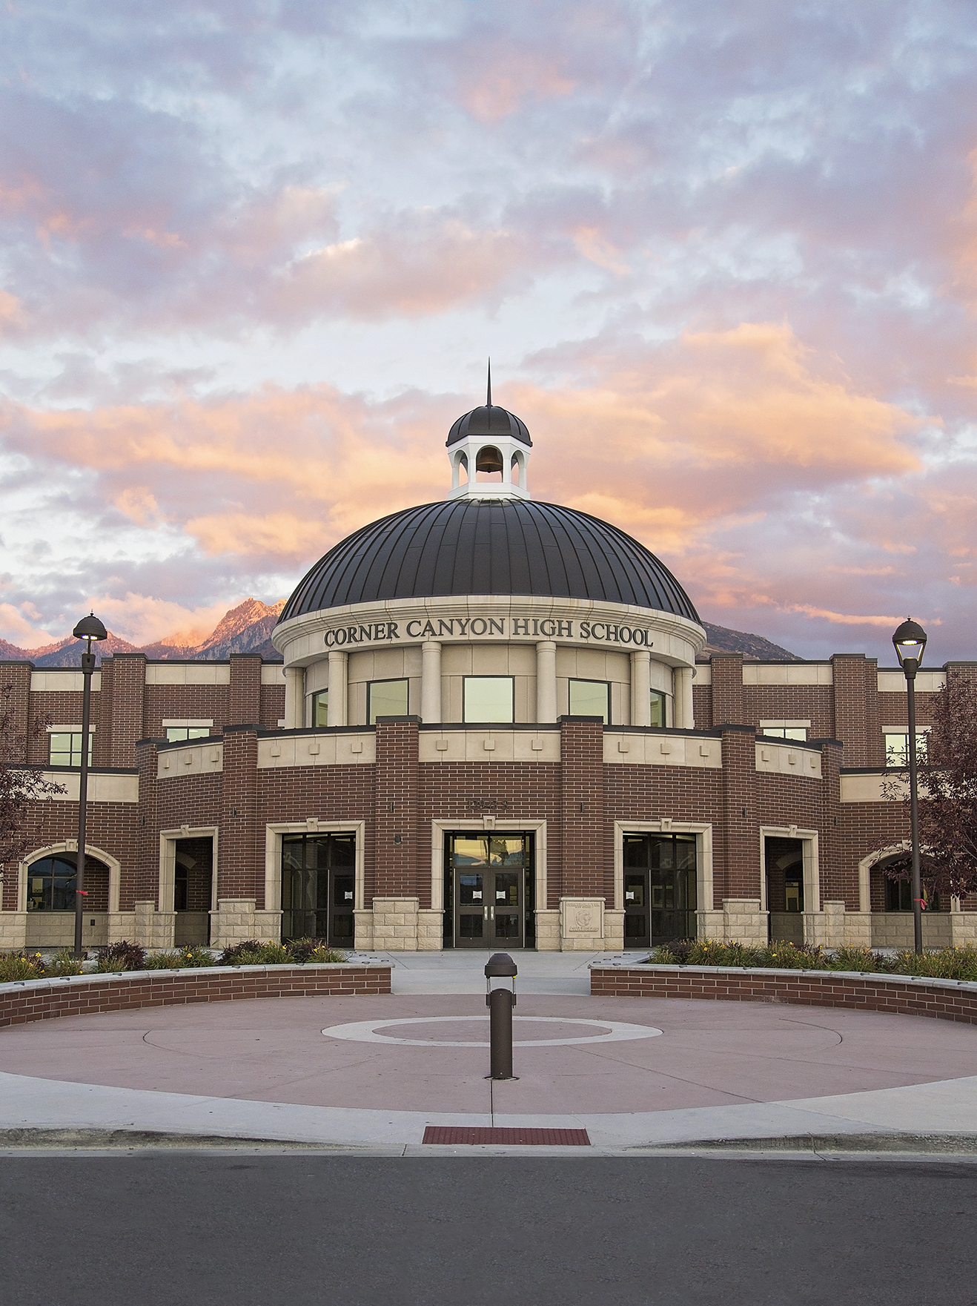

STAKEHOLDERS
1
Law Enforcement/ Fire/ EMS
2
Education
3
Community

Slide 53


QUESTIONS?

Slide 54
Contact:
Lieutenant Jeremy Barnes
jerbarnes@utah.gov
801-503-5815

Slide 55


