Slide 1
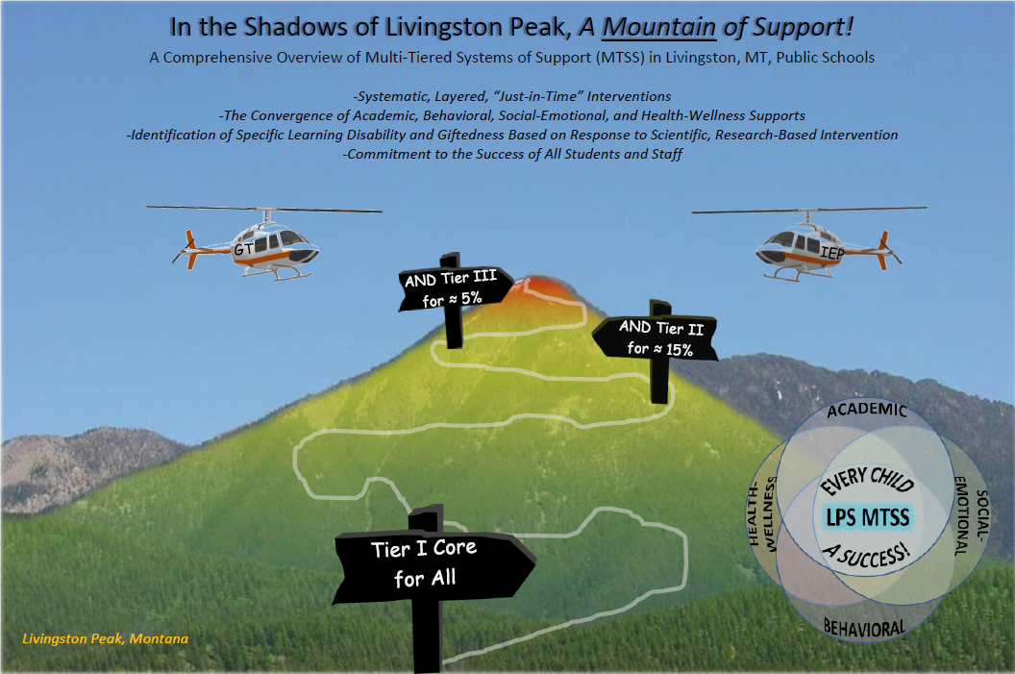


Slide 2
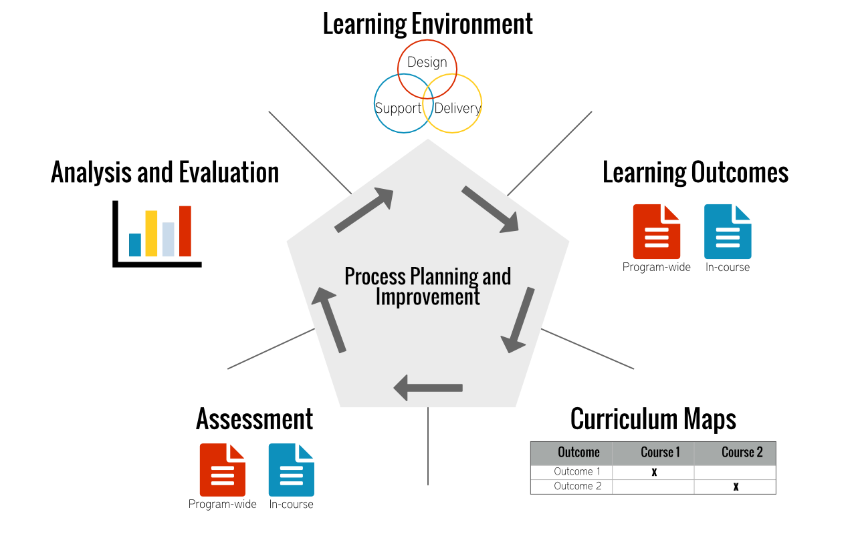
Five Essential Questions of LPS MTSS
What do students need to know and be able to do?
How do we know if they know and can do it?
How do we teach it?
What do we do if they don’t know or can’t do it?
What do we do if they already can do it?
MTSS Informs Continuous Improvement Planning
Notes:
Todd will present, 2 mins
What do students need to know and be able to do? (Standards and Curriculum – Essential Skills and Knowledge)
How do we know if they know and can do it? (Assessments)
How do we teach it? (Tier I Instruction, whatever 80% of our kids need next)
What do we do if they don’t know or can’t do it? (Tier II designed for 15%, and Tier III customized to meet the needs of 5%)
What do we do if they already can do it? (Tier II and III instruction for high-achieving, gifted and talented learners)

Slide 3
What is LPS MTSS?
Borrowed from an Effective Public Health Model
Layered, Tiered, Productive System of Supports for All Students
Includes Academic, Socio-Emotional, Behavioral, and Wellness Components
Early Intervention; Replaces, “Wait to Fail,” Method of Discrepancy Model
High Quality Assessment (Validated, Aligned to Standards)
Data-Driven Decision Making (“Taking Temperature” Regularly)
Heightened Awareness Across the District, LPS Taking Responsibility for It
All Children Learning and Growing
Appropriate and Differentiated Curriculum Daily, All Day, in Every Classroom
Notes:
Caitlin, Leah and Hannah will present. 10 minutes.
Think, health screenings that lead to different levels of preventative and responsive treatment.
Emphasis that students receive Tier I and Tier II and Tier III as necessary (layered, tiered, productive)
Not just academics!
Remember, Gifted kids are gifted all day☺
The East Side Story – Waiting to start REACH because 80% needed SIPPS

Slide 4


LPS MTSS Is Not . . .
A Wait-to-Fail Model
A Referral Process or Fast-Track to Special Education
A Way to Delay Access to Special Education Services
Siloed or Done Only by Specialists
A Model that Excludes the Classroom Teacher
MTSS is a strengths-based model based on evidence of what kids can do now and what they could do next
Notes:
Sherry will present, 5 minutes
Replaces discrepancy model, which required students to essentially fail before they qualified for services
The intent is to provide early, effective intervention to prevent need for special education service
At the glimmer of an issue, we contact parents to recommend intervention. Students remain in Tier II for 6-12 weeks, and, Tier III for perhaps another 6 weeks, totaling 18, and, if there is not sufficient progress, special education evaluation takes place.
MTSS is integrated across the entire organization.
Tier I instruction is designed to meet the needs of 80% of students as determined by assessment. The 20% of students who need fundamental or advanced intervention may receive such interventions in class or, sometimes, in pullout or, at grades 6-12, in specially-designed sections.

Slide 5
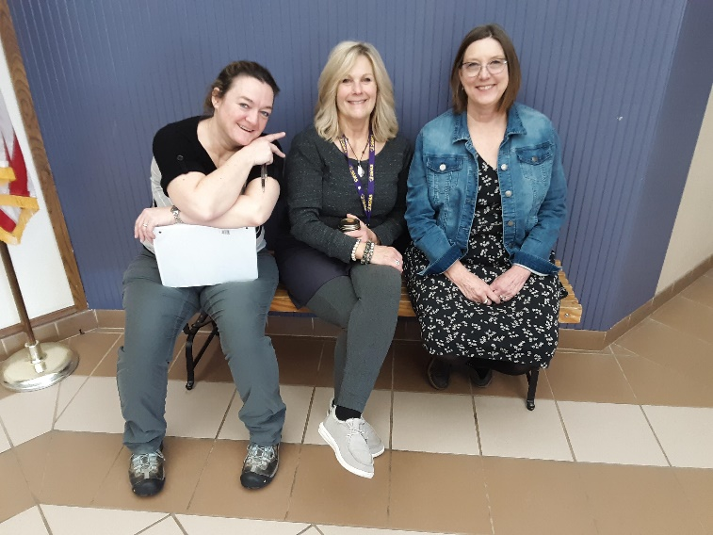
Who Does LPS MTSS?
System-Wide
School Psychologists May Utilize the MTSS Process to Identify Specific Learning Disability
MTSS Leadership Teams Exist in Each Building
Para-Educators Play an Important Role
Classroom Teachers Play a Central Role
Specialists, e.g., OT, PT, Speech Advise and Assist
Counselors Provide Instruction and Supports
Administrators Guide and Support Implementation
Community Partners (e.g., L’esprit, LHC, CHP)
LPS “MTSSers” Discussing Data and Planning Instruction
Notes:
Ashlie and Gretchen will present, 5 minutes
Emphasis that this is not something that only specialists do, system-wide
MTSS Teams the Board may have heard about – essentially, MTSS underlies all academic and SEB decision-making
Paras are joining literacy and SEL professional learning, and, some, like Janine Ensign, have received specialized trainings, e.g., Right Response De-Escalation, Registered Behavior Technician
Administrators support and guide implementation with strategic hiring, repurposing of positions to facilitate improved designs
CSCT, the Ranger Clinic, and the Parent Liaison Program are examples of treatments and interventions in our Tier I, II and III domains
Ashlie and Gretchen will share a story from their experience, showing the broad involvement of diverse staff

Slide 6
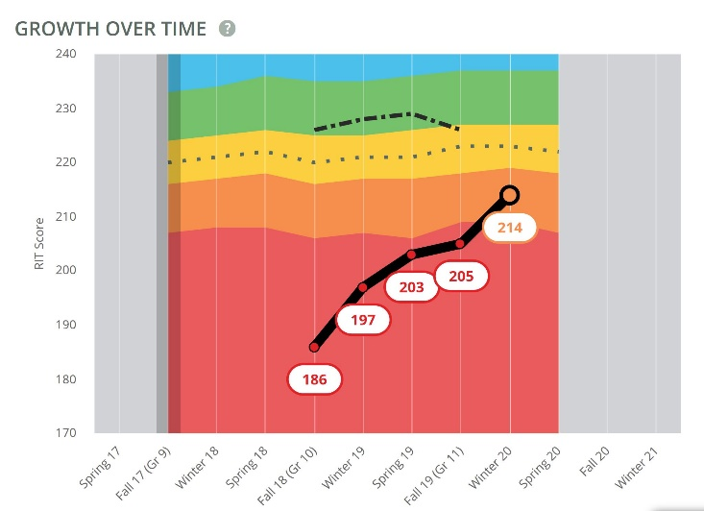
Where is LPS MTSS?
Ideal (Within the next 5 years): Throughout All Instruction, All the Time
Current: Taking Intentional, Incremental Steps Toward Implementation
Literacy, then, Socio-Emotional Learning/Behaviors, then, Math, then, All Subjects
PLC, MBI/PBIS, and SST Teams Have Gathered under the Umbrella of MTSS Teams
Special Education is Now Integrated with MTSS, Rather than Separate
Professional Learning Focused on Ways to Dive Deeper With Kids who Need it Most
Continuous Improvement Cycle in Tier I Evolving
Actual Growth over Time for A Student Receiving Special Education Services at LPS →
Notes:
Jodi and Sabrina, Susan, Patti, and Anne Penn will present, 8-10 minutes
We don’t want to overstate that we have a fully-functioning MTSS system; we are in early stages, but, are committed
Highly recommended and typical to map and implement MTSS first in literacy, then, socio-emotional behavioral, then, math, then, across all subjects
The work of many teams becomes the work of one
Special education is not separate from MTSS, it’s a central part of it
Our January 24 day and our literacy trainings have been focused on intervention for students who need help with fundamentals or with accelerated learning
Continuous improvement means looking at data, deciding what kids need, finding the best curriculum and instructional strategies to meet that need, and, monitoring student outcomes after implementation. That is, it’s an ongoing cycle.

Slide 7

When Does LPS MTSS Happen?
Ultimately, Continuously
Time is Dedicated for Teachers to Analyze and Respond to Data
MTSS PLC Teams are Improving Approaches to Working with Data Regularly
For Placement
For Grouping
For Differentiation
For Progress Monitoring
On the Horizon – Adoption of PLC Protocols for MTSS
Of critical importance to staff is that MTSS not be a passing fad done once or temporarily, but rather, an embedded, ongoing process
Notes:
Deb Tedstrom and Susan Martenson will present, 5 minutes
Our aim is that MTSS become the new paradigm, the new way of doing business, the new status quo
On the calendar, we can see days dedicated to data analysis, and, trade days that provide valuable MTSS data and placement meeting time
More and more do educators see the relevance of using data to place, group and progress-monitor students and to differentiate and individualize instruction

Slide 8
Who is LPS MTSS For?
All Students
What about the 80% Tier I, 15% Tier II, 5% Tier III – is the human population predictable enough to fall neatly in such percentages?
Tiered instruction is not static, term to term
Tier I is modified based on screening data to meet the needs of 80% of the students
In this way, we avoid “Tier three-ing” our way out of a Tier I issue
As fidelity of instruction increases, so too do fewer students require extra intervention
Ultimately, everyone in the organization
In simplest terms, MTSS is about knowing what individuals know and can do now, and, helping them achieve what they could know and do next, as rapidly as possible
Notes:
Bob, Lynne and Sherry will present, 5 mins
A common misconception about MTSS is that Tier I is necessarily a particular textbook or instructional approach. Instead, Tier I is designed to fulfill what 80% of kids need next.
Tier I could be understood as a program that contains a blend of research-based practices.
Tier II could be understood as additional, discrete interventions that we can buy that, when they supplement instruction, meet the needs of about 15% more
Tier III could be understood as more intensive, customized intervention with the Tier II resource
Some districts take a tiered approach to continuous improvement for all employees

Slide 9
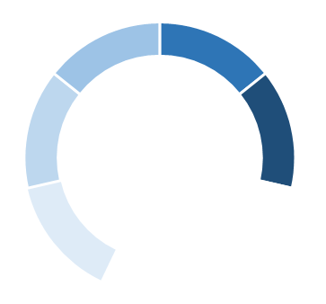
The LPS MTSS dashboard
Validated Screeners and Diagnostics Inform Instruction, Grouping, Placement, and Intervention
All Students
Learn
Tier I Instruction Optimizes Outcomes for 80% of Students, Tier II for 15%, Tier III for 5%
Reduced Absenteeism, Dropout, Unexpected Behaviors, Compassion Fatigue
Staff, Student and Parent Awareness of Essential 21st Century Skills and Knowledge
Increased Academic and Behavioral Outcomes, Compassion Satisfaction
Notes:
Susan Martenson and Todd present, 3 min

Slide 10
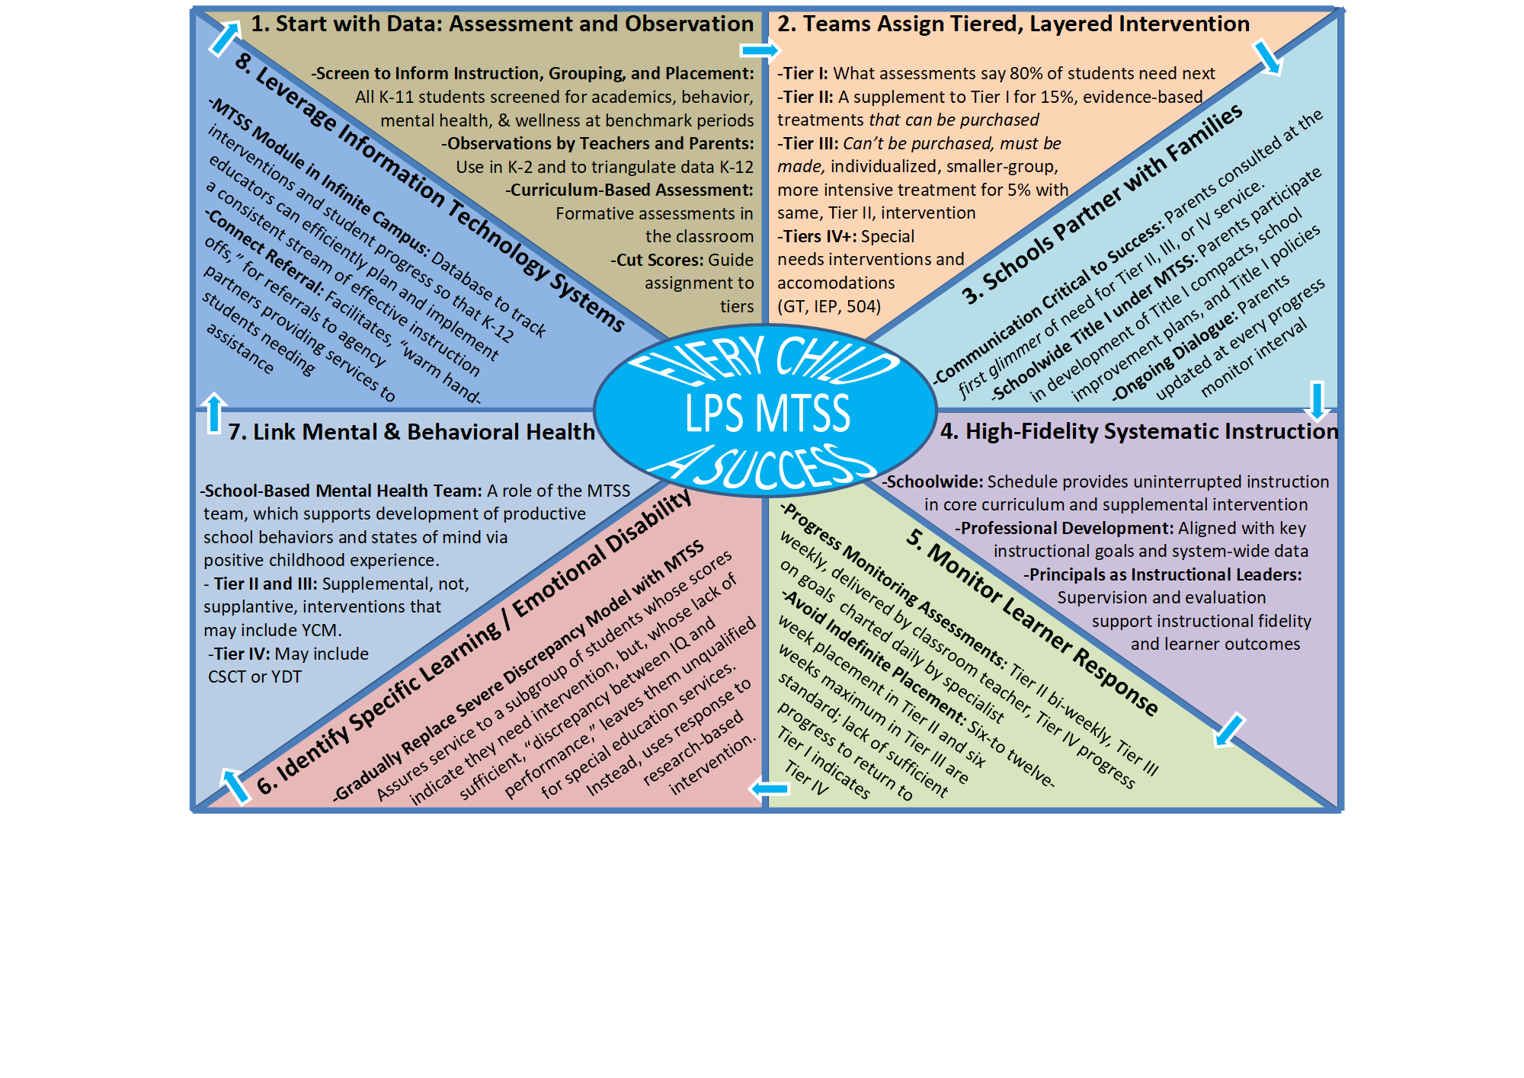

Slide 11
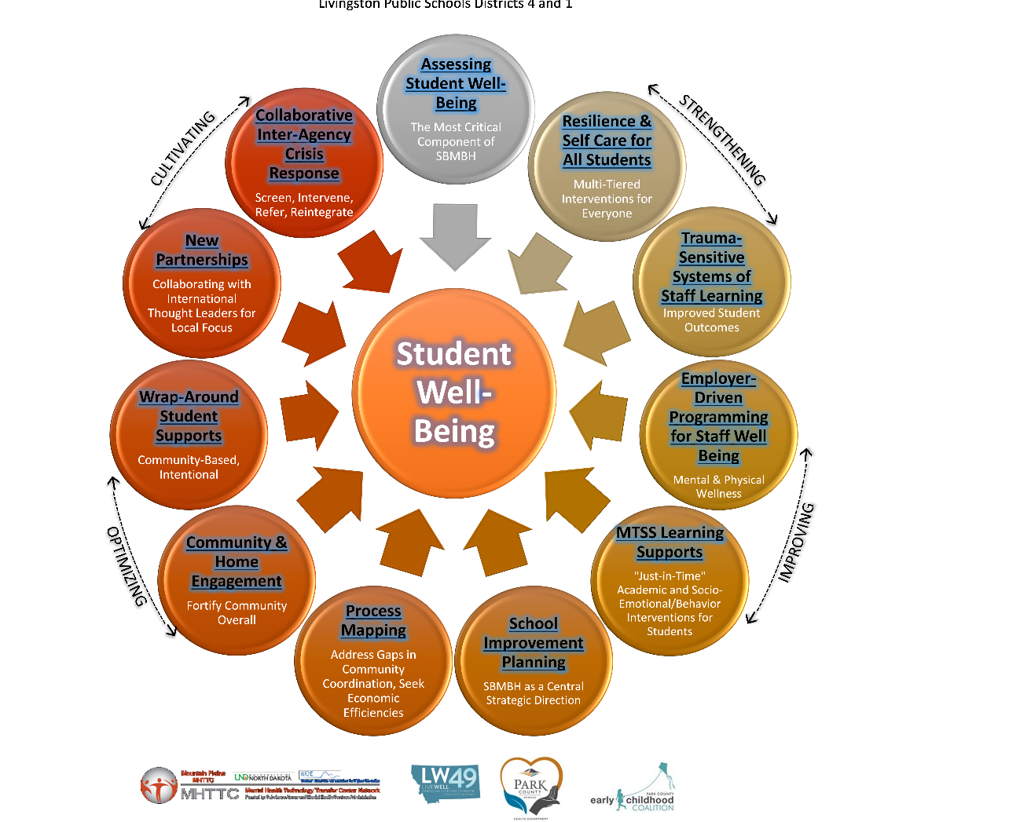
The LPS MTSS Student Well-Being Compass – All Focused on Student Well-Being

