Slide 1

The Three Cs of School Safety;
Context - Climate - Culture
Presented by:
Guy Bliesner Idaho School
Safety & Security Program
August 6-7, 2024
East Middle School
Butte, Montana
Lt. Mikelshan Bartschi
Cache County
Sheriff’s Office

Slide 2
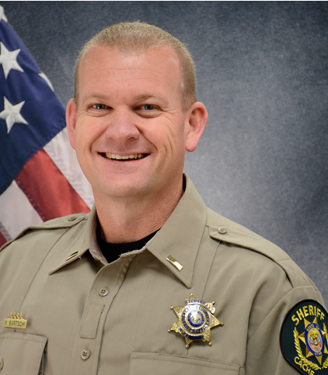




Who We Are
Lt. Mikelshan Bartschi
Cache Co.
Sheriff’s Office
Criminal Division
mbartschi@cachesheriff.org
(435) 755 - 1142
Guy Bliesner
Idaho State Board of Ed. School Safety and Security Program
gbliesner@edu.idaho.gov
(208) 221 - 3145

Slide 3
A School Security Reality
Processes, Procedures, Systems, Technology,
And
Equipment
DO NOT
keep schools safe!

Slide 4


PEOPLE
keep
Schools
Safe!!!
The Secret to Effective School Safety and Security

Slide 5
Competing Mandates
a warm, open, welcoming educational environment where students and parents feel not only free but encouraged to actively engage with student learning
A safe and secure bastion for both students and staff. A Castle where teaching and learning can both safely and effectively occur.
Schools must be both!

Slide 6
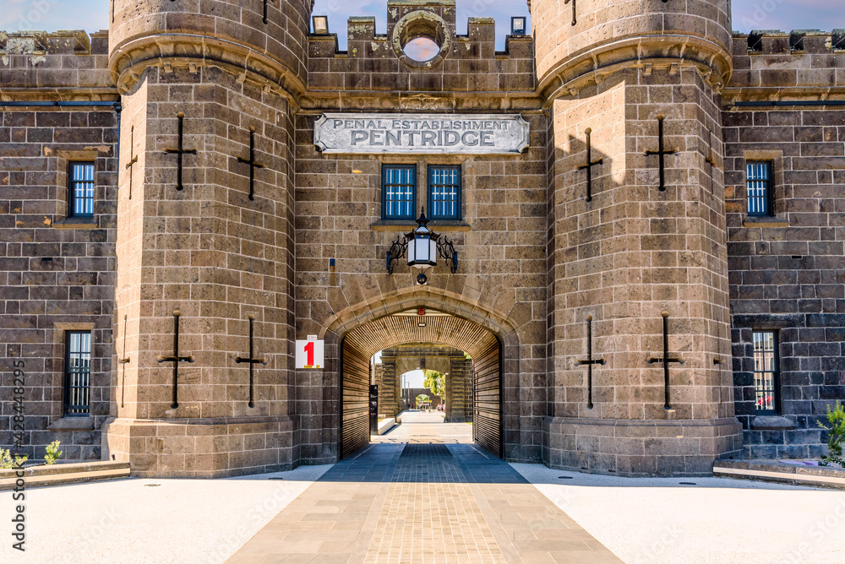

We
are
Creating
Castles!
We are
Not
Creating
Prisons!

Slide 7
Understanding The Terms
The operational PROCESSES required to successfully accomplish the core mission of education.
The environment required to foster effective teaching and successful learning, and within which education exists or happens.
Context:

Slide 8
Context Counts An effective school security program acknowledges, accepts and provides for the necessarily competing operational realities that exist in a healthy school environment

Slide 9

The Balancing Act
School Safety &
Security
Convenience
&
Operational Necessity

Slide 10
Understanding The Terms
The overall perception or feeling of the safety and security conditions in a school.
Climate:

Slide 11
Perception Matters
Exposed and feel Exposed
Exposed and feel safe
Safe and feel exposed
Safe and feel safe

Slide 12
Understanding The Terms
The group ethos, the commonly expected and generally accepted safety and security processes, and practices in place in a school
Culture:

Slide 13
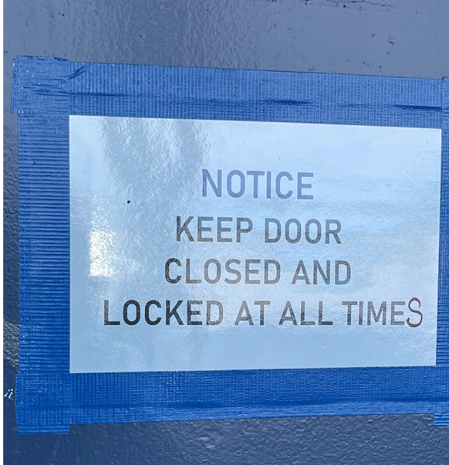
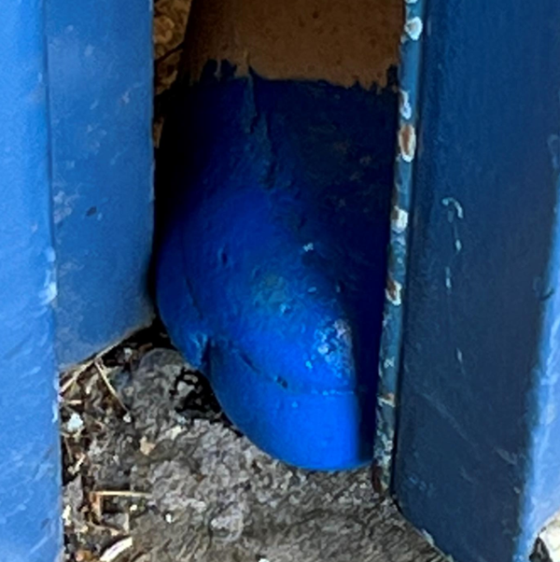
Most School Security Failures are Cultural Failures!
What
Cultural
Failure
looks like.

Slide 14
Developing An Effective School Security Culture
Effective School Security is
Holistic
and considers
more than just
active shooter

Slide 15


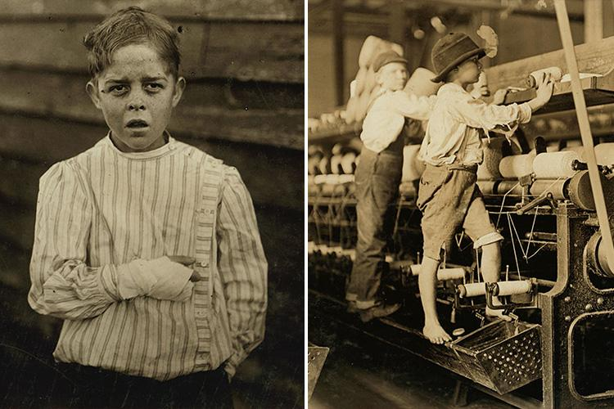
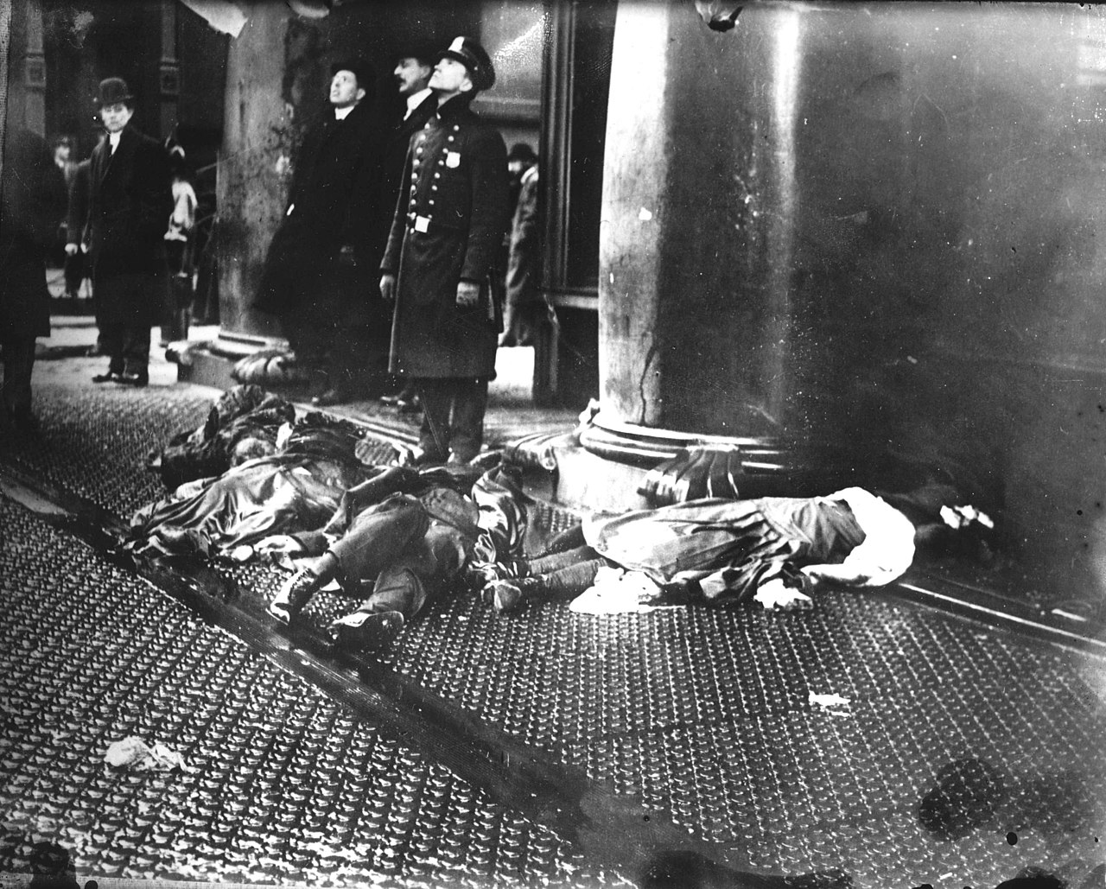
Early Industrial Safety (or lack of)

Slide 16
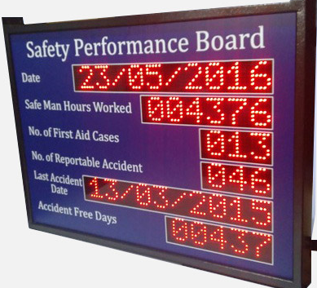
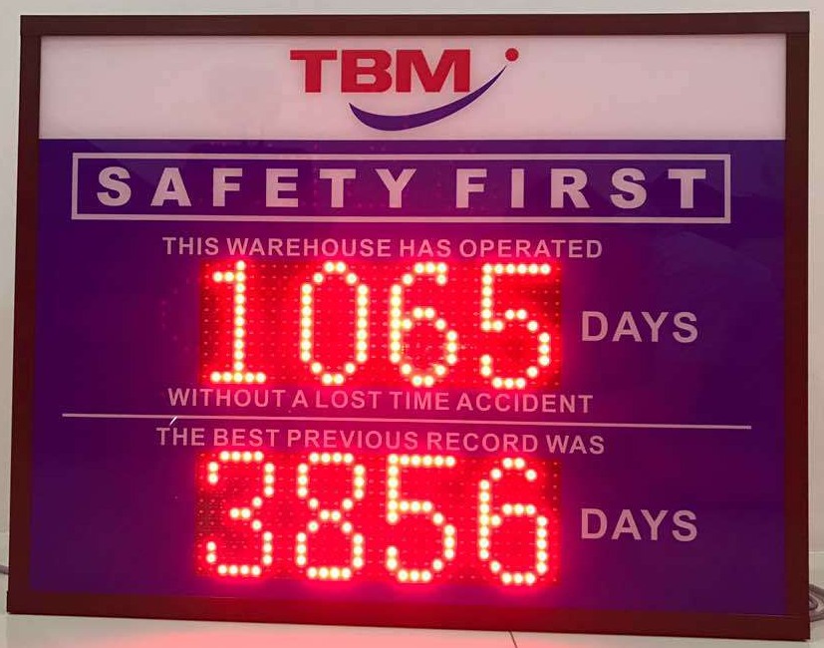
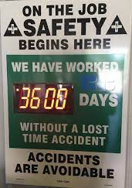
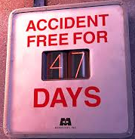
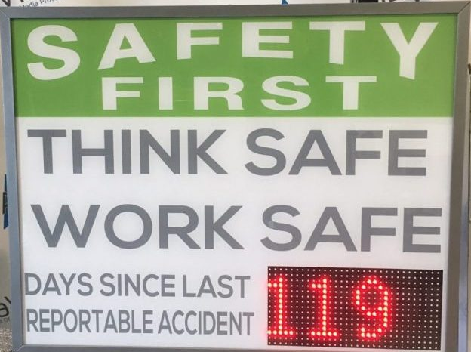
The modern reality in Industrial Safety

Slide 17
Developing An Effective School Security Culture (the Industrial Safety Model)
Develop achievable milestones
Measure your progress
Celebrate your success
Incentivize compliance
Engage the all the stakeholders
Assess BEFORE you treat
Prioritize your efforts
Define what success is

Slide 18
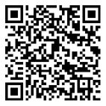
Tell us how we Did

Slide 19
Resources:
NASRO National Association of School Resource Officers: https://www.nasro.org/
ATAP Association of Threat Professionals: https://www.atapworldwide.org/
ASIS International Security Management Association: https://www.asisonline.org/
P.A.S.S. Partner Alliance for Safer Schools: https://passk12.org/
Safe and Sound Schools: https://safeandsoundschools.org/
Zeronow: https://www.zeronow.org
National Council of School Security Directors: https://www.ncssd.org
SchoolSafety.gov: https://www.schoolsafety.gov/
REMS-TA Readiness And Emergency Management For Schools Technical Assistance Center: https://rems.ed.gov/
Idaho School Safety & Security Program: https://schoolsafety.idaho.gov/
I Love U Guys: https://iloveuguys.org/

