Slide 1

School-based Threat Assessment and violence Prevention
Michele Henson, OPI
Tina Eblen, Montana Safe Schools Center

Slide 2
Agenda
Background Information
  What does the data tell us about preventing school violence?
    National and state-level data on targeted school violence and gun violence
    10 Key Findings from the Safe School Initiative and Averted School Violence reports
Threat assessment and intervention
Purpose and example of a threat assessment model
  Scenarios
Questions and answers

Slide 3

What does the data say?
State and national facts about school violence

Slide 4
Data helps with informed decision-making
State and national facts about school violence show trends in behaviors
Ultimately, human behavior is unpredictable

Slide 5


Definitions
Targeted violence: violence that is premeditated and directed at specific individuals, groups, or locations
Targeted school violence: targeted violence that occurs within a school
Mass attack: A violence attack in which three or more individuals were harmed (U.S. Secret Service)
Active shooter: An active shooter is an individual actively engaged in killing or attempting to kill people in a populated area (FBI)

Slide 6

True or false: The number of active shooter events in the U.S. have increased in the last 5 years

Slide 7
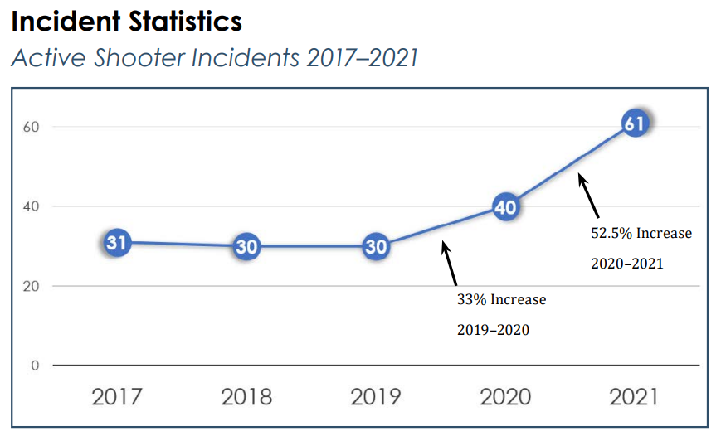
Active shooter incidents occurring in any location across the US
The FBI defines an active shooter as one or more individuals actively engaged in killing or attempting to kill people in a populated area.
Data shows a 33% increase in active shooter incidents between 2019 and 2020 and a 52.5% increase between 2020 and 2021 (FBI, 2021).

Slide 8
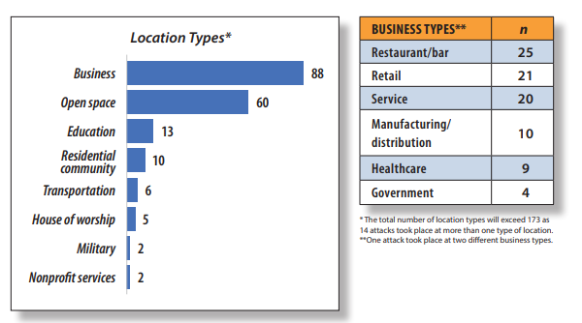
Mass attack: A violence attach in which three or more individuals were harmed (U.S. Secret Service)- Includes all types of weapons and vehicles
Of the 13 attacks at schools:
3 elementary schools
7 high schools
3 universities
Source: U.S. Secret Service: Mass Attacks in Public Places 2016-2020

Slide 9
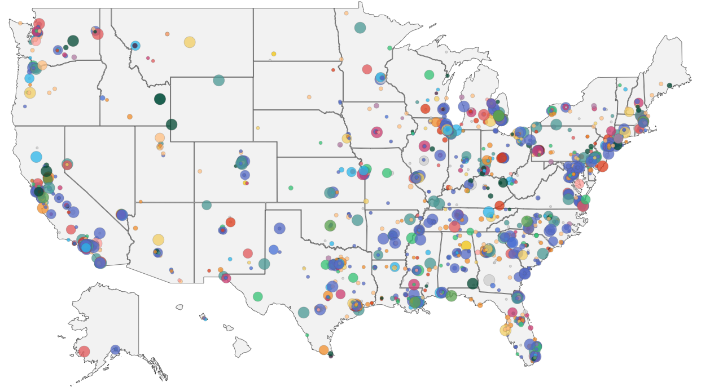
Shooting Incidents are based on publicly available data on incidents from the beginning of 1970 through June of 2022 following the definition of each and every instance a gun is brandished, is fired, or a bullet hits school property for any reason, regardless of the number of victims, time of day, or day of week.
Source: Center for Homeland Defense and Security

Slide 10
Source: Center for Homeland Defense and Security

Slide 11

10 key findings of the Safe school initiative
Notes:
Next, let’s talk about the 10 key findings from the safe school initiative. This research study occurred after Columbine and other high profile school shootings and the data and findings are when led the U.S. Secret Service and U.S. Dept of Education to recommend the implementation of school threat assessments.

Slide 12
True or false: Students who carry out acts of violence in school usually “just snap”, making it very difficult to predict when violence may occur.

Slide 13
10 Key Findings from the
Safe School Initiative
1. Incidents of targeted violence are rarely sudden, impulsive acts
2. Prior to most incidents, other people knew about the student’s idea and/or plan to attack
3. Most students did not threaten their targets directly
4. There is no accurate or useful “profile” of students who engage in targeted school violence
5. Most students engaged in some behavior, prior to the incident, that caused concern or indicated a need for help
Notes:
Next, let’s talk about the 10 key findings from the safe school initiative. This research study occurred after Columbine and other high profile school shootings and the data and findings are when led the U.S. Secret Service and U.S. Dept of Education to recommend the implementation of school threat assessments. Each of the findings is important but for the sake of time, I will highlight a couple of the findings.
Students who carry out an act of violence typically did not “just snap”. Instead, acts of targeted violence tend to be the result of a comprehensible process of thinking and behavior. This means it may be possible to identify the thinking and planning that may occur before an attack is carried out.
In most cases, other youth, such as friends, classmates, or siblings, knew about a student’s idea or plan for an attack before the incident occurred. However, this information was never relayed to an adult.
5. Typically, students who engaged in acts of violence first displayed other behaviors that caused at least one other person to be concerned.

Slide 14
10 Key Findings from the
Safe School Initiative
6. Most students were known to have difficulty coping with significant losses or personal failures; many had considered or attempted suicide
7. Many students felt bullied, persecuted, or injured by others prior to the attack
8. Most students had access to and had used weapons prior to the attack
9. In many cases, other students were involved in some capacity
10. Despite prompt law enforcement responses, most shooting incidences were stopped by means other than law enforcement
Notes:
6. There continues to be a strong connection between students who carry our acts of violence and suicide ideation.
7. There is also a strong connection between bullying and acts of violence. The majority of students who have carried out acts of violence in schools described a history of being bullied in ways that tormented the student and could be considered acts of harassment or assault.

Slide 15
Duration of an attack
44% lasted 60 seconds or less
68% lasted 2 minutes or less
83% lasted 5 minutes or less
*Percentages do not total 100 due to rounding
U.S. Secret Service: Data from 2008-2017

Slide 16
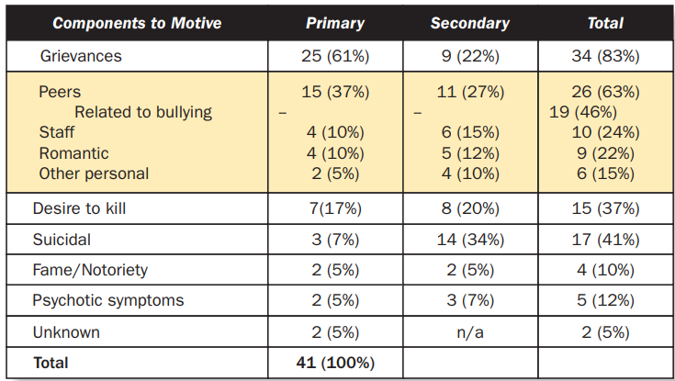
Motives for violence
One key difference between those who carry out an attack and those who do not: Humiliation
U.S. Secret Service: Data from 2008-2017

Slide 17
Behaviors prior to an attack
Of the 41 incidents studied, in 21 cases the offender engaged in observable planning behaviors prior to the attack:
Researching weapons (32%)
Documenting the plan for attack (17%)
Surveilling or researching the intended target(s) (12%)
Researching prior attacks (12%)
Recruiting others to assist in the planning of an attack or in the attack itself (10%)
Practicing with a weapon (10%)
Packing a bag of materials for the attack (5%)
U.S. Secret Service: Data from 2008-2017
Notes:
The larger the attack, the more planning behaviors occurred

Slide 18
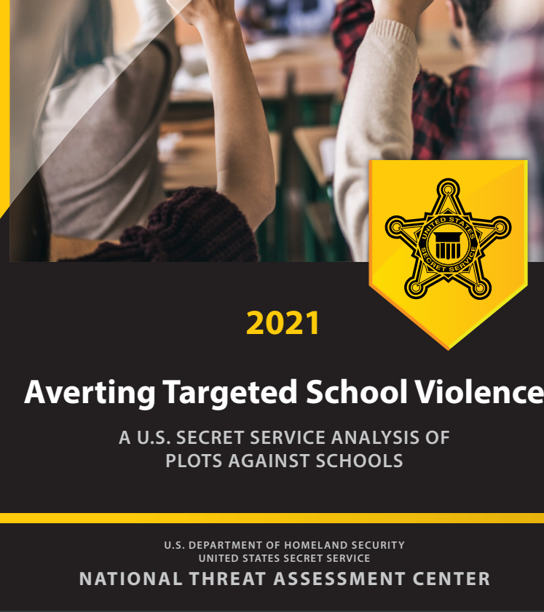
Averted school violence
Data from 67 cases of averted school attack plots between 2008-2017
Key finding and implications:
  Targeted violence is preventable when communities identify warning signs and intervene
  Schools should seek to intervene with students before their behavior warrants legal consequences
  Students were most often motivated to plan a school attack because of grievances with classmates
  Students are best positioned to identify and report concerning behaviors displayed by their classmates

Slide 19
Averted school violence
Data from 67 cases of averted school attack plots between 2008-2017
Key finding and implications:
  The role of parents and families in recognizing concerning behavior is critical to prevention
  SROs play an important role in school violence prevention
  Removing a student from school does not eliminate the risk they might pose to themselves or others
  Students displaying an interest in violent or hate-filled topics should elicit immediate assessment and intervention

Slide 20
Averted school violence
Data from 67 cases of averted school attack plots between 2008-2017
Key finding and implications:
  Many school attack plots were associated with certain dates, particularly in the month of April
  Many of the student plotters had access to weapons, including unimpeded access to firearms

Slide 21
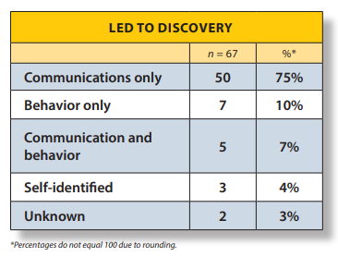
Discovery of plot to act violently

Slide 22
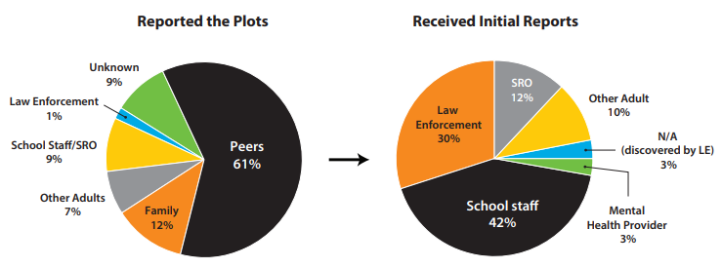
Discovery of plot to act violently

Slide 23

Threat Assessment and Intervention
A team approach to preventing violence and supporting students

Slide 24
Threat assessment and intervention
A threat assessment is a violence prevention strategy that that aims to:
  Identify students who may be planning to commit an act of violence
  Determine the seriousness of the threat of violence
  Intervene to prevent the act from occurring and address the underlying problem or conflict
The ultimate goal of a threat assessment is to keep school safe while providing support to students who may be considering carrying out an act of violence to overcome what ever issues are driving those violent inclinations.
Effective threat assessments will include both an assessment and intervention.
  Promotes a team approach to supporting all students

Slide 25
School Threat Assessment Decision Tree- CSTAG Model
Step 1. Evaluate the threat
Obtain a detailed account of the threat, usually by interviewing the person who made the threat, the intended victim, and other witnesses
Write the exact content of the treat and key observations by each party
Consider the circumstances in which the threat was made and the student’s intentions
Is there communication of intent to harm someone or behavior to suggest intent to harm?
NO
Not a threat. Might be an expression of anger that merits follow-up.
YES
Step 2. Attempt to resolve the threat as transient
Is the threat an expression of humor, rhetoric, anger or frustration that can be easily resolved so that there is no intent to harm?
Does the person retract the threat or offer an explanation and/or apology that indicates no future intent to harm anyone?
TRANSIENT
Case resolved as transient; add services as needed.
SUBSTANTIVE
Step 3. Respond to a substantive threat
Serious threat includes a threat to hit, fight, or beat up. A very serious threat includes: kill, rape, or cause very serious injury
For all substantive threats:
  Take precautions to protect potential victims
  Warn intended victim and parents
  Look for ways to resolve conflict
  Discipline student, when appropriate
SERIOUS
Case resolved as serious substantive threat; refer to services as needed
VERY SERIOUS
Step 4. Conduct a safety evaluations for a very serious substantive threat
In addition to actions outlined in Step 3:
  Screen student for mental health services and counseling and refer as needed
  Law enforcement investigation for evidence of planning and preparation, criminal activity
  Develop safety plan that reduces risk and addresses student needs. Plan should include review of Individual Education Plan if already receiving special education services and further assessment if possible disability.
Step 5. Implement and monitor the safety plan
Document the plan
Maintain contact with the student
Monitor whether plan is working and revise as needed

Slide 26
School Threat Assessment Decision Tree- CSTAG Model
Step 1. Evaluate the threat
Obtain a detailed account of the threat, usually by interviewing the person who made the threat, the intended victim, and other witnesses
Write the exact content of the treat and key observations by each party
Consider the circumstances in which the threat was made and the student’s intentions
Is there communication of intent to harm someone or behavior to suggest intent to harm?
NO
Not a threat. Might be an expression of anger that merits follow-up.
YES
Step 2. Attempt to resolve the threat as transient
Is the threat an expression of humor, rhetoric, anger or frustration that can be easily resolved so that there is no intent to harm?
Does the person retract the threat or offer an explanation and/or apology that indicates no future intent to harm anyone?
TRANSIENT
Case resolved as transient; add services as needed.
SUBSTANTIVE
Step 3. Respond to a substantive threat
Serious threat includes a threat to hit, fight, or beat up. A very serious threat includes: kill, rape, or cause very serious injury
For all substantive threats:
  Take precautions to protect potential victims
  Warn intended victim and parents
  Look for ways to resolve conflict
  Discipline student, when appropriate
SERIOUS
Case resolved as serious substantive threat; refer to services as needed
VERY SERIOUS
Step 4. Conduct a safety evaluations for a very serious substantive threat
In addition to actions outlined in Step 3:
  Screen student for mental health services and counseling and refer as needed
  Law enforcement investigation for evidence of planning and preparation, criminal activity
  Develop safety plan that reduces risk and addresses student needs. Plan should include review of Individual Education Plan if already receiving special education services and further assessment if possible disability.
Step 5. Implement and monitor the safety plan
Document the plan
Maintain contact with the student
Monitor whether plan is working and revise as needed

Slide 27
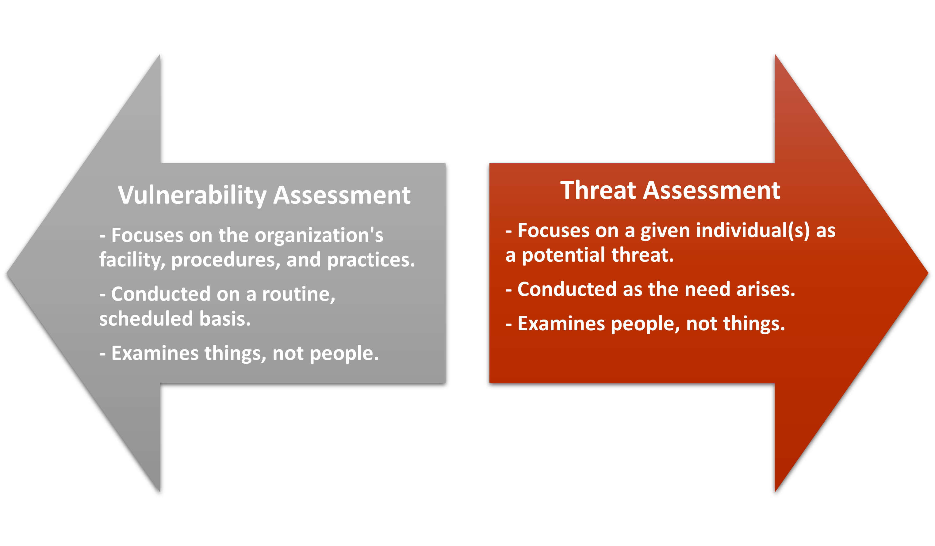

Slide 28
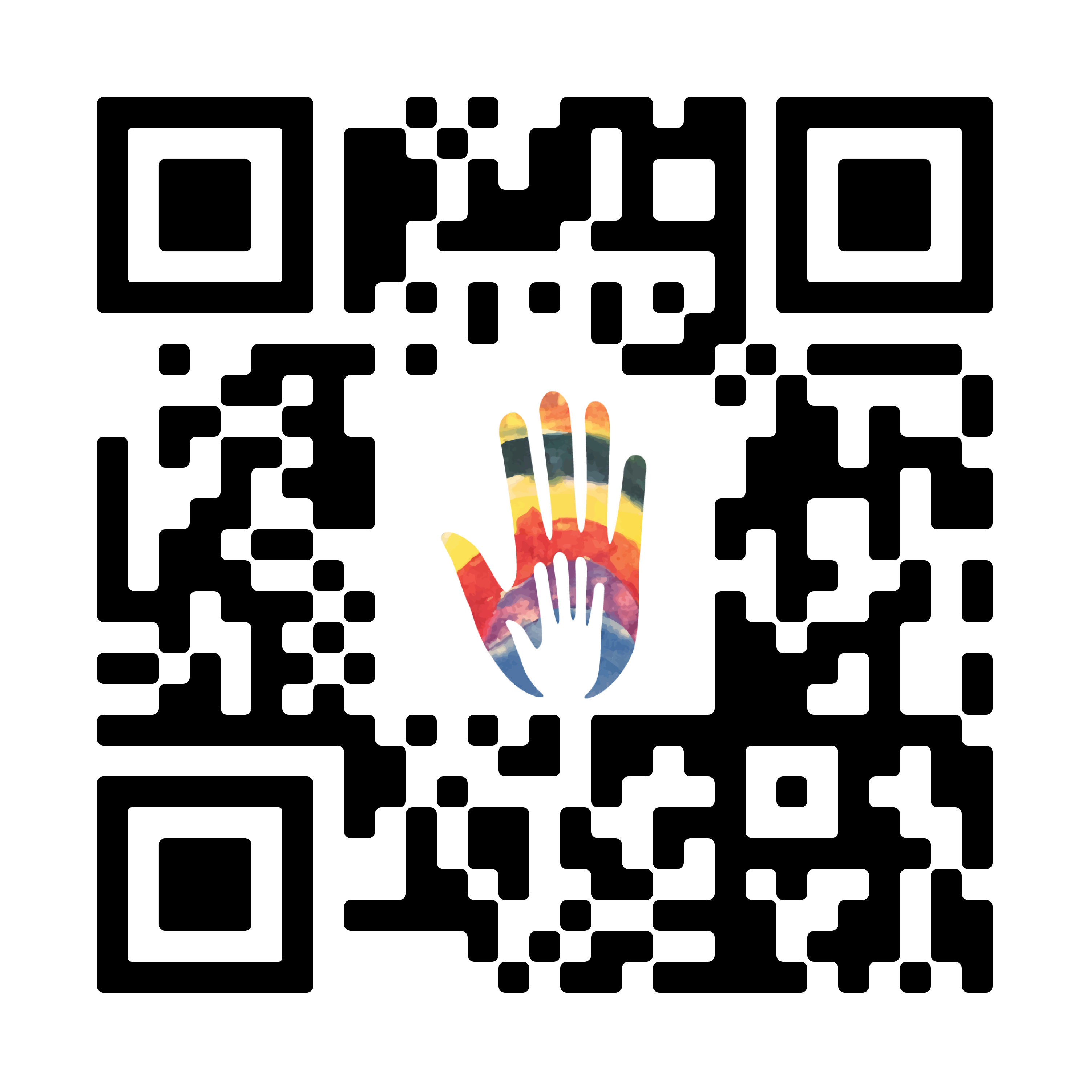
Interested in school safety?
Reach out!
Tina Eblen, Montana Safe Schools Center
  christina.eblen@mso.umt.edu
Michele Henson, School Safety Program Manger OPI
  michele.henson@mt.gov or 406-595-1058
Please use the QR code and give us your feedback! We value your thoughts and opinions.

