Slide 1
STRENGTH-BASED SOCIAL EMOTIONAL LEARNING FOR ADULTS
KATE STETZNER
LEADERSHIP COACH
Notes:
How are you feeling right now? Share Teachers are asked repeatedly to provide adult support so students can function in school. My current trauma. Pandemic has changed the way we view our “system” Chance for us to face our own SEL capacity and be part of building supportive relationships Look at the trauma facing educators and families today. Covid, systemic racism, economic problems, climate change---teaching are ramping up to digital and or hybrid learning.

Slide 2
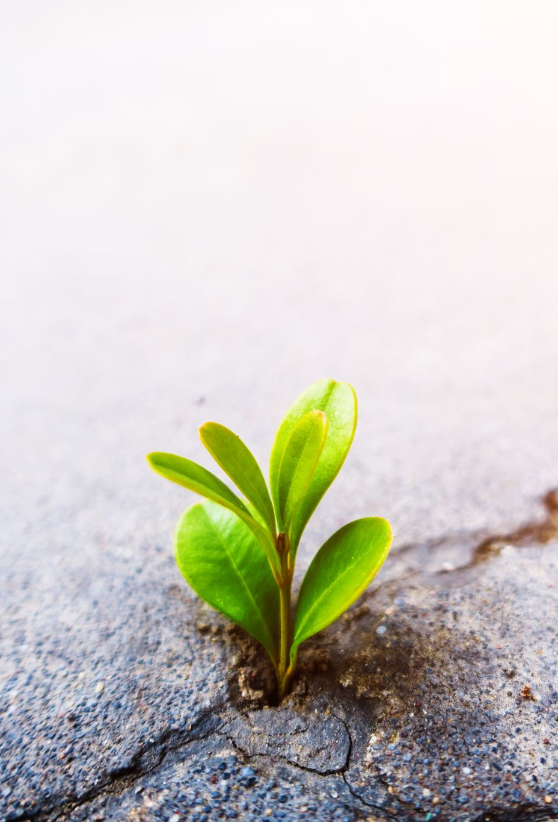
Our Time Together
Strength-Based SEL for Adults
Crisis, Change, and How to Lead as a teacher, administrator, or paraprofessional
Systemic support of Strength-Based SEL
Activities to reinforce Strength-Based SEL
Notes:
Interactive agenda – link interactive agenda

Slide 3
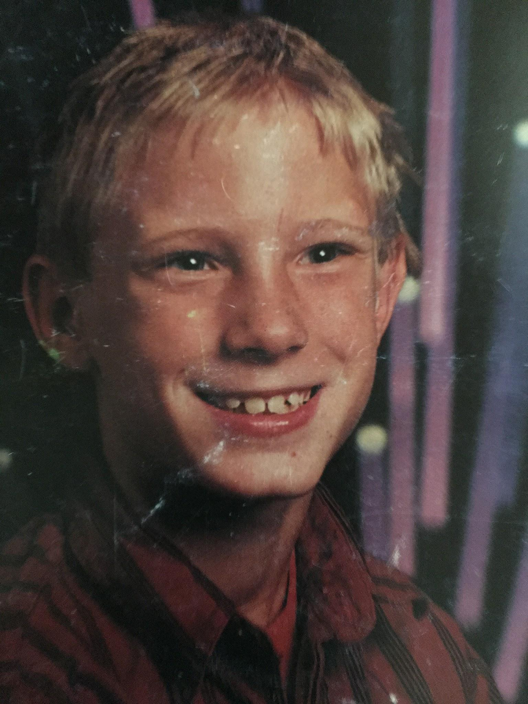
You’re It!
Crisis, Change, and How to Lead When It Matters!
Learn to practices our values.
*review list
+individually list 10 top values
*reduce your list to 5 top values
*reduce your list to your 3 top values
*take 5 minutes each in your group to discuss your top value
Notes:
What a beautiful face!
Core Values activator. List of core values From Brene Brown - Dare to Lead.

Slide 4
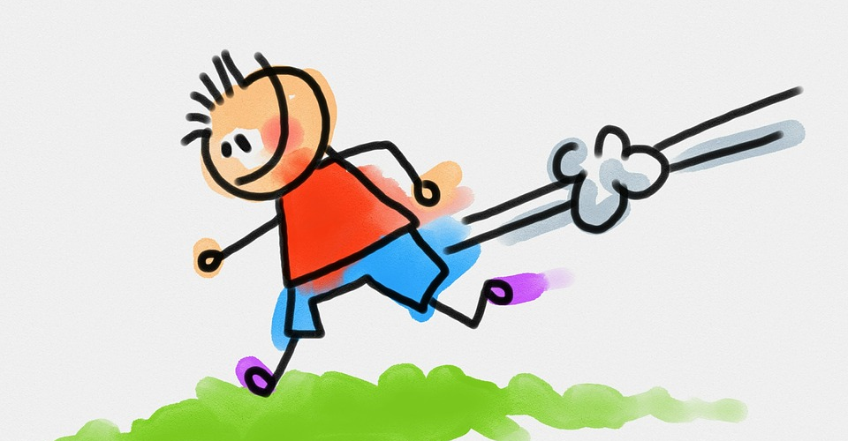
Notes:
Your It! As a kid this was the designation in a game of tag. You ran to avoid getting tagged. You moved fast. What happened when you became it? Your perspective changed, your view of others changed and your strategy changed. You are suddenly the center of attention. You can be it by virtue of title “teacher” etc. Adult SEL Who do you lead? For your students you are it. To lead is defined by not by command and management. It is defined through behavior and attitude, not role or rank. Question. Describe a situation when you were “it”. Describe a situation when someone else was “it”. What does that memory mean to you?

Slide 5


What does this picture remind you of?
Notes:
Kate
What does this picture remind you of? Add teamwork picture of boat rowing – how does this relate to your current work. How are you going to ensure that you have all voices heard. Equity, Inclusionary Practices added to school goals, Integrate SEL into all academics. Not a siloed.
Add picture of teamwork – todays focus is on strength based adult SEL.
We cannot do the same way as we did before the pandemic. Include all stakeholders, Trauma and pandemic
All is the same boat but going different directions –
SEL training – different silos and how do we bring it together as a cohesive system and collaboration as team to ensure strong relationships to support a strength based approach to SEL.

Slide 6
“During a time when many students and adults have experienced some form of trauma, even a single nurturing personal connection can work to reverse the negative aspects of trauma.”
Notes:
Trauma of returning from a pandemic – most of the traumatic incidents are one –time events (hurricane, 9-11, etc.) This is an entire different set of resources to support the SEL – every student and educator will be affected in some way. Need to prepare for this in a systemic way and begin preparing for this year. Recovery ESSR funds! Time to listen to people instead of numbers and test scores. Street Data Top down support for bottom up reformation.

Slide 7
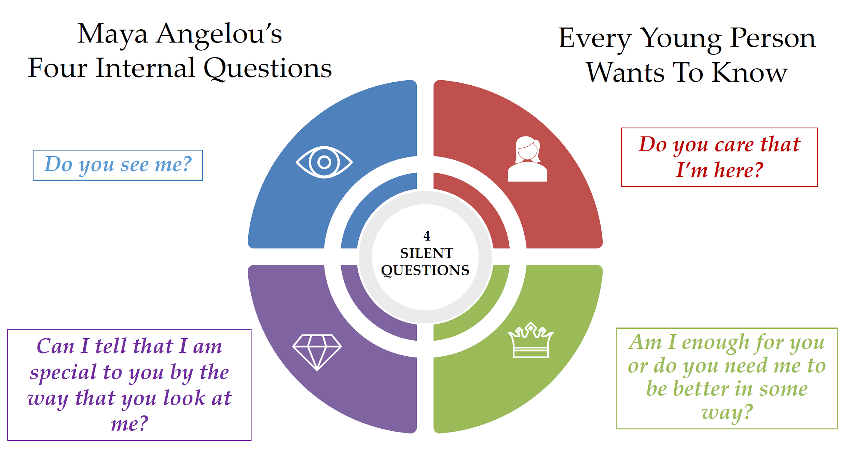
Notes:
Kate
This is from a student’s lens – always front and center- think about these questions for yourself
I may not remember what you said, but I will always remember how you made me feel.

Slide 8

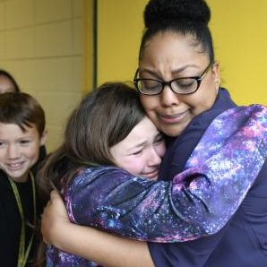
SEL Standards
SEL Standards
Relationships
Notes:
Coaching for Equity- Muhammad
Foundation – relationships , frame standards, finish work - how you create your own custom designed systems – determines what my climate and culture is and how intentional goal settings can change the trajectory.

Slide 9
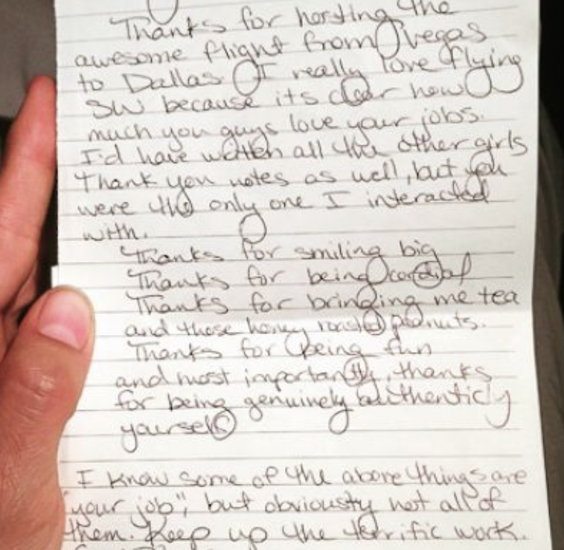
Think of a special note you received during your education career that had an impact on you.
Notes:
Kate
Share out as a whole group – what impact did that note have on you? Antiracism is part of inclusion. Native Americans, families deserve to be part of the process. Not telling them what to do but allowing them to make decisions with you. Look at the DATA - adult attendance- do you have marginalized members of your own staff! Do you feel supported?

Slide 10
The Systems of Strength-Based SEL Relationships Strength-Based Hope
Student - Adult Relationships
Mentors – students are connected to a caring adult outside of family
Peer - Peer Relationships
Values Everyone – students are encouraged to recognize the value each person contributes regardless of their differences, culture, or beliefs
School - Family Relationships
Empathy – schools focus on understanding the challenges, successes, and stories of their families
School - Community Relationships
Partnerships – build intentional partnerships with city and county leaders and community organizations that provide support in areas that enhance what the school district can provide
Administration - Staff Relationships
Feeling Valued – determine ways in which each and every staff member feels valued and heard
Student - Hopefulness
Hopefulness – schools prioritize time to engage in activities that instill hopefulness for students regarding personal, school, and future (family, home, job they enjoy, etc.) goals
Notes:
RSVP program- proud of it. Adults
Just a reinforcement of what we are often already thinking about. These can’t be siloed they need to be considered as a whole system!

Slide 11
Student - Adult Relationships
Mentors – students are connected to a caring adult outside of family
Peer - Peer Relationships
Values Everyone – students are encouraged to recognize the value each person contributes regardless of their differences, culture, or beliefs
School - Family Relationships
Empathy – schools focus on understanding the challenges, successes, and stories of their families
School - Community Relationships
Partnerships – build intentional partnerships with city and county leaders and community organizations that provide support in areas that enhance what the school district can provide
Administration - Staff Relationships
Feeling Valued – determine ways in which each and every staff member feels valued and heard
Student - Hopefulness
Hopefulness – schools prioritize time to engage in activities that instill hopefulness for students regarding personal, school, and future (family, home, job they enjoy, etc.) goals
Notes:
Hope Science- Improvement Science

Slide 12
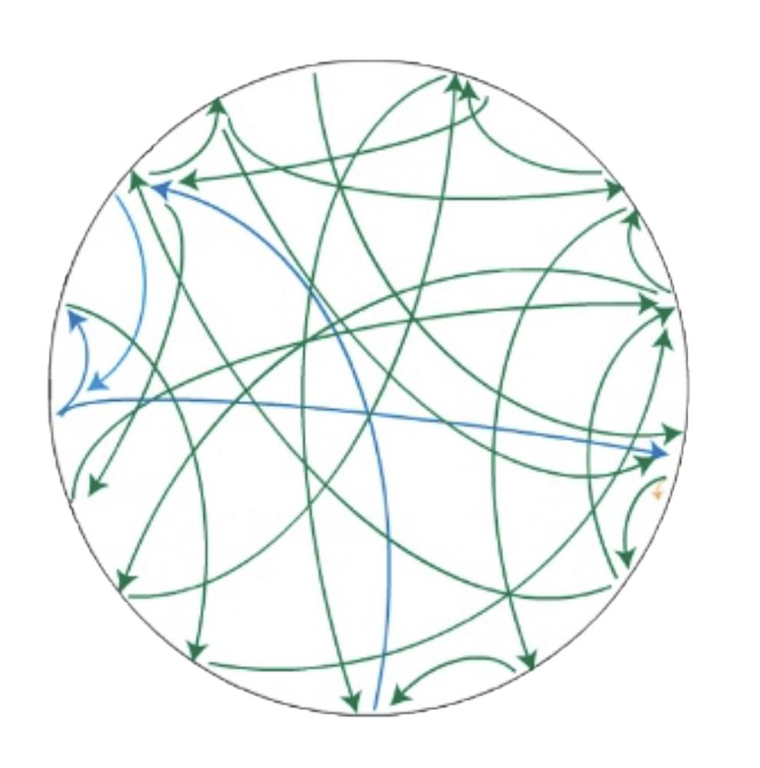
School Systems that Support Strength-
Based SEL
Notes:
All coming back to school from experiencing trauma. Can’t have a “trauma support time” and then go back to business as usual.
Not a program – we do SEL at this time. – how is every aspect of the school intentionally planning to integrate building relationships and elevating the strengths and assets of students? Abuse – work with community partners –
How do you consider the trauma that teachers and principals – districts supporting principals have –
Hour Glass – Where the sand is caught in the center – those are where the principals are.
Type into the chat: What aspects or components of schools do or can support strength-based SEL?
In what ways do these support one another? How are they connected?
Couple people sharing out.

Slide 13
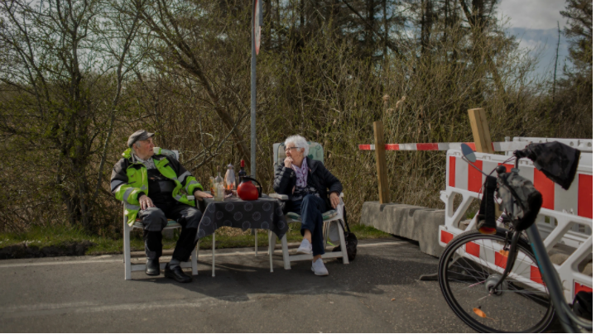
Notes:
Berlin wall photo- from your lens.

Slide 14


Strategy #1: Resilience Meditation
via The Rooted School
GOAL: Building strength and resilience can help you deal with the stress of teaching and managing a classroom. This mindful activity aims to help you become aware of biases and provides a mindful self-awareness meditation that combines self-resilience and positive self-talk to help decrease negativity bias.
INTRODUCTION:
Building strength and resilience can help you deal with the stress of teaching and managing a classroom. Believing that you can ‘bounce back’ or figure out issues goes a long way in supporting mental health.
You can try this meditation once a day or as often as needed to boost your overall resilience.
STEP-BY-STEP TECHNIQUE:
Find a quiet space to sit or lay down. Place your palms face-up on your lap. Close your eyes if it feels comfortable, and begin to breathe deeply, connecting with your breath.
Begin to tap your fingers together, starting with your thumb and pointer, then thumb and middle, and so forth. Take a breath with each tap.
When you are ready, begin tapping on the breath in, and with the breath out, mentally or out loud, say: “I HAVE ____________” and insert something that you have as a support in your life. (For example: I have co-workers that care for me. I have a healthy body. I have a kind heart. I have the ability to change the situation.) Continue until you have tapped to the pinky finger.
For the next round, shift to “I CAN” statements. Continue tapping on the breath in, and with the breath out, express things you can do. (For example: I can choose to answer others with kindness. I can ask for help if needed. I can ask for a moment to formulate my thoughts.) Again, continue until you have tapped your thumb to the pinky finger.
Finally, repeat with the word I AM, tapping on the breath in, and with the breath out, express positive or productive words that support who you are. (For example: I am strong enough to get through this. I am smart enough to figure this out. I am able to change my thoughts or mindset on this subject.) Tap until you reach the pinky finger.
About The Rooted School The mission of The Rooted School is to partner with schools and communities to make mindful social-emotional skills and brain-boosting techniques a part of everyday life as a way to increase academic potential, self-awareness, and resiliency. The Rooted School offers SEL curriculum, a school employee wellness program, and resources for building a stronger home-school connection. Click here to learn more.

Slide 15

Strategy #2: Unpacking Educator Identity
via FuelEd
GOAL: Everyday, educators build relationships with dozens of staff, students, and parents, wearing just as many different hats as coach, parent-figure, counselor, leader, and more. In this activity, learn about the four styles of building relationships (also known as “attachment styles”) and strengthen the way you create relationships while fostering a culture of change in your classroom and school.
MATERIALS: For this exercise, educators can engage independently or with a group. Click here to download the facilitation guide.
INTRODUCTION: Relationships drive learning and yet how much do we really know about our own styles of building relationships, as people and as educators? This exercise will share the science-backed research on relationship styles, also known as attachment styles, so that you can begin to understand yourself and others more.
WHAT IS AN ATTACHMENT STYLE? Attachment styles describe the way we build relationships throughout our lives. The way we relate to both children and adults (i.e. our attachment style) is a manifestation of whether we learned in our earliest childhood relationships to trust others and trust ourselves. While attachment styles are malleable throughout the lifespan, they are predominantly shaped by our earliest relationships with parents or caregivers. When we have secure early relationships with caregivers, we develop a secure attachment style. When we have insecure early relationships with caregivers, we develop an insecure attachment style. While there are two categories of attachment styles (called Secure Attachment and Insecure Attachment), there are actually four distinct styles.
One of these four attachment styles is called secure attachment, and the other three are different types of insecure attachment styles that result from different kinds of early insecure relationships. These insecure attachment styles are called:
Anxious attachment
Avoidant attachment
Disorganized attachment
About FuelEd FuelEd a gap in educator preparation and development by equipping educators with the social and emotional competencies essential for building relationships in schools. Their mission is to develop emotionally-intelligent educators who build relationship-driven schools. Click here to learn more.

Slide 16

Notes:
Adult SEL Just looking back! Do we as educators reflect these same values today! SEL for adults is critical!

