Slide 1

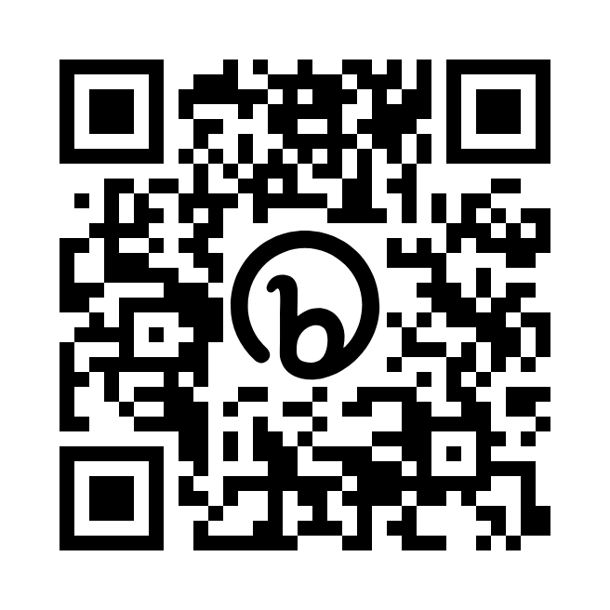
Student Driven Engagement + Voice and Choice = Joyful and Safe Learning Environments
https://bit.ly/safeschoolsummit2023

Slide 2


Hello! I’m...
Ericha Anderson
PBIS Coach (K-5)
Vancouver Public Schools
Vancouver, WA
22,000 students
3,300 teachers
39 Schools - 24 Elementary, 6 Middle School, 5 High School, Art School (6-12), STEM school (6-12), 6 Dual Language Schools (K-5), PBL School (K-5), Home Connections, Virtual Learning Academy
Montana Native
U of M Graduate

Slide 3

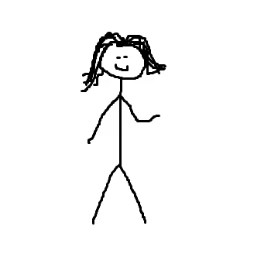
Get a post it note
Find a partner
Draw your partner on your post it note

Slide 4
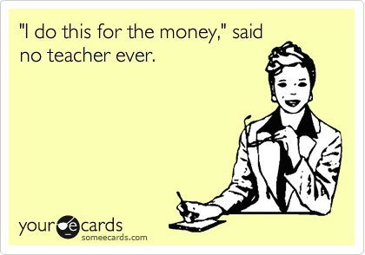
What is your role?
Why did you go into education?
Why do you stay?

Slide 5

What Is Your WHY?
Notes:
Why We Teach

Slide 6
GOALS FOR TODAY…
01
Identify the difference between teacher-driven engagement and student-driven engagement instructional methods.
02
Discuss how project based learning increases student engagement and creates ownership of learning for students.
Explore strategies for giving every student a voice, helping them find their purpose and connection with others, and find joy in being a part of the classroom learning community.
03

Slide 7
A study of Chicago Public Schools found that connectedness between teachers and students was a stronger predictor of students feeling safe within school than the poverty level of students or the crime rate of the neighborhoods where students live.
Research using nationally representative data also suggests that positive student-teacher relationships predict fewer incidences of misbehavior and violence in school.
https://safesupportivelearning.ed.gov/topic-research/engagement
Notes:
Plenty of studies out there give this same information. We know relationships are key, we know PBIS and SEL increase academics and lower behavior problems. How do we create these relationships and also make the learning inviting. Some students are starting to take advantage of the relationships and use them as work avoidance. How do we create an environment where relationships are cultivated and students want to be a part of the learning?
https://safesupportivelearning.ed.gov/topic-research/engagement

Slide 8
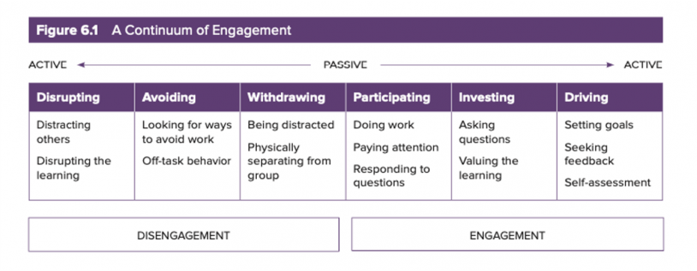
https://www.edthena.com/student-engagement-doug-fisher/
Notes:
Even with relationships in place and SEL strategies taught, many students may still get stuck on the left side of the continuum. Relationships come first, but we can’t move students into the active participation space without also focusing on student-driven engagement methods.

Slide 9
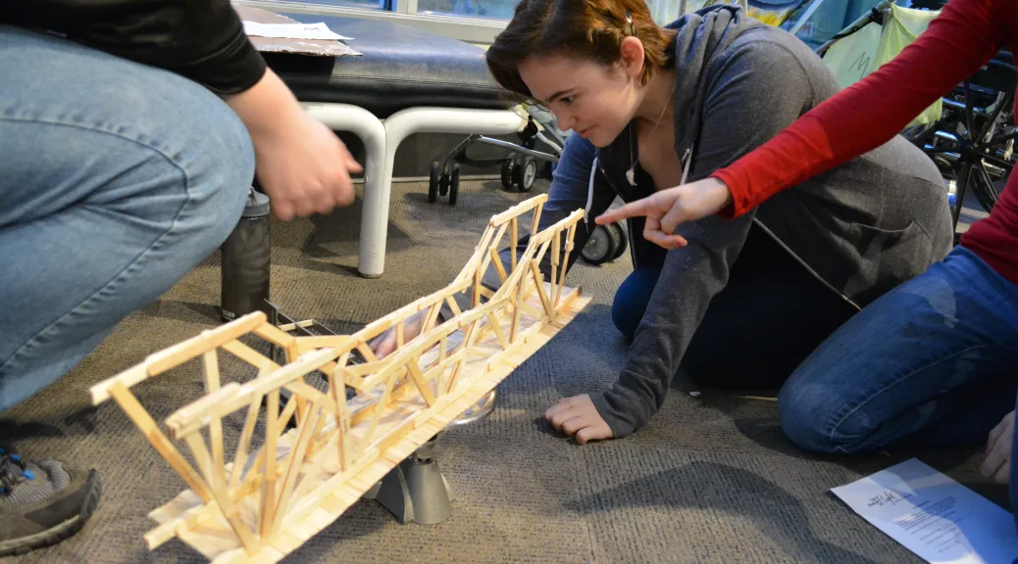

Why Do We Have To?
We Get To…

Slide 10
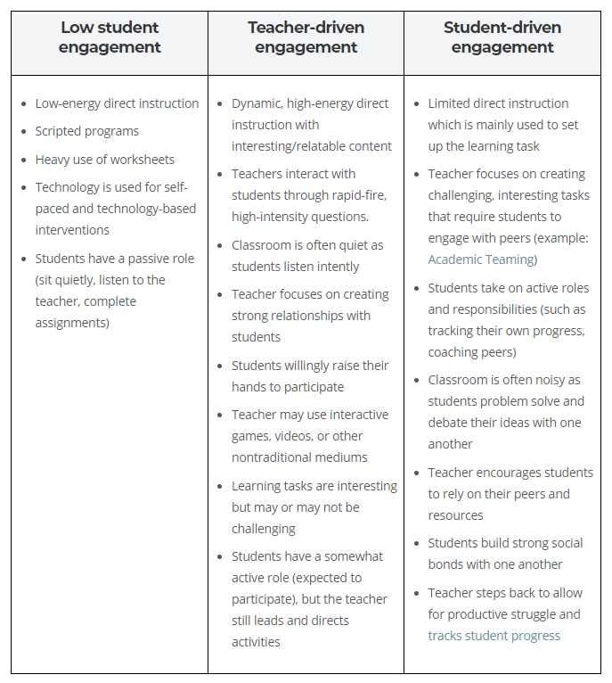
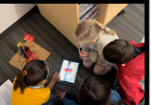
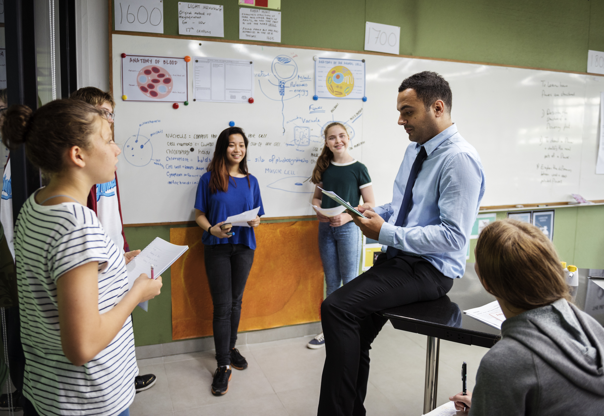
Notes:
But the truth is, student-driven engagement can be much more effective. These methods focus on creating challenging learning tasks and giving students the roles, responsibilities, and collaborative structures to engage in these tasks with their peers. Engagement comes from peer interactions and the challenge of the tasks, rather than primarily from interactions with the teacher.

Slide 11
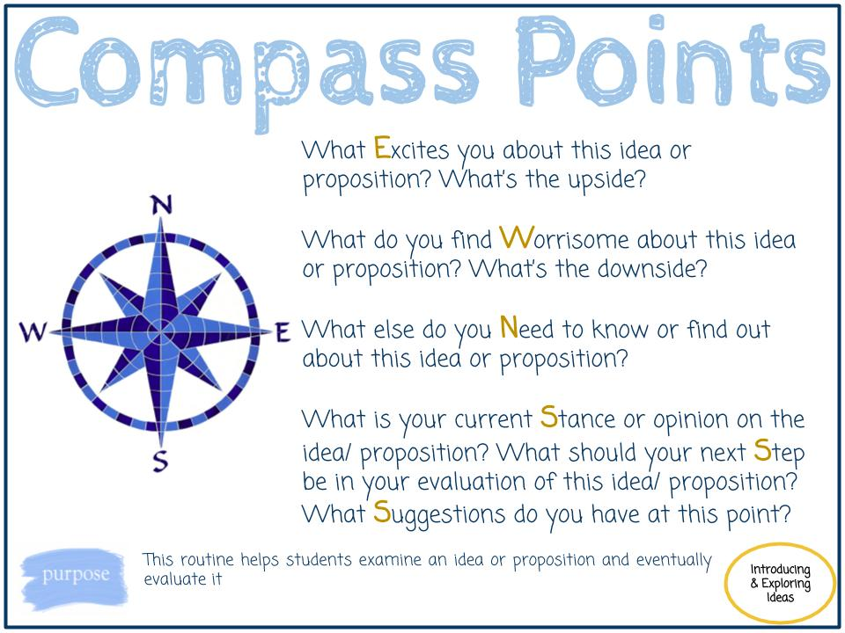


Slide 12
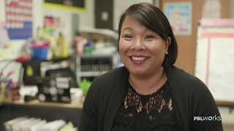

Slide 13
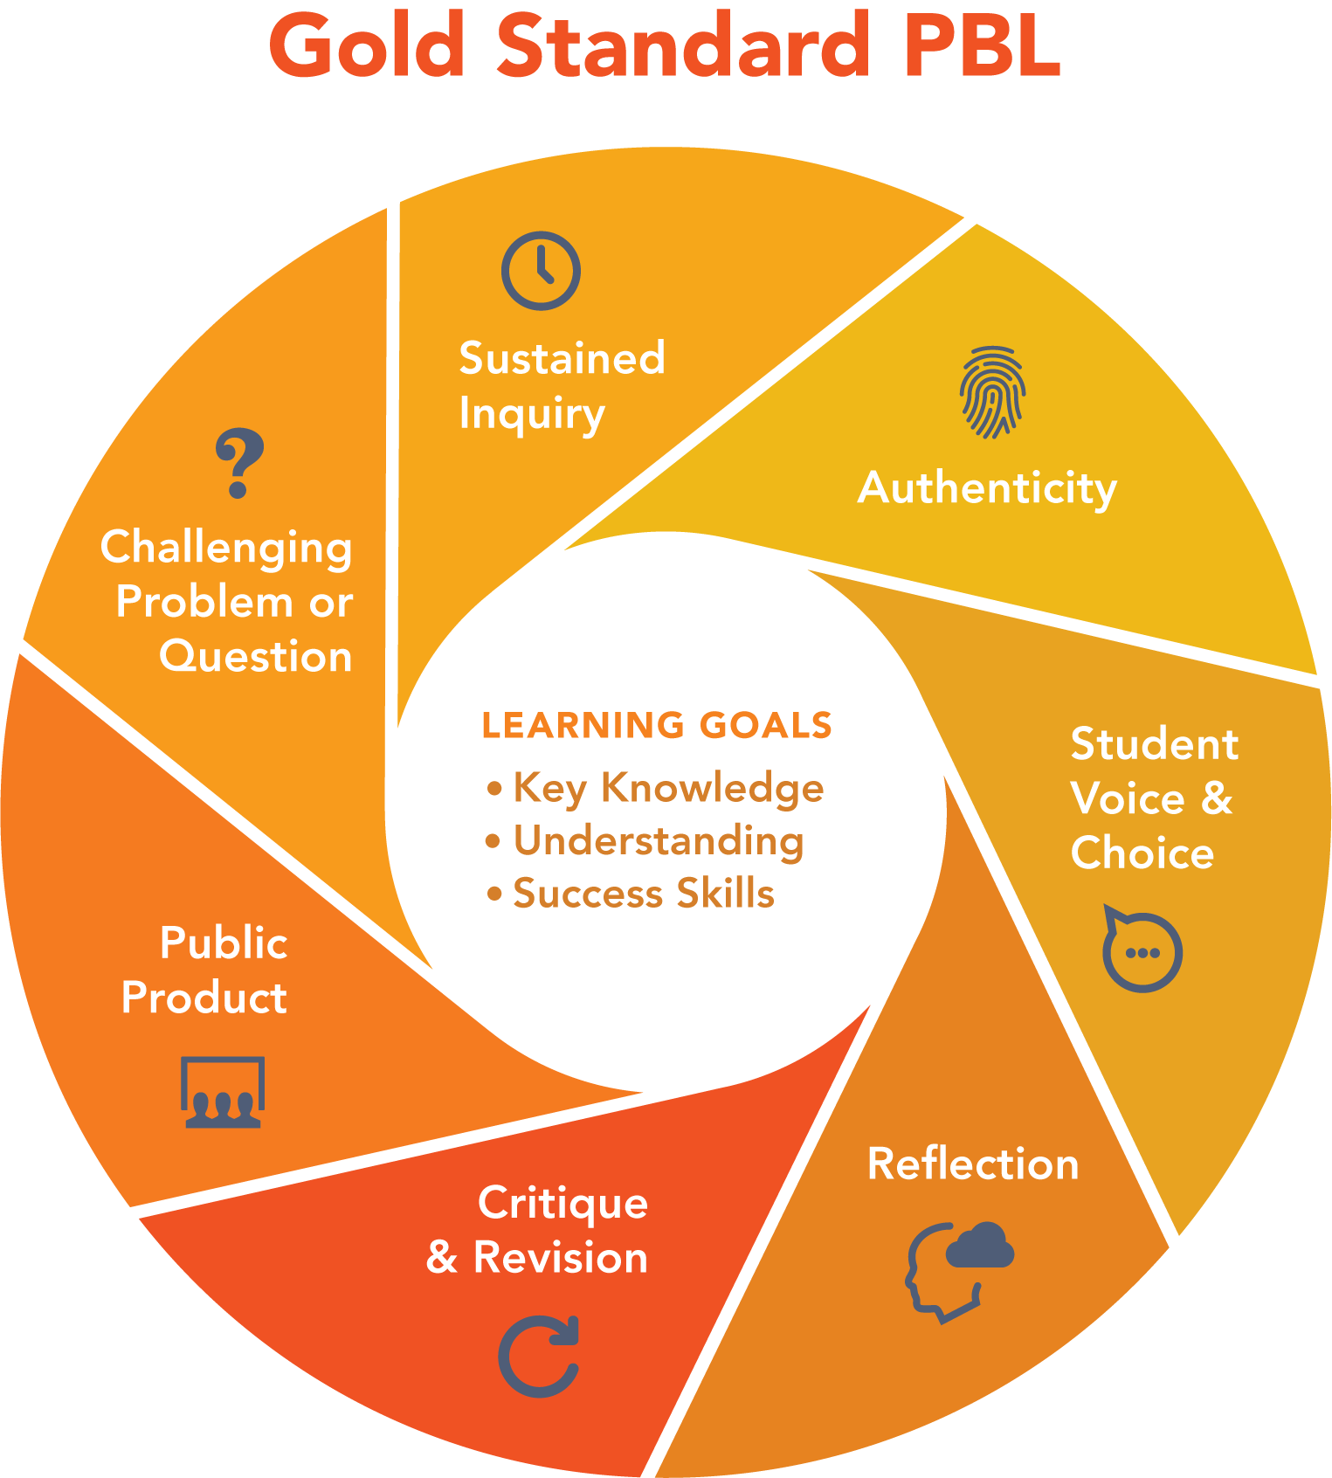


Slide 14

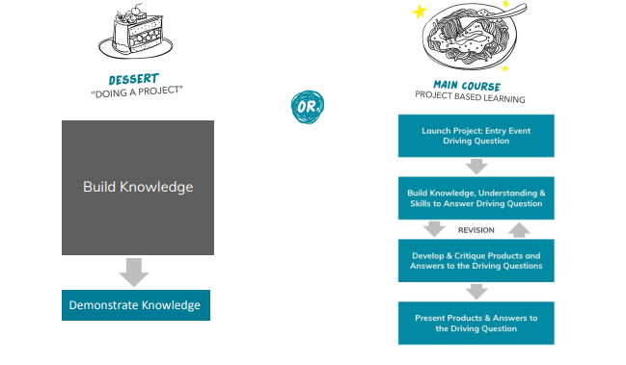
Notes:
Learn about landforms in the state of WA and create a salt dough map. Hands-on yes. PBL no. Same product. Where is the thinking? Why are kids not invested? Main Course: How can we help our community prepare for a natural disaster such as a flood, landslide, or earthquake? Students will still learn about landforms in their area. Why are they more engaged and invested? Will their products be the same?

Slide 15
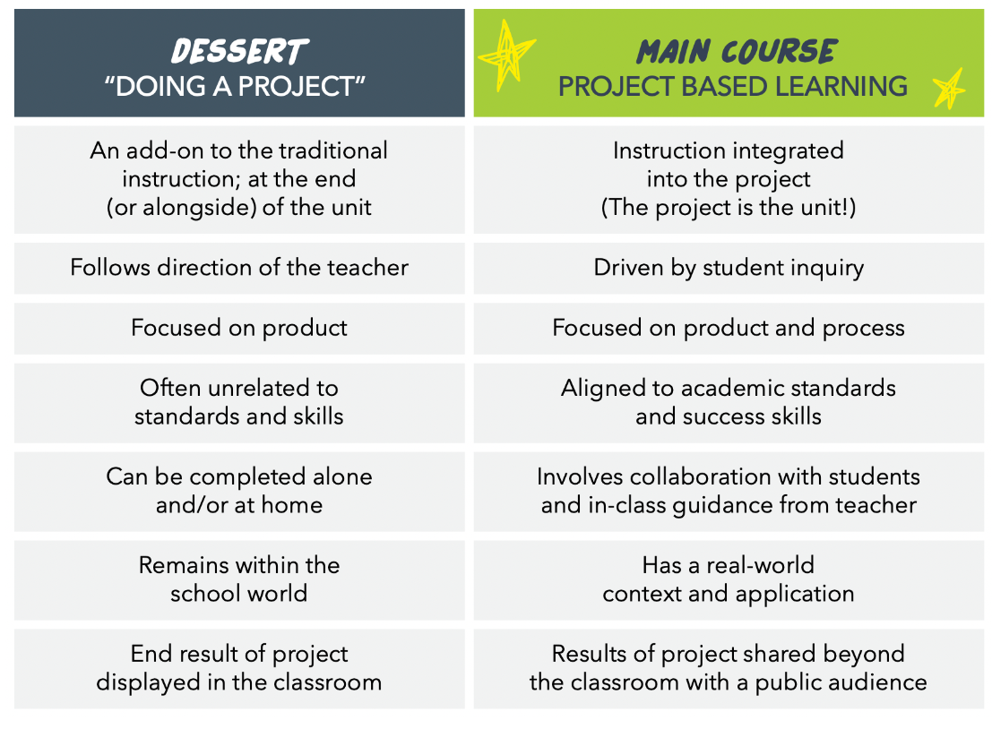
Notes:
Look at the chart. Where did you see examples of PBL as a main course in the video we watched?

Slide 16
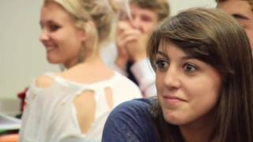
Entry Events
A good entry event captures both heads and hearts.
Activate prior knowledge
Generate excitement
Invites inquiry
Real world connection
Notes:
An interesting problem creates cognitive dissonance while an empathetic situation generates an emotional perspective to the issue at hand. Different students will react more strongly to each, so including both engages more students into the project.Entry events can include simulations, inspiring videos, field work, guest speakers, a controversial article, open-ended science experiments, or a puzzling problem.

Slide 17
Driving Question
A good driving question meets the following criteria…
Engaging for students. It is understandable and interesting to students, and it provokes further questions and focuses their inquiry process.
Open-ended. There are several possible answers, and it cannot simply be Googled.
Aligned with learning goals. To answer it, students will need to learn the targeted content and skills.
― Irene M. Pepperberg

Slide 18
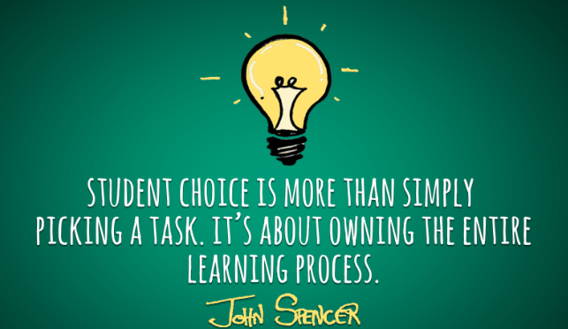
Voice and Choice
“We have to stop doing school to kids. Make it more about what they care about.” Mike Kaechele, PBLWorks National Faculty
Notes:
to meet the challenges facing the world today and in the future, we‘re going to need leaders and problem-solvers who will take initiative. Schools can help create these citizens by letting kids explore what matters to them – when given voice and choice in PBL – and teaching them how to tackle real-world problems.

Slide 19
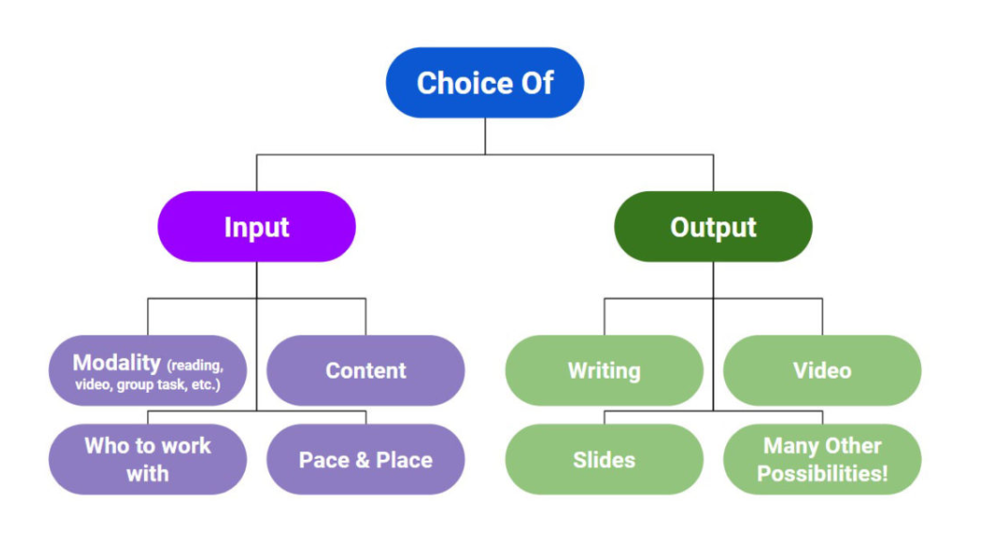
Voice and Choice
Notes:
Consider the purpose of giving students voice and choice; why are you offering it? Would it be done in a comparable real-world project? Don’t offer it just because they ask or it’s what you think you’re “supposed to do” in PBL.
Voice and choice should be limited at times, just like in the real world, where we often work under constraints. For example, adults can’t always choose their own work groups. Or think of an architect who is constrained by budgets, building codes, location, and client preferences.
Too much choice can be paralyzing for students, so provide scaffolding. Especially for students who are new to PBL, some structure is needed, and you can always given them more freedom. For example, instead of allowing totally wide-open choice of products in a project, have them pick from a list.
Create a list of product options with students, so they won’t feel like they’re being over-directed by the teacher. And as Jennifer noted, the divergent thinkers in your class will come up with 15 options you had not thought of! (Mike said he sometimes tells students what they can’t do – e.g., “no slide presentations” if they’ve become too common.)
Consider the purpose of giving students voice and choice; why are you offering it? Would it be done in a comparable real-world project? Don’t offer it just because they ask or it’s what you think you’re “supposed to do” in PBL.
Voice and choice should be limited at times, just like in the real world, where we often work under constraints. For example, adults can’t always choose their own work groups. Or think of an architect who is constrained by budgets, building codes, location, and client preferences.
Too much choice can be paralyzing for students, so provide scaffolding. Especially for students who are new to PBL, some structure is needed, and you can always given them more freedom. For example, instead of allowing totally wide-open choice of products in a project, have them pick from a list.
Create a list of product options with students, so they won’t feel like they’re being over-directed by the teacher. And as Jennifer noted, the divergent thinkers in your class will come up with 15 options you had not thought of! (Mike said he sometimes tells students what they can’t do – e.g., “no slide presentations” if they’ve become too common.)
Find out what your students are interested in; conduct a survey or inventory at the beginning of the year.
Find out what your students are interested in; conduct a survey or inventory at the beginning of the year.

Slide 20
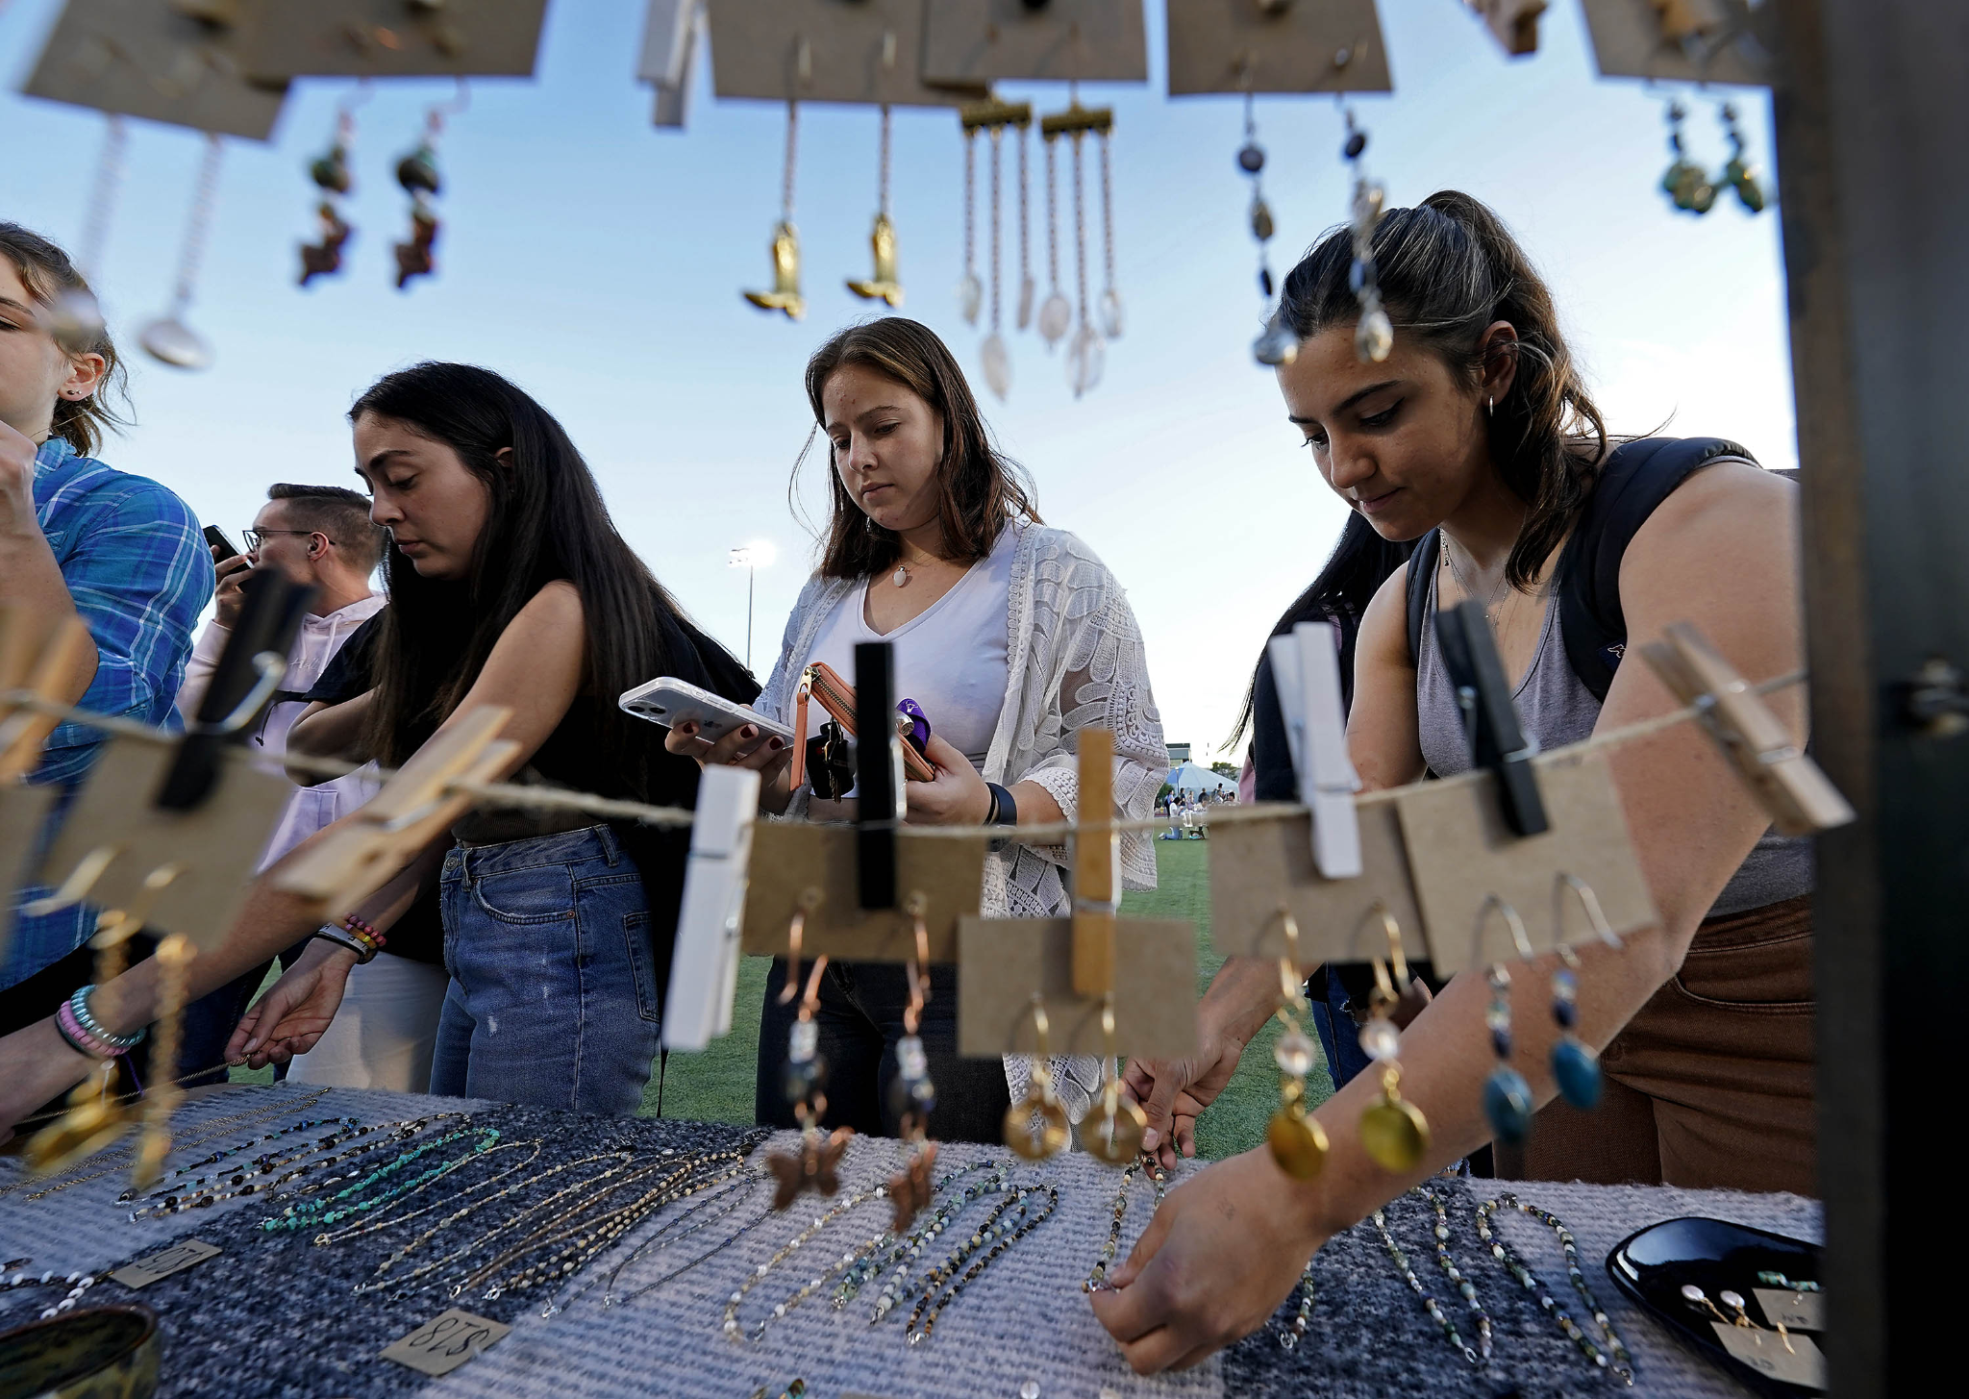
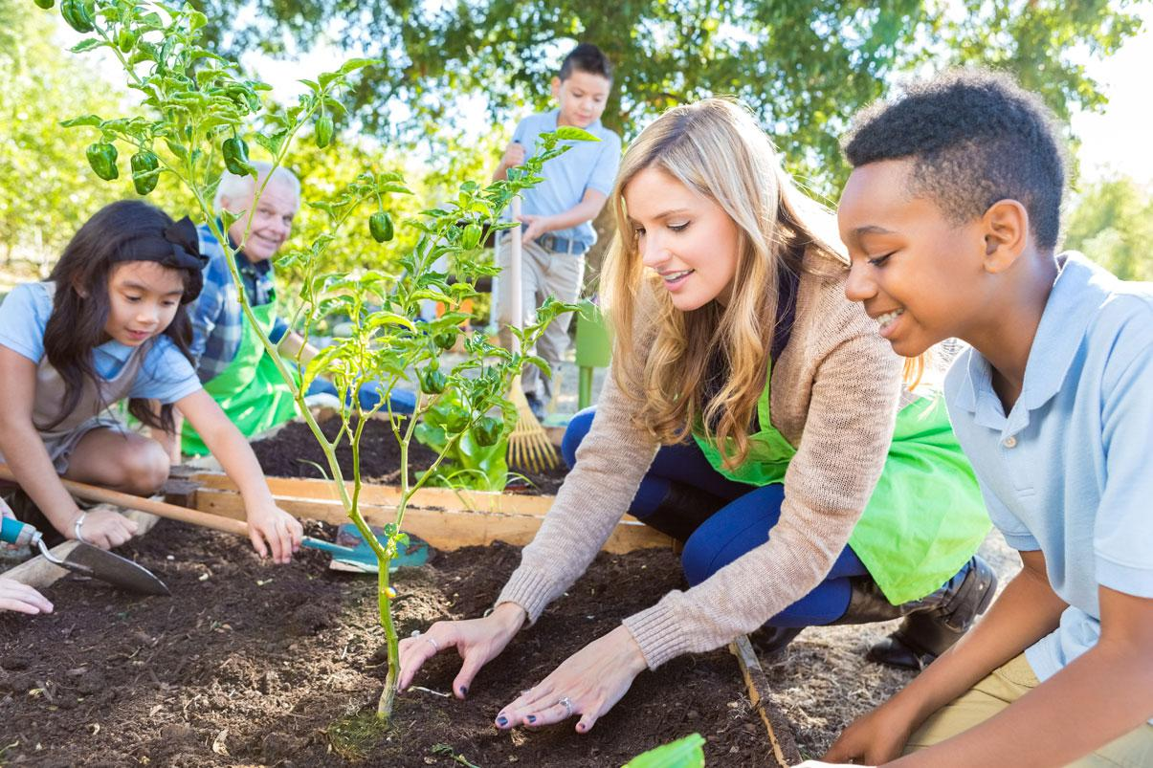
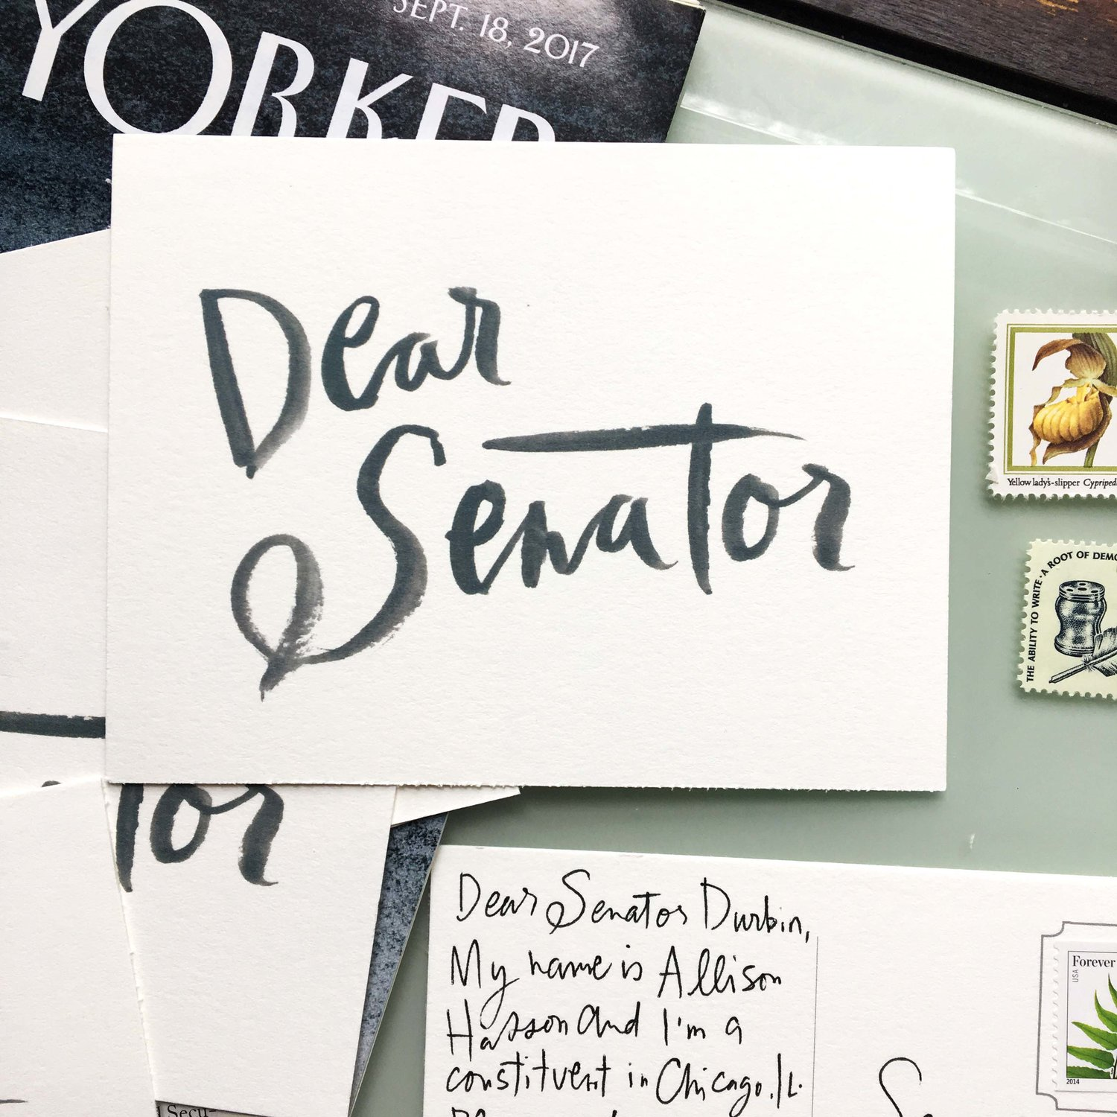
Public Product
Notes:
Student ownership, ups the stakes, students can see the impact they have. What are some other ways to create public products? Maybe write, slap, pass if time?

Slide 21
Public Products
Create a website
Engineer a model
Write a song
Interactive exhibit
Photo journal
Mural
Gallery
Market a product
Video tutorial
Podcast
Letter to government leaders
Documentary
Campaign poster
Create a map
Write a petition

Slide 22
Driving Question? How can we help new friends feel welcome in our neighborhood?
Standards
SSS3: Deliberates public issues.
Knows that there are many ideas, issues, and conflicts going on in the world around one and can listen in order to understand the different points of view and use one’s own voice to enact change.
R17: Break It Down
Draw on information from multiple print or digital sources, demonstrating the ability to locate an answer to a question quickly or to solve a problem efficiently.
SL4: Presenting Information
Present information, findings, and supporting evidence such that listeners can follow the line of reasoning and the organization, development, and style are appropriate to task, purpose, and audience.
Notes:
You all are now going to participate in a student driven PBL activity

Slide 23

Entry Event

Slide 24
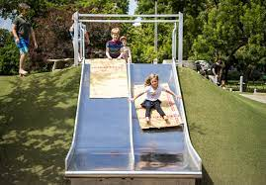
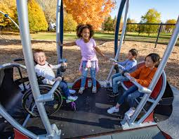
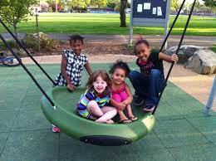
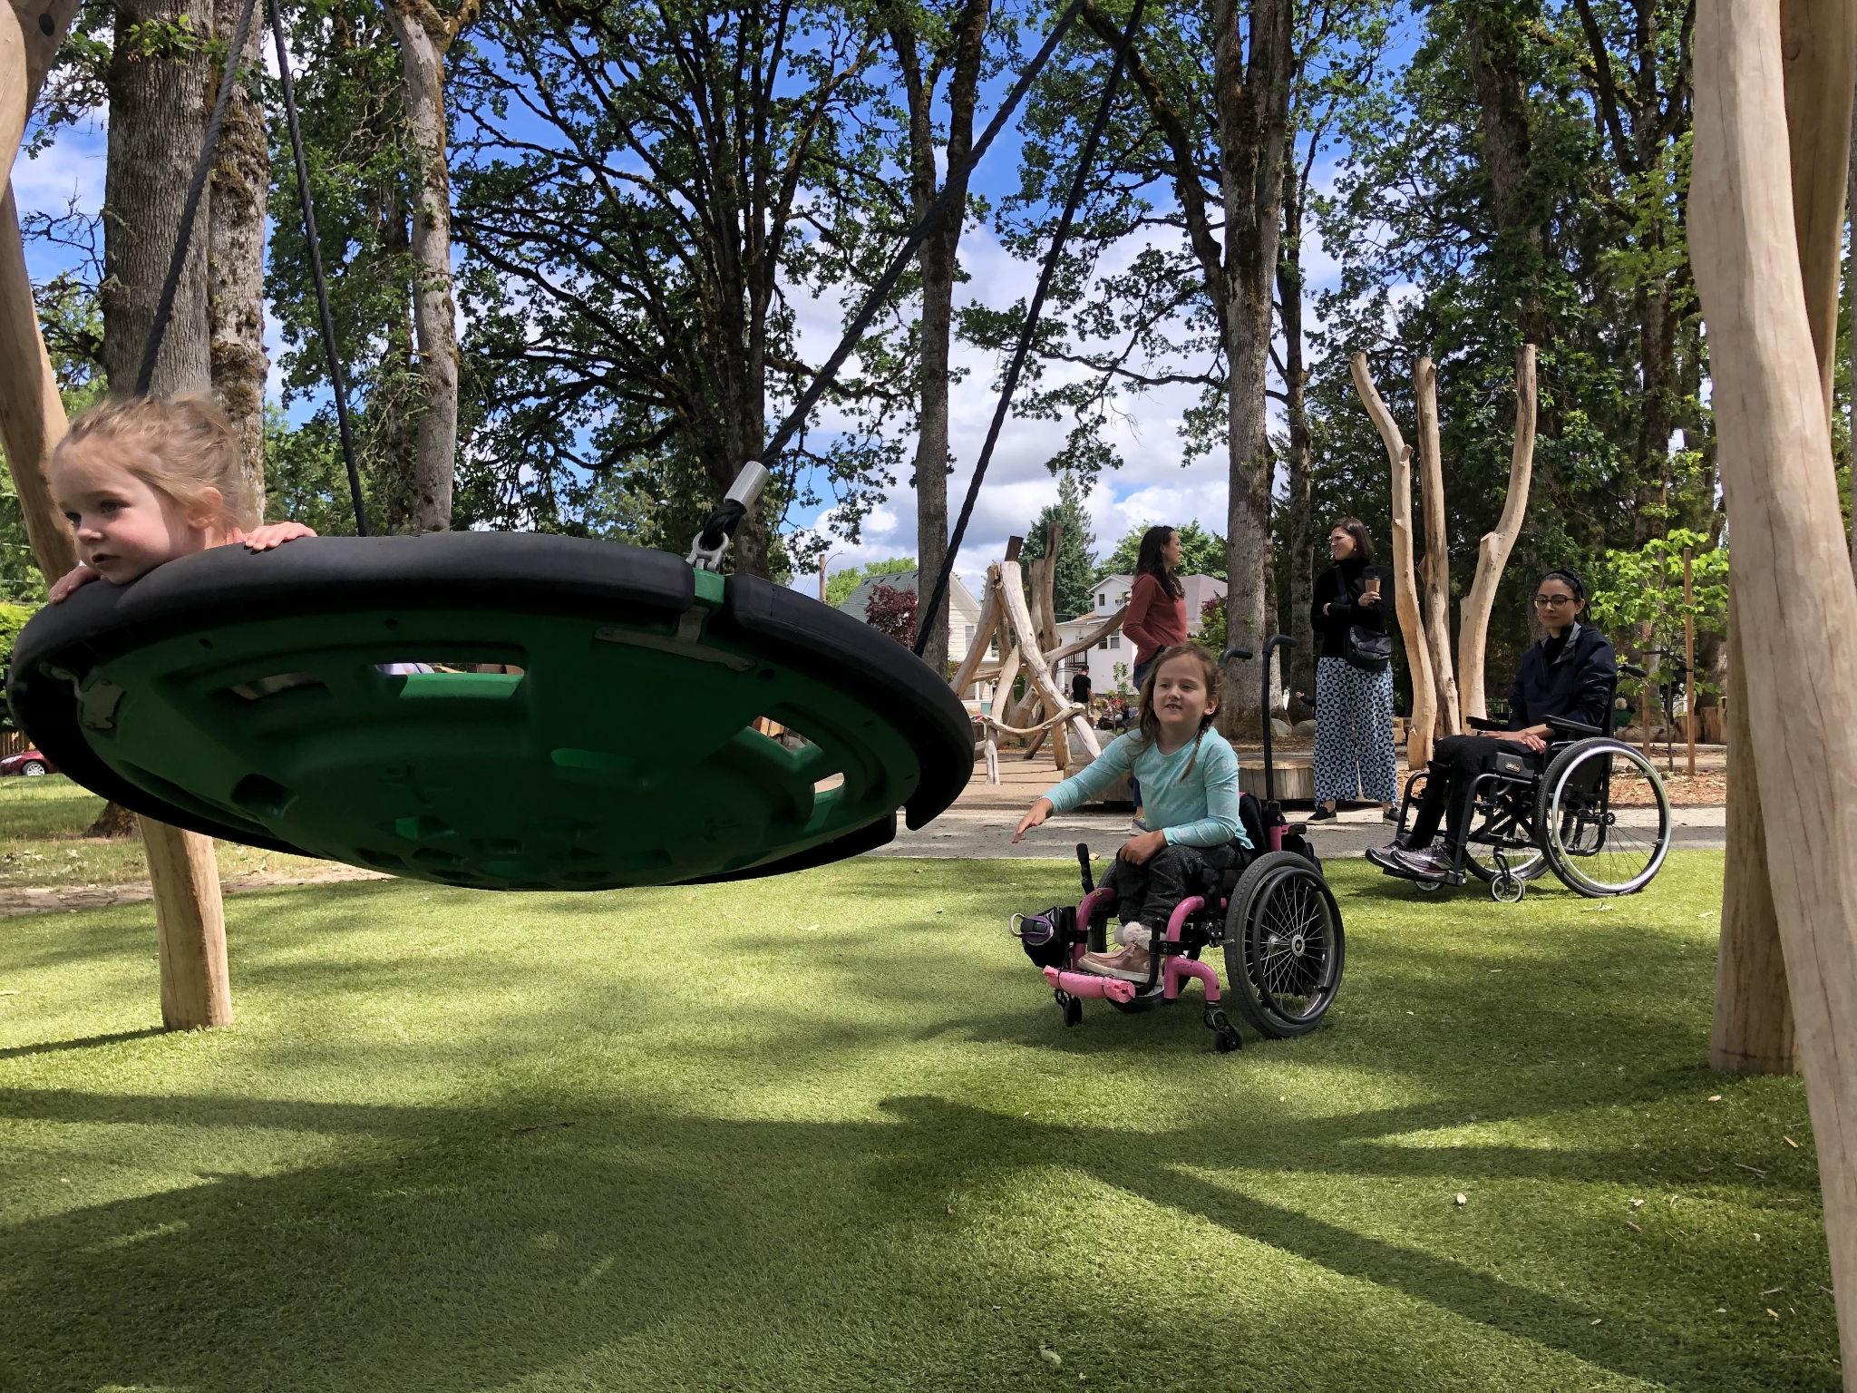
Playground Challenge
A new playground is being built and they have asked your team to design one accessible structure for the new playground.
Your job is to plan, design, and build one playground structure using the materials provided in your bag to present to the construction crew.

Slide 25

Playground Challenge
Work in teams of 3-4
Design and create your accessible equipment prototype
Discuss your equipment’s unique features and how it helps new friends feel welcome
Plan how you will present this new design to the construction crew.
Prepare your presentation

Slide 26
Your Voice Your Choice
Team
Team
Team
Team
Notes:
Discuss how students would generate the teams based on what they see is needed for this park. Students may form teams and then choose which equipment to build or choose the equipment in order to form the team.

Slide 27
Your Voice Your Choice
Team
Team
Team
Team
Notes:
Discuss how students would generate the teams based on what they see is needed for this park. Students may form teams and then choose which equipment to build or choose the equipment in order to form the team.

Slide 28
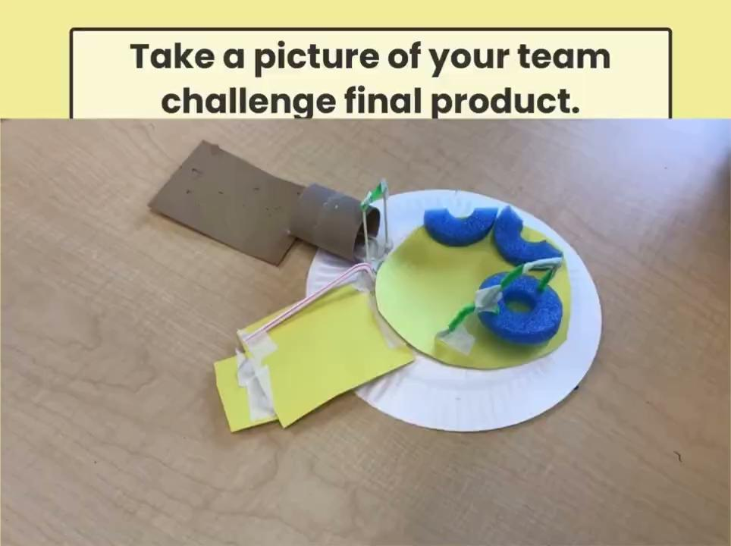


Slide 29
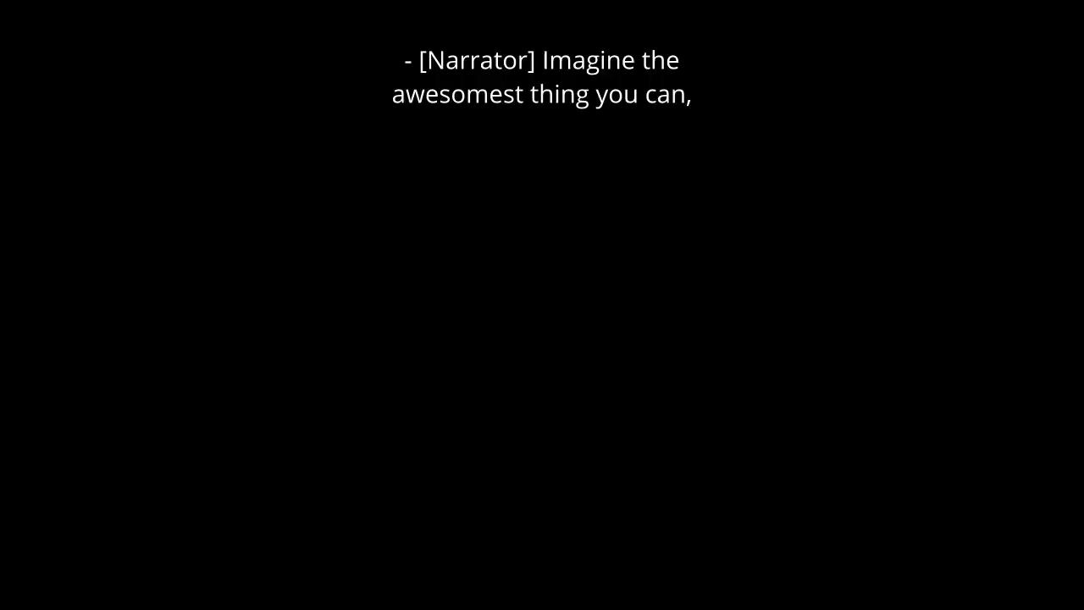

Slide 30
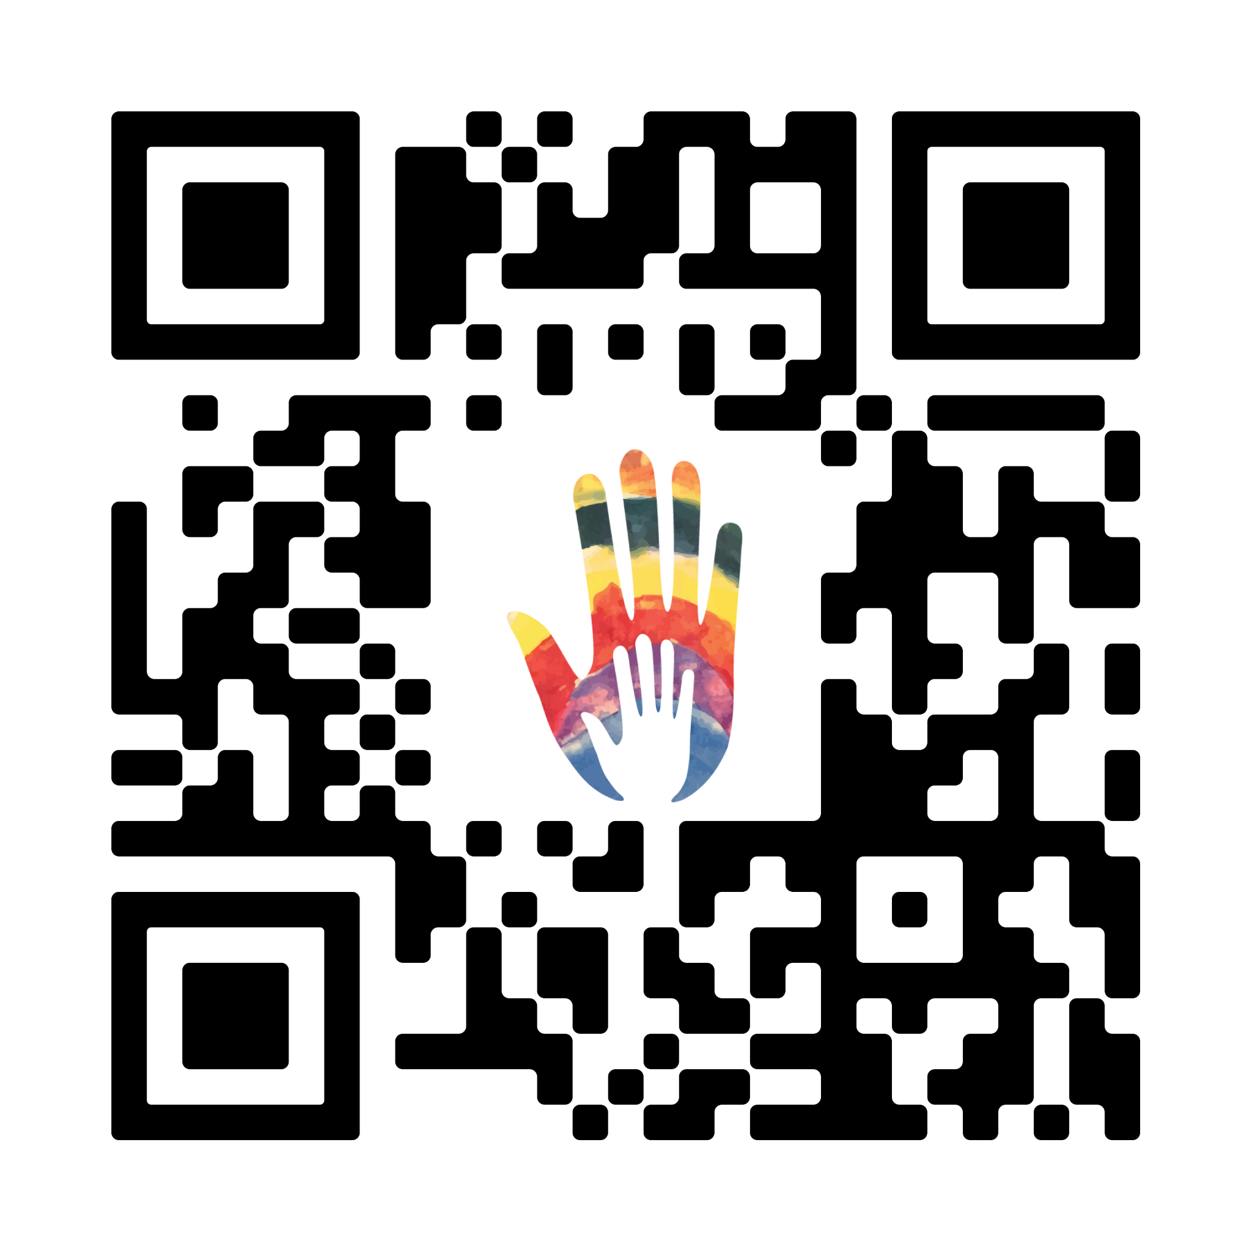

Session Survey
Please help us keep the things you love and find areas of improvement by filling out this quick survey.
We appreciate you and your thoughtful feedback!

Slide 31
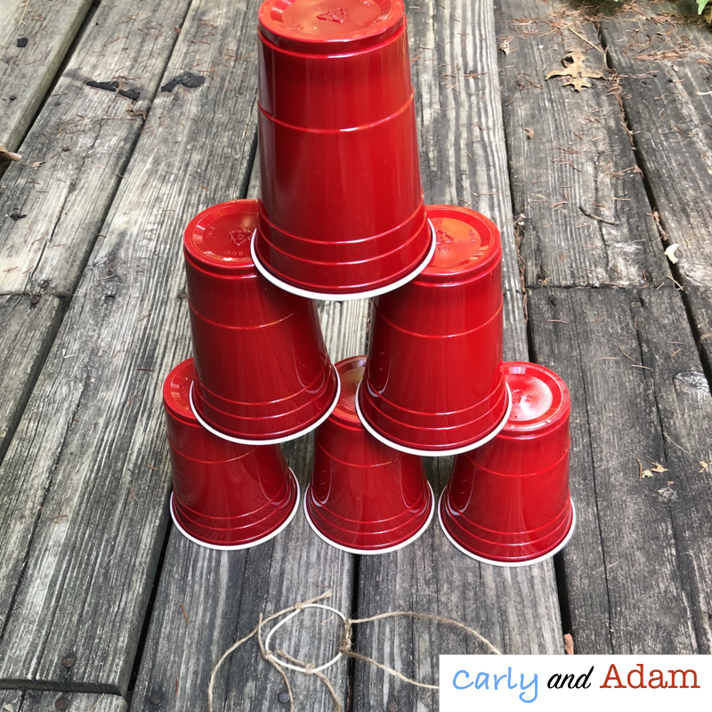

Pyramid Challenge
Work in teams of 3-4
Build a pyramid with 6 cups using only the string and rubberband to touch the cups. NO HANDS!

Slide 32
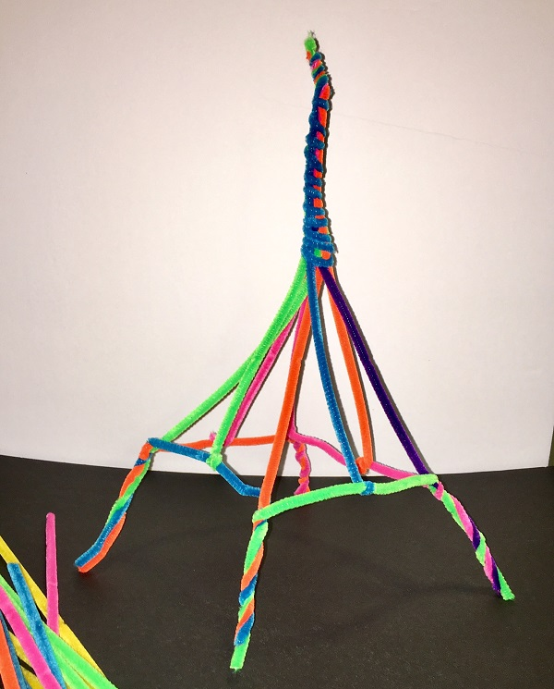
Tower Challenge
Work in teams of 3-4
Build the tallest free standing tower that you can with 12 pipe cleaners.

Slide 33
Quizlet Live

