Slide 1
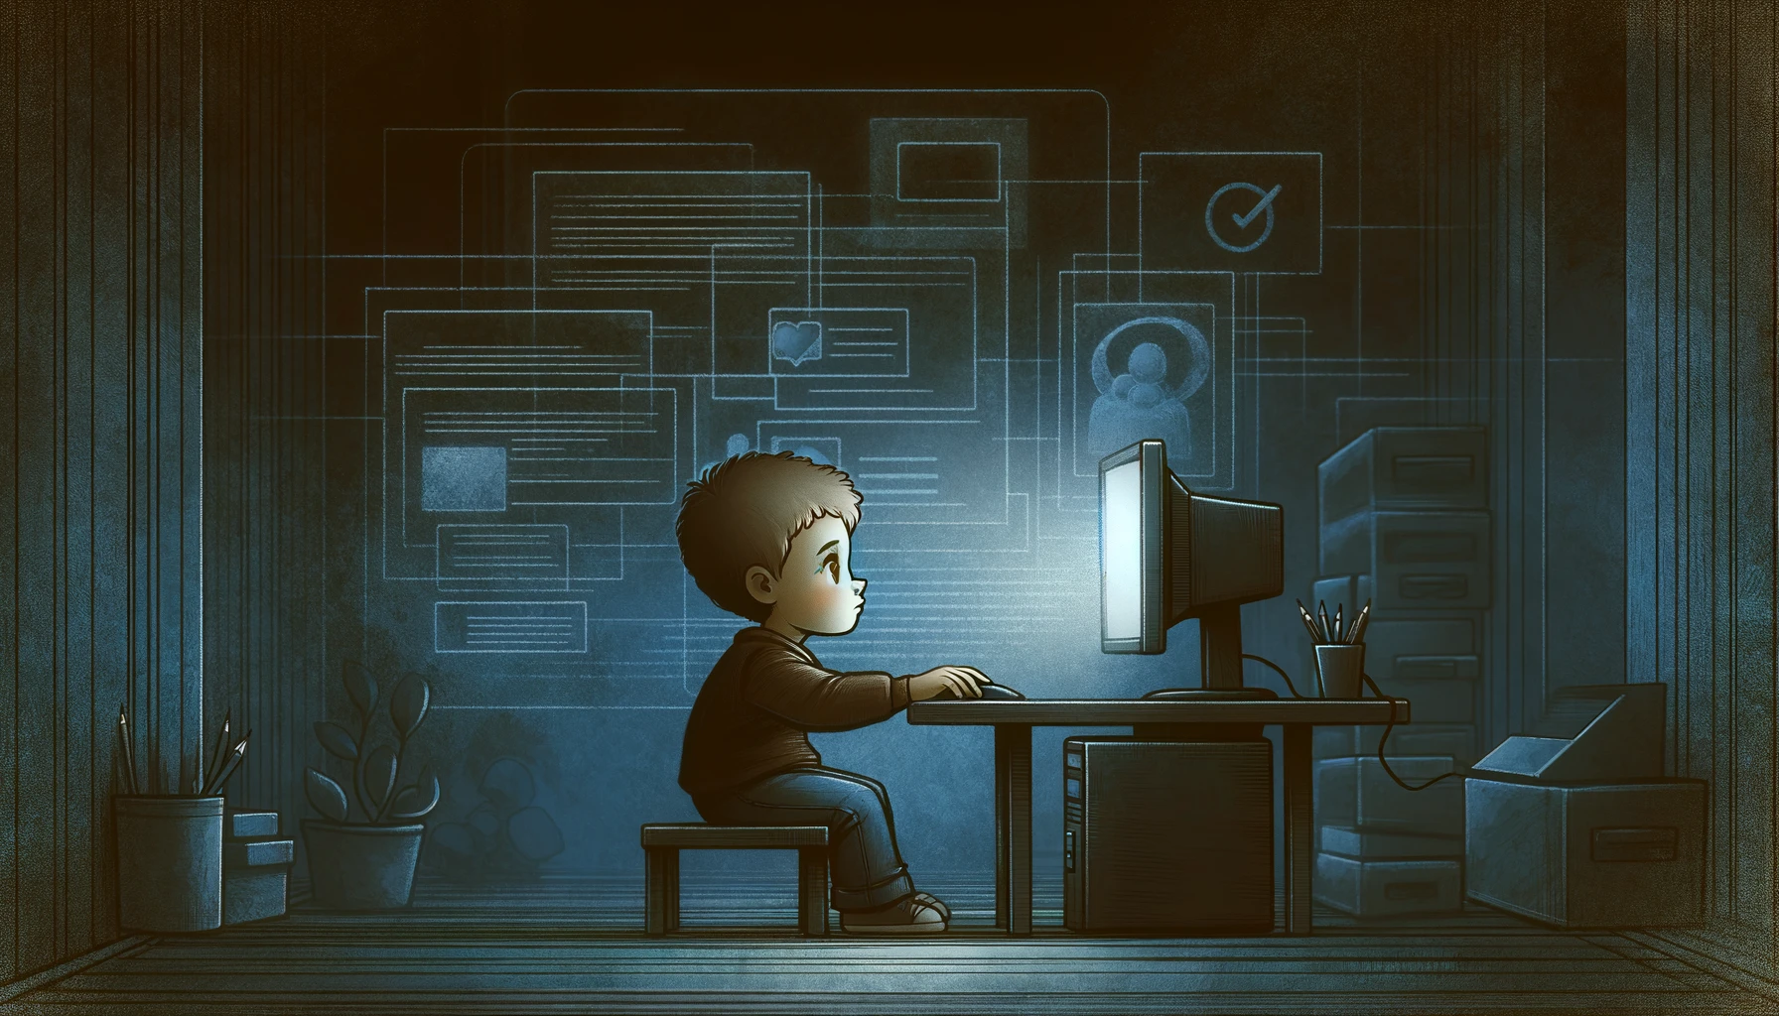

Technology, Trauma, and Teens
Montana ICAC Task Force
Agent David Humphries
Agent Cody Donahue
Montana Department of Justice
Division of Criminal Investigation

Slide 2




Who am I?
Attended Sheridan College (A.A.S) and then went on to Chadron State College (B.S)
Started in law enforcement as a Deputy in Toole County Montana in 2010.
Came to Yellowstone County as a Deputy and then transitioned into the Detective Division.
Became certified in cell phone extractions and began working mainly crimes against children. Forensic Interviewer, Fire Investigator.
Became a part time TFO with the FBI Child Exploitation and Human Trafficking Task Force. OCE operations
Transitioned to DCI as an ICAC agent in 2025.

Slide 3




Who’s the other guy?
Born in Birmingham, Alabama.
Attended the University of Alabama in pursuit of a bachelor’s degree in computer science.
Dropped out, joined the United States Marine Corps as an Infantry Assaultman.
Worked for Pelham Police Department in Alabama for five years.
Graduated from Faulkner University with a bachelor’s degree in forensic psychology.
Graduated from the University of Alabama at Birmingham with a master’s in management information systems.
Currently here at DCI as a digital forensic examiner and ICAC investigator.

Slide 4
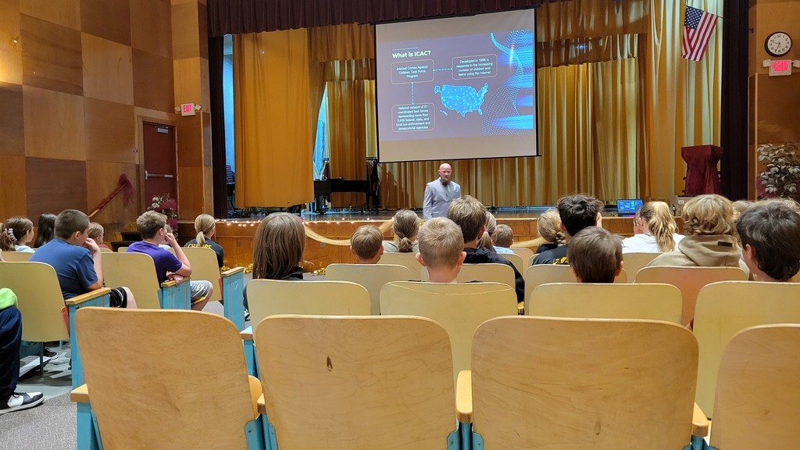
What this presentation is
An overview of Internet Crimes Against Children.
A deep dive on sextortion, and how it can affect you, children, and your community.
Some resources you can turn to if you become a victim of sextortion.
A few examples of how abusers target children.
Some social media concerns and tips.
Potentially a life-saver. Children in this state have committed suicide because of dealing with some of the stuff we are here to talk about.

Slide 5

What do we do with ICAC?
Investigate crimes involving the internet and children.
Proactively enforce State of Montana laws as they pertain to crimes against children.
Planning, execution, and service of search warrants in support of these investigations.
Collect evidence, prepare reports, testify in court, etc.
Retrieve information from computers, mobile devices, and other electronics to support investigations.
Community outreach, such as presentations to schools, parents, teachers, or other organizations.

Slide 6

July 20, 1969
Facts
On July 20, 1969, the Apollo 11 guided Neil Armstrong and Buzz Aldrin across 221,000 miles of space to land humans on the moon for the first time.
A pocket calculator, or even a USB-C charger has more computing power than the computer used to send the Apollo 11 to the moon.
Your smartphones? They could guide 120,000,000 Apollo 11s to the moon at the same time.
Average age a child gets their first smartphone? Seven.
We’re trusting seven-year-olds with supercomputers that have near unlimited internet access.
What happened on this date?

Slide 7
01
02
03
What is ICAC?
How does ICAC work?
Why do we need ICAC?

Slide 8

What is ICAC?
Internet Crimes Against Children Task Force Program
Developed in 1998 in response to the increasing number of children and teens using the internet
National network of 61 coordinated task forces representing more than 5,400 federal, state, and local law enforcement and prosecutorial agencies

Slide 9
How does ICAC work?
Electronic Service Providers (ESP) notify NCMEC of suspected CSAM
As a task force, we work together to investigate the CyberTip
CSAM is Child Sexual Abuse Material
NCMEC notifies the applicable law enforcement agency
NCMEC stands for National Center for Missing & Exploited Children
This is called a CyberTip

Slide 10
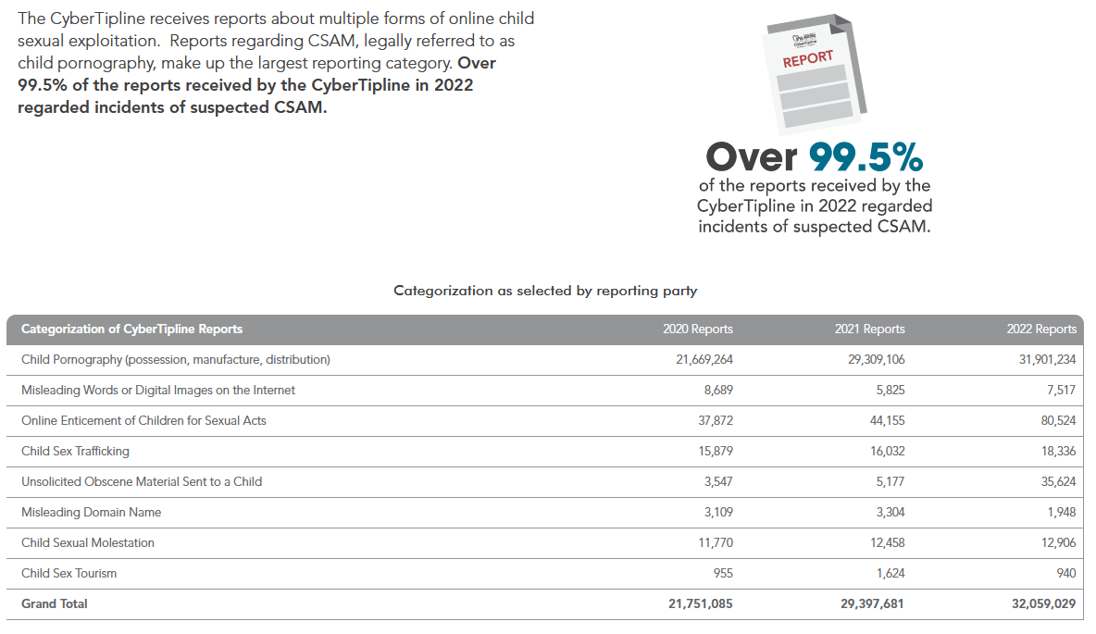
Why do we need ICAC?
37,775,034
Video Files
88,289,207
Total Files reported to the CyberTipline
1,197,394
Other Files
49,404,779
Image Files

Slide 11
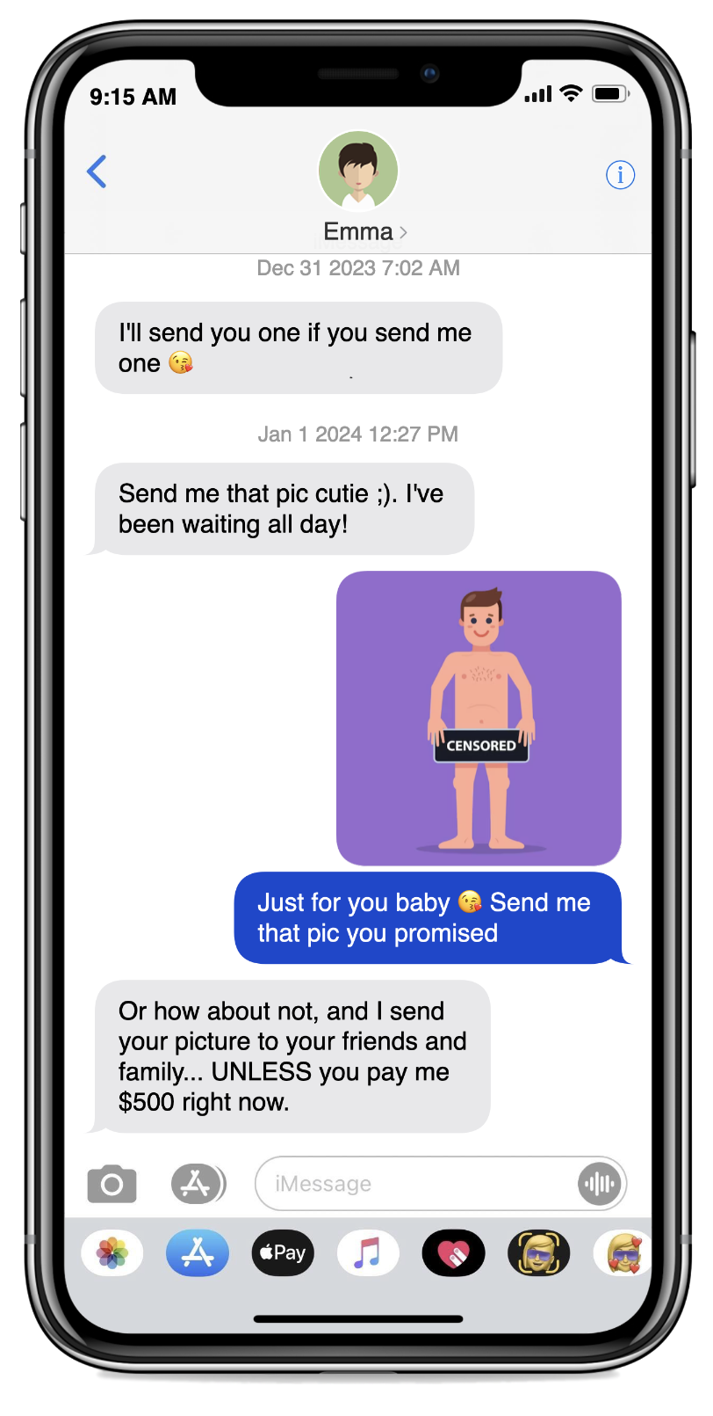
What is sextortion?
Sextortion is sexual exploitation. It occurs when someone threatens to send a sexually explicit image or video of you to other people.
This can happen to anyone – boys or girls, but boys are the primary target.
The offender will promise to not send the image or video if you provide:
Money
More Images or Videos
Sexual Acts or Favors

Slide 12

Amanda Todd
Nov 27, 1996 – Oct 10, 2012
First majorly publicized victim of cyberbullying and sextortion.
Made a single mistake – exposed her breasts on a webcam chat service.
A Dutch-Turkish man on the other side of the chat, Aydin Coban, screenshotted that instance and used it to blackmail and stalk Amanda Todd for several years.
Amanda experienced a wide range of issues common with teenagers who are victimized by sextortion: anxiety, depression, panic disorder, bullying, stalking, self-harm, suicidal ideation, and eventually suicide.

Slide 13




Where can sextortion start?

Slide 14

How does it begin?
With a hello. The offender will reach out with friendly conversation, often posing as someone with similar interests or as a potential romantic partner.
They will lie or embellish personal details to seem more trustworthy.
They will share pictures – not explicit ones – and encourage you to do the same.
A shift to sexual topics occurs. “Have you ever…?” “What’s your favorite…?”
They will ask to video call, or may offer to exchange explicit photos. In some cases, they may send explicit photos to you – but it is not of them. This continues until you send an explicit image or video to them.

Slide 15

What’s Next?
The offender reveals their true intentions. They are not who they say they are. They are not the pretty little girl or the handsome hunk of a man you thought.
They threaten to release the material to the victim’s family, friends, or the public unless the victim complies with their demands.
What do they want?
Money
More Images or Videos
Sexual Acts or Favors
So – What are your options?

Slide 16
Options
1 in 8
Refuse
Report
Comply
1 in 3
The offender might follow through, or they might move on to somebody else.
Law enforcement intervenes and provides you with support and help.
Give the offender what they want, and they keep asking for more.

Slide 17

How do they deceive you?
AI-enhanced photo imagery. They alter their appearance to appear younger, more attractive, or a different gender entirely.
They know you. They know your interests, after-school activities, and hobbies. Maybe even your friends. They can find this stuff out pretty quickly…
They make you believe you know them. They might tell you they saw you at a basketball game and got your number from someone on your team.
They might even pretend to be someone you know, but not know personally.

Slide 18



Slide 19

Sextortion Red Flags
Something doesn’t add up. Their online profile isn’t matching what you see and hear when you talk to them.
Slow down. Strong emotions right away, requests to move to a private form of chat, “I love you,”.
They push for sexually explicit photos. This usually happens quickly, often before the end of the first day you speak with them.
Show me your face. They want pictures or videos of you – without clothes – with your face in them.

Slide 20

Ask yourself…
Do I personally know who I am talking to online?
Do I know that person won’t show anybody else the pictures and videos I send?
Is that something I really want to send? Would I be comfortable explaining that to mom and dad?
Who else might see them? Friends? Family?
Once that image or video leaves your phone, you lose control.

Slide 21
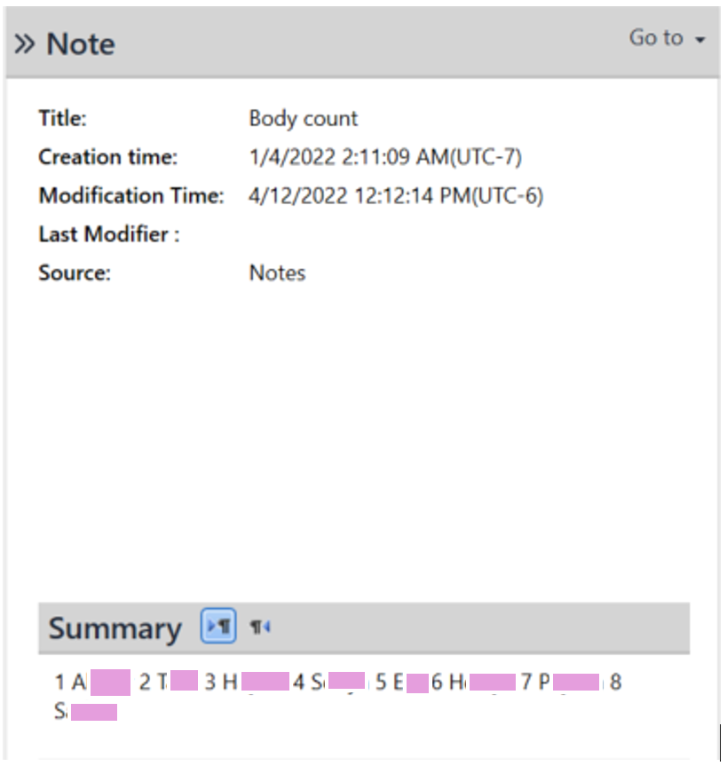
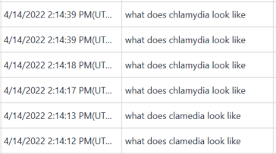
Some Questions to Ask Yourself…
Are there times you don’t personally know who you are talking to online?
Do I know that my girlfriend or boyfriend won’t show anybody else the pictures and videos I send?
Would I be comfortable explaining that to mom and dad?
What about the other stuff on your phone…? Internet search history. Notes. Text messages. Social media messages. Snapchat conversations.
Once that image or video leaves your phone, you lose control of it.

Slide 22
Some Big Points
1 in 8
Sextortion victims relocated after the experience.
1 in 4
1 in 3
Sextortion victims sought mental health or medical care
Teens who are targeted share sexually explicit images

Slide 23
What if it happens to me?

Slide 24
What to do
Report the account using the platform’s reporting feature.
Block the suspect, but do not delete your profile or messages. These may aid in stopping the blackmailer.
Ask for help before paying any money or complying with any demands:
Tell an adult or a professional.
No adults in your corner? Call somebody.
NCMEC: 1-800-THE-LOST (1-800-843-5678)
Your local law enforcement agency: 911
Me: 406-594-8401

Slide 25

If you are a victim…
You are not at fault. You are a victim. Even if you regret your choice, what they are doing is criminal, and they are to blame.
There are strong emotions associated with this crime. It is embarrassing, dehumanizing, and isolating. That’s why it works. Victims often experience hopelessness, fear, anxiety, depression, self-harm, suicidal ideation, attempted suicide, or the completion of suicide.
You’re not alone. Reach out:
Talk to somebody. Parent, older sibling, friends, teachers, counselors, coaches, etc.
No adults in your corner? Call somebody.
NCMEC: 1-800-THE-LOST (1-800-843-5678)
Your local law enforcement agency: 911
Suicide Prevention Lifeline: 988
Me: 406-594-8401

Slide 26
Take it Down
https://takeitdown.ncmec.org/
Free service offered by NCMEC that can help you remove or stop the online sharing of nude, partially nude, or sexually explicit images or videos taken of you before you were 18.
You don’t have to share any personal information.
That includes your image or video.
NCMEC requests you use the device you took the images or videos on to submit the request.
A hash is taken from your video and added to a hash set of known child sexual abuse material. That hash set is submitted to companies who participate with Take It Down, and they screen their platforms for materials matching these hashes. Once found, they remove it.

Slide 27










Participating Companies

Slide 28
The Bad News
Take It Down does not work for the entire internet.
Remember this?
The most important point to understand: while there are resources to help you deal with this, no organization, law enforcement agency, or anybody else can erase your image or video off the internet.
Once it is out there, it is out there forever.
once that image or video leaves your phone, you lose control.

Slide 29
Case Studies

Slide 30


Raul Beltran, 57, was convicted of sexual assault and sexual abuse of children in relation to acts committed against a 7-year-old girl.
Beltran was on parole for a previous incest offense against a 13-year-old girl.
The 7-year-old girl described a pornographic video that Beltran used to groom her. I was able to find the specific video she described in digital forensic artifacts on Beltran’s cell phone.
Prosecutor Ann Shea noted that, “Unlike cases involving known predators, this offense represents what every parent
fears the most, the unknown predator in the neighborhood.”

Slide 31


Theodore Cherry, 35, was sentenced to five 100-year sentences for acts committed against two children.
Videos and photos on his devices that I located showed, as prosecutors described, “lurid sex acts and rapes of children.”
Prosecutor Angie Rolando noted that, “the crimes were so horrific, they affected not only the girls, but every police officer, detective, court official, and anyone else who played a role in the case.”

Slide 32

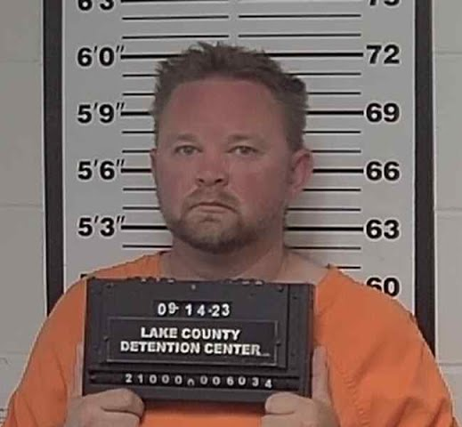
Matthew Timm, 42, was a former police officer, and is serving a 40-year sentence after admitting to photographing and filming a girl under the age of 18.
The girl indicated that Timm had been “touching her in a sexual manner,” from the age of approximately 12-years-old.
The victim had caught Timm placing recording devices in her bathroom. I was able to locate digital forensic artifacts to corroborate her statements and piece them together by date.

Slide 33

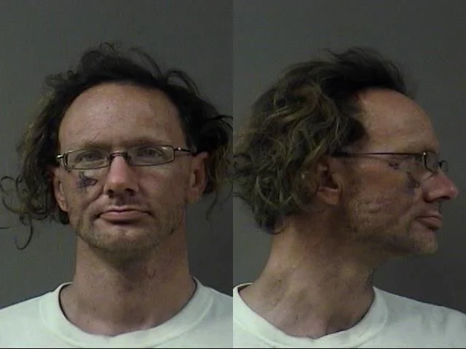
Eric Jaynes was convicted of Sexual Abuse of Children and Sexual Assault of Youth Causing Injury.
Started talking with a 14-year-old female he knew via Facebook Messenger.
Sent her over one thousand messages in a 24-hour period before picking her up.
Took her back to his house, where he raped her and she self-reported a couple of weeks later.

Slide 34


Betances and a 14-year-old Billings teen began communicating online.
Betances directed the teen to have sexual encounters with other men, record the encounters, and then send the photos and videos to him.
Betances paid for premium Bumble, a dating app, and created a profile for the teen. He and the teen used the app to find sexual partners for her.

Slide 35
Social Media

Slide 36
July 20, 1969
Facts
On July 20, 1969, the Apollo 11 guided Neil Armstrong and Buzz Aldrin across 221,000 miles of space to land humans on the moon for the first time.
A pocket calculator, or even a USB-C charger has more computing power than the computer used to send the Apollo 11 to the moon.
Your smartphones? They could guide 120,000,000 Apollo 11s to the moon at the same time.
Average age a child gets their first smartphone? Seven.
We’re trusting seven-year-olds with supercomputers that have near unlimited internet access.
What happened on this date?

Slide 37

Social Media and Children
90% of teenagers aged 13-17 report using social media.
20% of children aged 9-12 report using social media – and 76% of their parents helped them gain access.
Most popular? TikTok, Instagram, Snapchat.
33% of internet sex crimes involved social media.
81% of internet initiated sex crimes involving social media and children result in a face-to-face meeting.

Slide 38

The darker side of Social Media
“Face card” comparisons harms self-esteem and contributes to body image issues.
A study involving American teens aged 12-15 showed that those exceeding three hours of daily social media use had twice the risk of negative mental health outcomes.
Algorithms can facilitate the growth of self-harm networks or other harmful media.
Lastly?
There are some weird people on social media.

Slide 39
Let’s talk about that…
Your children are sponges, and these are not the kind of people you want teaching them about intimacy and sex.
… But they are, if you are not paying attention to the platforms your children are on.
When a gap in knowledge exists, children will fill it with the first piece of information they find related to the topic. At that point, it is entrenched, and everything else must fight against it.
This means – sex, intimacy, religion, love, body image, infidelity, relationship dynamics, and more.
You need to get there first. If you don’t, then you become the “prude parents” who are “out of touch” with the world.
When it is age appropriate, have that discussion. If it is not age appropriate, then they are not old enough for social media.

Slide 40
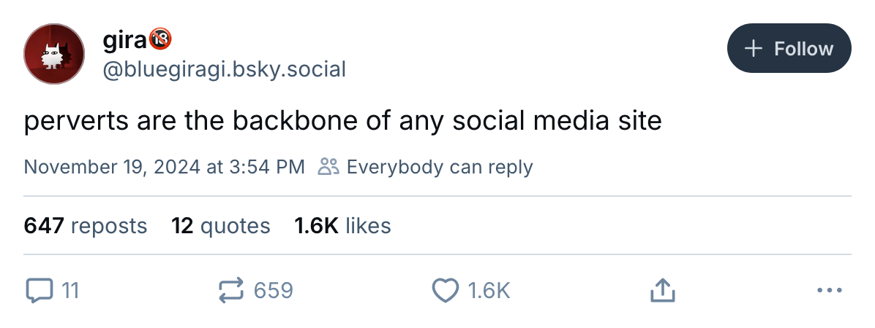
What about this?

Slide 41
Let’s talk about that too.
It takes four actions to access adult material on a smartphone.
Adolescent brains cannot handle this stuff. Adult brains cannot handle this stuff.
  Unrealistic expectations that can shape a child’s understanding of intimacy.
  Teaches children to view others as objects rather than individuals.
There has been one thing in common with every single device belonging to children that I’ve examined relating to the sexual exploitation of minors.
Pornography consumption.
Pornography can…
  Encourage sexual risk-taking behaviors that are not developmentally appropriate.
  Open the door to sextortion, grooming, or the normalization of abuse or violence.

Slide 42

Set healthy habits and boundaries
Do you know all the social media platforms your child is active on?
Bargain with them. There is a healthy balance! Encourage them to make good decisions and choices.
Just like you would want to know the parents, you should know the platforms.
Communication, communication, communication. Foster an environment where your child is comfortable approaching you with occurrences online. It is up to you to build that trust!
Make sure to bring communication out of the family as well. We are a community, and many of these trials children face also effect the community.

Slide 43

Warning signs for sextortion or bullying?
Withdrawing from family and friends?
Experiencing mood swings, especially right after using the internet?
Do they have a very strong reluctance to disconnect from their devices?
Are they avoiding school? Are they avoiding social situations?
Are they clearing browser history? “Incognito mode”? Do they hide screens?
Are they struggling in school uncharacteristically?
Loss of appetite? Other stress-related symptoms?
Reacting strongly to criticism? Overly emotional or defensive?
Receiving gifts, money, other items?

Slide 44
What if you know something is wrong?
Trust your gut. You are parents, you know when something is off with your child.
Naturally, you will want to know what is wrong, but you also must understand that communication cannot be forced. The child must be ready and willing to communicate… but there are some tricks.
Do an activity. Ever heard of play therapy?
Use silence to your advantage.
Offer choices, not commands. “Do you want to talk about it here or go for a walk?”
Sit beside them, not across. It’s not an interrogation!
Normalize being human. “Sometimes we all feel overwhelmed, but that’s okay.”
Get specific. “Is something bothering you?” versus “Is something on Instagram upsetting you?”

Slide 45
And now, a warning to you:
Don’t screw this up. If you are approached by a child who wants to tell you something serious about their online experiences, remember:
  There are strong emotions associated with this crime. It is embarrassing, dehumanizing, and isolating. That’s why it works. Victims often experience hopelessness, fear, anxiety, depression, self-harm, suicidal ideation, attempted suicide, or the completion of suicide.
You only have one shot. If they are coming to you for answers, comfort, or help, they are swallowing every bit of that embarrassment and fighting the isolation and shame.
They are entrusting you with something that is an enormous ordeal for them. That’s an honor for you and a lot of courage for the child. You need to be there for them.

Slide 46
Parental Controls for Android
Not as robust. Must also have a Google account.
Settings > Digital Wellbeing and parental controls.
  Set app limitations, and screen time limitations.
  Prevent Google Play Store purchases.
  See location of the child’s device.
  Set content restrictions for Google apps, including YouTube.
  More settings exist in the downloadable app Family Link.
    In Family Link, you can access settings such as “daily limits” and “bedtime”, which disables/locks the device during set hours.

Slide 47
Parental Controls for iPhone
Native to iOS – it is already built into the device.
Settings > Screen Time. In this menu, you can…
  Set age-related restrictions for content in apps, books, TV shows, movies, etc.
  Prevent iTunes & App Store purchases.
  Allow or disallow built-in apps and features.
  Limit access to websites, including adult websites.
  See location of the child’s device.
  Lock settings to disallow apps and websites to use location, including Share My Location features.
  Like Android, you can disable/lock the phone between set hours, but also disable applications as well.

Slide 48
Other ideas?
Life360. This is a cross-OS application that allows you to monitor someone’s location, speed, and set up alerts for when a device leaves a certain perimeter.
Google it! If you’re wondering if you can or cannot do something with integrated parental controls, search and see if you can.
Not invasive enough?
  Bark, Canopy, Net Nanny, etc. These are applications that can help monitor and block content on another devices. This means you may be able to view your child’s phone screen, text messages, videos, web searches, internet history, etc.
A word of caution – These applications may keep your children safe, but at what cost?

Slide 49
Remember, kids are smart.
They’ll use a friend’s phone at school.
They’ll find an old deactivated phone in a junk drawer and use it as a “WiFi – only” phone.
They’ll find a way to bypass the restrictions on school-issued computers.
How do you combat this?
  Talk with parents of your child’s friends and see if they can help enforce these rules.
  Make sure your old deactivated phones aren’t ‘missing’.
  Change your Wi-Fi password frequently.
  Go to your router settings and see what devices are connected.
  Monitor their social media.

Slide 50

Our recommendation?
Social media? At least age 13+, and only one platform at first – after you have researched it appropriately.
Phones in private spaces? Not until they’re 18. Anywhere that clothes come off is where phones do not go. Anything that can take a picture needs to stay in a common space.
Ground rules for social media:
  Friends only. Not social media friends, but actual friends.
  All accounts set to private.
  I must know the password you use.
  I must be your “friend” on social media.

Slide 51

Recap
We went over…
What is ICAC
  How it works
  Why we need it
Cyberbullying
Sextortion
  How it works
  How to identify it
  What to do if it happens to you
Resources and Mental Health
Take It Down
Social Media
  Prevalence of use among children
  What children may be seeing on social media
  Get to them before they do
  Warning signs
Parental Controls
  iOS, Android
  3rd party applications

Slide 52
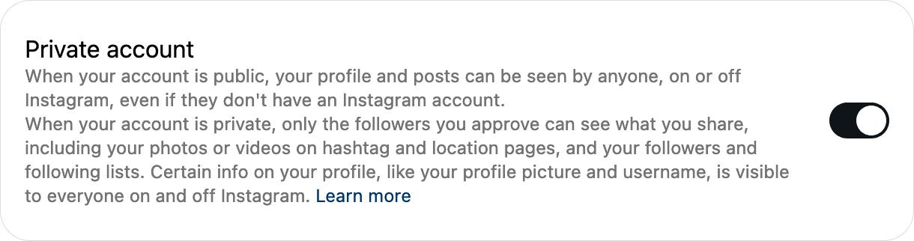
Scared of Technology?
Don’t be scared, just be careful. Sextortion is something that can happen to you, but you can lower the chances by understanding the risks and red flags of sextortion schemes.
Be open with your experiences online with families, schools, and friends. Normalize open discussion, because for your generation, this is unfortunately becoming more normal.
Check with your friends. “Did you give this guy my number?” “Are you adding me on Snapchat?”
If you don’t personally know the other person, be careful what you share. After all, you tell your best friend your deepest secrets that you wouldn’t tell just any friend.
Be a hard target. Keep your social media visible only to verified friends. Don’t engage in flirtatious, sexually charged conversations with someone you do not personally know.

Slide 53
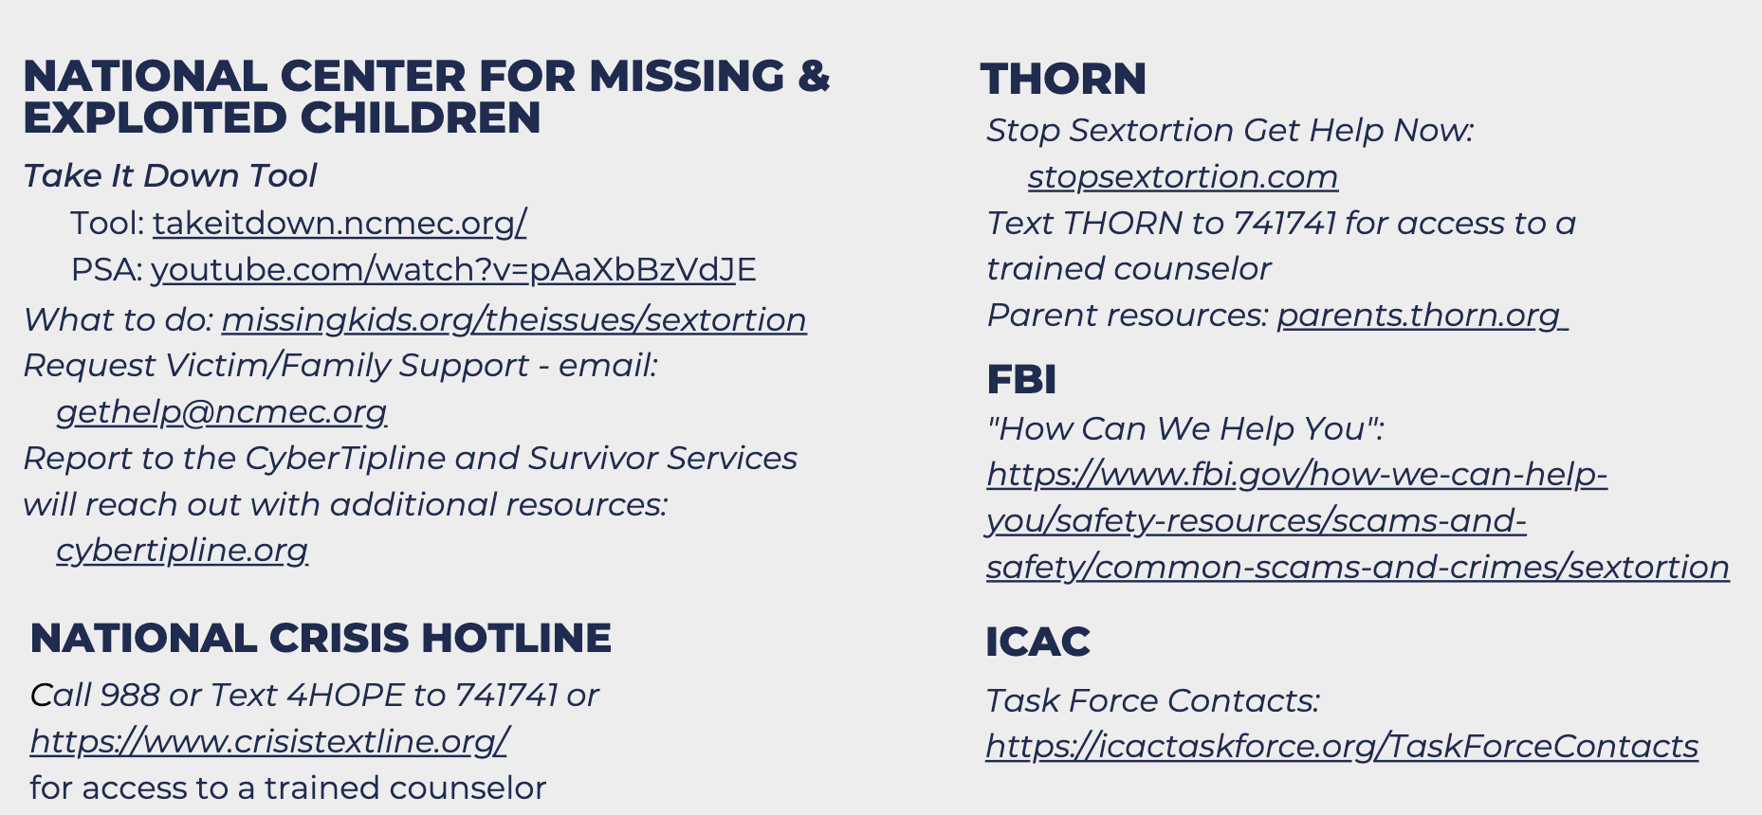
Resources

Slide 54

Questions?
Agent Cody Donahue
Montana Department of Justice
Division of Criminal Investigation
Email - Cody.Donahue@mt.gov
Agent David Humphries
Montana Department of Justice
Division of Criminal Investigation
Email - David.Humphries@mt.gov

