Slide 1
Montana Safe Schools Center
Transitioning to the importance of having an EOP and Threat Assessment
Presented by Tina Eblen

Slide 2
What is an EOP?
Emergency
Operations
Plan
An emergency operations plan describes who will do what, as well as when, with what resources, and by what authority--before, during, and after an emergency.

Slide 3
Why an EOP?
-Vital to ensure a disaster response is not impeded by disorganization or miscommunication.
-Basically it's a map.
A mapping of the best course of action during an emergency.

Slide 4
What is needed to create an EOP
Planning must be supported by leadership.
Planning uses assessment to customize plans to the building level.
Planning considers all threats and hazards.
Planning provides for the access and functional needs of the whole school community.
Planning considers all settings and all times.
Creating and revising a model emergency operations plans is done by following a collaborative process.

Slide 5
EOP Resources
OPI HUB COURSE – EOP
Teacher Learning Hub (mrooms.net)
REMS EOP ASSIST
EOP ASSIST Software | EOP Interactive Tools | Readiness and Emergency Management for Schools Technical Assistance Center (ed.gov)

Slide 6
One of the components of your EOP is
Threat Assessment

Slide 7
Threat Assessment as a Practice
Threat Assessment defined:
A systematic, fact-based method of investigation and examination that blends the collection and analysis of multiple sources of information with published research and practitioner experience.
Focuses on an individual’s patterns of thinking and behavior to determine whether, and to what extent, a subject of interest is moving toward an attack.
A beginning process that guides a course of action to mitigate a threat of potential violence or self-harm.

Slide 8
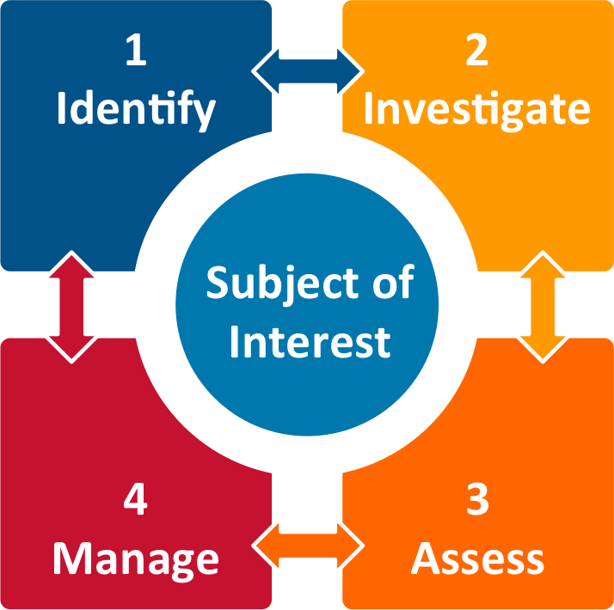
Threat Assessment Model
Identify
Investigate
Assess
Manage

Slide 9
Identify
Form a threat assessment team (or include in behavior intervention team)
Identify laws related to privacy, civil rights, civil liberties
Increase community involvement
Triage reported communications

Slide 10
Threat Assessment Team
A threat assessment team must be creative, flexible, multi-disciplinary, and consultative in nature.
  School/district leaders (administrator, superintendent)
  Specialists (school counselor, school psychologist)
  School Nurse, or similar
  School Resource Officer, or similar
*Consider a multi-district team, particularly in smaller communities!
    r
Who would be part of your team?

Slide 11
Identify Related Laws
Privacy -
From a legal perspective
Build confidentiality into the process for the reporting parties and subject of interest
Civil Rights -
Issue of civil rights is critical → No demographic profile of a targeted violence offender
Objective assessment of threat-enhancing and mitigating circumstances is key
Civil Liberties -
Refers to fundamental individual rights and limitations on the power of the government to restrain or dictate the actions of individuals
Offers protection to individuals from improper government action and arbitrary governmental interference

Slide 12
Investigate
Information sharing (FERPA, HIPAA, IDEA, PIIs)
Information-gathering process
Referral and data sources
Social media considerations

Slide 13
Information Sharing (FERPA, HIPAA, IDEA, PIIs)
Safety Emergency Disclosure:
Permits disclosures, without consent of the parent or student, to protect the health/safety of the student or others
Limited to the period of the emergency
Case-by-case basis

Slide 14
Information-Gathering Process/Plan
WHAT information to gather?
WHO will gather the information?
WHO will interview?
HOW to record the information?
WHAT is the timeline?

Slide 15

Referral and Data Sources
Referral Sources:
Office Discipline Referrals (ODRs)
Law enforcement report
Student/Teacher/Parent report
Written or other educational content
Anonymous reporting tip line
*Social media
Data Sources:
Academic data
Behavioral data
Attendance data
Interviews
Law enforcement
*Social media

Slide 16



Social Media Considerations
Source of Referrals AND Data
What safeguards are on school computers? Available for home use?
GoGuardian
Bark
Qustodio
How are students being taught digital citizenship?
→ Digital Futures Initiative (https://www.dfinow.org)

Slide 17
Assess
Avoid bias
Assessment guidelines/goals
Three-step process
  Gather data
  Interpret threat enhancers and mitigators
  Prepare the findings

Slide 18

Avoid These:
Avoid Bi
Avoid Bias:

Slide 19
Assess Guidelines/Goals
Goals:
Prevent future acts of targeted violence
Develop a holistic view of the subject and his or her environment
Inform determinations about how to move a person off the pathway to violence

Slide 20
It's a Three Step Process
Step 1 - Gather Data: Focus on Totality
Team effort using standardized assessment protocol
Examine evidence consistent with the likelihood of a violent attack
Multifaceted process
  Holistic view
  Direction of interest
  Situational
  Context of setting

Slide 21

Three-Step Process: Step 2 - Enhancers
Risk Factors:
Violence history
Health/mental health
Personality disturbances
Severe mental illness
History of suicidality
Concerned peers
Social/environmental
Problematic behavioral history
Weapons
Life Stressors:
Financial
School or Home
Relationships
Law Enforcement

Slide 22
Three-Step Process: Step 2 - Enhancers
Warning Behaviors:
Fixation
Identification
Novel Aggression
Leakage
Directly Communicated Threat
Approach Behavior
Potential Imminence:
Deviations in normal non-aggressive behavior
End of life planning
Last resort
Sudden withdrawal from life pattern

Slide 23
Three-Step Process: Step 2
Mitigators
Flexibility of Thinking
Positive, Realistic Goals
Supportive Family
Healthy Social Supports
Conflict Resolution
“On the Radar”
Access and Receptiveness to Assistance
Positive Coping Mechanisms

Slide 24
Three-Step Process: Step 3
Step 3 - Prepare the findings
Utilize district-adopted documentation throughout
Include the threat assessment team
Communicate findings and plan to student and family

Slide 25
Manage
Implement effective threat management plans
Implement S.T.E.P.
  Subject
  Target
  Environment
  Precipitating
Apply case management resources

Slide 26
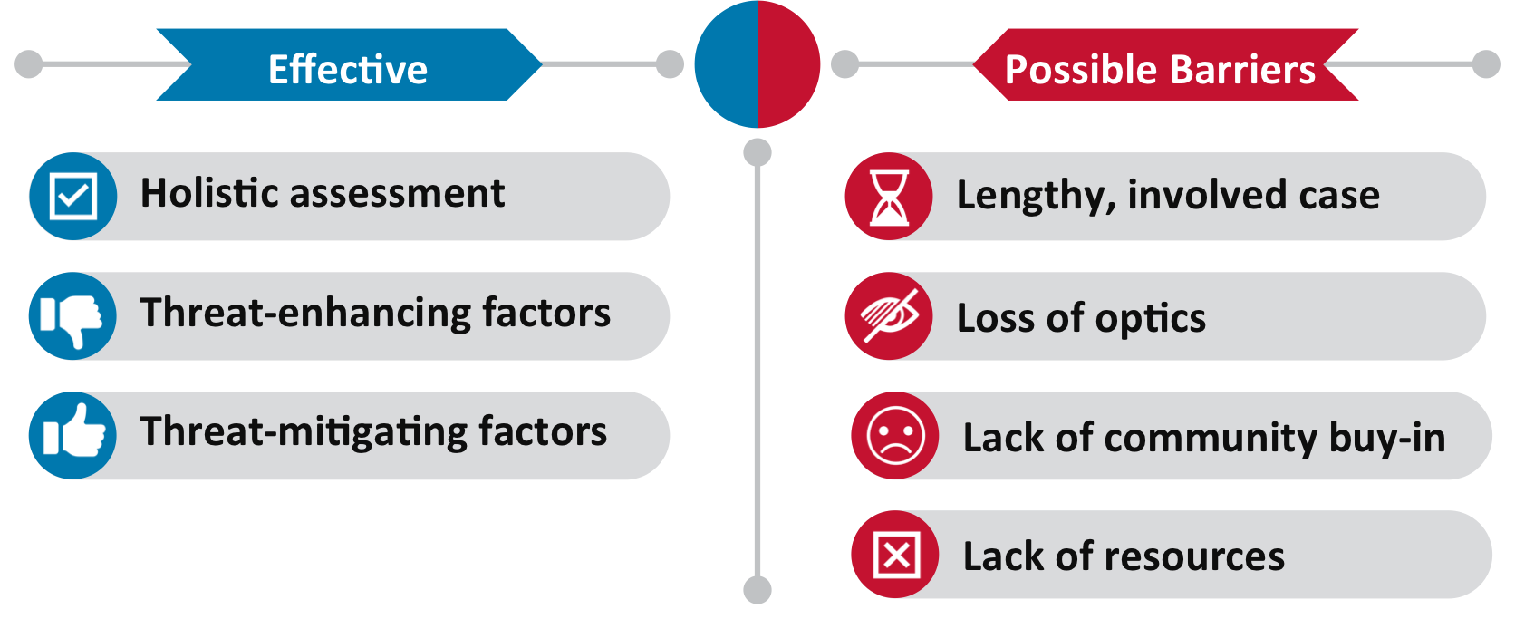
Effective Threat Management

Slide 27
Case Management Resources
The WHO, WHAT, WHERE, WHEN, etc…
Wraparound supports
Consider totality of circumstances
Utilize documentation
Include data collection
Authorization to Exchange Information with outside providers

Slide 28
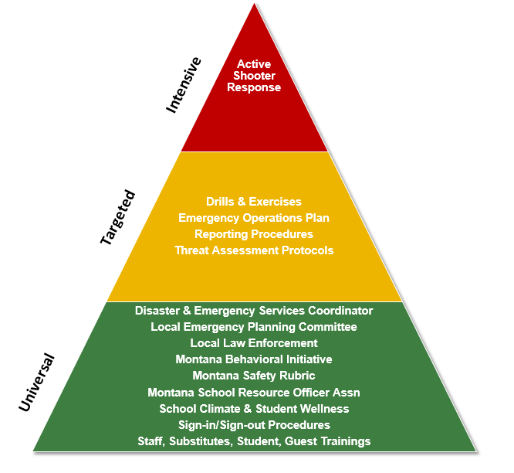
Prevention, Intervention, and Postvention

Slide 29
Scenario
Michal is a highschool senior. His Social Studies teacher Mr. Joe, contacted the vice principal because of recent emails from Michael expressed increasing hostility toward the teacher. Mr. Joe asked Michael to stop by his desk yesterday afternoon, so they could discuss the emails and Michael’s declining grades. Mr. Joe said the conversation was largely one-sided, with Michael just listening. Mr. Joe said last last night he received a hostile email in which Michael told him he “better watch out” if he gave Michael a bad grade.

Slide 30
Initial Team Questions
Based on the information provided, what is the first step the team should take?
Is there an imminent situation or a need for the team to call for immediate law enforcement intervention?
Is there a need for the team to gather information?
If so, where should the team look for information? (Report source requests to the case study facilitator.)

Slide 31
Investigatet
1. What are Michael’s motives and goals?
2. Have there been any communications suggesting ideas or an intent to attack?
3. Has Michael shown inappropriate interest in any of the following?
◾ Workplace, school, or campus attacks or attackers ; Weapons (including recent acquisition of any relevant weapon)
Incidents of mass violence (e.g., terrorism, workplace violence, and mass murderers)
4. Has Michael engaged in attack-related behaviors? This means any behavior that moves an idea of violence toward actual violence. Such behaviors might include:
◾ Developing an attack idea or plan
◾ Making efforts to acquire or practice with weapons
◾ Surveying possible sites and areas for attack
◾ Testing access to potential targets
◾ Rehearsing attacks or ambushes
5. Does Michael have the capacity to carry out an act of targeted violence?

Slide 32
Sources
Organizations:
Trauma Aware Schools (https://traumaawareschools.org)
The National Child Traumatic Stress Network (NCTSN; https://www.nctsn.org)
National Threat Evaluation and Reporting Program (NTER; DHS; https://www.dhs.gov/national-threat-evaluation-and-reporting-program)
National Association for Behavioral Intervention and Threat Assessment (NABITA; https://www.nabita.org)
OPI Teacher Learning Hub (https://opi.mt.gov/Educators/Teaching-Learning/Teacher-Learning-

Slide 33
Montana Safe Schools Center
Christina.Eblen@mso.umt.edu

