Slide 1


What about You!
Realistic Cognitive and Behavioral Interventions

Slide 2
Self-Care
“By caring for the soul faithfully, every day, we step out of the way and let our full genius emerge.”
Thomas Moore

Slide 3

Healthy Habits
Getting Enough Sleep
Eating Nutritious Foods
Drinking Water
Spending Time in Pleasant Activities

Slide 4



Agenda
Practice emotional awareness
Use grounding skills to quiet the mind
Assess negative thoughts
Practice cognitive defusion
Engage mindfully in values-based actions

Slide 5
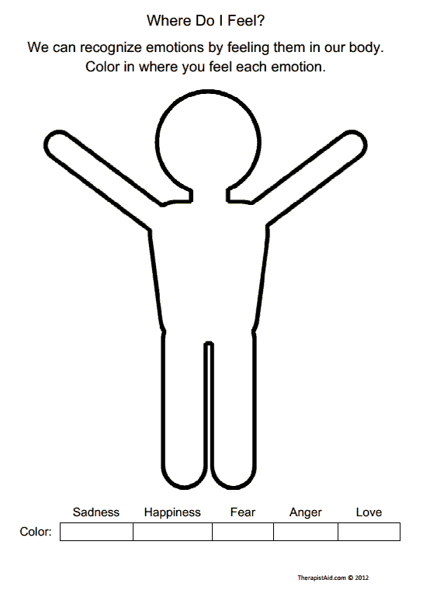
Emotional Awareness
How does your body react to stress?
How is your personal life impacted by stress?
How is your professional life impacted by stress?

Slide 6
Staying in the Moment
Breathing Exercises
Grounding Techniques
Progressive Muscle Relaxation
“I’ve got to keep breathing. It’ll be my worst business mistake if I don’t.”
Steve Martin

Slide 7
Sign or Noise? Feeling or Fact?
Step back and gain new perspective
Step away from the content and the moment

Slide 8


The Sky and Weather
Your observing self is like the sky. Thoughts and feelings are like the weather. The weather changes continually, but no matter how bad it gets, the weather cannot harm the sky in any way. The mightiest thunderstorm, the most turbulent hurricane, the most severe winter blizzard–these things cannot hurt or harm the sky. And no matter how bad the weather, the sky always has room for it. Plus, sooner or later the weather always changes.
Sometimes we forget the sky is there, but it is still there. And sometimes we cannot see the sky because is it obscured by clouds. But if we rise high enough above those clouds–even the thickest, darkest thunderclouds–sooner or later we will reach clear sky, stretching in all directions, boundless and pure.
More and more, you can learn to access this part of you, a safe space inside from which to observe and make room for difficult thoughts and feelings.

Slide 9
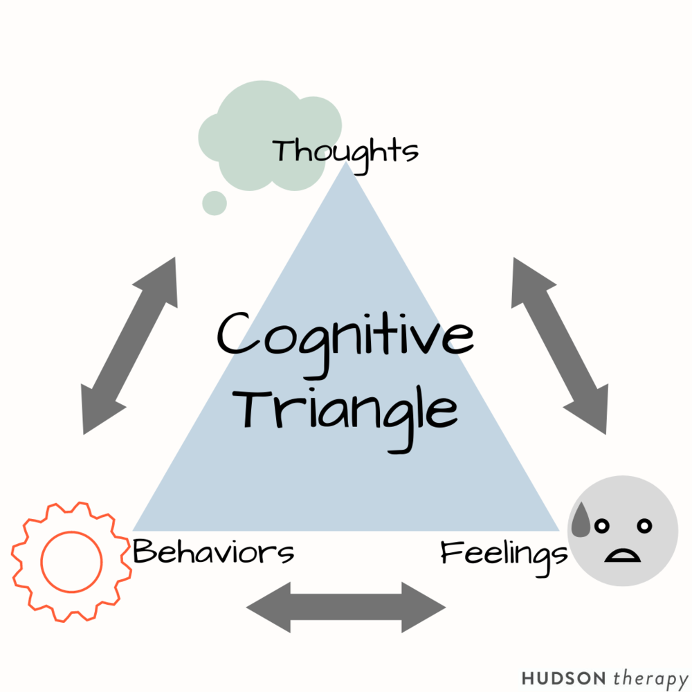

Cognitive Behavioral Therapy

Slide 10
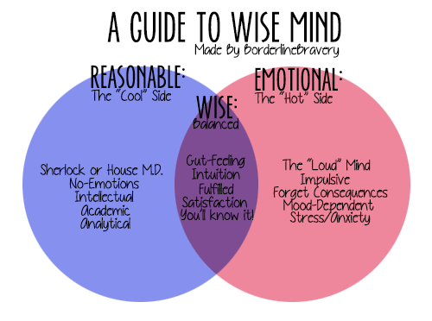
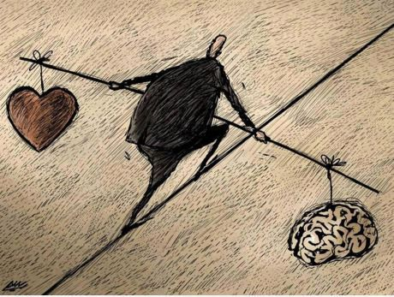
DBT: Wise Mind

Slide 11
Value Based Actions
Dancing with Danger: Can You Do It Well?
Bring your attention to yourself, your mind, your body, and your heart. How are you doing? What do you need at this moment?
Use the scale (on worksheet) to look at the strength of your connection to what matters and who matter in 4 important areas of your life now, during this very difficult moment in our world.

Slide 12
Wade Through the Swamp
Suppose you love mountain climbing. It’s something you are absolutely passionate about. One day, you set out to climb this mountain that you’ve heard great things about, but when you get close to the mountain, you discover that a swamp runs all the way around it. It’s a big surprise. No one told you about it. Now the only way you’ll get to climb that mountain is to wade through the swamp. So that’s what you do. You wade through the swamp. You don’t wallow in it just for the sake of it. You wade through the swamp because climbing that mountain matters.

Slide 13
Helpful Resources
Kirk Strosahl and Patricia Robinson
In This Moment
John Arden
Rewire Your Brain

