Slide 1
Safe Firearms Storage Communication
August 5, 2026
The potential role that schools and districts can play
Trevor Fronius, PhD
Director, Justice & Prevention
WestEd

Slide 2


ROADMAP
What we’ll cover in the next hour
1
Why this matters in Montana
Learning objectives
Youth suicide, household storage, and the role schools can play
01
2
What Texas did and why
The mandate, the campaign, and what Montana does not have
Build knowledge on the current state of practice for a statewide firearms storage communication campaign.
3
What administrators told us
Awareness, action, messengers, channels, and the blind spot
02
4
What parents told us
Receive practical guidance and recommendations for implementing effective school-based firearms safety communication.
The delivery gap, the trust surprise, and why owners don’t lock up
5
Next steps
Potential shift for Montana schools

Slide 3


DISCUSSION
Where is your school/district today?
Turn to your neighbor
Does your district send families anything about safe firearms storage? If so, how often?
If not, what do think has stopped it (e.g., time, materials, politics, or it simply never came up)?
If yes, do you have any way of knowing whether families received it?

Slide 4

WHY THIS MATTERS IN MONTANA
60%
2×
#2
of youth suicides
the national rate
in the nation
in Montana were firearm-related among ages 10–17, 2019–2023
Montana’s youth suicide rate has been consistently more than double the U.S. rate
Montana had the second-highest gun suicide rate in the country in 2023
Most of these deaths were not visible coming
Montana’s violent death review found 77% of youth who died by suicide were in a “hidden risk” group — minimal contact with mental health or legal systems, few documented problems — and that group was more likely to use a firearm. Storage is a protection that works without anyone identifying the child in advance.
Sources: MT-VDRS 2019–2023 · CDC WISQARS · CDC WONDER · MT DPHHS

Slide 5
SECTION 1 · WHY THIS MATTERS
The gun comes from home
Suicide is the dominant risk in Montana. But the same unsecured firearm sits behind the school-violence pathway too — and that pathway runs through the home.
76%
6.7M
children lived in a household reporting a firearm stored loaded and unlocked — of roughly 32 million living in homes with firearms (Miller et al., 2026).
of school attackers who used a firearm acquired it from the home of a parent or other relative
Leading
cause of death nationally among young people ages 1–17 in recent years is firearms, ahead of car crashes. In Montana it ranks second.
U.S. Secret Service NTAC, Protecting America’s Schools (2019) — 41 targeted school attacks, 2008–2017. 61% of attackers used a firearm.
Takeaway – Securing a firearm at home reduces the risk of a suicide nobody saw coming and closes the most common route a student takes to bringing a gun to school.
Sources: U.S. Secret Service NTAC (2019) · CDC MMWR (2023) · CDC WONDER

Slide 6

SECTION 1 · WHY THIS MATTERS IN MONTANA
The storage picture in Montana homes
30%
Highest
Montana consistently ranks first in the nation in household firearm ownership — modeled estimates put it near 6 in 10 households.
of Montana adult firearm owners living with someone under 18 had an unlocked firearm in the home
1 in 4
Montana high schoolers seriously considered attempting suicide in the past year (YRBS, 2023).
Statistically speaking…
#1
cause of preventable death for Montana youth ages 10–14 is suicide (MT Vital Statistics, 2023).
Most people in this room own firearms. This is not a conversation about other people...it is a conversation about us.
Sources: MT BRFSS 2024 · MT YRBS 2023 · MT Vital Statistics 2023 · RAND (ownership est.)

Slide 7

SECTION 1 · WHY THIS MATTERS
Understanding why families leave firearms unsecured
“I need quick access”
Many owners keep firearms loaded and unlocked because they believe it is necessary for home protection — prioritizing perceived security over storage safety.
“My kids know better”
Parents often underestimate the likelihood that their child will handle a firearm. Many believe education alone is sufficient protection.
“It’s just how it’s done”
Social norms and cultural identity around firearms can make safe storage feel like a challenge to values rather than a complement to them.

Slide 8

SECTION 1 · WHY THIS MATTERS
What the research already told us
WHERE STORAGE COMMUNICATION HAS BEEN STUDIED
Storage laws: strong evidence
Healthcare
RAND’s Science of Gun Policy (5th ed., 2026) gives its strongest rating — “supportive” — to evidence that child-access and safe-storage laws reduce firearm self-injury and homicide among youth. Roughly 27 states and DC have such a law.
Pediatric & primary care. Counseling works when paired with a free lock (Rowhani-Rahbar 2016; Barkin 2008).
Veterans & military
VA lethal means safety counseling; firearms were involved in about 72% of veteran suicide deaths in 2021.
Community programs
Lock giveaways and temporary out-of-home storage during periods of elevated risk.
But that evidence is about the laws — not about whether notifying families changes what they do.
Firearm retailers & ranges
Gun Shop Project; AFSP–NSSF partnership — trusted voices at the point of sale.
The throughline: across every setting, what moves behavior is a trusted messenger paired with an easy action, like a free lock. Reaching families through schools is a newer and far less-studied channel, which is exactly what this study examines.
RAND (2026) · Rowhani-Rahbar et al. (2016) · Barkin et al. (2008) · VA · Gun Shop Project · AFSP–NSSF

Slide 9

SECTION 1 · WHY THIS MATTERS IN MONTANA
Why schools → the theory of change
Every family
Credibility
3× or more
Reach
Trust
Repetition
Schools are the one institution with recurring, expected contact with essentially every family that has a child. This includes rural families far from any clinic.
Who delivers a message shapes whether people act on it. In small communities, the principal is often a known neighbor rather than an agency.
Unlike a one-time campaign, schools can reinforce at enrollment, during hunting season, and before summer, and that raises the odds of behavior change.
That is the theory underlying the Texas campaign and study.

Slide 10

SECTION 2 · WHAT TEXAS DID
Why Texas acted — the mandate
House Bill 3 (88th Legislature, 2023), Section 19
$750K
TEC § 37.222
Resources on Safe Firearm Storage
appropriated for FY 2025–2026
TxSSC, in collaboration with DPS, must:
The 89th Legislature funded DPS to continue a statewide safe gun storage awareness and education campaign — Keep ‘Em Safe Texas.
Develop and provide safe firearm storage information and resources to districts and open-enrollment charter schools
Include the offense for making a firearm accessible to a child (Texas Penal Code § 46.13)
4,561
Include ways parents and guardians can prevent children from accessing firearms
Districts and charter schools must:
firearm deaths in Texas in 2023
Distribute this safe firearm storage information
The overall Texas gun death rate rose 39% between 2014 and 2023 — the backdrop against which this mandate was written.
Provide it to the parent or guardian of each enrolled student
TEC § 37.222 · Texas Penal Code § 46.13 · TxSSC

Slide 11


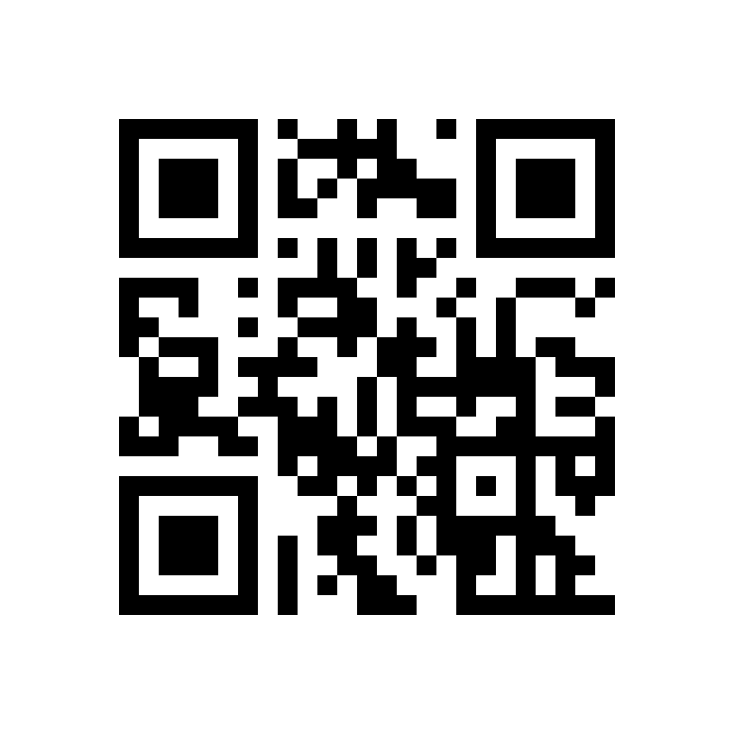
SECTION 2 · WHAT TEXAS DID
What Texas built behind the mandate
Keep ‘Em Safe Texas
TxSSC recommends distributing
multiple times a year
The statewide DPS campaign, with free English and Spanish resources on safe storage practices.
1
At the beginning of the school year
Partner toolkit
3 steps to safe storage · storage checklist · how to talk to others · ways to store safely
Enrollment and back-to-school packets reach nearly every family.
Educator toolkit
flyers · posters · student activity sheets · slide decks · marquee messages · parent letters
Before holidays and breaks
2
Firearms change hands as gifts; homes get busier and less supervised.
The materials are free and easy to adapt
At the end of the school year
3
Summer means more unstructured time at home.
TxSSC sends reminders around each of these windows.

Slide 12

SECTION 2 · WHAT TEXAS DID
Early-stage implementation and outcome study
Implementation
Reach
Effectiveness
Are districts distributing materials, and how?
Do the materials get to families and do families notice?
Does any of it change how firearms are stored at home?
The NIJ-funded study
A Study of a Statewide Safe Firearms Storage Message Campaign in Texas Schools · Award #15PNIJ-24-GG-02407-STOP
Administrator survey
Parent survey
Coming next
731 respondents · fielded through July 2026
639 respondents · Ongoing
Parent and student focus groups · Fall 2026

Slide 13

SECTION 3 · ADMINISTRATORS
Who we heard from
A decision-maker sample
Nearly two-thirds are principals. The rest are district leaders and are the people who set communication policy and decide what goes home to families.
INSIDE “OTHER DISTRICT & SAFETY LEADERS”
Police chiefs, safety directors & coordinators
70
Superintendents & assistant superintendents
59
Directors of operations & communications
36
731 administrators named a role
Administrator survey, N = 731

Slide 14

SECTION 3 · ADMINISTRATORS
The mandate is landing for the most part
74%
72%
63%
were aware of the Texas law
say their school has shared
communicate a few times a year
requiring schools to share safe firearms storage information with families
507 of 688 answered
information with parents and guardians about safe storage
495 of 686 answered
another 35% share once a year; monthly or incident-only was rare
n = 471
Who are the last to reach districts?
Cadence is a fillable gap
About one in four administrators did not know about the law, and one in four say their school has not shared. Worth asking: are these the smallest or least-resourced districts and what would help them start?
TxSSC recommends multiple times a year, and 63% meet that. But 35% send once annually and that is out of compliance with current the statute.

Slide 15

SECTION 3 · ADMINISTRATORS
Who should carry the message?
Share of administrators rating each group “Excellent” or “Good” as a messenger to firearm owners
School staff: 40%
Administrators rank their own staff near the bottom for reaching adult firearm owners.
Remember this number.

Slide 16

SECTION 3 · ADMINISTRATORS
How schools are reaching families
Channels administrators rate most effective (select all that apply)
Digital-first
Roughly 7 in 10 point to the district website and social media.
Practice matches belief
Among schools that have shared, website (60%) and social media (55%) are the channels used and the same two they rate most effective.

Slide 17

SECTION 3 · ADMINISTRATORS
The blind spot
“To my knowledge, families are changing their storage practices because of what my school shared.”

Slide 18
DISCUSSION
Before we turn to parents…what do you predict?
Write down your guesses.
Schools say 72% have shared. What share of PARENTS will say they received it?
Administrators rated school staff 40% as a messenger. Where will parents put school staff — higher or lower?
Which single channel will parents say they most want?
Among owners who don’t properly store firearms, what is their top reason?

Slide 19

SECTION 4 · PARENTS
Schools are sending more than families are receiving
72%
56%
Schools that say they
have shared information
Parents who say they
received information
n = 686 administrators
n = 629 parents
But the families who did receive it rate the materials higher than schools rate themselves
98%
clearly communicated legal requirements
97%
clearly communicated risk of injury
97%
clearly communicated steps to store safely

Slide 20
SECTION 4 · PARENTS
The school community is more than administrators think
Share rating each group “Excellent” or “Good” as a messenger to firearm owners
+27
points
“People I know” is the widest gap in the study. Parents trust friends and family far more than schools assume.
School staff
40% → 50%
Parents rate school staff ~10 points higher than administrators rate themselves. The credibility gap is self-doubt, not standing.

Slide 21

SECTION 4 · PARENTS
Schools prefer to post and parents want it sent
Administrators: channels rated most effective · Parents: channels they would prefer to receive
Email wins with parents
54% of parents want email from an administrator, which 13 points above where schools rank it.
Social media is problematic
70% of administrators call social media most effective; only 37% of parents prefer it. The widest mismatch here.

Slide 22

SECTION 4 · PARENTS
The blind spot, filled in
Administrators could not tell whether families were changing.
Families changing
storage practices
Administrators
50%
11.0%
Parents
of parents who received information say they feel more knowledgeable about safe storage.
Parent item asked only of firearm owners who received information (n = 228)
31.6%
Families changing how
they talk about storage
Administrators
Disclaimer!
17.5%
Different questions: administrators guessed about all families; parents reported on themselves
This does not suggest that the schools caused these changes.
Parents
40.9%
Net agree (“agree” + “strongly agree”).

Slide 23
SECTION 4 · PARENTS
Why owners don’t store the recommended way
Among firearm-owning parents who do not follow the DPS recommendation (unloaded, separate from ammunition, locked)
30% of owning parents already store per the recommendation and are excluded here. N = 254 owners citing at least one reason.

Slide 24
SECTION 4 · PARENTS
The conversation that isn’t happening
Only 3 in 10 parents talk to the adults in homes their children visit.
13% talk to nobody at all. Norms and taboos were cited by 14% as a reason not to.
Why they do talk: concern for my child’s safety (70%) and trust in the other person (44%).
“Who do you talk to about safe firearms storage practices?” n = 633 parents

Slide 25

SECTION 5 · NEXT STEPS
Five considerations for Montana schools
01
You can be the credible messenger
School staff 40% → 50%
Parents rate school staff higher than schools rate themselves.
02
Fix reach before content
72% sent · 56% received
97–98% of parents who got the materials found them clear. Don’t redesign the flyer. Ensure consistent delivery.
03
Pick the channel families check
Email 54% vs social 37%
Texas parents wanted email. In a rural district that may be the activity newsletter, the sports text chain, or the front office. Ask before you assume.
04
Answer the real objection
61% cite quick access
Address concerns of quick access and “my kids know better”.
05
Make it forwardable
“People I know” +27 points
Word of mouth showed the widest trust gap in the study. Give parents a script for asking another parent whether firearms are secured.

Slide 26

SECTION 5 · NEXT STEPS
A potential one-year plan
Four potential no cost and light touch target dates
August
September/October
December
April–May
Enrollment & back-to-school
Target hunting season
Holidays & gifting
Before summer
Highest-reach moment of the year. Include it in the packet every family already has to complete.
Co-sign with local sportsmen’s group. Acknowledging seasons vary by game!!
Firearms change hands as gifts; homes fill with visiting kids. Pair with quick-access storage options.
Unstructured time at home. Include the script for asking another parent.
And add one measurement question anywhere along the way…
“Did you receive information from your school about safe firearms storage this year?” Add it to an existing parent survey, a conference sign-in, or a registration form.

Slide 27
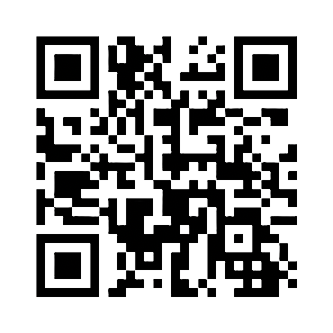
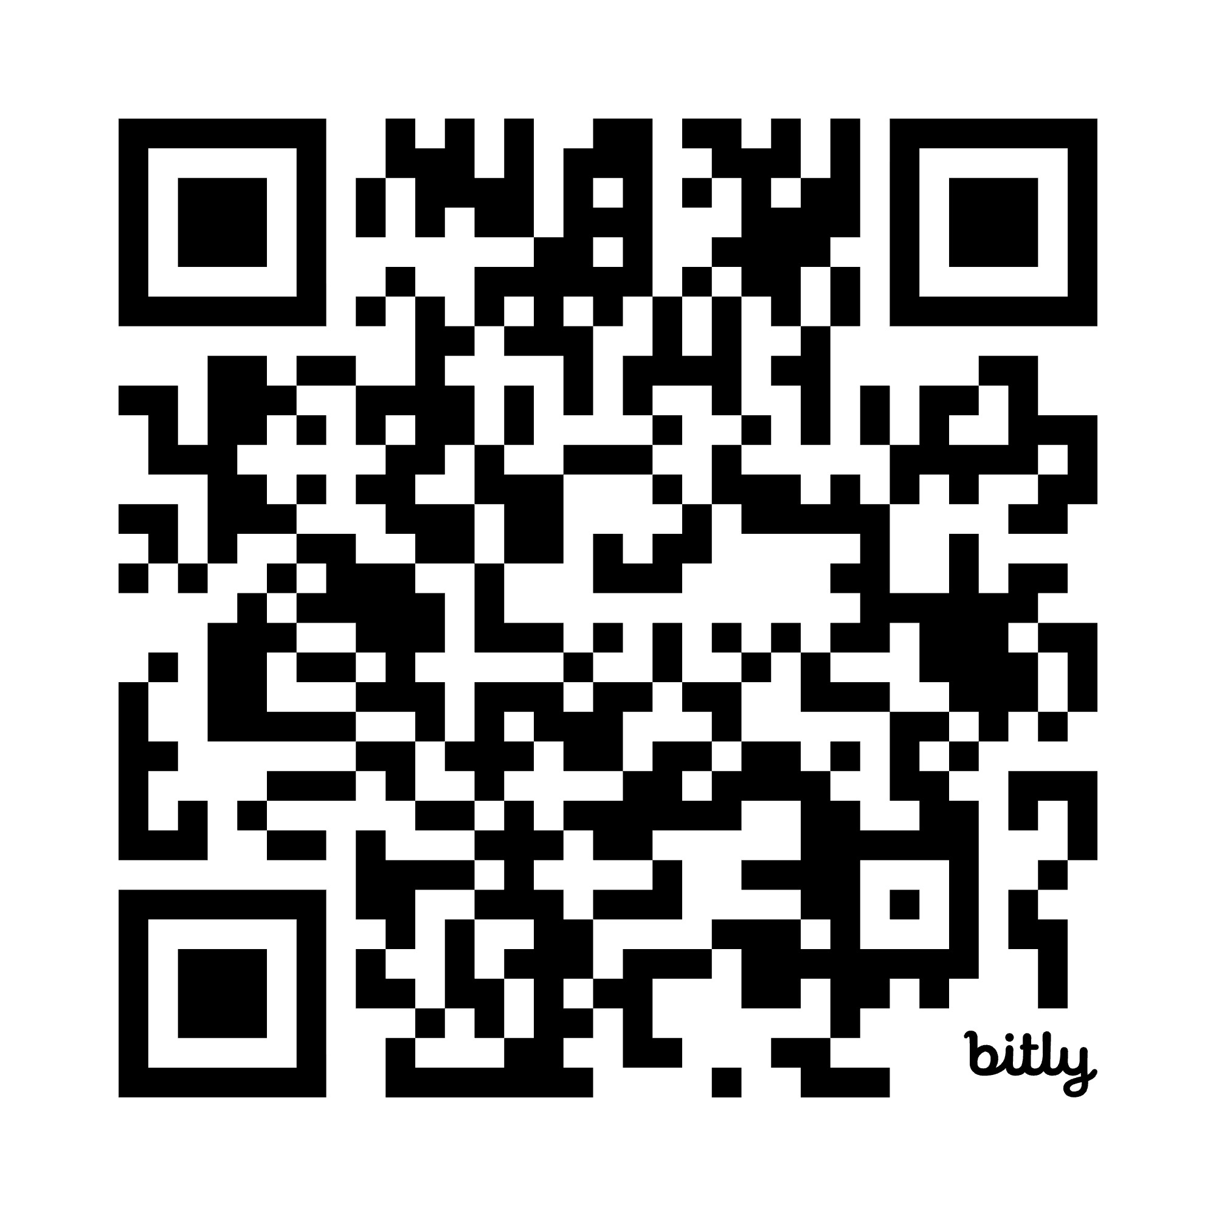
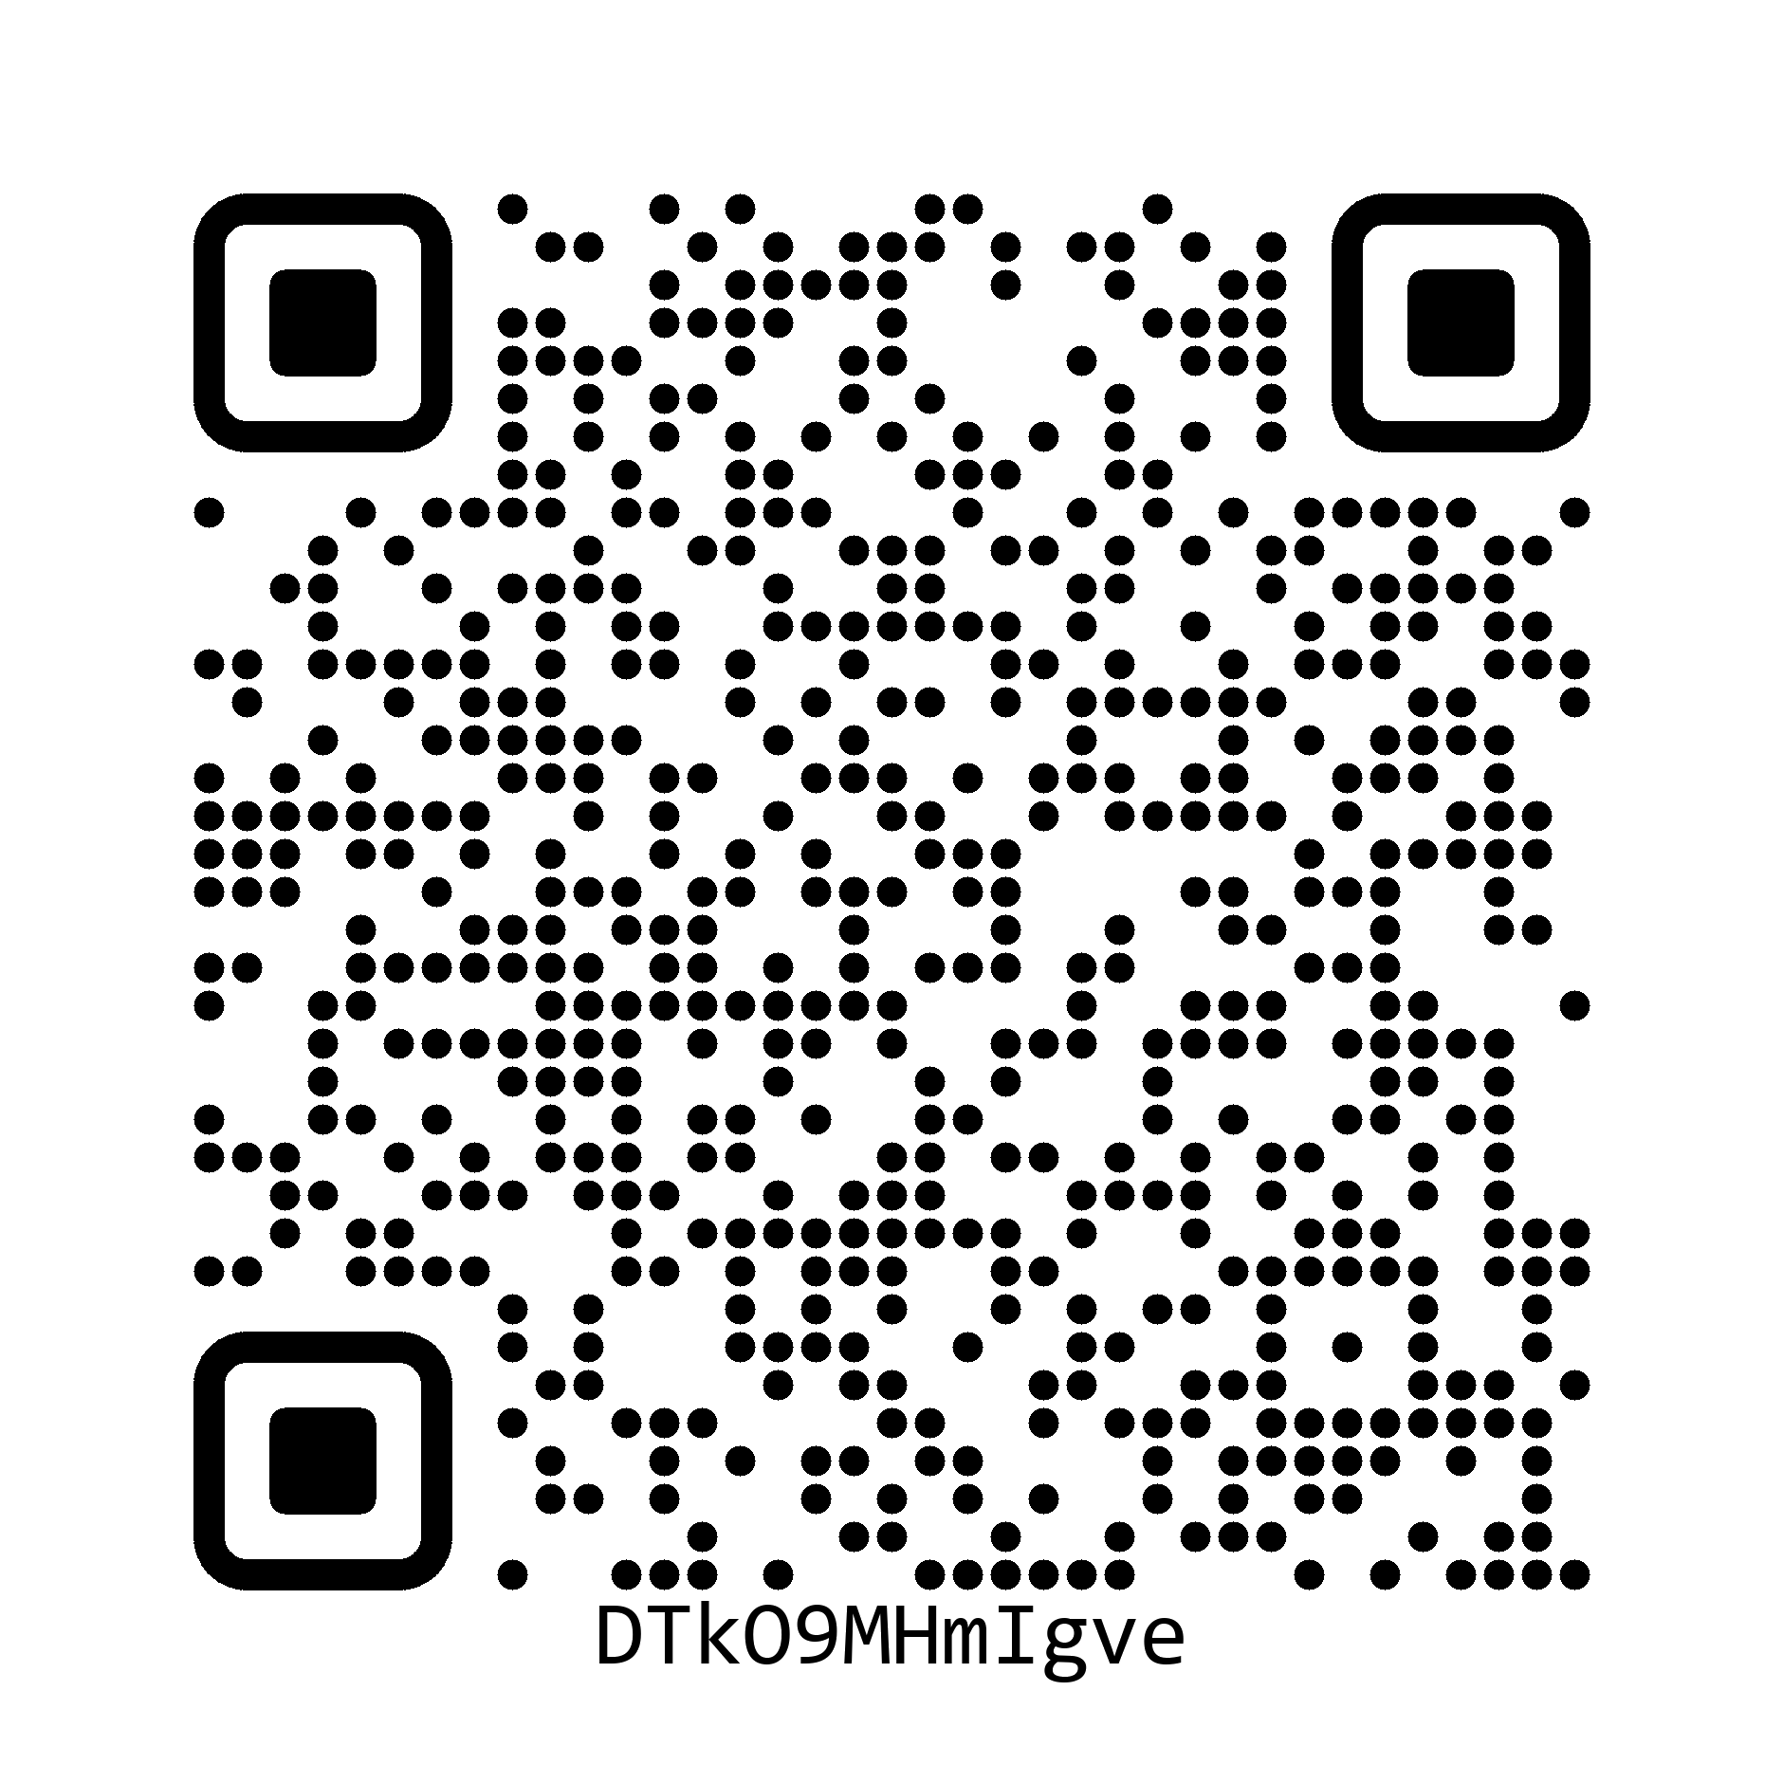
Thank you.
Connect with me on LinkedIn.
Connect with me by email.
tfroniu@wested.org
Session survey

