Slide 1
Community Schools
Strengthening the School-Community Fabric: Cultivating Belonging and Safety Through the Community School Strategy

Slide 2

Welcome
Role
What is your level of familiarity with the Community School strategy?
0(beginner) – 5 (expert)

Slide 3

Activity
Notes:
Objective: To visually demonstrate how individual assets (people, places, and things) connect to create a safety net for a single child.
1. The Setup (2 Minutes)
Divide the room into small groups of 5–8 people.
Give each group a large ball of colorful yarn or string.
Ask each group to designate one person to stand in the center. This person represents "The Child/Family."
2. The Asset Toss (8 Minutes)
The people standing in a circle around the "Child" represent different categories of support. On your signal, they must start passing the yarn ball across the circle, but with a twist:
The Rule: You cannot pass the yarn unless you shout out a specific asset that supports a child.
The Categories: Encourage them to think beyond just "school."
Formal: Pediatricians, libraries, speech therapists, food banks.
Informal: Neighbors, grandparents, faith communities, local parks.
Internal: The teacher's patience, the parent's resilience, the child’s curiosity.
The Action: Each person holds onto a piece of the string before tossing the ball to someone else. Very quickly, a complex, physical web of yarn will be woven over and around the "Child" in the center.
3. The "Stress Test" (3 Minutes)
Once the web is thick and tangled, ask the "Child" to lean back against the string.
Observation: The web holds them up. This represents the strength of a coordinated community.
The Pivot: Ask one person to "drop" their string (e.g., "The local library closes" or "A lead teacher leaves"). Notice how the web sags. Ask another to drop theirs.
4. The Debrief (X Minutes)
Close with these two powerful questions:
"When you looked at the web, were you surprised by how many 'strands' it took to keep that child safe?"
"Which strand do you represent, and who is the person next to you that strengthens your hold?"

Slide 4
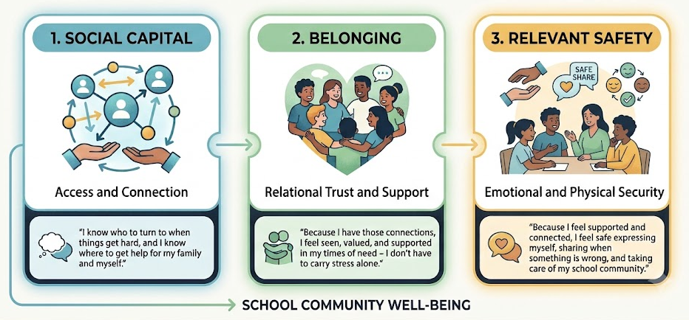
Notes:
The Thesis for Your Audience:
"Hard safety infrastructure (locks, cameras) mitigates threats; social capital prevents them. When a family has social capital, a crisis gets intercepted by community support long before it turns into a safety incident at school."
Relational Security: Define social capital for school safety teams as trusting relationships + swift resource access. A connected family gets housing, food, or mental health support before panic or isolation manifests as a crisis at school.
The "Notice & Signal" Factor: Belonging doesn't just make a student feel good — it makes them visible. In a high-social-capital school, adults and peers notice micro-changes in student behavior early, creating an organic "early warning system" grounded in care rather than surveillance.

Slide 5
To Create Safe and Supportive Schools…
Increase mental health support
Integrate student support systems and Community Schools
Foster strong relationships
Invest in restorative practices & social emotional learning
Prepare all staff for well-being support
Improve safety and well-being data
Review safety measures and discipline impact
Learning happens best when a student feels safe and a sense of belonging.
DePaoli, J., & McCombs, J. (2023). Safe schools, thriving students: What we know about creating safe and supportive schools [Brief]. Learning Policy Institute.

Slide 6
Why Partner Externally? It Takes a Village!
Expanded resources/capacity (mental health, social services)
Holistic support (health, housing, food)
Shared responsibility
Preventative support
Increased trust with community
Additional capacity to ensure every student has a trusted adult

Slide 7
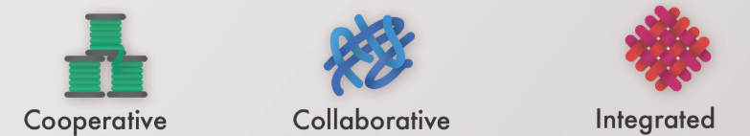
Spectrum of School Community Partnerships
Image from https://beststartsblog.com/2020/07/07/best-starts-for-kids-supports-school-community-partnerships/
School with ad hoc partnerships, sharing resources but not collaborating
School with wrap around partners that collaboratively address challenges
Community School Strategy: school is a hub for services and opportunities with fully embedded community partners in an ecosystem of support

Slide 8
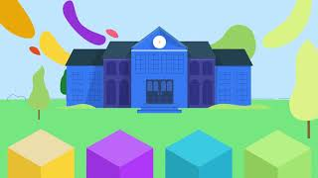
What is a Community School?
Notes:
Ryan

Slide 9
Why Community Schools?
Schools are hyper-local and we all interact with them
Whole child, whole family, whole community strategy
High ROI (Return on Investment)**
Increase in student attendance*
Reduction in disciplinary incidents*
Improvement in school climate*
Increase in academic success*
Source
*(Johnston, W. R. et. al. (2020). “Illustrating the Promise of Community Schools: An Assessment of the Impact of the New York City Community Schools Initiative”. Rand Corporation. Retrieved from https://www.rand.org/pubs/research_reports/RR3245.html)
**(Bloodworth, Michelle R., & Horner, Anna C. (2020). “Return on Investment of a Community Schools Coordinator: A Case Study”. Apex & ABC Community School Partnership. Retrieved from https://www.communityschools.org/wp-content/uploads/sites/2/2020/11/ROI_Coordinator.pdf)

Slide 10



Slide 11
Community Schools in Montana
Missoula Public schools launch Community School around 2023
Origin (2023): MTHF grant to Missoula highlighted the need for statewide Community Schools support; connected with IEL/CCS expertise.
Coalition Launch: Formed a statewide peer network after local districts missed out on federal FSCS grant funding.
Broad Impact: Facilitated by MTHF, spanning 7+ MT communities and partners across education, health, and local United Ways.
Vision: Champion Community Schools across Montana so every child thrives.
Key Support: Funds expert coaching, site visits, statewide convenings, grant seeking, and national conference access.
Governance: SAM serves as fiscal sponsor with ongoing commitment from MTHF.

Slide 12
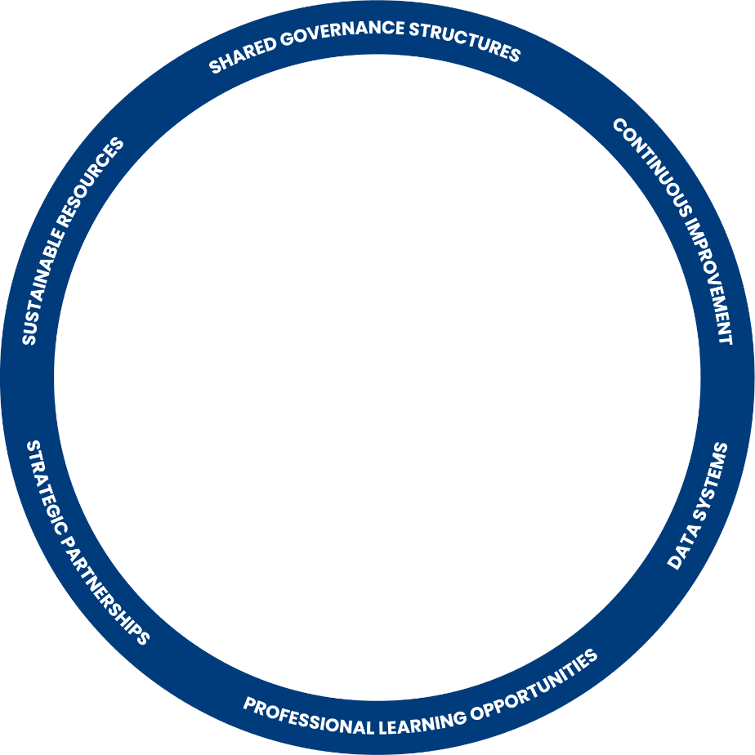
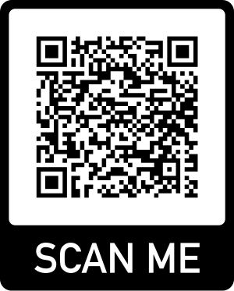
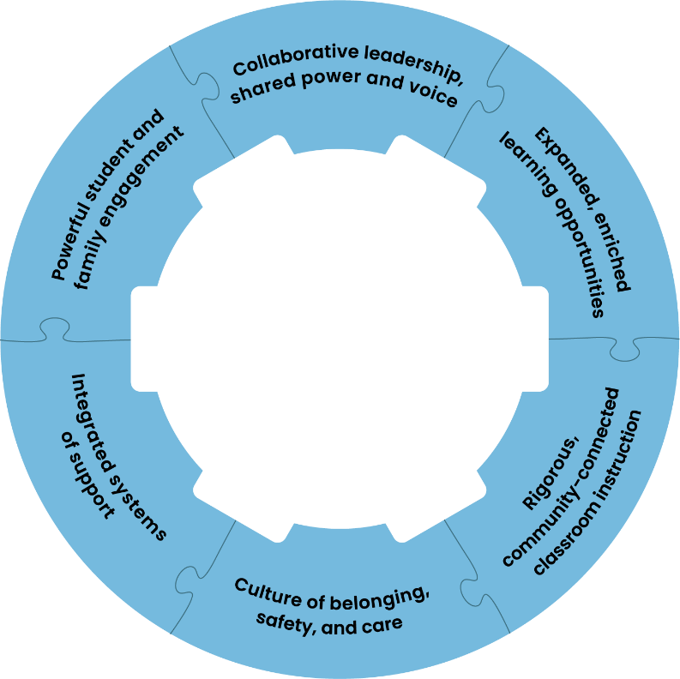
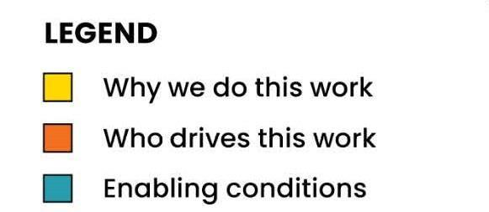
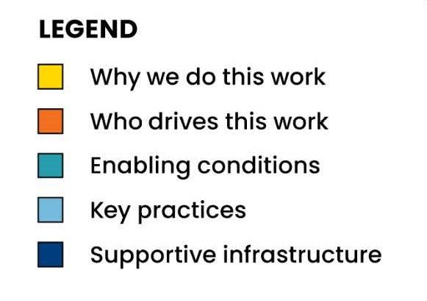
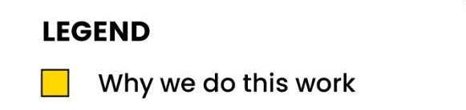
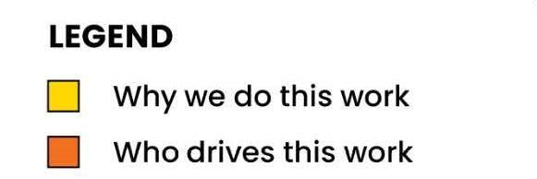
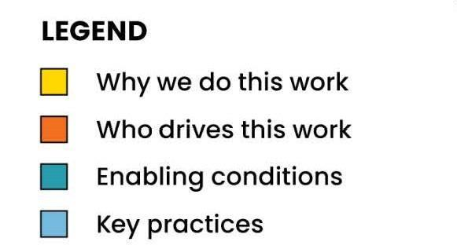
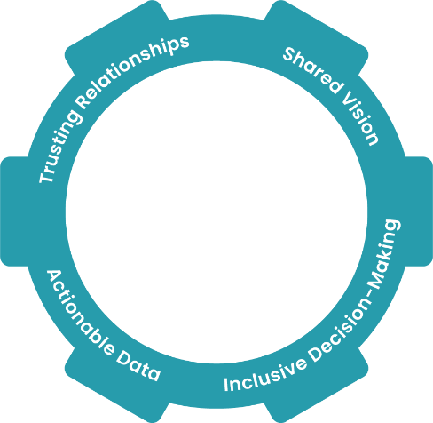
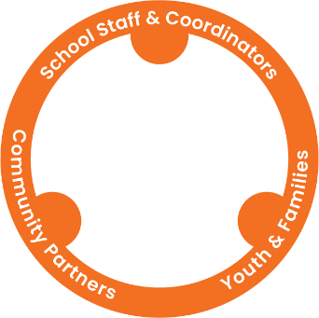
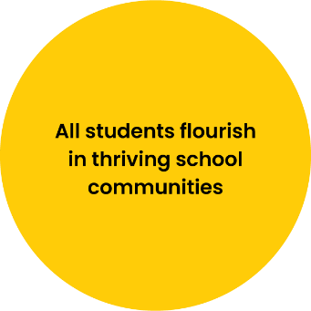
Essentials for Community School Transformation
Source: Community Schools Forward (2023)
1.4
Notes:
The Rubber Band that keeps it all together.
Last part is the supportive infrastructure. Speaks to a CS cannot function without some top-down support. What is happening at all of the systems levels that supports the work. Sustainable resources—cannot be done by the school alone or even the district alone. Coordination of practices.

Slide 13
CLOSING: What Did You Learn Today?
1 | AHA you had
1 | Question You Still Have
1 | Thing You are Excited About
Notes:
Table talk

Slide 14
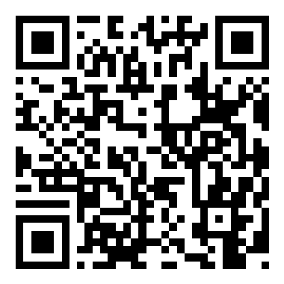
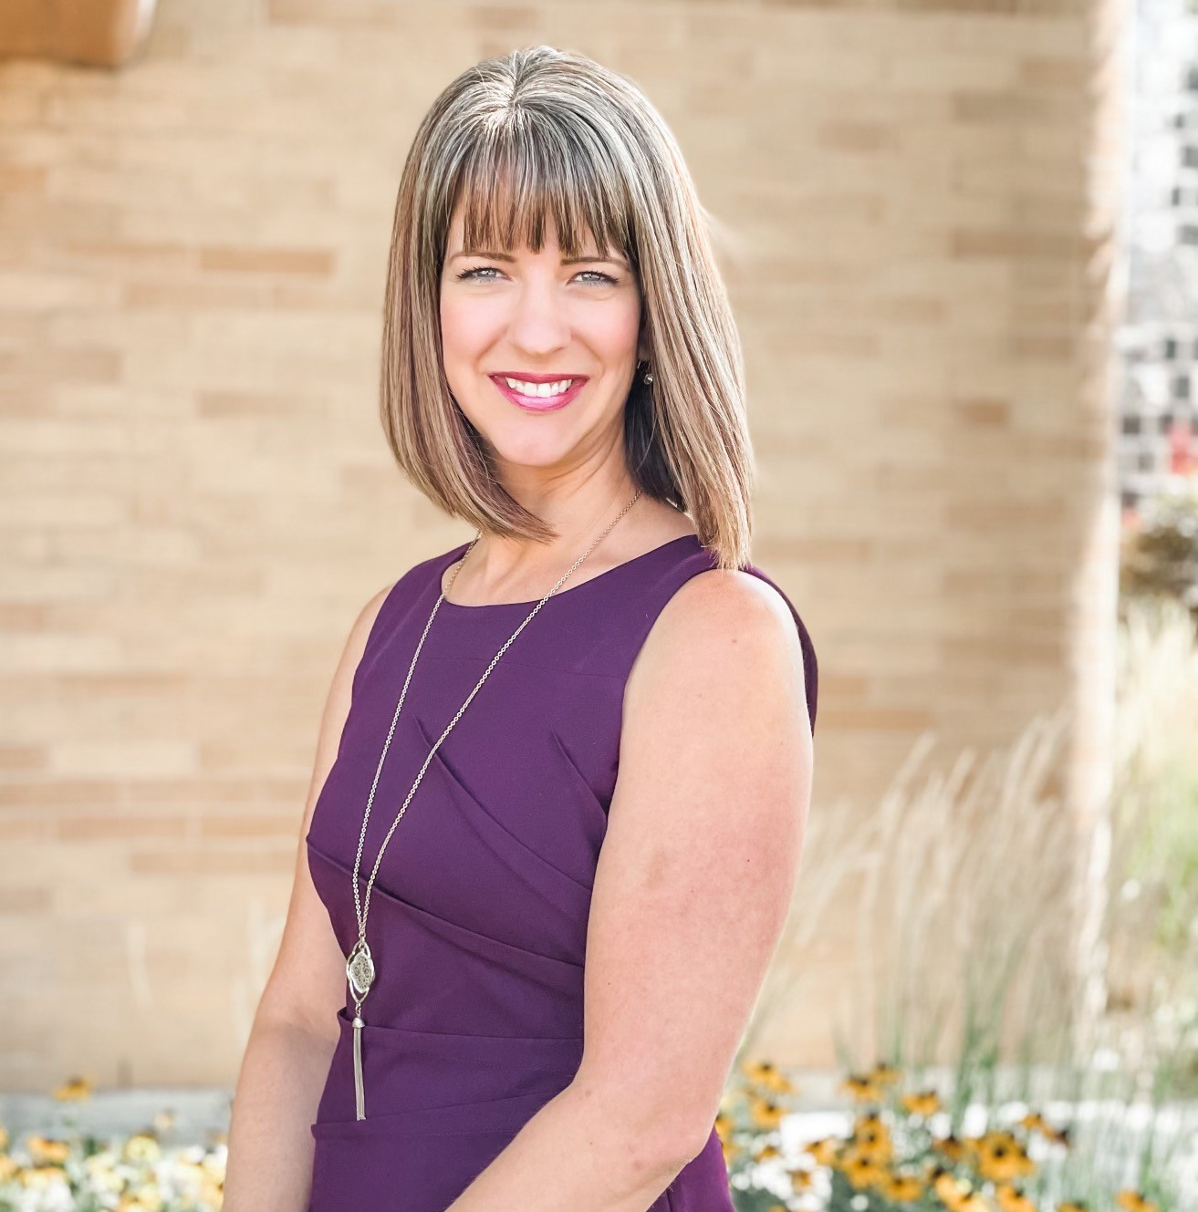
Institute for Educational Leadership/Coalition for Community Schools
Christa Rowland
Regional Director
rowlandc@iel.org
Access my Blinq business card!

